Slide 1
Data Science Project
Predicting the outcome of soccer games
Lisa Boos, Till Hoffmann, Khaled Jallouli, Hemlata Prajapati
Notes:
Lisa

Slide 2
Agenda
Predicting the outcome of soccer games
Goals
Data Profiling
Data Pre-Processing
Modelling
Deployment
Conclusion
Outlook
Notes:
Lisa

Slide 3
0. Goals
Improve skills in python
Gaining knowledge about data-preprocessing
Gaining knowledge about neural network
Finding the right features
Normalizing the features in a proper way
Finding a good model for the prediction – classification & regression
Getting a decent accuracy with the prediction

Slide 4
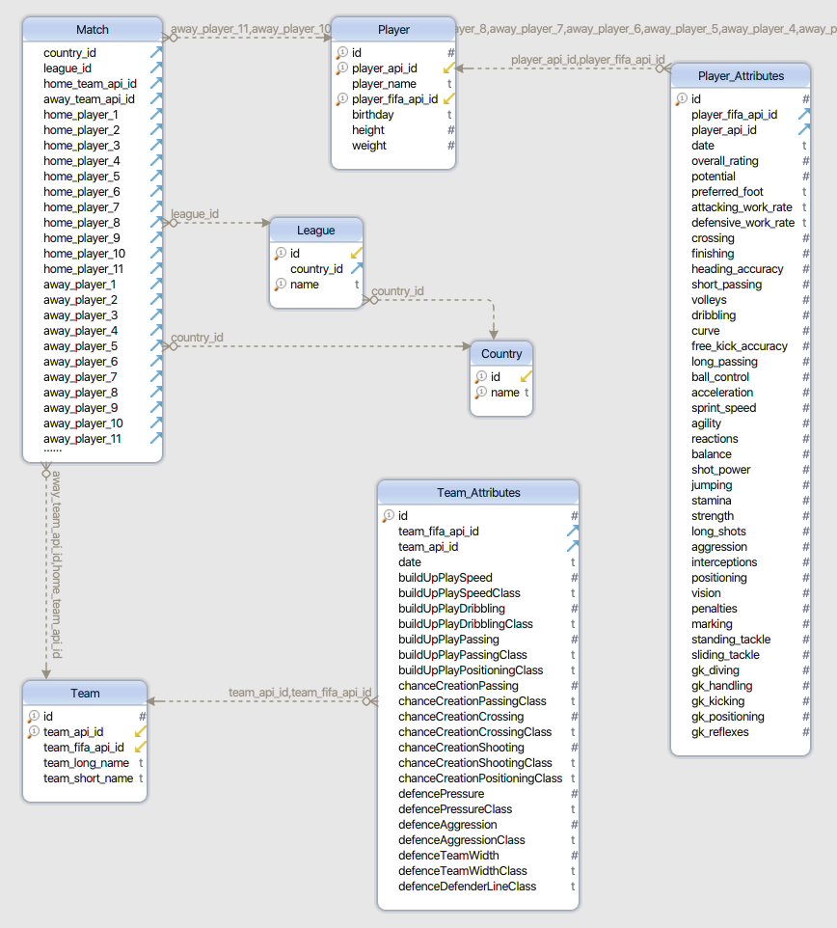
1. Data Profiling
Notes:
Khaled

Slide 5
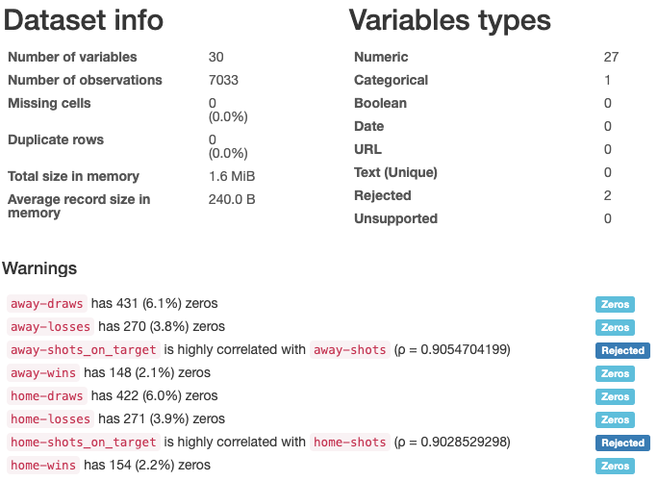
1. Data Profiling
Notes:
Khaled

Slide 6
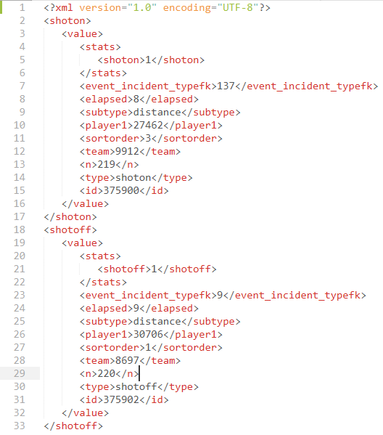
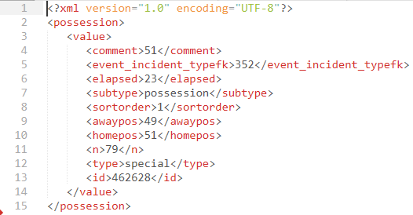
2. Data Pre-Processing - Feature Extraction
Notes:
Khaled

Slide 7
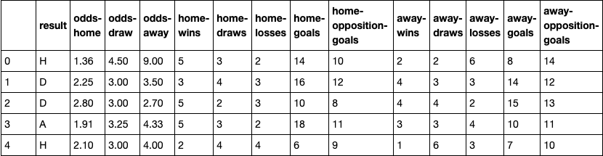
2. Data Pre-Processing - Sliding Window Option 1
Notes:
Khaled

Slide 8
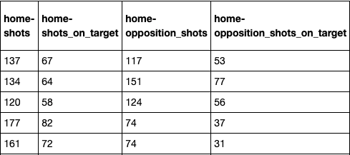
2. Data Pre-Processing - Sliding Window Option 2
Notes:
Khaled

Slide 9
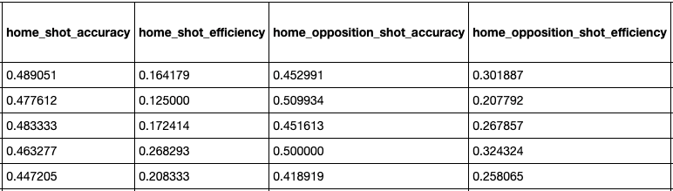
2. Data Pre-Processing - Sliding Window Option 3
Notes:
Khaled

Slide 10
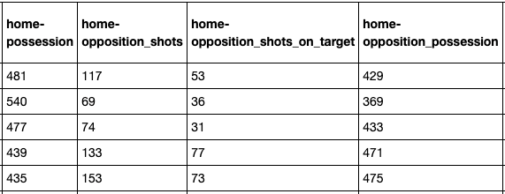
2. Data Pre-Processing - Sliding Window Option 4/5
Notes:
Khaled

Slide 11
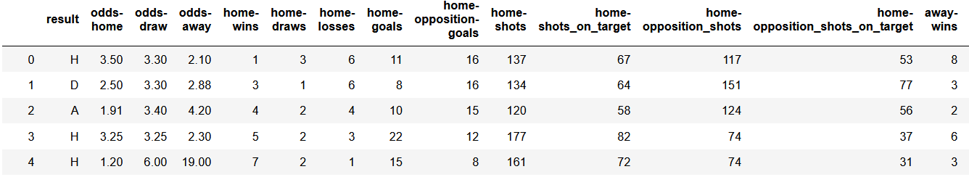
2. Data Pre-Processing - Prediction of the final results
Normalization – old and new better way
Encoding
Notes:
Lisa

Slide 12
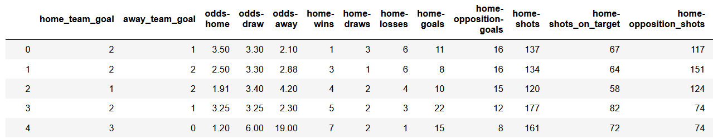
2. Data Pre-Processing - Prediction of scored goals
Normalization for Classification vs Regression
Notes:
Lisa

Slide 13
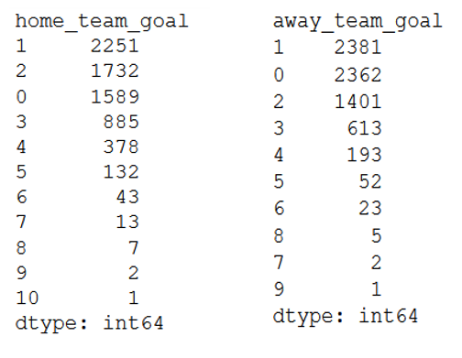
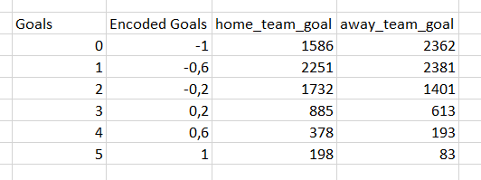
2. Data Pre-Processing - Prediction of scored goals count…
Encoding
Notes:
Lisa

Slide 14
3. Modelling - Predicting the results
Select modelling techniques
Supervised Machine Learning Algorithms: Multi-class classification
Decision Tree and Neural Networks
Generate test design
Data Splitting:
Training set (70%) and Test set (30%) not shuffled
Test set (5%), Training set (80% of the remaining 95%) and Validation set (20% of the remaining 95%)
Strategy to stop: Automated stop (0.0001 loss improve or 1000 epochs)
Test Criteria: Accuracy
Notes:
Khaled

Slide 15
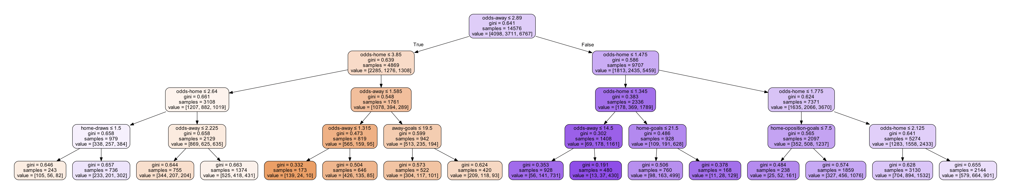
3. Modelling - Predicting the results
3. Build Models
Decision Tree
Dataset: First sliding window option (13 features)
Depth of the tree: 4
Accuracy: 52.95%
Notes:
Khaled, Lisa

Slide 16
3. Modelling - Predicting the results
Multi-layer Perceptron
Dataset: First sliding window option (13 features)
Hidden layers: 2(52,32 neurons)
Output layer: 3 neurons
Activation functions: Sigmoid and softmax
Optimizer: Stochastic gradient descent
Accuracy: 53.45% for training dataset and 52.77% for testing dataset
Notes:
Khaled

Slide 17
3. Modelling - Predicting the results
Keras Sequential Neural Network
Different depths: From 1 to 4 hidden layers
Activation functions: ReLU and Softmax(last layer, multi-class classification)
Optimizer: Adam
Optimizations: Gradual reduction of learning rate, batch size optimized for GPUs, patience of 200 epochs
Loss function: Sparse Categorical Crossentropy (due to class-encoding)
Regularization techniques: Weight regularization (L2) and/or dropout
Accuracy: 56.25%
Problem: Predicts only 2 classes
Notes:
Khaled

Slide 18
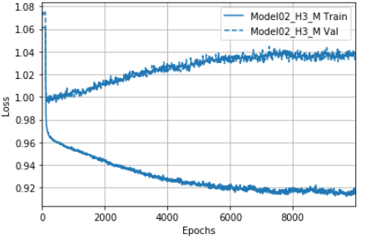
3. Modelling - Predicting the results
Improvements:
Better normalization
No early step out
Test accuracy: 51.14%
Problem solved: Predicts 3 classes
Notes:
Lisa

Slide 19
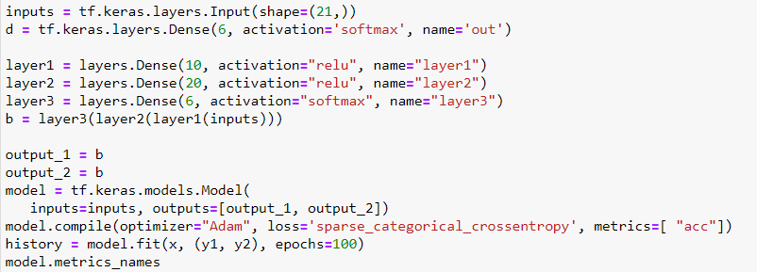
3. Modelling - Multi-Class Classification
Notes:
Lisa

Slide 20
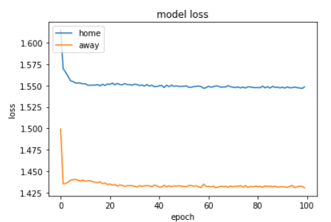
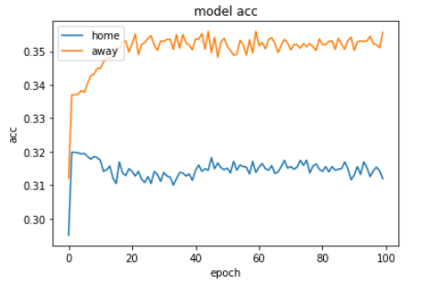
3. Modelling - Multi-Class Classification
Quality test accuracy: 80%
Test accuracy: 34%
Notes:
Lisa

Slide 21
3. Modelling - Predicting the goals (using Scikit)
Multi-Output Regressor: Gradient boosting regressor
Quality Criteria: 79% (Home: 77%, Away:81%)
Decision Tree Regressor
Quality Criteria : 77% (Home: 76%, Away:78%)
Random Forest Regressor
Quality Criteria : 77% (Home: 75%, Away:79%)
MLP Regressor: Solver Adam
Quality Criteria : 79% (Home: 78%, Away:80%)
MLP Regressor: Solver SGD
Quality Criteria : 77% (Home: 75%, Away:79%)
Notes:
Hemlata

Slide 22
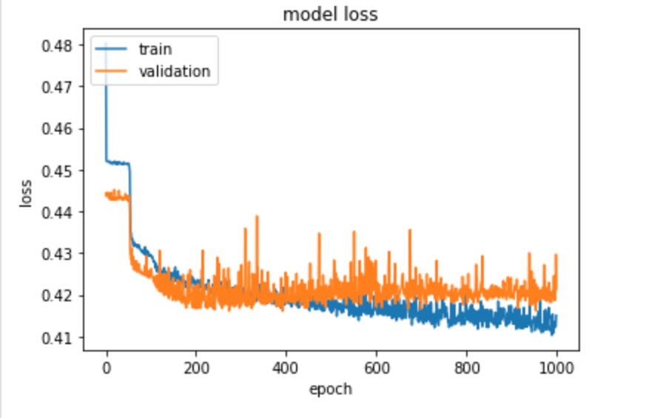
3. Modelling - Predicting the goals (using Keras)
ANN
21 features in Input layer, 3 Hidden layers (30,20,10) and Output layer (2)
Test accuracy: 47 %
Quality Criteria:
Training: 79% (Home: 78%, Away:80%)
Test: 78% (Home: 77%, Away:80%)
Notes:
Hemlata

Slide 23
3. Modelling - Round predicted value
Predicted value | Round predicted value | Decoded value
[-1, -0.75] | -1 | 0
[-0.67, -0.33] | -0.60 | 1
[-0.33, 0] | -0.20 | 2
[0,0.33] | 0.20 | 3
[0.33, 0.67] | 0.60 | 4
[0.67, 1] | 1 | 5
Round and decode the predicted value
Decode the original value
Compare them => Quality Criteria
Notes:
Hemlata

Slide 24
3. Modelling - Quality Criteria
Based on degree difference:
abs (yoriginal_home - ypred_home)
The final result: (degree difference home goals + degree difference away goals) / 2
abs (yoriginal - ypred) | Degree difference
0 | 1
1 | 0.8
2 | 0.6
3 | 0.4
4 | 0.2
5 | 0
Notes:
Hemlata

Slide 25
4. Deployment
Backend
db
helper.py
db.sqlite
ml
Frontend
server.py
controller.py
helper.py
model.h5
fetching
helper.py
Notes:
Till

Slide 26


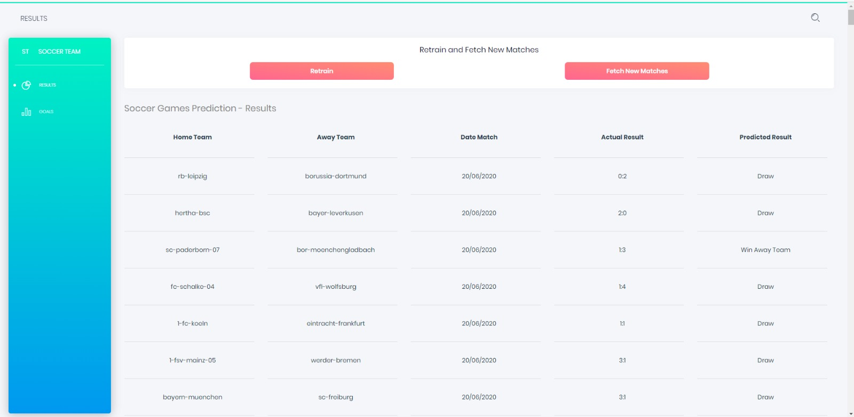
4. Deployment - Frontend
+ AXIOS
Notes:
Till

Slide 27
4. Deployment - API
GET /soccerGamesClassification
Returns matchlist with classificiation result
GET /soccerGamesRegression
Returns matchlist with regression result
GET /retrainClassification
Backend retrains a new classification model
Backend reruns new model on whole database
Returns “ok”
GET /retrainRegression
Backend retrains a new regression model
Backend reruns new model on whole database
Returns “ok”
GET /fetchNewMatches
Backend fetches new matches from datasources
Returns “ok”
Notes:
Till

Slide 28
5. Conclusion
Scrum teamwork
Learned very much about Neural Networks
Pretty good outcome
Looking forward to work further on the project
Notes:
Till
Scrum master was best
Scrum is working fine
SOME OF US want to work further on the project

Slide 29
6. Outlook
Try different ways of normalization
Use more features
Remove dependency on betting data
Improve frontend (design, functionality)
Improve deployment (f.e. container, scaling)
Notes:
Till

Slide 30
Thanks for your attention!
Notes:
All

