Slide 1
Data Science Project
Predicting the outcome of soccer games
Sprint Review

Slide 2
This Sprint
Data Preprocessing: Create the sliding windows for 5 options
Normalization and data preparation for regression
Test Multi Target Regressors (Scored Goals)
10 Class Classification
Backend

Slide 3
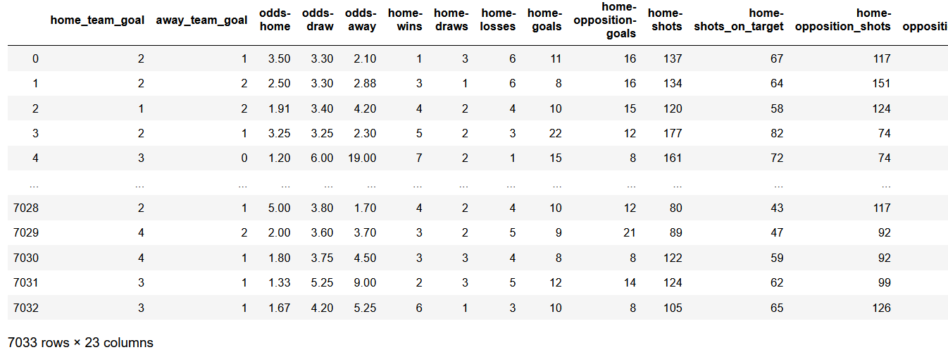
Data Preprocessing
Sliding Window Option 2:

Slide 4
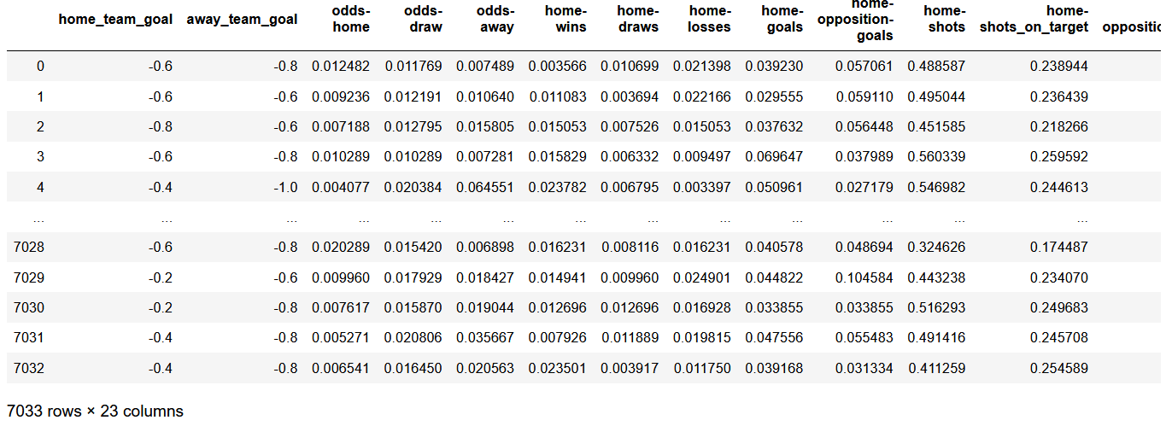
Data Preparation For Regression
Goals [0,10] => Encoding [-1,1]
Notes:
0,1 OR 0,2 OR -1,1

Slide 5
Test Multi Target Regressors (Scored Goals)
Multi-Output Regressor: Gradient Boosting Regressor
R² Score: 0.16117
Training accuracy: 20.59% (H: 17.10% , A: 24.08%)
Test accuracy: 18.89% (H: 12.93% , A: 24.86%)
Decision Tree Regressor
R² Score: -0.6563
Training accuracy: 100% (H: 100% , A: 100%)
Test accuracy: 26.49% (H: 25.00% , A: 27.98%)
Random Forest Regressor
R² Score: 0.1514
Training accuracy: 21.39% (H: 16.59% , A: 26.23%)
Test accuracy: 20.74% (H: 14.06% , A: 27.41%)
MLP Regressor: Solver Adam
R² Score: 0.1320
Training accuracy: 18.01% (H: 16.26% , A: 19.77%)
Test accuracy: 18.11% (H: 13.21% , A: 23.01%)
MLP Regressor: Solver SGD
R² Score: -0.0005
Training accuracy: 16.68% (H: 1.34% , A: 32.01%)
Test accuracy: 17.33% (H: 0.85% , A: 33.81%)
Notes:
R^2 (coefficient of determination) regression score function.
Best possible score is 1.0 and it can be negative (because the model can be arbitrarily worse). A constant model that always predicts the expected value of y, disregarding the input features, would get a R^2 score of 0.0.
https://scikit-learn.org/stable/modules/generated/sklearn.metrics.r2_score.html#sklearn.metrics.r2_score
https://www.statisticshowto.com/probability-and-statistics/regression-analysis/#intro

Slide 6
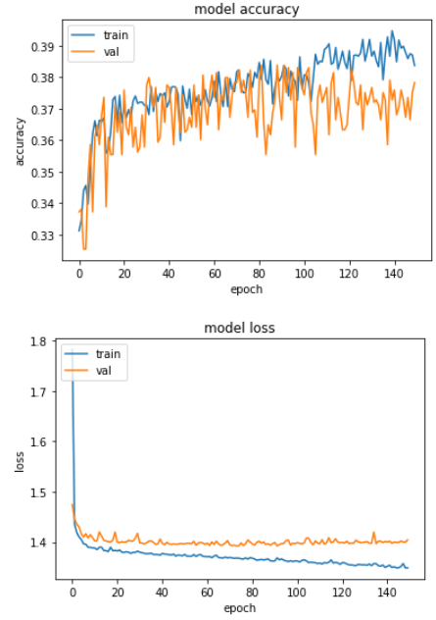
10 Class Classification
Accuracy of about 34%

Slide 7
Backend
Model integration finished
Database research, for realtime predictions

Slide 8
Next Sprint
Regression: Improve models
Backend: Database integration, fetch realtime data

