Slide 1
Data Science Project
Predicting the outcome of soccer games
Lisa Boos, Till Hoffmann, Khaled Jallouli, Hemlata Prajapati
Notes:
Lisa

Slide 2
Agenda
Predicting the outcome of soccer games
Goals
Data Profiling
Data Pre-Processing
Modelling
Deployment
Conclusion & Outlook
Notes:
Lisa

Slide 3
0. Goals
Improve skills in python
Gaining knowledge about data-preprocessing
Gaining knowledge about neural network
Finding the right features
Normalizing the features in a proper way
Finding a good model for the prediction- classification and regression
Getting a decent accuracy with the prediction

Slide 4
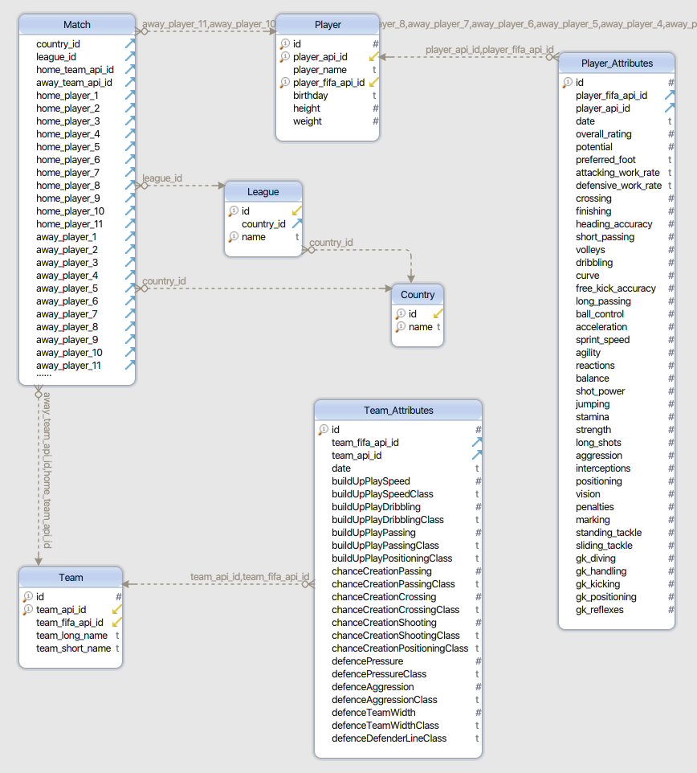
1. Data Profiling
Notes:
Khaled

Slide 5
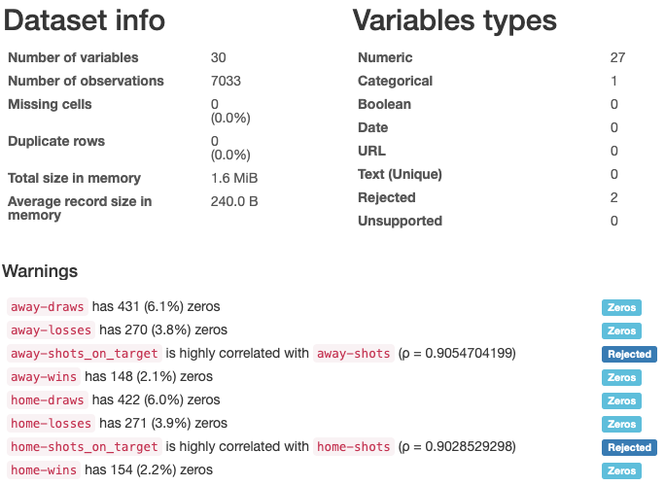
1. Data Profiling
Notes:
Khaled

Slide 6
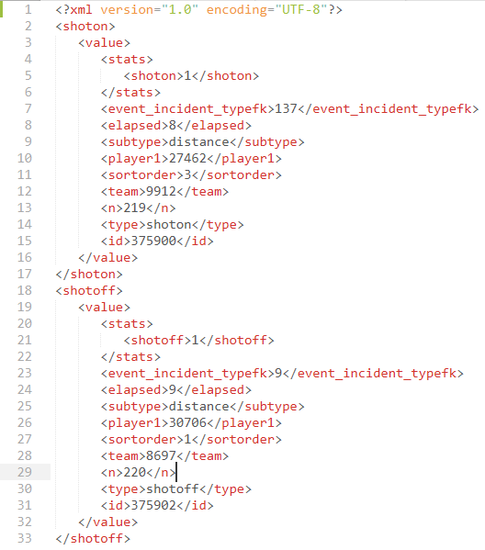
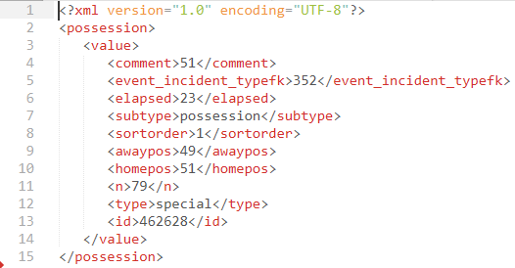
2. Data Pre-Processing - Feature Extraction
Notes:
Khaled

Slide 7
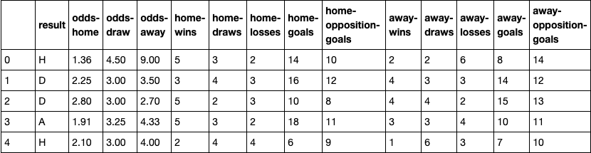
2. Data Pre-Processing - Sliding Window Option 1
Notes:
Khaled

Slide 8
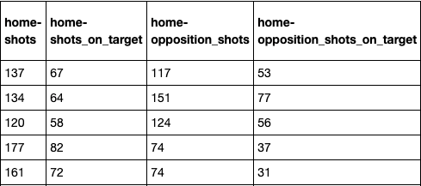
2. Data Pre-Processing - Sliding Window Option 2
Notes:
Khaled

Slide 9
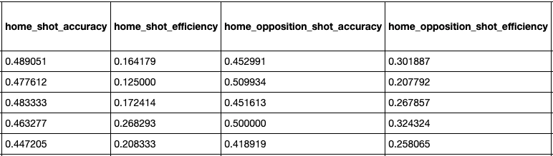
2. Data Pre-Processing - Sliding Window Option 3
Notes:
Khaled

Slide 10
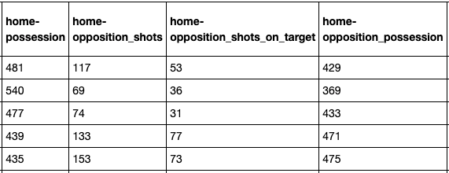
2. Data Pre-Processing - Sliding Window Option 4/5
Notes:
Khaled

Slide 11
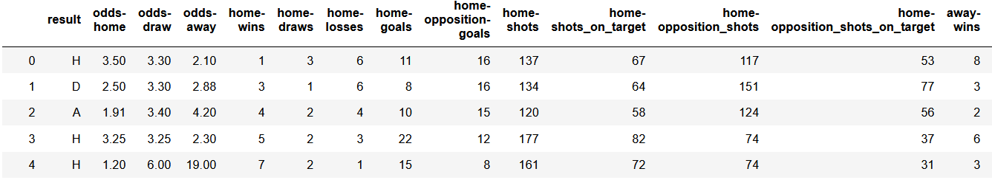
Prediction of the final results
Normalization – old and new better way
Encoding
Notes:
Lisa

Slide 12
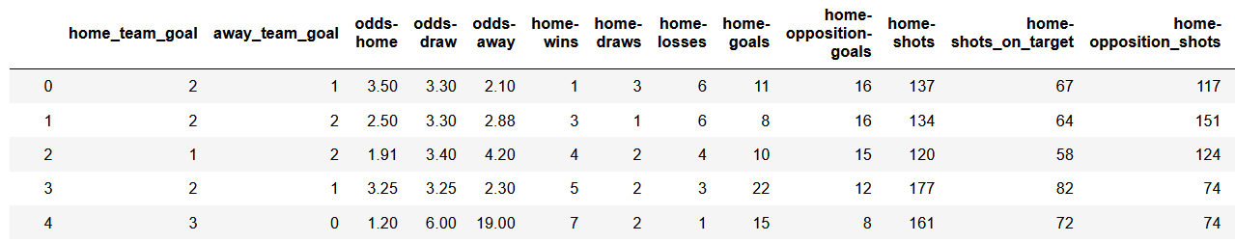
Prediction of scored goals
Normalization for Classification vs Regression
Notes:
Lisa

Slide 13
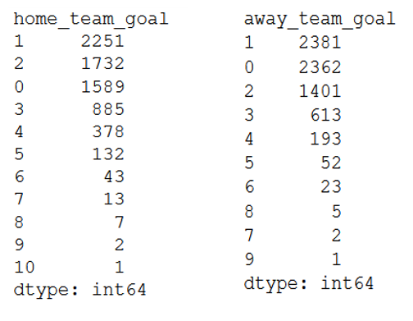
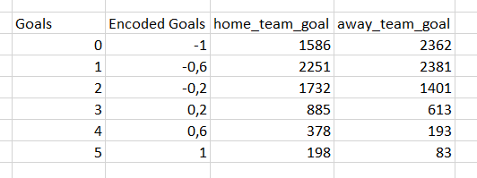
Prediction of scored goals cont…
Encoding
Notes:
Lisa

Slide 14
3. Modelling-Predicting the results
Select Modeling Techniques
Supervised Machine Learning Algorithms: Multi-class classification
Decision Tree and Neural Networks
Generate Test Design
Data Splitting:
Training set (70%) and test set (30%) not shuffled
Test set (5%), Training set (80% of the remaining 95%) and Validation set (20% of the remaining 95%)
Strategy to Stop: Automated stop (0.0001 loss improve or 1000 epochs)
Test Criteria: Accuracy
Notes:
Khaled

Slide 15
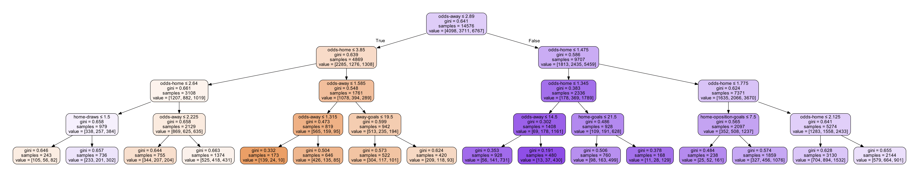
3. Modelling-Predicting the results
3. Build Models
Decision Tree
Dataset: First sliding window option (13 features)
Depth of the tree: 4
Accuracy: 52.95%
Notes:
Khaled, Lisa

Slide 16
3. Modelling-Predicting the results
Multi-layer Perceptron
Dataset: First sliding window option (13 features)
Hidden layers: 2(52,32 neurons)
Output layer: 3 neurons
Activation functions: sigmoid and softmax
Optimizer: stochastic gradient descent
Accuracy: 53.45% for training dataset and 52.77% for testing dataset
Notes:
Khaled

Slide 17
3. Modelling-Predicting the results
Keras Sequential Neural Network
Different depths: from 1 to 4 hidden layers
Activation functions: ReLU and Softmax(last layer, multi-class classification)
Optimizer: Adam
Optimizations: gradual reduction of learning rate, batch size optimized for GPUs, patience of 200 epochs
Loss function: Sparse Categorical Crossentropy (due to class-encoding)
Regularization techniques : weight regularization (L2) and/or dropout
Accuracy: 56.25%
Problem: Predict only 2 classes
Notes:
Khaled

Slide 18
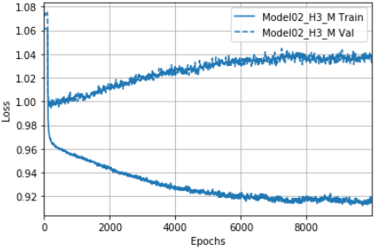
3. Modelling-Predicting the results
Improvements:
Better Normalization
No Early step out
Test Accuracy: 51.14%
Problem Solved: Predict 3 classes
Notes:
Lisa

Slide 19
3. Modeling- Predicting the goals (Using Scikit)
Multi-Output Regressor: Gradient Boosting Regressor
Quality Criteria: 79% (Home: 77%, Away:81%)
Decision Tree Regressor
Quality Criteria : 77% (Home: 76%, Away:78%)
Random Forest Regressor
Quality Criteria : 77% (Home: 75%, Away:79%)
MLP Regressor: Solver Adam
Quality Criteria : 79% (Home: 78%, Away:80%)
MLP Regressor: Solver SGD
Quality Criteria : 77% (Home: 75%, Away:79%)
Notes:
Hemlata

Slide 20
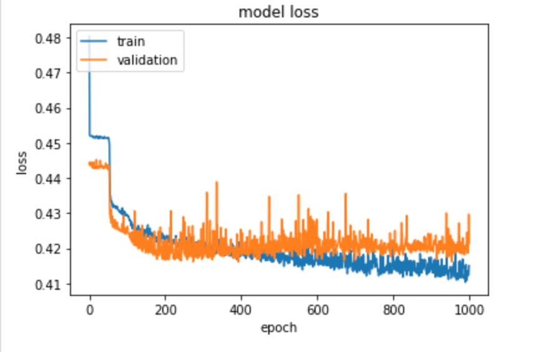
Modeling- Predicting the goals (using Keras)
ANN
21 features in Input layer, 3 Hidden layers (30,20,10) and Output layer (2)
Test Accuracy: 47 %
Quality Criteria:
Training: 79% (Home: 78%, Away:80%)
Test: 78% (Home: 77%, Away:80%)
Notes:
Hemlata

Slide 21
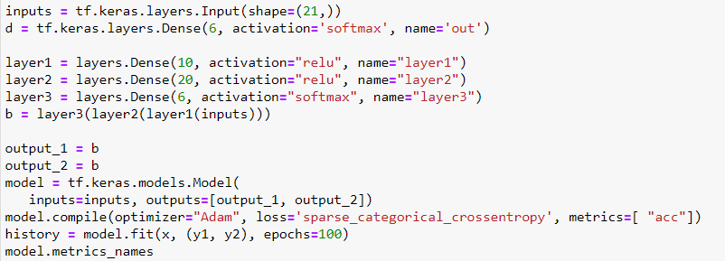
Multi-Class Classification
Notes:
Lisa

Slide 22
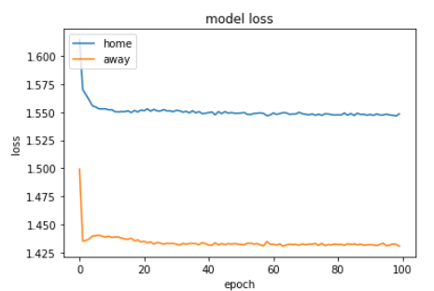
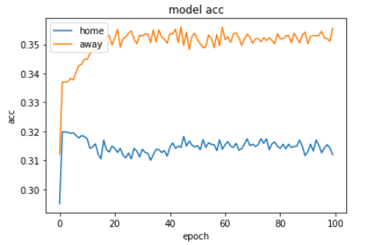
Multi-Class Classification
Quality Test Accuracy: 80%
Test Accuracy: 34%
Notes:
Lisa

Slide 23
Round predicted value
Predicted value | Round predicted value | Decoded value
[-1, -0.75] | -1 | 0
[-0.67, -0.33] | -0.60 | 1
[-0.33, 0] | -0.20 | 2
[0,0.33] | 0.20 | 3
[0.33, 0.67] | 0.60 | 4
[0.67, 1] | 1 | 5
Round and decode the predicted value
Decode the original value
Compare them => Quality Criteria
Notes:
Hemlata

Slide 24
Quality Criteria
Based on Degree difference:
abs (yoriginal_home – ypred_home)
The final result: (degree difference home goals + degree difference away goals) /2
abs (yoriginal - ypred) | Degree difference
0 | 1
1 | 0.8
2 | 0.6
3 | 0.4
4 | 0.2
5 | 0
Notes:
Hemlata

Slide 25
Deployment
Notes:
Till

Slide 26
5. Conclusion
Scrum Team-Work
Learned very much about Neural Network
Decent Outcome
Looking forward to work further on the project
Notes:
Lisa

Slide 27
Outlook
Test different paramaters (activation functions, optimizers)
Test different modeling techniques: Logistic Regression
Test different features
Deployment (Flask app)
Notes:
Lisa

Slide 28
Thanks for your attention!
Notes:
All

