Slide 1
Data Science Project
Predicting the outcome of soccer games
Sprint Review

Slide 2
This Sprint
Regression
Multi-Class Classification
Product

Slide 3
Regression: Sliding Window 02 (21 Features)
Models | Hidden Layers | Quality Model: Training | Quality Model: Test | Val_acc | Val_loss | Train_acc | Train_loss
Model1 | 30 - 20 - 10 | 0.83 | 0.82 | 68% | 0.3453 | 70% | 0.3362
Model2 | 21 – 10 - 5 | 0.83 | 0.83 | 66% | 0.3470 | 72% | 0.3486
Model3 | 21- 14- 12- 10 | 0.83 | 0.83 | 56% | 0.3427 | 69% | 0.3402

Slide 4
Regression: Sliding Window 03 (29 Features)
Models | Hidden Layers | Quality Model: Training | Quality Model: Test | Val_acc | Val_loss | Train_acc | Train_loss
Model1 | 30 - 20 - 10 | 0.84 | 0.82 | 67% | 0.36 | 73% | 0.18
Model2 | 21 – 10 - 5 | 0.82 | 0.82 | 70% | 0.2306 | 71% | 0.2322
Model3 | 21- 14- 12- 10 | 0.83 | 0.82 | 67% | 0.2144 | 72% | 0.1893
Difference between validation loss and training loss is close to each other, so low overfitting and underfitting. Also, Quality model accuracy is better.

Slide 5
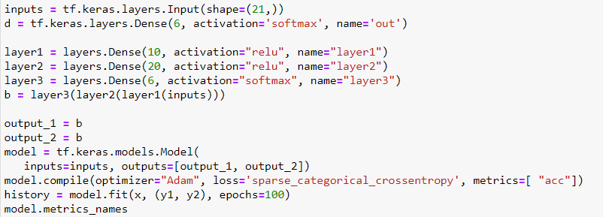
Multi-Class Classification

Slide 6
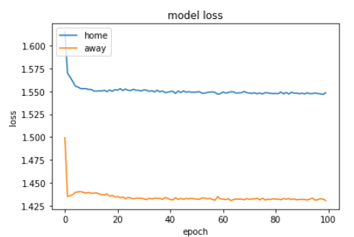
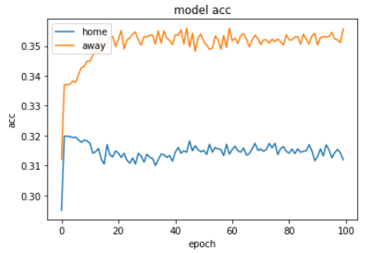
Multi-Class Classification
Quality Model Training: 80%
Quality Model Test: 34%

Slide 7
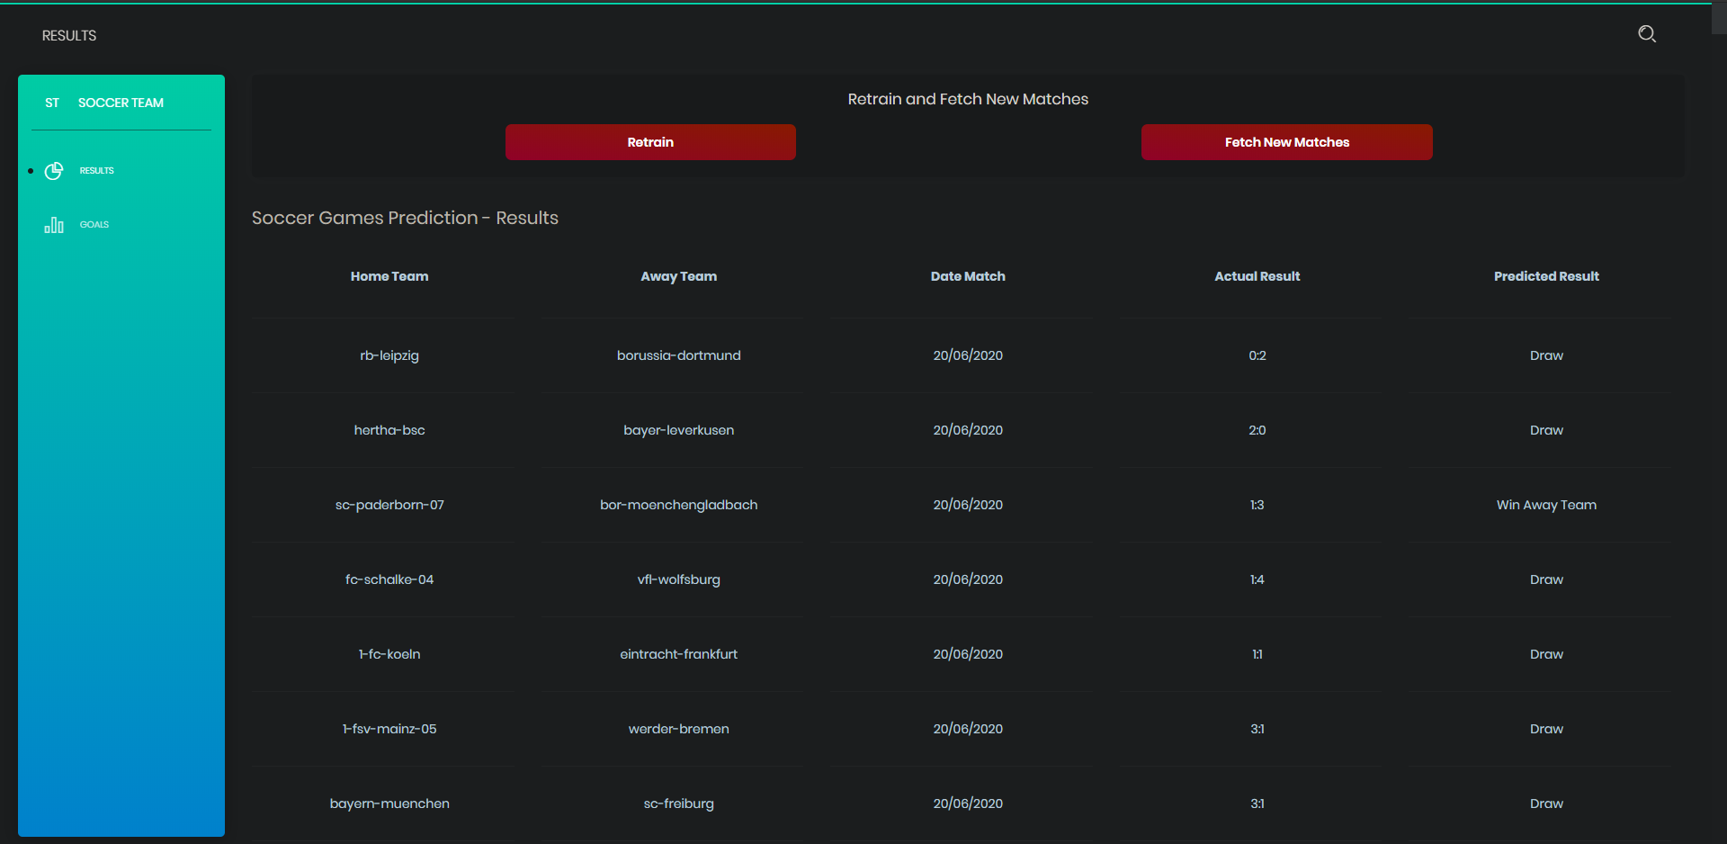
Product: Results prediction

Slide 8
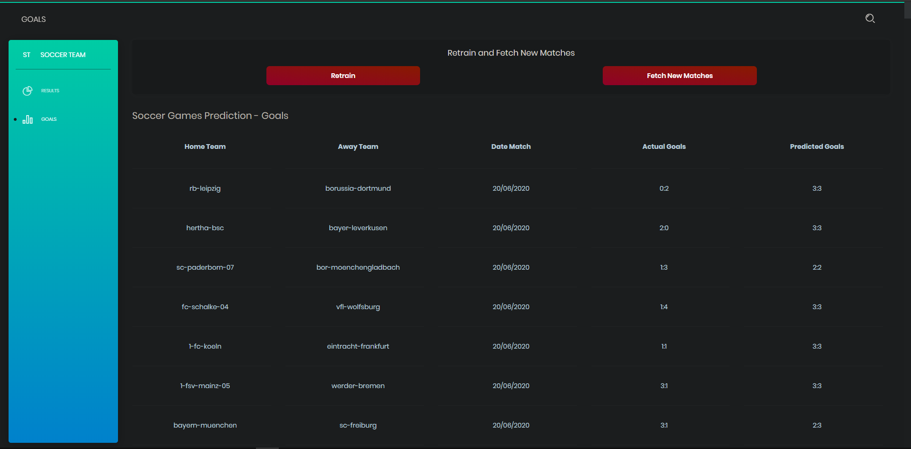
Product: Goals prediction

Slide 9
Next Sprint
Write the report

