Slide 1
Data Science Project
Predicting the outcome of soccer games
Sprint Review

Slide 2
This Sprint
Data Preprocessing
Round predicted value
Quality Criteria
Test Multi Target Regressors (Scored Goals)
Multi Label classification
Front- and Backend completion

Slide 3
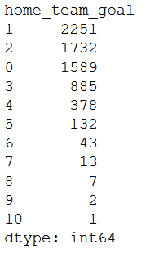
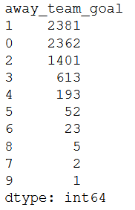
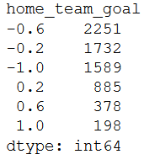
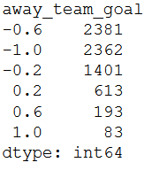
Data Preprocessing
Goals [0,10] => Goals [0.5]
1
2
0
3
4
5

Slide 4
Round predicted value
Predicted value | Round predicted value | Decoded value
[-1, -0.75[ | -1 | 0
[-0.75, -0.25[ | -0.5 | 1
[-0.25, 0.25[ | 0 | 2
[0.25, 0.75[ | 0.5 | 3
[0.75, 1] | 1 | 4
Round and decode the predicted value
Decode the original value
Compare them => Quality Criteria
Notes:
Decoded to 0 1 2 3 4

Slide 5
Quality Criteria
Based on Degree difference:
abs (yoriginal_home – ypred_home)
The final result: (degree difference home goals + degree difference away goals) /2
abs (yoriginal - ypred) | Degree difference
0 | 1
1 | 0.75
2 | 0.5
3 | 0.25
4 | 0
Notes:
abs (yoriginal_home – ypred_home) + abs (yoriginal_away – ypred_away) => score !!
OR
abs (yoriginal_home – ypred_home) :
Difference between them! Are they independent or not (goals)!!

Slide 6
Test Multi Target Regressors (Scikit) (Scored Goals: Test dataset prediction)
Multi-Output Regressor: Gradient Boosting Regressor
Quality Criteria: 79% (Home: 77%, Away:81%)
Decision Tree Regressor
Quality Criteria : 77% (Home: 76%, Away:78%)
Random Forest Regressor
Quality Criteria : 77% (Home: 75%, Away:79%)
MLP Regressor: Solver Adam
Quality Criteria : 79% (Home: 78%, Away:80%)
MLP Regressor: Solver SGD
Quality Criteria : 77% (Home: 75%, Away:79%)
Notes:
R^2 (coefficient of determination) regression score function.
Best possible score is 1.0 and it can be negative (because the model can be arbitrarily worse). A constant model that always predicts the expected value of y, disregarding the input features, would get a R^2 score of 0.0.
https://scikit-learn.org/stable/modules/generated/sklearn.metrics.r2_score.html#sklearn.metrics.r2_score

Slide 7
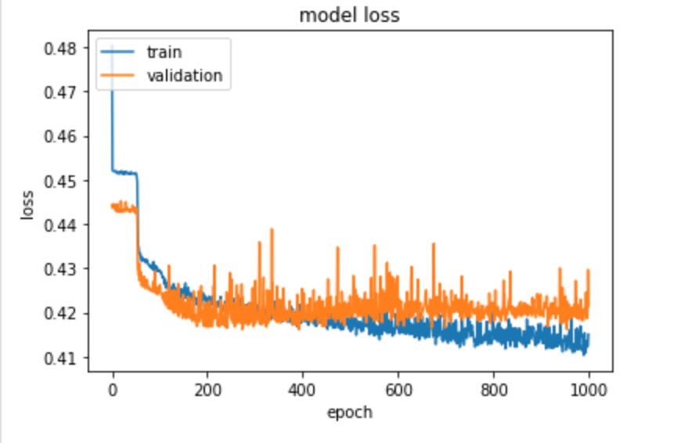
Regression using Tensorflow ANN (Scored Goals)
ANN
21 features in Input layer, 3 Hidden layers (42,42,42) and Output layer (2)
Quality Criteria:
Training: 79% (Home: 78%, Away:80%)
Test: 78% (Home: 77%, Away:80%)
Notes:
R^2 (coefficient of determination) regression score function.
Best possible score is 1.0 and it can be negative (because the model can be arbitrarily worse). A constant model that always predicts the expected value of y, disregarding the input features, would get a R^2 score of 0.0.
https://scikit-learn.org/stable/modules/generated/sklearn.metrics.r2_score.html#sklearn.metrics.r2_score

Slide 8
Multi-Label Classification
Better than customized Output Layer
Two different loss functions
Same model for both outputs
Only one output instead of two

Slide 9
Backend
db
helper.py
db.sqlite
server.py
controller.py
ml
helper.py
model.h5
fetching
helper.py

Slide 10
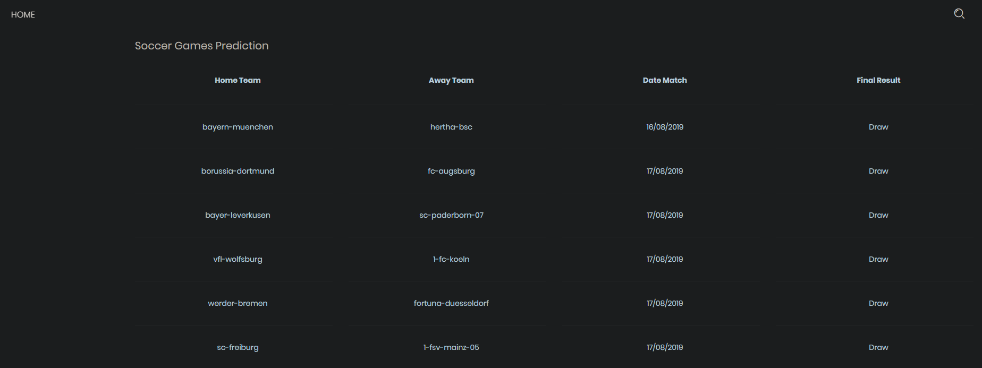
Frontend

Slide 11
Next Sprint
Regression improvements
Multi-label classification
Frontend improvements
Backend improvements

