Slide 1
Data Science Project
Predicting the outcome of soccer games
Sprint Review

Slide 2
This Sprint
Regression
Multi-Class Classification
Product

Slide 3
Regression: Sliding Window 02 (21 Features)
Models | Hidden Layers | Quality Model: Training | Quality Model: Test | Val_acc | Val_loss | Train_acc | Train_loss
Model1 | 30 - 20 - 10 | 0.83 | 0.82 | 68% | 0.3453 | 70% | 0.3362
Model2 | 21 – 10 - 5 | 0.83 | 0.83 | 66% | 0.3470 | 72% | 0.3486
Model3 | 21- 14- 12- 10 | 0.83 | 0.83 | 56% | 0.3427 | 69% | 0.3402

Slide 4
Regression: Sliding Window 03 (29 Features)
Models | Hidden Layers | Quality Model: Training | Quality Model: Test | Val_acc | Val_loss | Train_acc | Train_loss
Model1 | 30 - 20 - 10 | 0.84 | 0.82 | 67% | 0.36 | 73% | 0.18
Model2 | 21 – 10 - 5 | 0.82 | 0.82 | 70% | 0.2306 | 71% | 0.2322
Model3 | 21- 14- 12- 10 | 0.83 | 0.82 | 67% | 0.2144 | 72% | 0.1893
Difference between validation loss and training loss is close to each other, so low overfitting and underfitting. Also, Quality model accuracy is better.

Slide 5
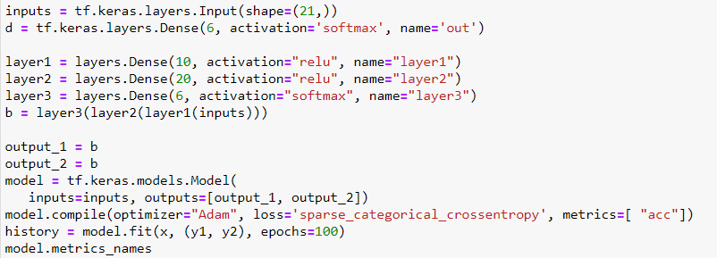
Multi-Class Classification

Slide 6
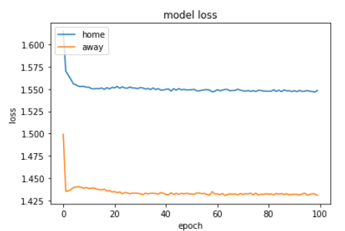
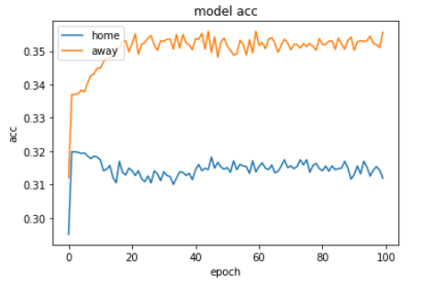
Multi-Class Classification
Quality Model Training: 80%
Quality Model Test: 34%

Slide 7
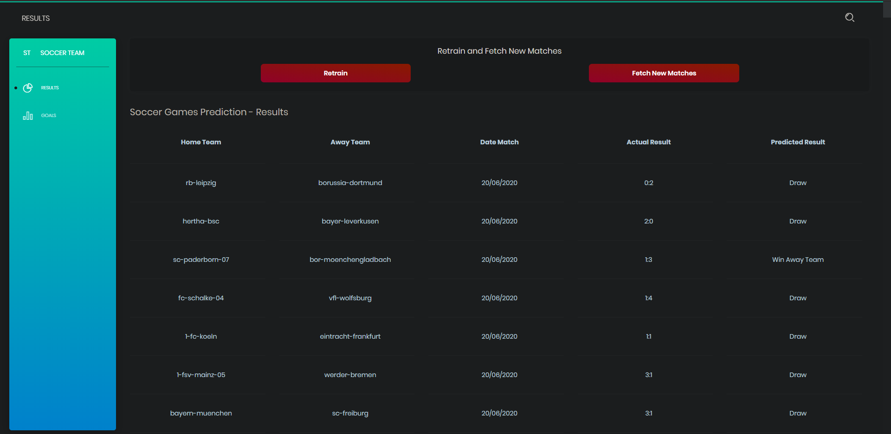
Product: Results prediction

Slide 8
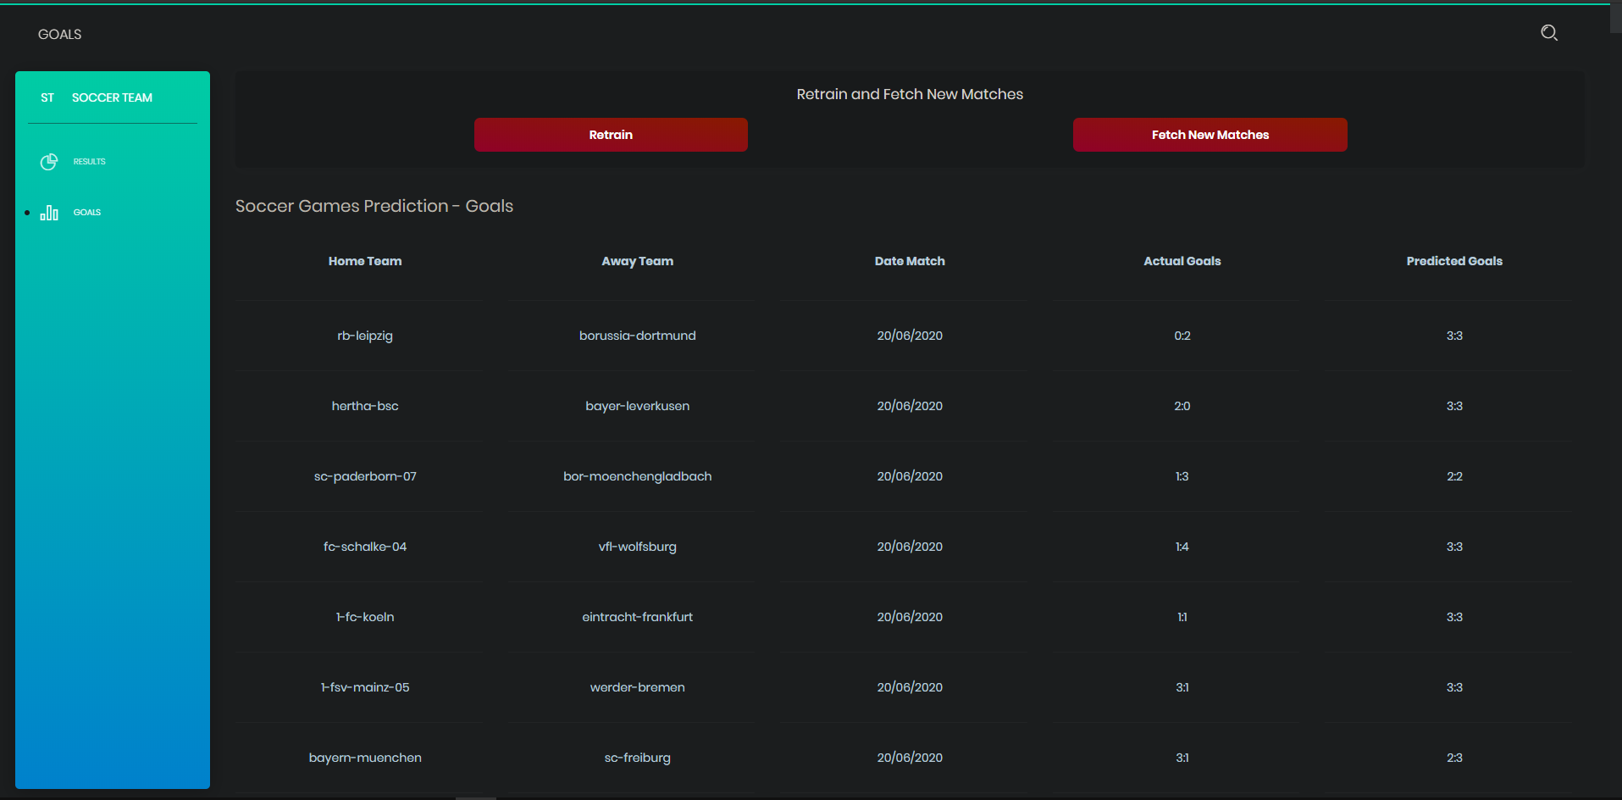
Product: Goals prediction

Slide 9
New Actions
Change between both views
Fetch new matches (including upcoming)
Retrain each model with current database (and repredict all)
Receive feedback from backend

Slide 10
Next Sprint
Write the report

