Slide 1
Data Science Project
Predicting the outcome of soccer games

Slide 2





Web Architecture
Web App
Front-end
HTML
JS
CSS
RESTful API (GET only)
Application code, Web services Python (Flask)
Database
(SQLite)
Trained Model (.h5 file)

Slide 3
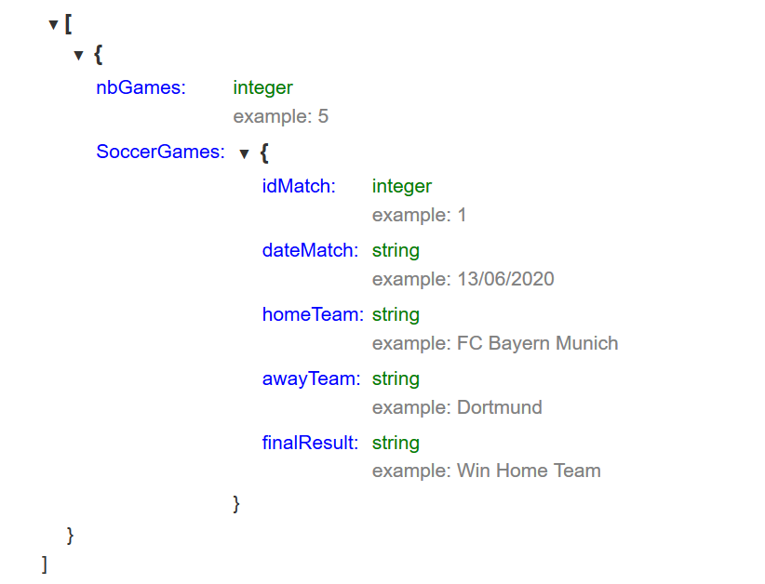
REST API Definition
GET the list of predicted soccer games: GET /soccerGames in a JSON format.

Slide 4
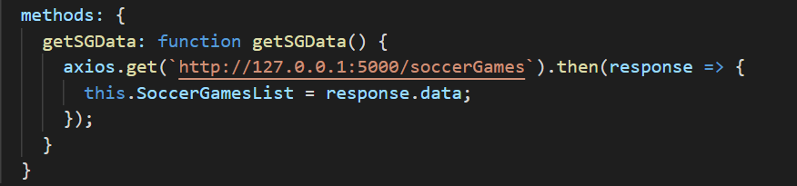
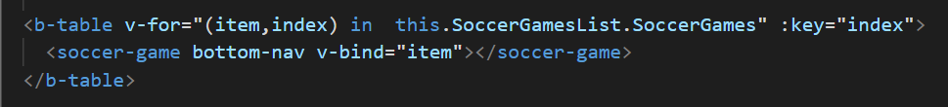
Frontend Implementation
- Get the list of predicted soccer games from the backend:
- Output the list of soccer games:

Slide 5
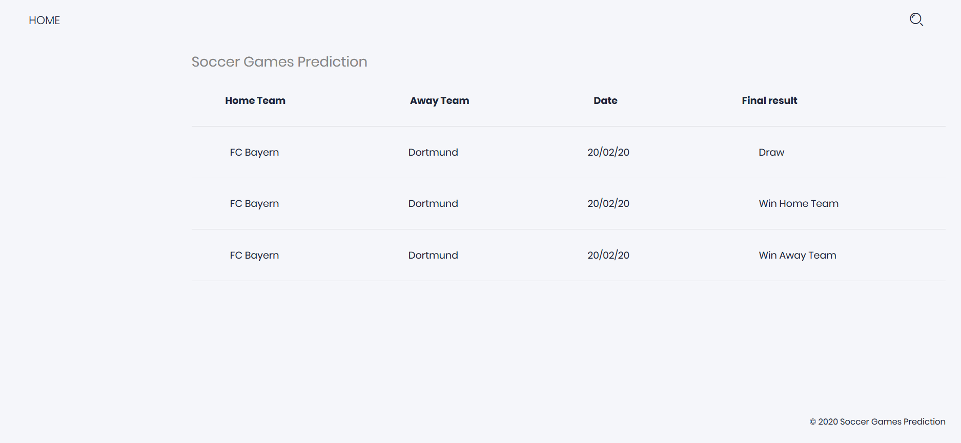
Frontend Web Page

