Slide 1
SPRINT 1
SAMPLE-Super STORE
Group members
C. Khaleel Basha
Sai Akshay Yellampalli
SRINIVAS KONDEPUDI
K Hanumanth Karthik
Deepak Ram P N

Slide 2
STEP -1
Creating an S3 bucket

Slide 3
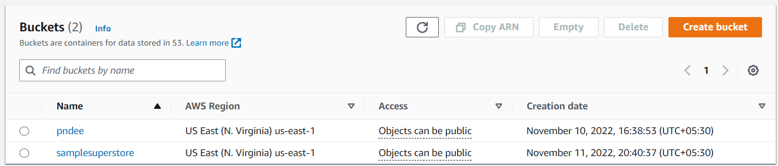
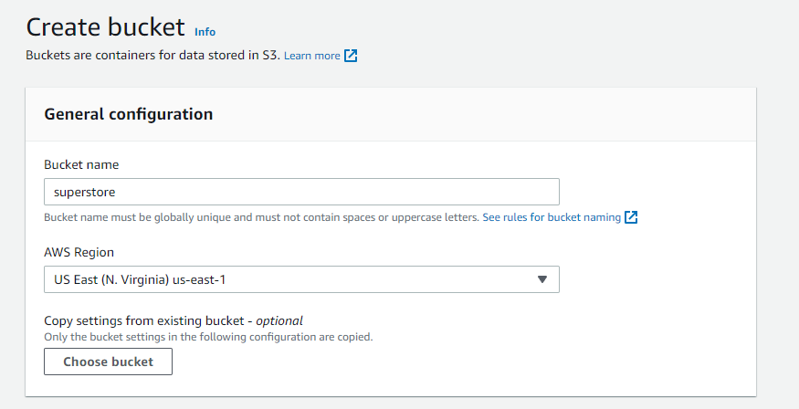

Slide 5
STEP - 2
CREATE AN IAM ROLE IN AWS
1)What is IAM role ?
2) How can we create IAM role ?

Slide 6
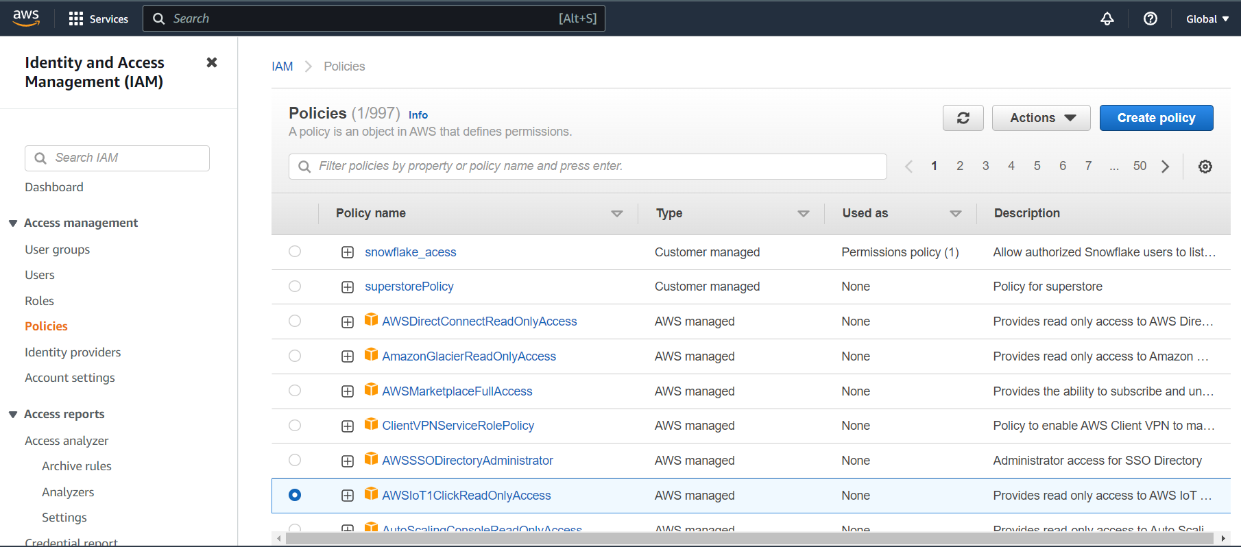
The following step-by-step instructions describe how to configure access permissions for Snowflake in your AWS Management Console to access your S3 bucket.
Log into the AWS Management Console.
From the home dashboard, choose Identity & Access Management (IAM):

Slide 7
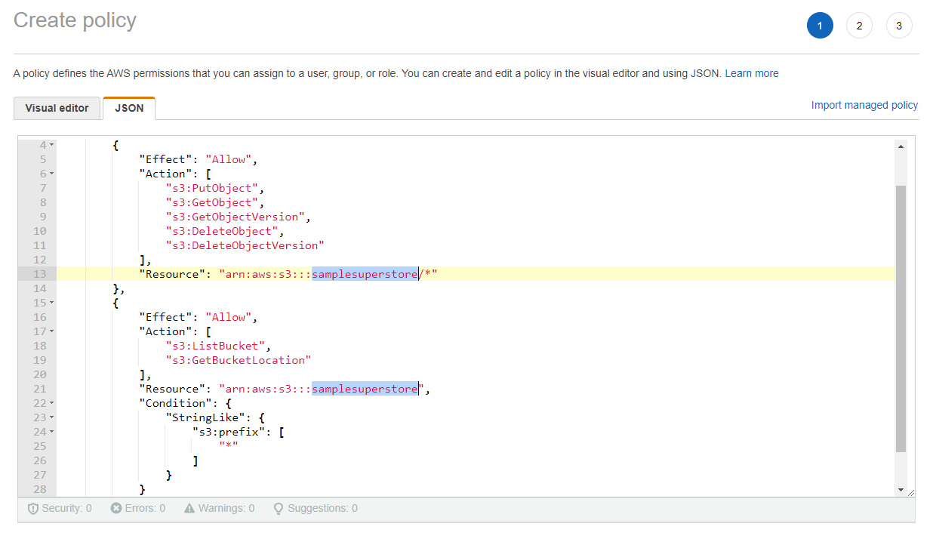
Click the JSON tab.
Add a policy document that will allow Snowflake to access the S3 bucket and folder.

Slide 8
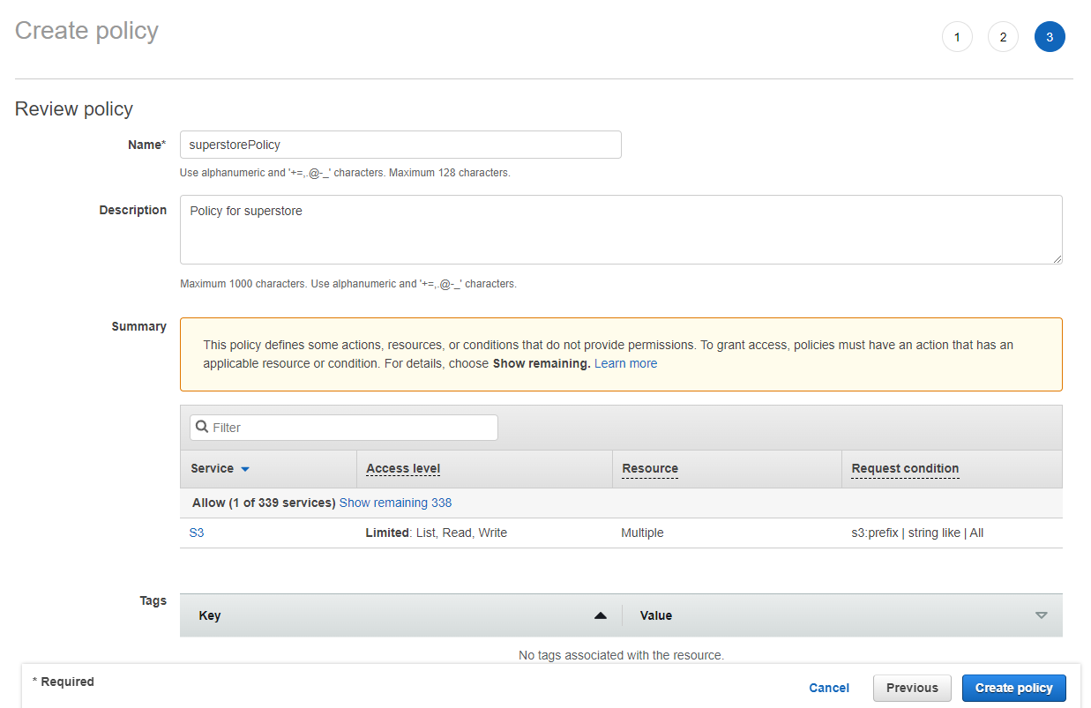
Enter the policy name and an optional description. Click Create policy.

Slide 9
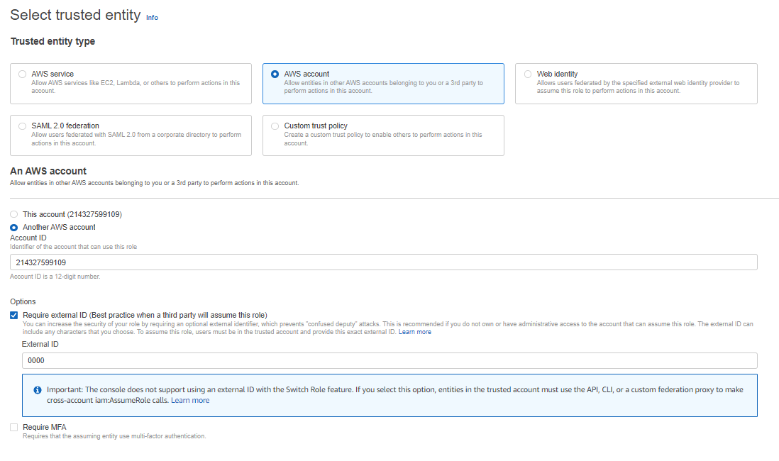
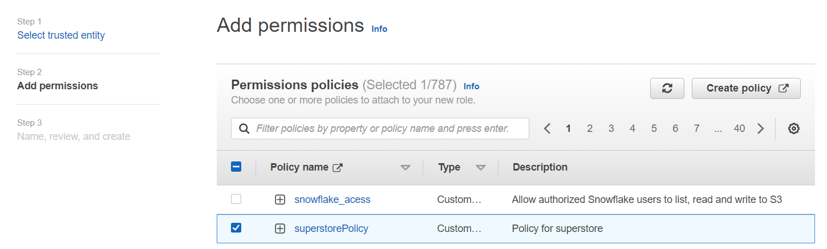
Create Role for integration

Slide 10
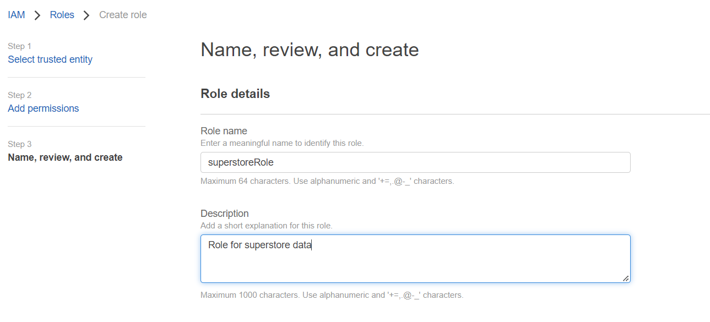

Slide 11
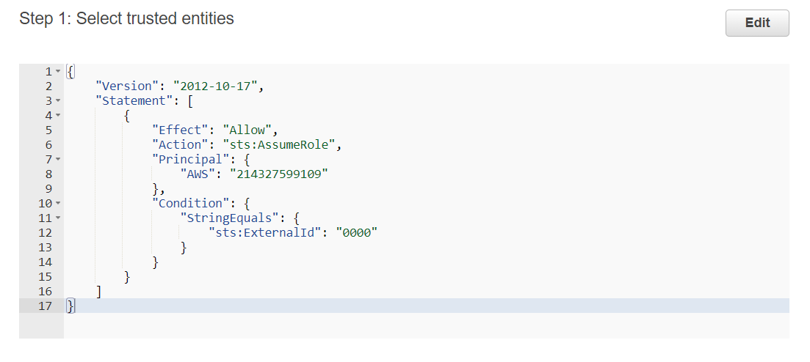
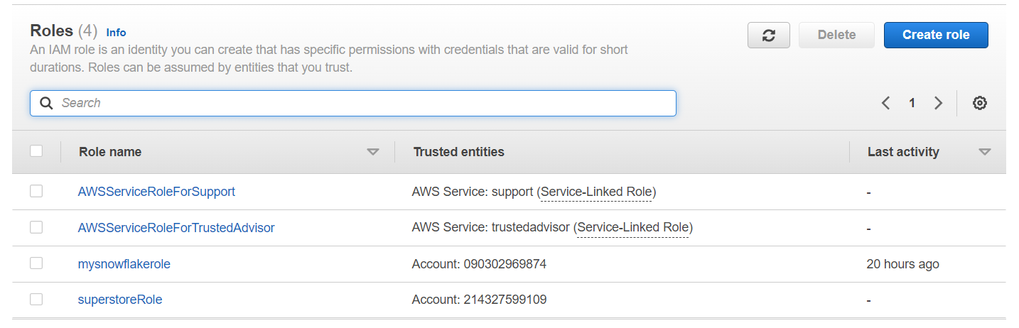
Will add AWS and External_ID after creating integration in snowflake

Slide 12
STEP -3
Creating a cloud storage Integration in snowflake
1) what is integration ?
2) what is stage ?
3) creating an external stage?

Slide 13
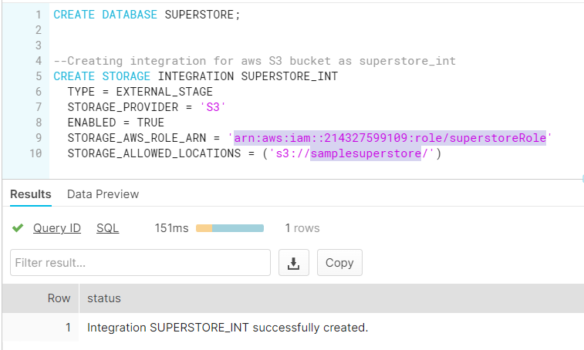
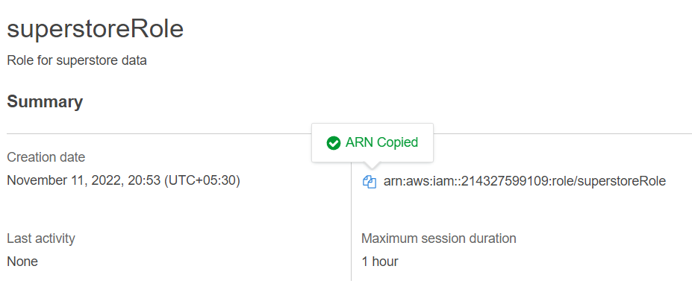
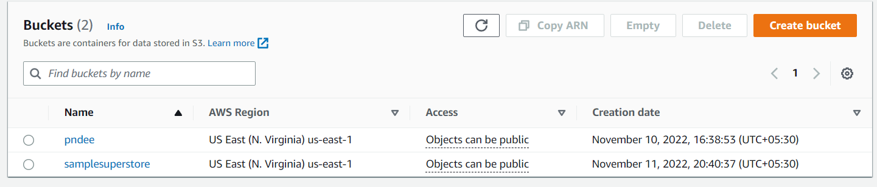

Slide 14
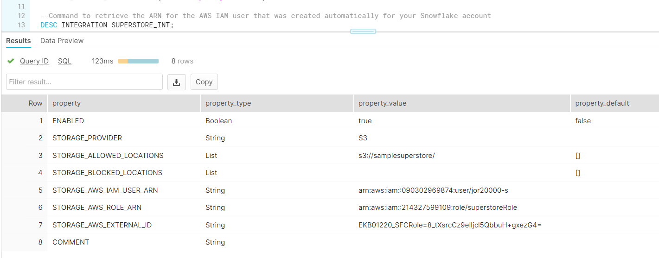
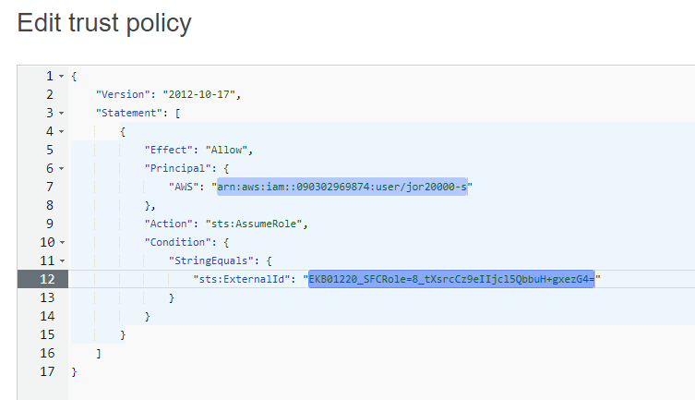

Slide 15
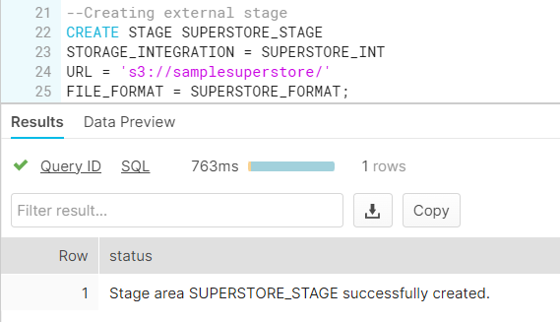
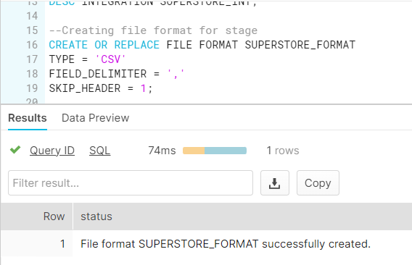

Slide 16
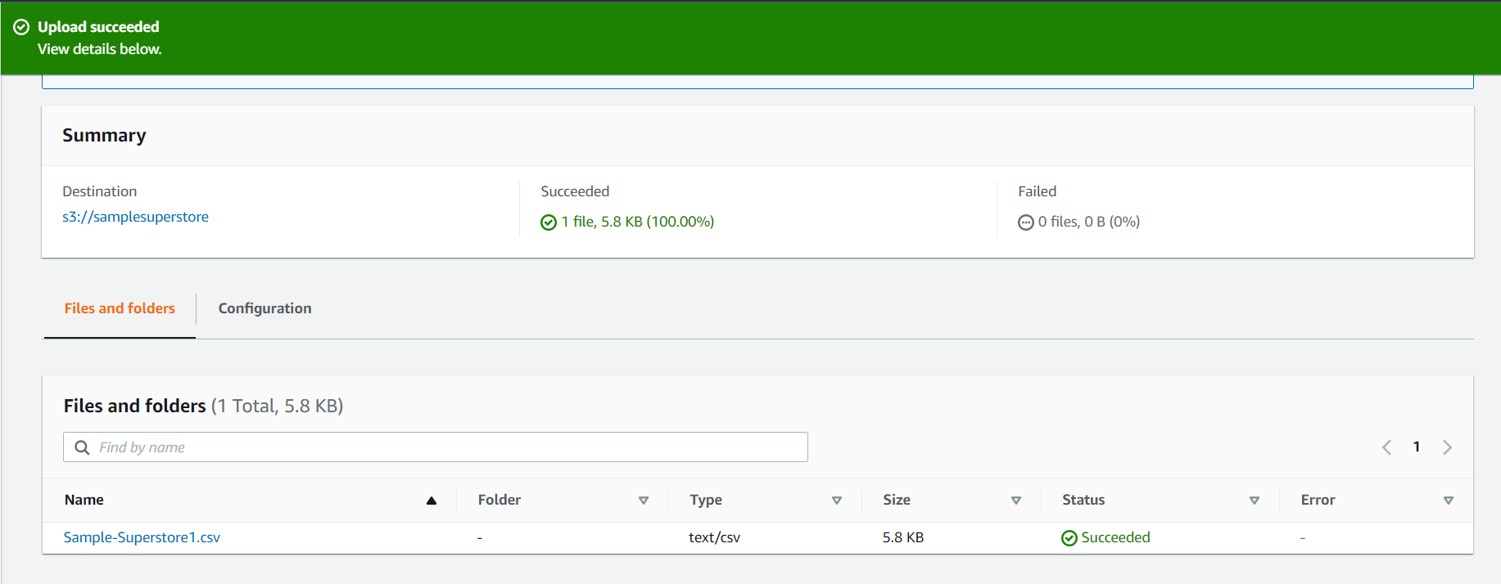
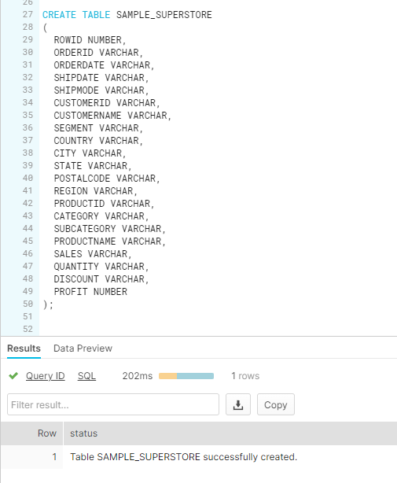
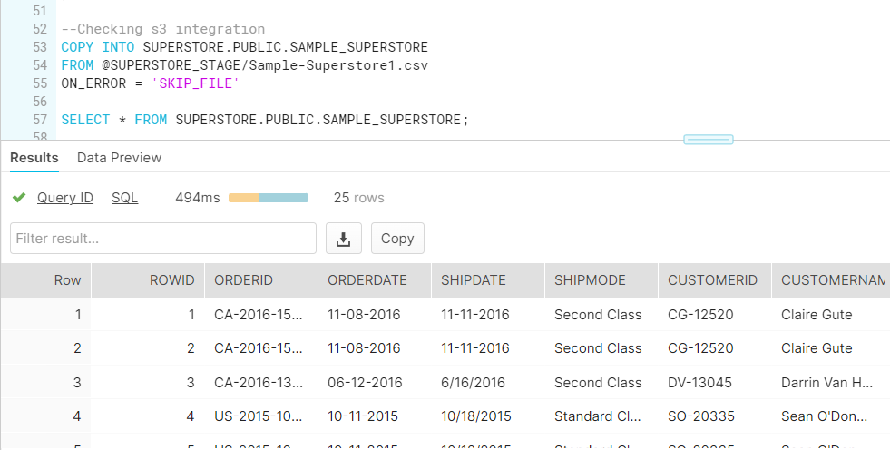

Slide 17
Step -4
CREATING A PIPE AND EVENT NOTIFICATIONS
Q1-What is a pipe and how to create a pipe?
Q2-what is event notifications and how to create it ?

Slide 18
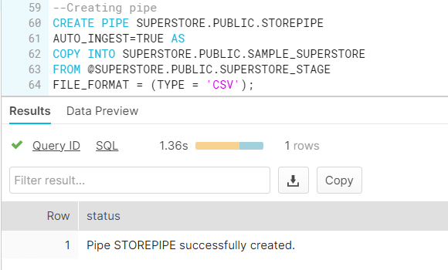

Slide 19
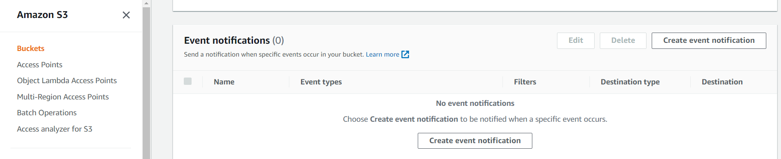
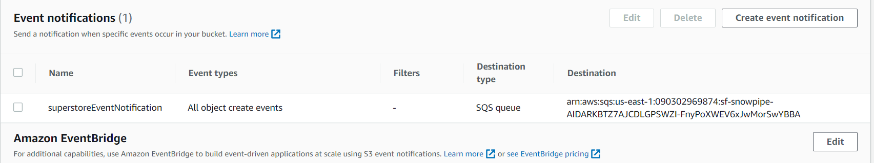
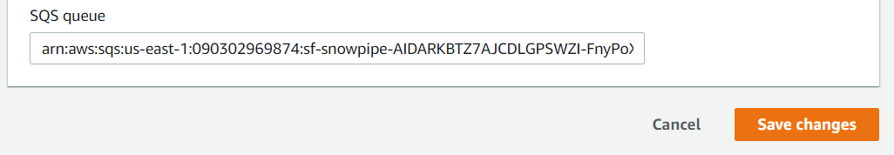

Slide 20
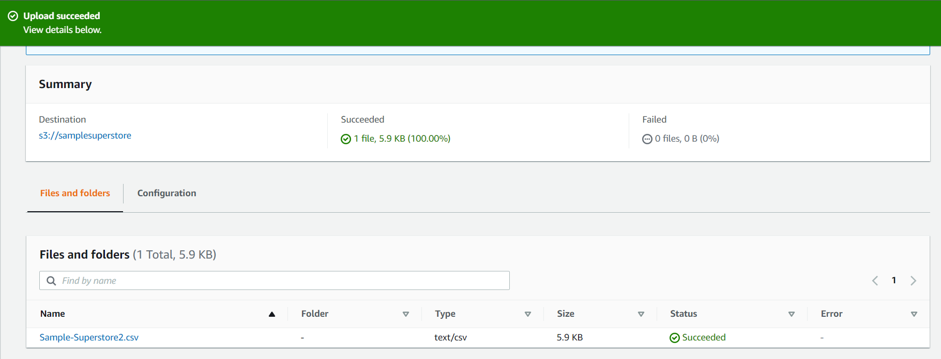
STEP -5
UPLOADING DATASET AND SOLVING THE QUIRES

Slide 22
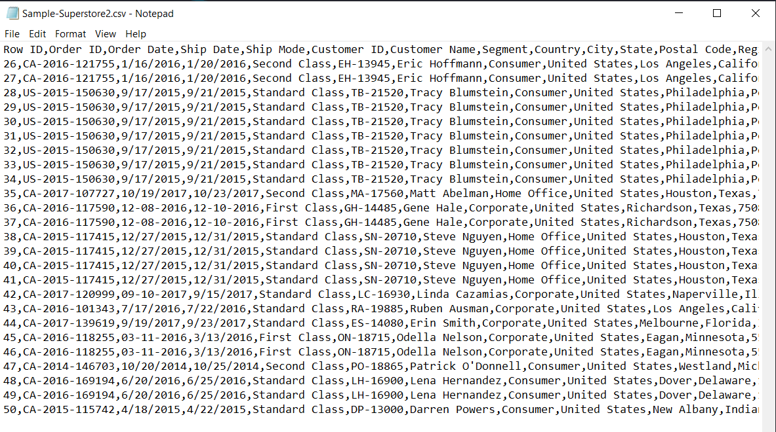

Slide 23
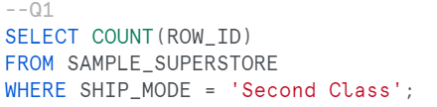
Calculate the number of Orders those with Ship Mode as ‘Second Class’
Query
output

Slide 24
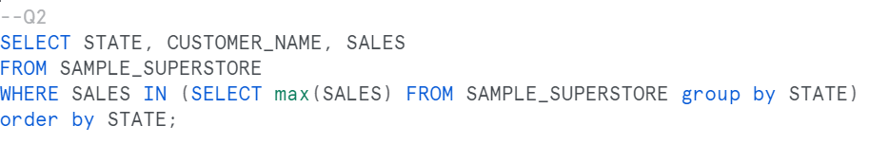
List down the most valuable customers Country wise
Output is too large to display

Slide 25
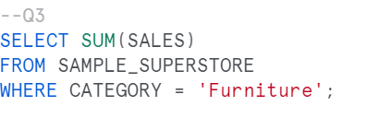
Total Sales for Category ‘Furniture’
query
output

Slide 26
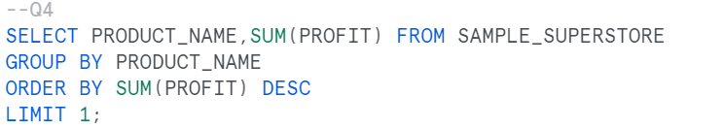
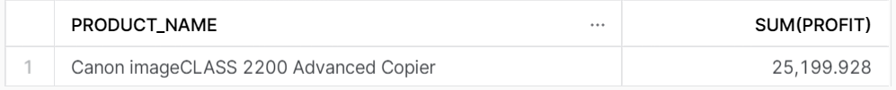
Which Product provides the maximum profit
query
output

Slide 27
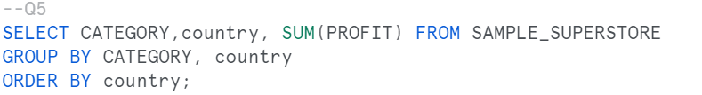
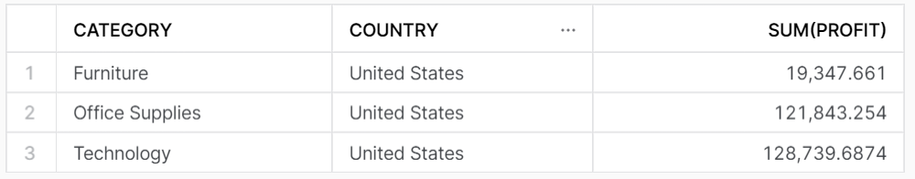
Calculate the total profit made by each product category country wise Which region of United States have majority loss?
Query
Output

Slide 28
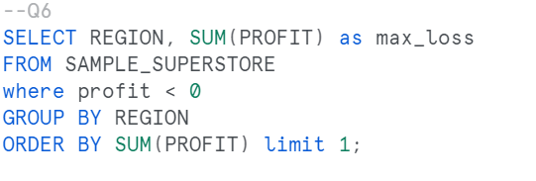
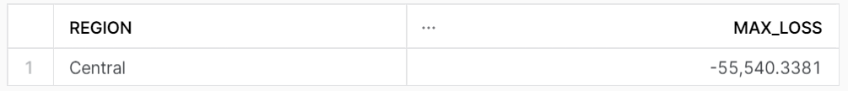
Which region of United States have majority loss?
Query
output

Slide 29
THANK YOU

