Slide 1
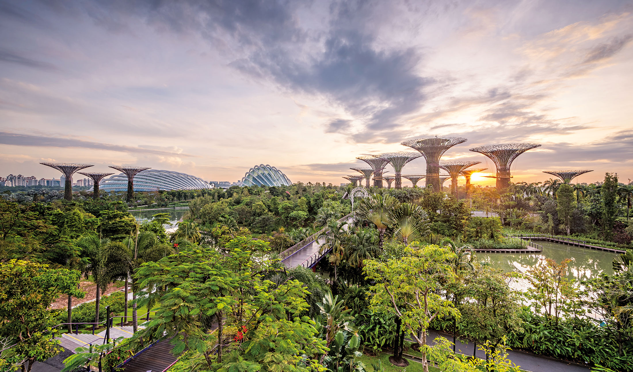
NUS Campus Masterplan
Group 8

Slide 2




Redevelopment of NUS - Overview
Background of Project
Stakeholder Engagement
Involvement of the NUS community, Singaporean society, and regulatory bodies
Consideration of both current needs and future projections
Focus:
Constructing new sustainable infrastructure to enhance its sustainability, where sustainability means actively involving essential systems at both the building and overall campus levels.
Financial & Social Returns
Initial SROI value of 2.65, indicating high positive social value
Analysis of externalities: cost savings, health benefits, etc.
Goal:
Encompasses a wide spectrum of systems, including leveraging renewable energy sources, creating water-efficient landscapes, enhancing connectivity to reduce carbon footprints, and curating public spaces that foster community, collaboration, and innovation.
Sensitivity Analysis
SROI fluctuation: worst case at 1.24, best case at 9.37
A high likelihood of positive net benefits under varying conditions
Identified Needs
Generate enhanced energy self-sustainability
Reduce daily water consumption rates
Establish connections across the vast campus
Elevate the number of lush green zones
Nurture inclusive public spaces for expanding student body
Future Implications
Potential national and global influence on educational institutions
Contribution to a greener, more sustainable future through design innovation
Introduction & Background | Theory of Change | Logic Model | Impact Valuation (SROI) | Sensitivity & Scenario Analysis | Other Considerations & Conclusion

Slide 3





Theory of Change
Energy | Water | Greenery | Mobility | Public Spaces
0.2% energy self-sufficient; Main source of energy supply is only from existing solar PV | Current demand is 1.66 mil meter cubes per year and no supply | Limited green coverage and lack of water-centric spaces | Long commuting time on campus; traffic congestion | Limited public space for community events
Installation of rooftop solar PV, façade solar PV, wind turbine; improve district cooling system | Implement measures to generate water – rain water harvesting and grey water recycling | Plant 100,000 new trees, create experiential landscape and freshwater habitat | Create canopy walk network, driverless shuttle bus; monorail | Create 7 new public space areas; merge public spaces with natural surroundings
163% energy self-sufficient, which annual energy supply of 226 mil kWh | 89% self-sufficient; target on-campus generation is 2.04mil m³ per year | Increase total green space by 23.4%; reduce campus daytime heat intensity by 1.6°C | Reduced commuting time; car-free walkable and cyclable area on campus | Increase total amount of public space available to 1/3 of campus area
Current State
Intervention
Desired State
Introduction & Background | Theory of Change | Logic Model | Impact Valuation (SROI) | Sensitivity & Scenario Analysis | Other Considerations & Conclusion

Slide 4
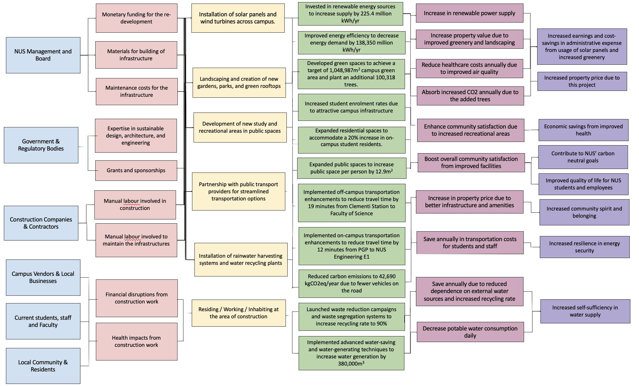
Logic Model
Positive long-term impacts for NUS community including students, management and staff
Introduction & Background | Theory of Change | Logic Model | Impact Valuation (SROI) | Sensitivity & Scenario Analysis | Other Considerations & Conclusion
Notes:
Thus, we first establish the Strategic Plan using Theory of Change to establish the problem and intended impact. Followed by the establishment of the Standards of Performance with the Logic Model in order to pick out weaknesses and barriers to implementation, measure progress and outcome metrics and design an evaluation plan for the impact achieved.

Slide 5

Impact Valuation (SROI) - Investments
Investment items
Key Estimates
Energy
Solar PVs
Wind Turbines
Microgrid controller
Retrofits
Retrofit areas = campus & office/education facilities area - 311,661m2 & 1,113,639m2 respectively (UCI)
Cost per Megawatt estimated =$212,329/MW of target supply (US Dept. Energy)
Water
Tanks for rainwater
Rainwater catchment
Greywater treatment facilities
Rainwater harvesting Tank Volume required is 5% of the target supply from Rainwater (Owls Hall)
Greenery
Tree Plantings
Cost of planting a Tree = $250 Benchmarked off costing from Nparks
Mobility
Monorail Construction
Cost Benchmarked using Sentosa Construction Cost
Scaled to Monorail length of 8.5km
Public Spaces
Public Space Construction
Benchmarked using Bishan Park Cost
Scaled to change in Public Space of 49 hectares
Introduction & Background | Theory of Change | Logic Model | Impact Valuation (SROI) | Sensitivity & Scenario Analysis | Other Considerations & Conclusion

Slide 6
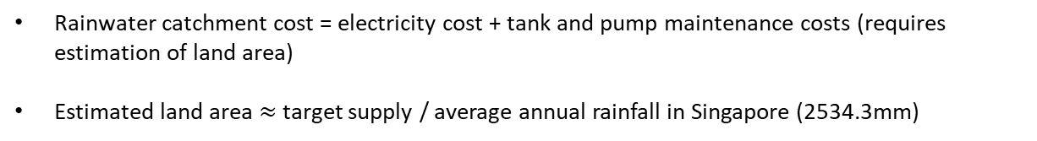
Impact Valuation (SROI) – Social Costs
Cost items
Key Estimates
Energy
Solar PV maintenance
Wind Turbine maintenance
Microgrid controller maintenance
Microgrid maintenance cost estimation = average microgrid maintenance costs from comparable microgrid in India (Sharma et al, 2022)
Water
Rainwater catchment maintenance
Greywater treatment maintenance
Rainwater catchment cost = electricity cost + tank and pump maintenance costs (requires estimation of land area)
Estimated land area $≈$ target supply / average annual rainfall in Singapore (2534.3mm)
Greenery
NUS greenery maintenance
Total Area to maintain = Vertical Green + Rooftop Green + Change in Land Greenery
Mobility
Monorail maintenance
maintenance cost / km proxied by Turkish monorail at $5.7million/km
Public Spaces
Public Space maintenance
Proxied by Nparks Operational Cost / m2
Does not include Depreciation Costs
Introduction & Background | Theory of Change | Logic Model | Impact Valuation (SROI) | Sensitivity & Scenario Analysis | Other Considerations & Conclusion

Slide 7

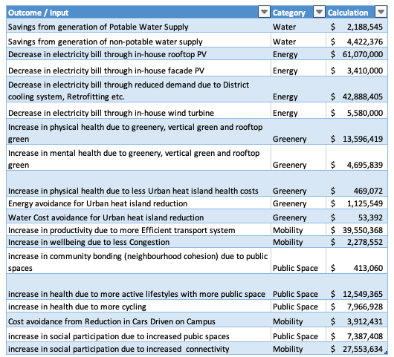

Key Financial Proxies: Overview by Categories
Total Benefit by Category of Activities
Introduction & Background | Theory of Change | Logic Model | Impact Valuation (SROI) | Sensitivity & Scenario Analysis | Other Considerations & Conclusion

Slide 8

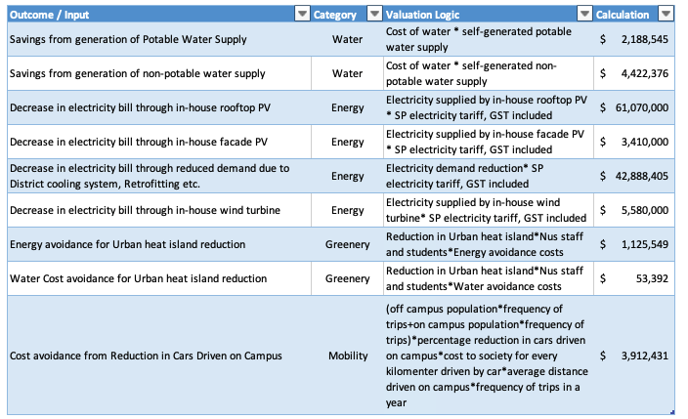


Key Financial Proxies: Cost Avoidance
Cost Avoidance due to Energy Produced and Demand reduced = [Energy produced by Rooftop & Façade Solar PV + Energy produced by Wind Turbine + (Current Energy Demand - Target Energy Demand)] * Energy Tariffs
Cost Avoidance due to generation of Non-potable and potable water supply = Price of water * Self-generated supply of Non-potable and Potable water
Cost avoidance due to reduction in cars driven on Campus = [Number of NUS Staff and Students that live off-campus * Number of trips made to Campus per year (off-campus) + Number of NUS Staff and Students that live on campus * Number of trips made to Campus per year (on Campus)] * Percentage that drive to Campus * Percentage willing to switch * Cost savings from reduction in distance driven in a car * Total distance covered per round trip
Introduction & Background | Theory of Change | Logic Model | Impact Valuation (SROI) | Sensitivity & Scenario Analysis | Other Considerations & Conclusion

Slide 9
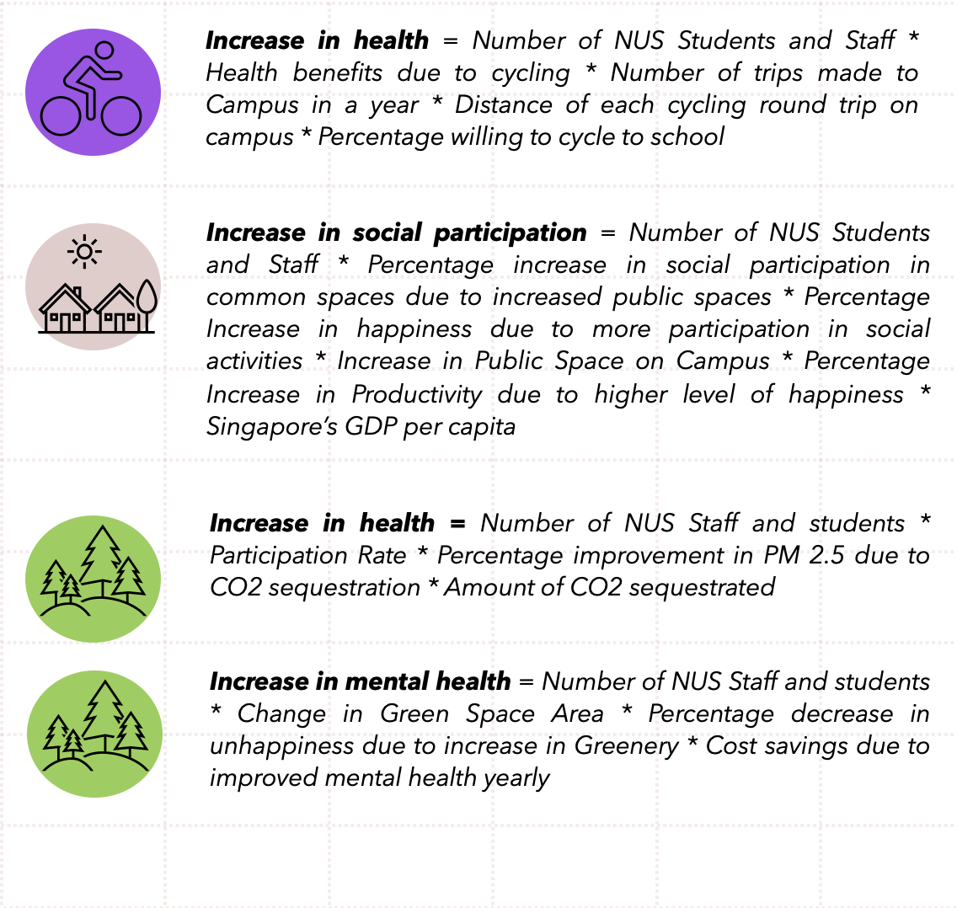
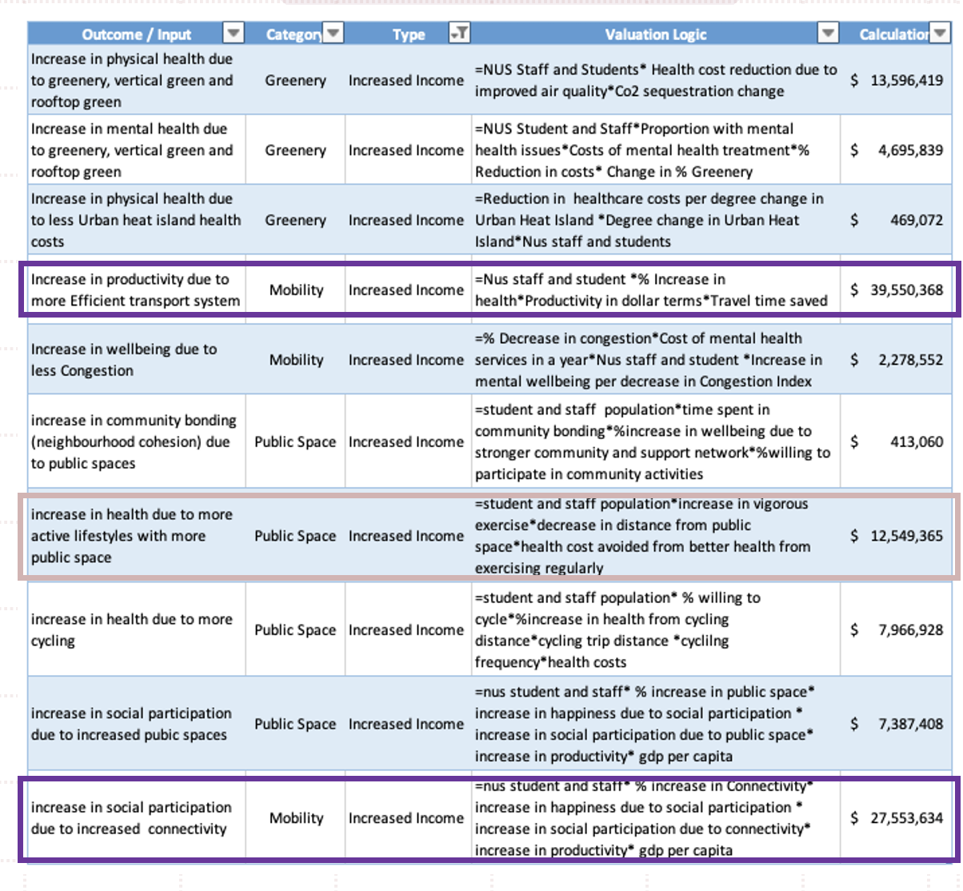
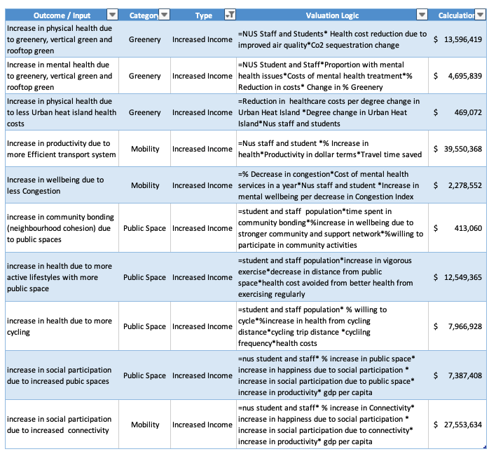

Key Financial Proxies: Increased Income
Increase in Productivity = (Number of NUS Staff and Students off-campus * Number of trips taken to Campus in a year (off-campus) + Number of NUS Staff and Students on campus * Number of trips taken to Campus in a year (on campus)) * Reduction in time taken to travel per round trip on Campus * Value of Productivity per minute on public transport * Scaling factor
Increase in Social participation = Number of NUS Staff and Students * Percentage Increase of social participation due to increased connectivity (via public transport and bicycle) * Percentage Increase in Happiness due to increased social participation (in common areas) * Increase in connectivity * Percentage Increase in productivity due to increased happiness * Productivity per person
Increase in health = Number of NUS Staff and students * Increase in exercise conducted per metre distance reduction between the common area and residential estate * Reduction in distance away from Public Space * Singapore GDP per capita * Decrease in mortality rate due to increased exercise
Introduction & Background | Theory of Change | Logic Model | Impact Valuation (SROI) | Sensitivity & Scenario Analysis | Other Considerations & Conclusion

Slide 10
Impact Valuation (SROI) - Analysis
SROI | Base Case
Total Social Benefit | 3,513,239,621.79
Total Social Cost | 1,273,062,260.87
Total Investment | 846,406,138.39
SROI | 2.65
1
We land at an SROI figure of 2.65
2
The largest Benefits come from adoption of Solar and Wind Energy accounting for 51% of net benefit
5
SROI for energy is 1.22, which is lower than the overall SROI
Greenery and Public Space account for 36% net benefit
6
However, SROI for Public Spaces and Greenery are 5.56 and 8.58 respectively
3
4
Monorail costs exceed benefits leading to negative net benefit contribution of 9%
Introduction & Background | Theory of Change | Logic Model | Impact Valuation (SROI) | Sensitivity & Scenario Analysis | Other Considerations & Conclusion

Slide 11
Sensitivity & Scenario Analysis
Sensitivity Analysis – Choice of Variables
Scenario Analysis
1
Select across key elements to get a comprehensive view of risk
1
Worst Case : Costs are higher than expected, participation is low
2
Select variables that materially affect SROI
2
Best Case : Costs are lower than expected, participation is high
3
Choose Variables we are most unsure about the estimation
Scenario Analysis
 | Worst Case | Base Case | Best Case
Total Social Benefit | 2,019,334,729.61 | 3,513,239,621.79 | 10,246,467,609.14
Total Social Cost | 857,843,842.43 | 1,273,062,260.87 | 3,151,541,132.34
Total Investment | 936,330,326.32 | 846,406,138.39 | 757,280,063.65
SROI | 1.24 | 2.65 | 9.37
Introduction & Background | Theory of Change | Logic Model | Impact Valuation (SROI) | Sensitivity & Scenario Analysis | Other Considerations & Conclusion

Slide 12
Other Considerations
Conclusion & Takeaways
Other Considerations
Campus-wide engagement and customization
Under the broad framework, different faculties may have varying priorities
Engagement with stakeholders to ensure the redesign accommodates their specific needs
Scaling effect
There is a significant scaling effect given Singapore as a densely populated country in need of self-sufficiency in resources (e.g. Singapore's aim to be self-dependent in water before 2061)
Conclusion & Takeaways
Base case SROI = 2.65
Worst case SROI = 1.24
Best case SROI = 9.37
The project has a positive return of 24% even in the worst-case scenario, so the group recommends going forward with the project.
The biggest contributor to the positive SROI are greenery and public spaces (77% combined).
Cost of capital has the largest impact on SROI compared to other parameters.
Introduction & Background | Theory of Change | Logic Model | Impact Valuation (SROI) | Sensitivity & Scenario Analysis | Other Considerations & Conclusion

