Slide 1
UK Cyber Risk Monthly Update – April 2026
03 April 2026
Prepared for the UK Technology Risk Committee

Slide 2
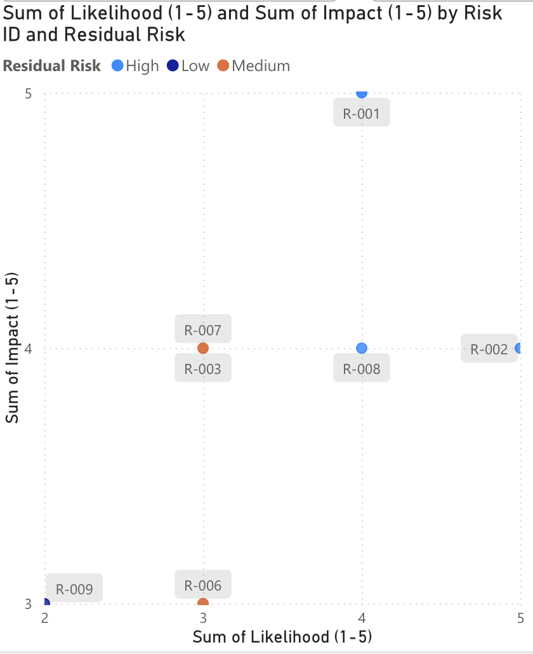
Top Risk Overview
10 total risks tracked
4 High residual risks (R‑001, R‑002, R‑005, R‑008)
4 Medium, 2 Low
8 risk categories including Cloud Misconfiguration, IAM, Insecure APIs, Backup & Recovery
Top 3 High risks by control gap:
10 total risks tracked
4 High residual risks (R‑001, R‑002, R‑005, R‑008)
4 Medium, 2 Low
8 risk categories including Cloud Misconfiguration, IAM, Insecure APIs, Backup & Recovery
Risk ID | Risk Category | Control Gap | Owner | Status
R‑001 | Cloud Misconfiguration | No automated CSPM; bucket audit disabled | Cloud Eng | In Progress
R‑005 | Insecure APIs | DAST pipeline missing; no rate limiting | Product Security | In Progress
R‑002 | IAM | No CI/CD for IAM policy generation | IAM Team | In Progress

Slide 3
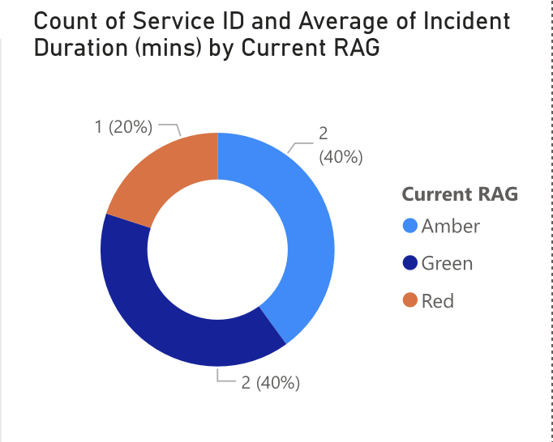
Operational Resilience – Important Business Services (IBS)
Status | Impact Tolerance | Remediation Owner | Due
At Risk | 30 mins | Payments Rel | 20-Apr-2026
In Progress | 240 mins | Platform Eng | 15-Apr-2026
Not Started | 15 mins | ML Ops | 10-May-2026

Slide 4
Product Governance & Change Readiness
Blocked change (critical):
At‑risk changes (Amber):
Product/Feature | Security Status | Blocker | Security Approver
Cloud Migration Phase 1 | Blocked | SQL injection found – fix required | CISO Office
Product/Feature | Status | Reason | Approver
New Checkout Flow | In Review | Pen test scheduled 10-May | CISO Office
Real‑time Balance API | In Review | Awaiting pen test report | CISO Office

Slide 5
Key Metrics Summary
Metric | Value | Target | Status
High residual risks | 4 | 0 | 🔴 Exceeds
IBS within tolerance | 2/5 | 100% | 🔴 Critical
Product changes blocked/at risk | 3/6 | <20% | 🟡 Needs focus
Average incident duration | 156 min | <60 min | 🔴 High
Remediation owners engaged | 8 teams | All | 🟢 On track

Slide 6
Recommendations
For the UK Technology Risk Committee:
Approve CSPM tool budget – addresses R‑001 (S3 misconfiguration) and enables automated audit.
Direct IAM Team to implement CI/CD for IAM policy generation (R‑002) by 30‑Jun.
Escalate IBS‑003 (Checkout) – daily status updates required from Payments Reliability.
Block Cloud Migration Phase 1 until SQL injection is re‑mediated and re‑scanned.
Expedite pen tests for New Checkout Flow and Real‑time Balance API – target completion by 15‑May.

