Slide 1
Particle Swarm Optimization (1)
Winter 2009
Application of Computational Intelligence in Engineering

Slide 2

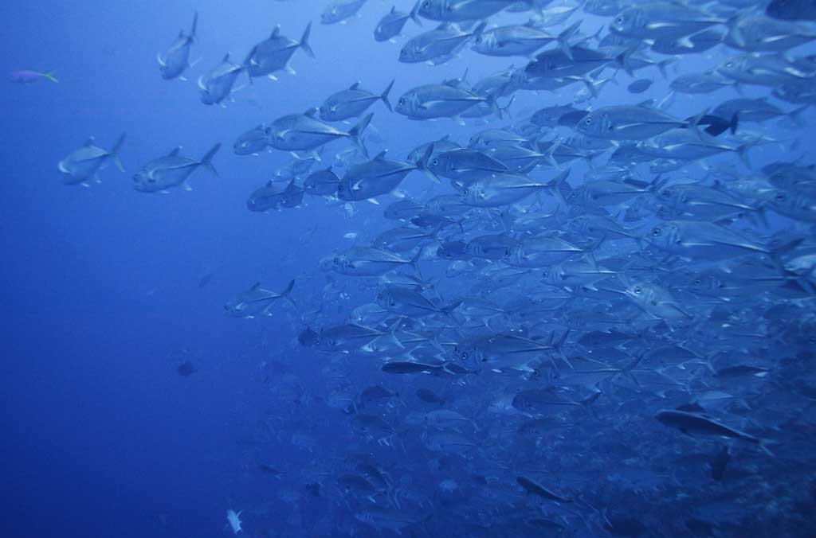
Learning from Creatures
Application of Computational Intelligence in Engineering

Slide 3
Swarm Intelligence
Swarm of creatures could achieve things that no individual could
  No central control
  Cooperation and self-organization
  Simple, and yet powerful rule for individual
Application of Computational Intelligence in Engineering

Slide 4
Introduction
First described in 1995 by James Kennedy and Russell Eberhart
Implement the underlying rules that enable large numbers of organisms (birds, fishes, herds) to move synchronously, often changing direction suddenly, scattering and regrouping
Attractiveness: simplicity, implement in little code; few parameters to adjust
Application of Computational Intelligence in Engineering

Slide 5
PSO Theory (1)
Each particle iteratively moves across the search space
Attracted to the position (location) of the best fitness (evaluation of the objective function) historically achieved by the particle itself (local best; pBest) and by the best among the neighbors of the particle (global best; gBest).
Application of Computational Intelligence in Engineering

Slide 6
PSO Theory (2)
In essence, each particle continuously focuses and refocuses the effort of its search according to both local and global best.
This behavior mimics the cultural adaptation of a biological agent in a swarm: it evaluates its own position based on certain fitness criteria, compares with others, and imitates the best in the entire swarm
Application of Computational Intelligence in Engineering

Slide 7
Basic PSO Flow (1)
Initialize a population of particles in the search space
  Provide each particle with a random location and a random velocity within the N-dimensional space
Evaluate each particle’s fitness, based on the objective value
If the fitness is better than the particle’s best experience (pBest), save the location vector for the particle as pBest
Application of Computational Intelligence in Engineering

Slide 8
Basic PSO Flow (2)
If the fitness is better than the best in the entire population (gBest), save the location vector for the particle as gBest
Update the particle’s velocity and location based on pBest and gBest
Application of Computational Intelligence in Engineering

Slide 9
Update the Velocity
w is an inertia weight to control influence of the previous velocity; usually between 0 and 1
r₁ and r₂ are two random numbers uniformly distributed in the range of (0,1);
c₁ and c₂ are two acceleration constants; usually between 1~4.
Application of Computational Intelligence in Engineering

Slide 10
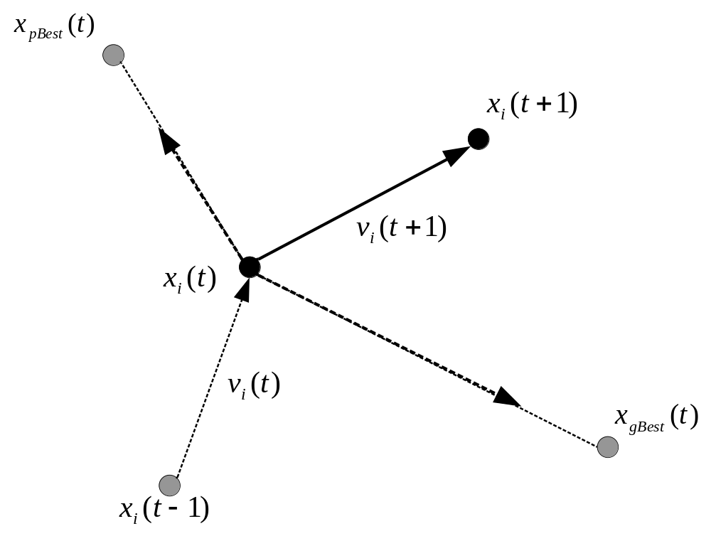

Update the Location
Application of Computational Intelligence in Engineering

Slide 11
Further Discussion
PSO models the “learning from own experience (cognition)” behavior of individual particles whereas reflects the “social interaction” phenomenon among particles.
These two terms are stochastically weighted by r₁c₁ and r₂c₁. The randomness provides the possibility to reach the global optimal solution without being trapped at local optimal solutions (exploration).
Application of Computational Intelligence in Engineering

Slide 12
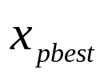
PSO in Pseudocode (1)
FOR each particle
Initialize particle randomly
WHILE maximum iteration or convergence criteria is not met
FOR each particle
Calculate fitness value F(i,t) corresponded to location X(i,t)
% i,t: particle i at iteration t
IF F(i,t) is better than pbest
pBest = F(i,t)
pBestLoc = X(i,t)
END
END
→
Application of Computational Intelligence in Engineering

Slide 13
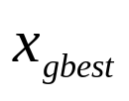
PSO in Pseudocode (2)
Choose the particle i* with the best fitness
gBest = F(i*,t)
gBestLoc = X(i*,t)
FOR each particle
Calculate particle velocity
Update particle location
END
END WHILE
Return gBest
→
Application of Computational Intelligence in Engineering

Slide 14
Numerical Example
Maximize f(x,y) = x^{0.5} – 1/y; 0≦ (x,y) ≦5
We will use this example to illustrate a PSO algorithm
Application of Computational Intelligence in Engineering

Slide 15
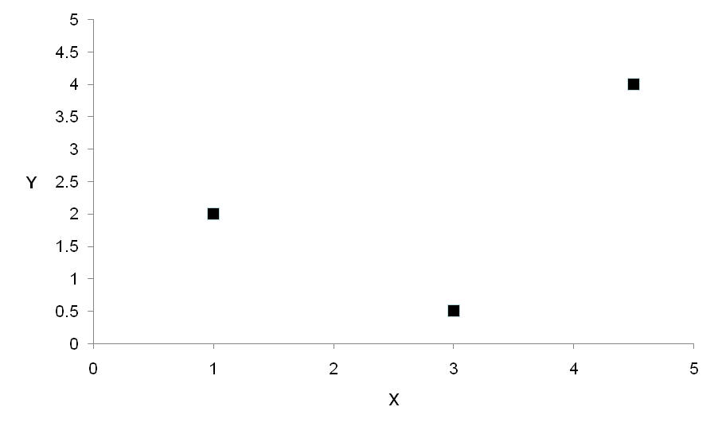
Numerical Example (1)
Randomly initialize locations and velocities
Location
x | y
1 | 2
4.5 | 4
3 | 0.5
Velocity
x | y
0.83 | -0.51
-0.67 | 0.94
0.45 | 0.89
Assume the initial velocity is randomly generated within range (-1,1)
Application of Computational Intelligence in Engineering

Slide 16
Numerical Example (2)
Iteration 1: Calculate Fitness
Location
x | y | Fitness
1 | 2 | 0.500
4.5 | 4 | 1.871
3 | 0.5 | -0.268
Application of Computational Intelligence in Engineering

Slide 17
Numerical Example (3)
Iteration 1: Update pBest and pBestLoc
  This is the first iteration, so pBest will be the current fitness
pBest
x | y | Fitness
1 | 2 | 0.500
4.5 | 4 | 1.871
3 | 0.5 | -0.268
Application of Computational Intelligence in Engineering

Slide 18
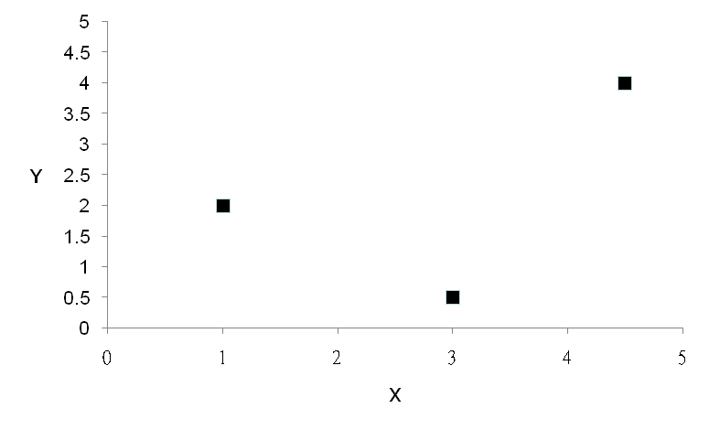
Numerical Example (4)
Iteration 1: Determine gBest and gBestLoc
gBest
x | y | Fitness
1 | 2 | 0.500
4.5 | 4 | 1.871
3 | 0.5 | -0.268
Application of Computational Intelligence in Engineering

Slide 19
Numerical Example (5)
Iteration 1: Calculate velocities
Velocity
x | y
3.49 | 1.01
-0.67 | 0.94
1.86 | 4.18
previous velocity
w
c₁
r₂
c₂
1×(0.83,-0.51) + r₁×2×(0,0) + 0.38×2×[(4.5,4)-(1,2)]
global best; 1×(-0.67,0.94)
1×(0.45,0.89) + r₁×2×(0,0) + 0.47×2×[(4.5,4)-(3,0.5)]
Location
x | y
1 | 2
4.5 | 4
3 | 0.5
Velocity
x | y
0.83 | -0.51
-0.67 | 0.94
0.45 | 0.89
pBest
x | y | Fitness
1 | 2 | 0.500
4.5 | 4 | 1.871
3 | 0.5 | -0.268
gBest
x | y | Fitness
4.5 | 4 | 1.871
Application of Computational Intelligence in Engineering

Slide 20
Numerical Example (6)
Iteration 1: Calculate locations
New Location
x | y
4.49 | 3.01
3.83 | 4.94
4.86 | 4.68
Location
x | y
1 | 2
4.5 | 4
3 | 0.5
Velocity
x | y
3.49 | 1.01
-0.67 | 0.94
1.86 | 4.18
＝
＋
Application of Computational Intelligence in Engineering

Slide 21
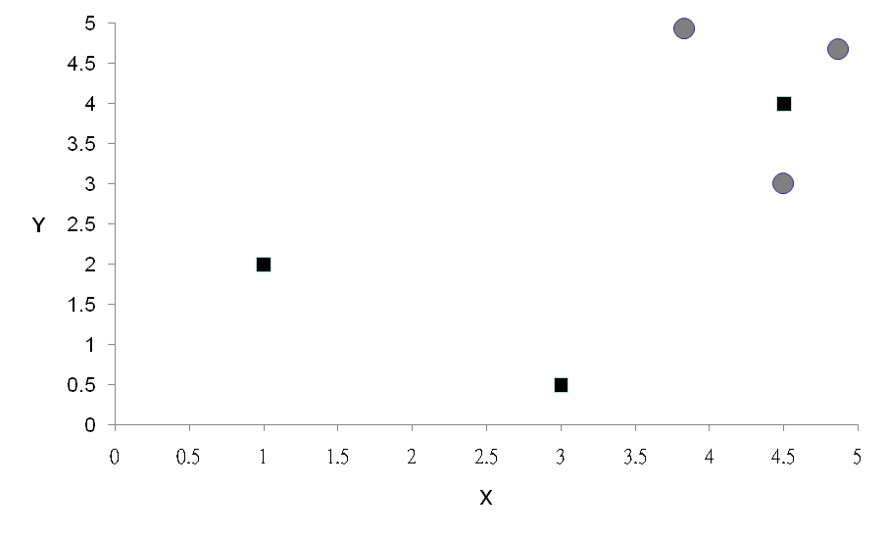
Numerical Example (7)
New Location
x | y
4.49 | 3.01
3.83 | 4.94
4.86 | 4.68
Location
x | y
1 | 2
4.5 | 4
3 | 0.5
Velocity
x | y
3.49 | 1.01
-0.67 | 0.94
1.86 | 4.18
＝
＋
Application of Computational Intelligence in Engineering

Slide 22
Numerical Example (8)
Iteration 2: Calculate fitness
Location
x | y | Fitness
4.49 | 3.01 | 1.787
3.83 | 4.94 | 1.755
4.86 | 4.68 | 1.991
Application of Computational Intelligence in Engineering

Slide 23
Numerical Example (9)
Iteration 2: Update pBest and pBestLoc
Original pBest
x | y | Fitness
1 | 2 | 0.500
4.5 | 4 | 1.871
3 | 0.5 | -0.268
New pBest
x | y | Fitness
4.49 | 3.01 | 1.787
4.5 | 4 | 1.871
4.86 | 4.68 | 1.991
Location
x | y | Fitness
4.49 | 3.01 | 1.787
3.83 | 4.94 | 1.755
4.86 | 4.68 | 1.991
Application of Computational Intelligence in Engineering

Slide 24
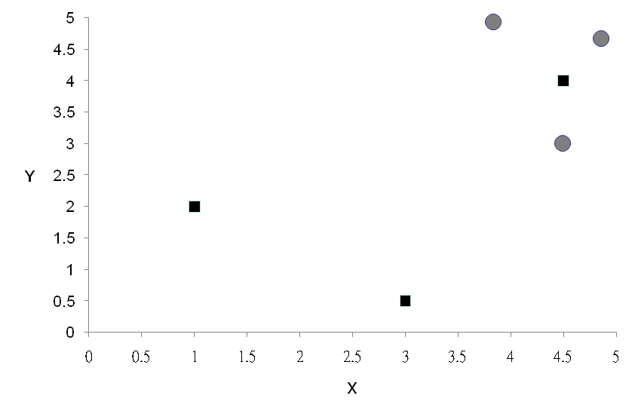
Numerical Example (10)
Iteration 2: Determine gBest and gBestLoc
gBest
x | y | Fitness
4.49 | 3.01 | 1.787
4.5 | 4 | 1.871
4.86 | 4.68 | 1.991
Application of Computational Intelligence in Engineering

Slide 25
Constrained Velocity and Location
If the velocity would lead the particle to move beyond boundaries, what should we do?
First, the velocity may be limited
Second, whether the location is allowed to move outside the boundary needs special caution
Application of Computational Intelligence in Engineering

Slide 26
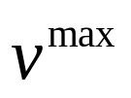
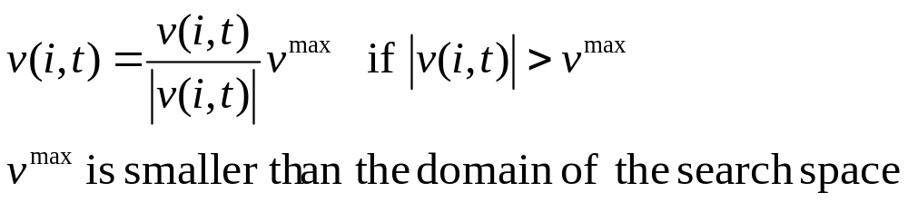
Damping Limit for Velocity
To prevent undesired oscillations (i.e., the velocity may expand wider and wider until approaching infinity), the velocity is often dampened by an upper limit
Application of Computational Intelligence in Engineering

Slide 27
Treatment for Boundary Violation
Do not allow any particle to move outside, infeasible solutions
Force particle to stick to the boundary; repair the location if necessary
There are some other alternatives; we will address them next time
Let’s continue iteration 2 of the numerical example to repair the location
Application of Computational Intelligence in Engineering

Slide 28
Numerical Example (11)
Recap
Velocity
x | y
3.49 | 1.01
-0.67 | 0.94
1.86 | 4.18
Location
x | y | Fitness
4.49 | 3.01 | 1.787
3.83 | 4.94 | 1.755
4.86 | 4.68 | 1.991
pBest
x | y | Fitness
4.49 | 3.01 | 1.787
4.5 | 4 | 1.871
4.86 | 4.68 | 1.991
gBest
x | y | Fitness
4.86 | 4.68 | 1.991
Application of Computational Intelligence in Engineering

Slide 29
Numerical Example (12)
Iteration 2: Calculate velocities
Velocity
x | y
4.038 | 3.482
0.151 | 0.286
1.860 | 4.180
1×(3.49,1.01) + 0.17×2×[(4.49,3.01)-(4.49,3.01)]
+ 0.74×2×[(4.86,4.68)-(4.49,3.01)]
1×(-0.67,0.94) + 0.29×2×[(4.5,4)-(3.83,4.94)]
+ 0.21×2×[(4.86,4.68)-(3.83,4.94)]
1×(1.86,4.18) + 0.68×2×[(4.86,4.68)-(4.86,4.68)]
+ 0.11×2×[(4.86,4.68)-(4.86,4.68)]
Application of Computational Intelligence in Engineering

Slide 30
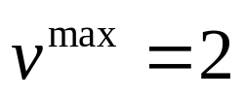
Numerical Example (13)
Iteration 2: Velocity damping; e.g.,
Velocity
x | y
4.038 | 3.482
0.151 | 0.286
1.860 | 4.180
Damped Velocity
x | y
2 | 2
0.151 | 0.286
1.860 | 2
Application of Computational Intelligence in Engineering

Slide 31
Numerical Example (14)
Iteration 2: Repair locations, e.g., ≦5
New Location
x | y
6.490 | 5.01
3.981 | 5.226
6.720 | 6.680
Location
x | y
4.49 | 3.01
3.83 | 4.94
4.86 | 4.68
Velocity
x | y
2 | 2
0.151 | 0.286
1.860 | 2
＝
＋
Repaired Location
x | y
5.000 | 5.000
3.981 | 5.000
5.000 | 5.000
Application of Computational Intelligence in Engineering

Slide 32
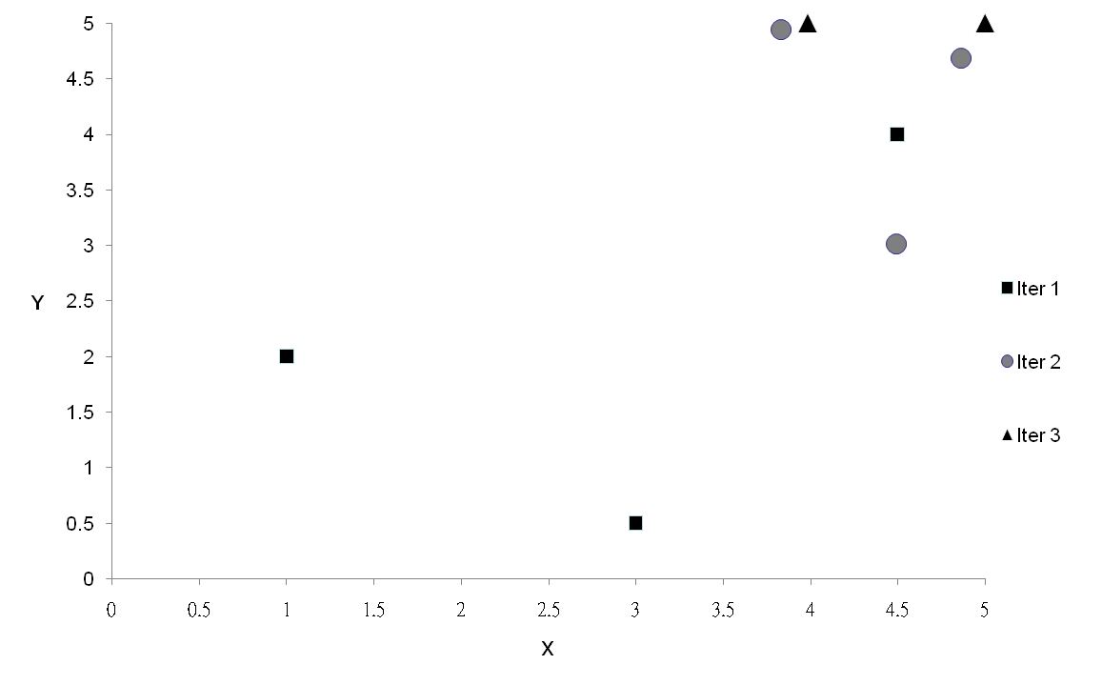
Numerical Example (15):
End of Iteration 2
Application of Computational Intelligence in Engineering

