Slide 1
BIKESTORE DATA ANALYSIS
Khalid Abdulhamid Hamdy

Slide 2
Outlines
Business Questions
Prepare
Data model
Explore
Analysis

Slide 3
Business Questions
There were 24 questions , We will Highlight some here
.
.
5)What is the total Sales per store ?
6)Which category is most Sold ?
.
.
13)Which brand is most liked?
.
.
21)How many bikes under Children category were sold in the last 8 months?

Slide 4
Prepare Data
The Data used for this project from a Bike store data base that can be accessed here
First you Create new Database
Then Create Tables using the Create Object.sql file
Then you can load data using Load data.sql file

Slide 5
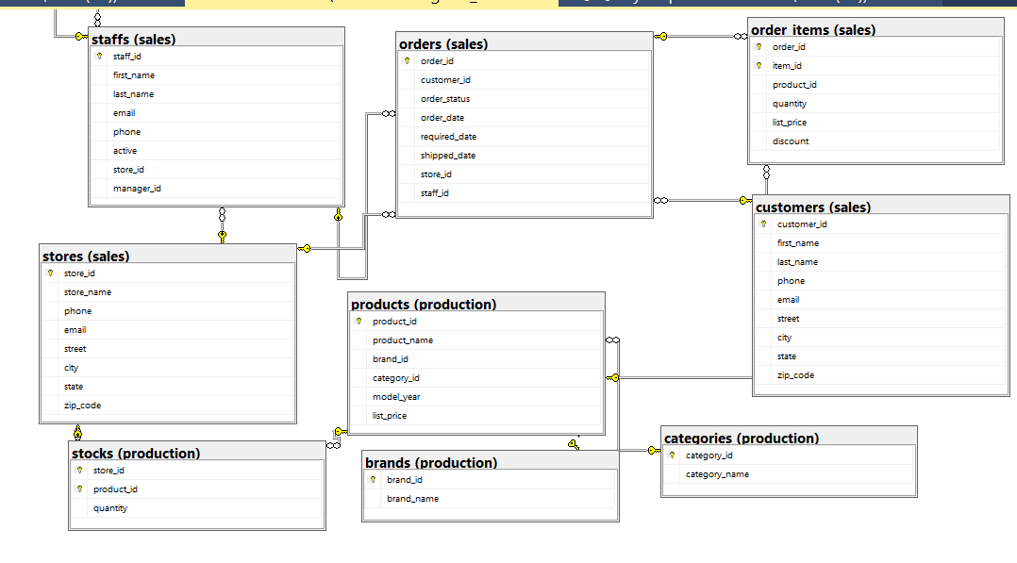
Data Model

Slide 6
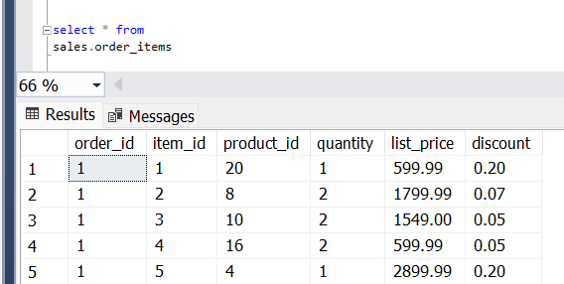
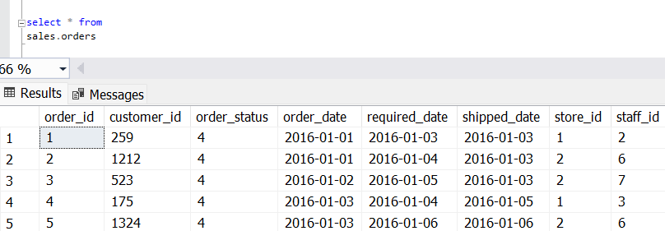
Explore Data
Looking at the data model, understand relationships and Exploring data is crucial step that you must do before the analysis
So, I display the data from all Table to understand the data and the structure
And here is some tables:

Slide 7
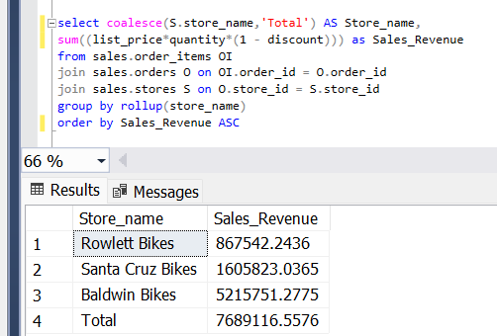
Analysis
5)What is the total Sales per store ?

Slide 8
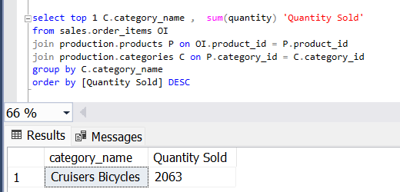
Analysis Cont.
6)Which category is most Sold?

Slide 9
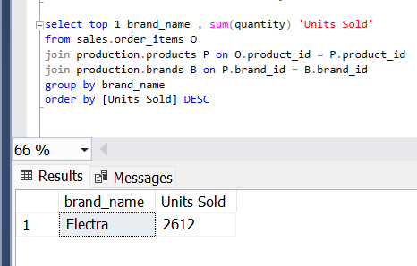
Analysis Cont.
13) Which brand is most liked?
The most liked brand is determined by the most sold brand

Slide 10
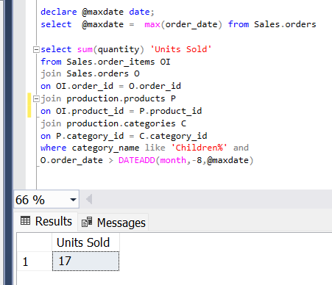
Analysis Cont.
21) How many bikes under Children category were sold in the last 8 months?
You can check the full Project in the git hub repository

Slide 11


Thank you

