Slide 1


DATA
ENGINEERING
END TO END PROJECT

Slide 2

INTRODUCTION
This project showcases the use of some software tools and the steps needed to carry out a data engineering project.
The main objective of the project is to store, manipulate and finally visualize the covid stats. dataset to find some meaningful insights.

Slide 3
THE PROCESS
Data collection and cleansing
Data storage
Data manipulation

Slide 4
THE PROCESS
Data analysis
Data visualization

Slide 5
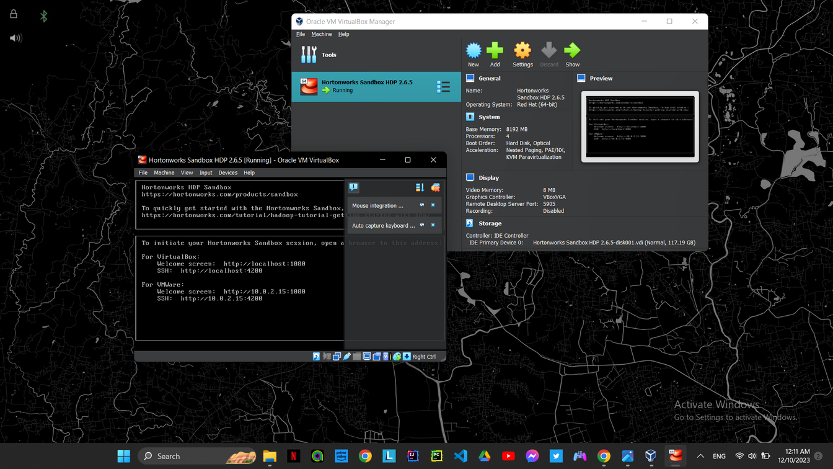
DATA STORAGE
The collected data needs to be stored on a software tool that allows me to navigate through it and perform multiple jobs and tasks on it.
Ambari is a software tool that allows me to store the data on distributed file system HDFS.

Slide 6
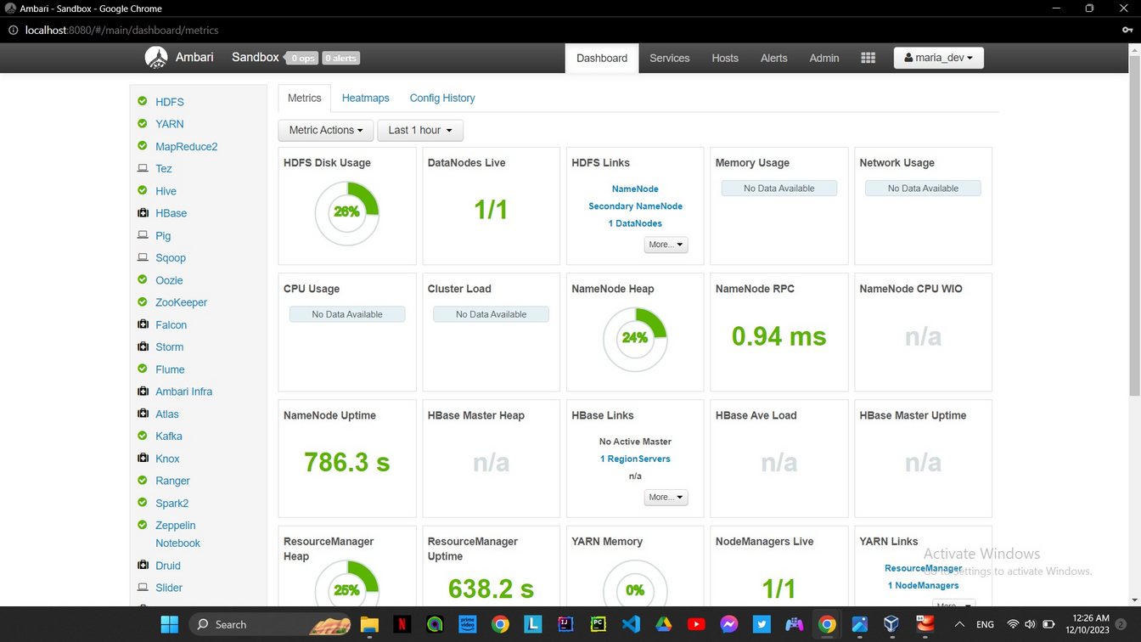
DATA STORAGE
The oracle virtual box allows me to operate and run a hadoop system on my windows machine and allows me to perform the jobs on my data through a web UI local host

Slide 7
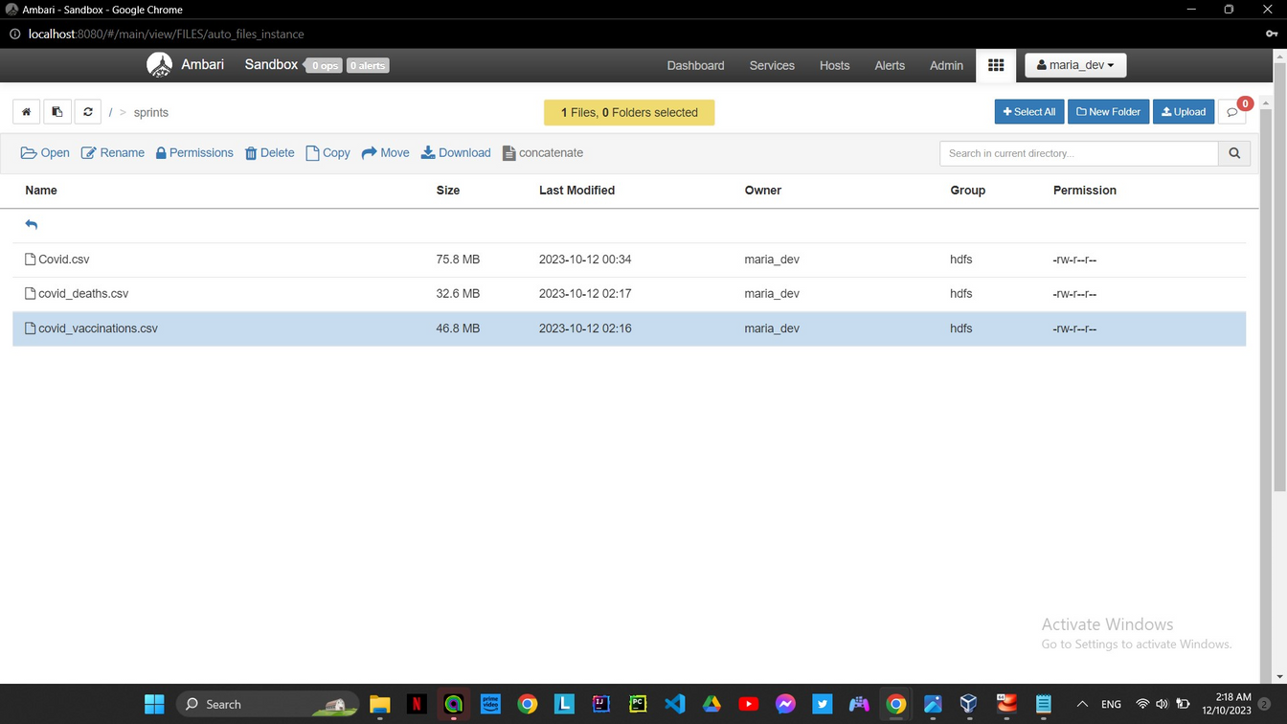
DATA STORAGE

Slide 8
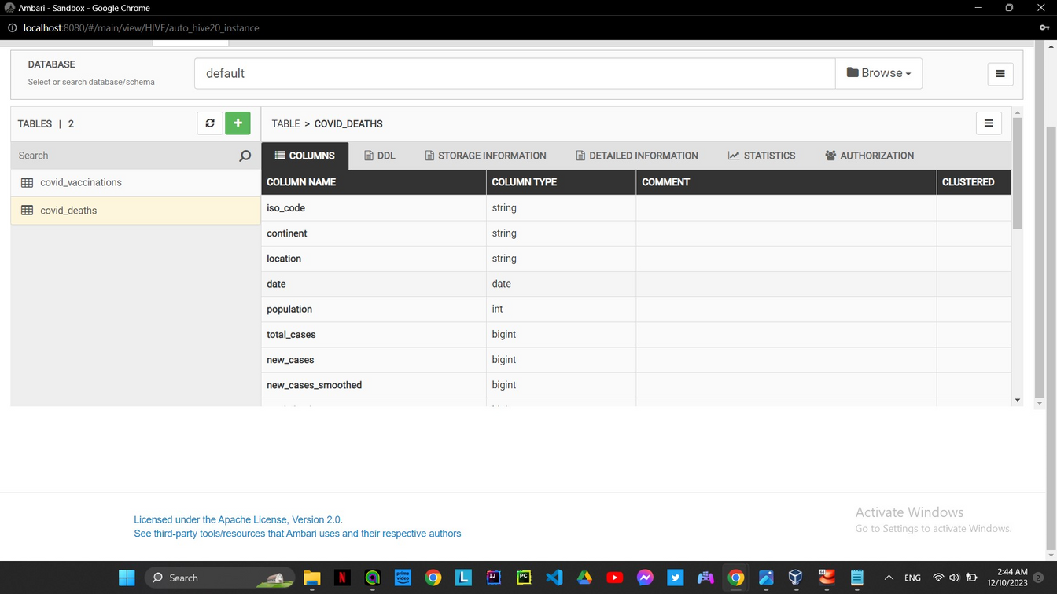
DATA MANIPULATION
Using “Hive” allows me to query my data in a SQL like syntax that helps me navigate through my data and perform jobs that can help me understand the dataset and come out with the needed output or targeted tables.

Slide 9
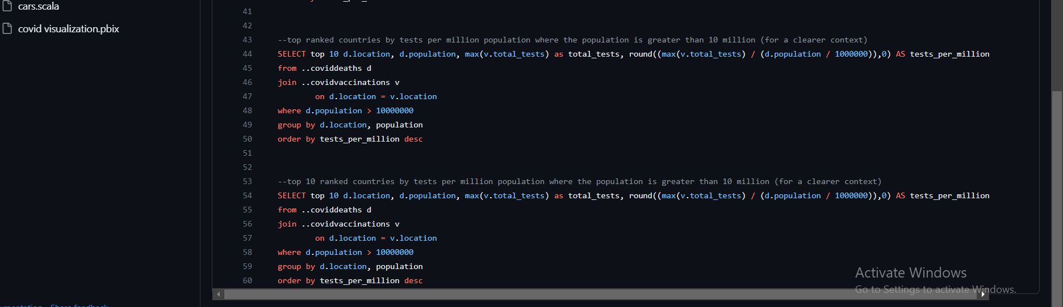
DATA ANALYSIS
TESTS RATE PER MILLION POPULATION WAS APPLIED TO THE COUNTRIES WITH A POPULATION OVER TEN MILLION TO PROVIDE CLEARER CONTEXT.

Slide 10
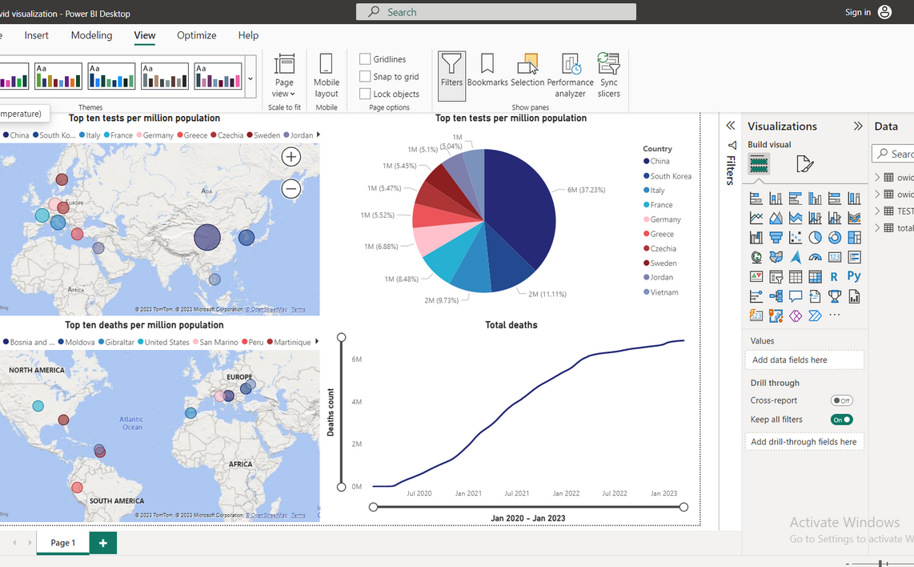
DATA VISUALIZATION

Slide 11
THANK YOU!

