Slide 1
Chapters 4 Behavioral Modeling: Part II Sequential Circuits
Dr. Ahmed Abou-Auf
Fall 2014

Slide 2
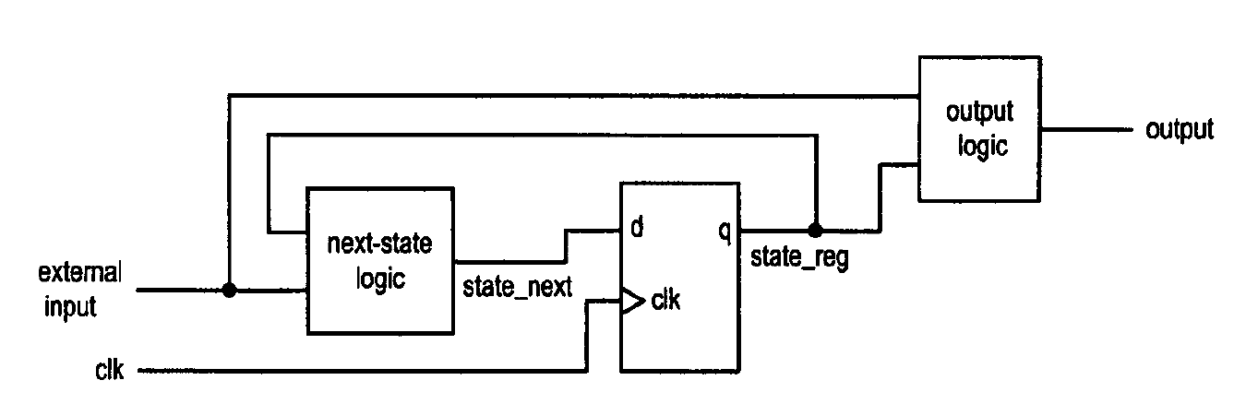
Model for Synchronous Sequential Circuit
Basic block diagram
– State register (memory elements)
– Next-state logic (combinational circuit)
– Output logic (combinational circuit)
• Operation
– At the rising/falling edge of the clock, state_next is sampled and stored into the register (and becomes the new value of state_reg
– The next-state logic determines the new value (new state_next) and the output logic generates the output
• Glitches has no effects as long as the state_next is stabled at the sampling edge

Slide 3
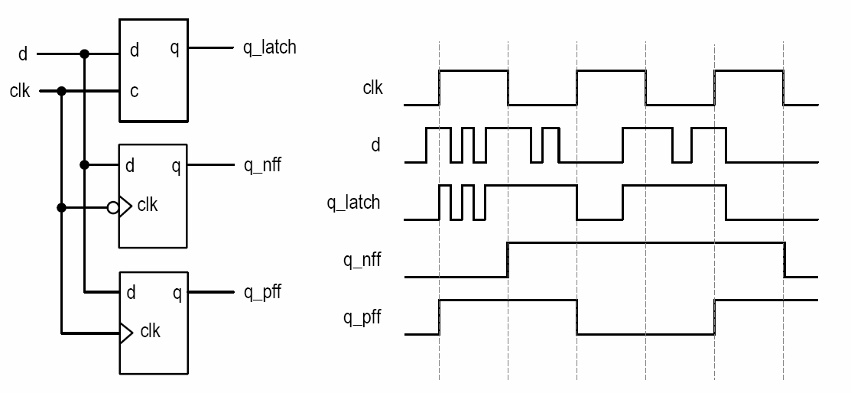
Difference in Operation

Slide 4
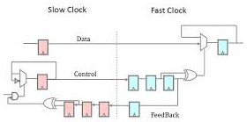
Types of Sequential Circuits: Clocking
asynchronous sequential circuit
Use no clock signal
synchronous sequential circuit
all memory elements (D FFs) controlled (synchronized) by a common global clock signal
Multi-clock domain synchronous sequential circuit
The design is divided into domains
All FFs within the domain has a single clock
Proper interfacing is required when crossing clock domains.

Slide 5
Inference of basic memory elements
Verilog code should be clear so that the pre-designed cells can be inferred
Verilog code can infer
D Latch
Positive edge-triggered D FF
Negative edge-triggered D FF
D FF with asynchronous reset
D FF with synchronous reset

Slide 6
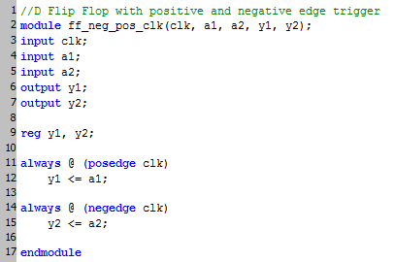
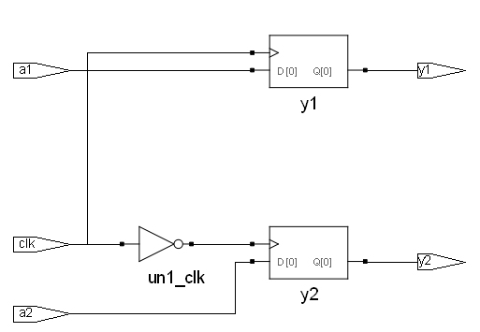
Inferring a D FF
Procedural assignment infers a FF when only the edge of the clock is in the sensitivity list

Slide 7
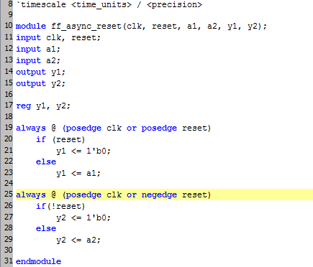
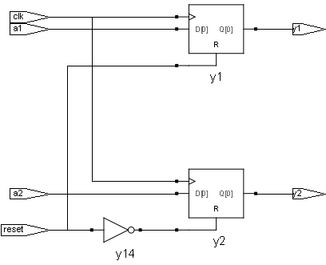
Inferring a D FF with asynchronous reset
Procedural assignment infers a FF with asynchronous reset when both the edge of the clock and the reset are in the sensitivity list

Slide 8
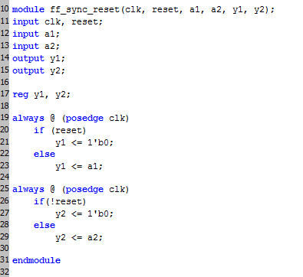
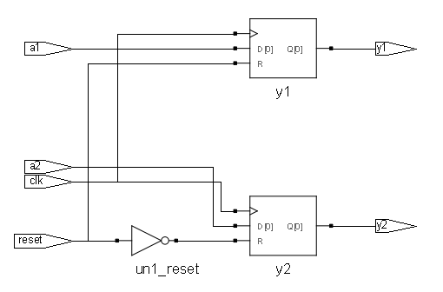
Inferring a D FF with synchronous reset
Conditional procedural assignment infers a FF with synchronous reset when only the edge of the clock is in the sensitivity list

Slide 9
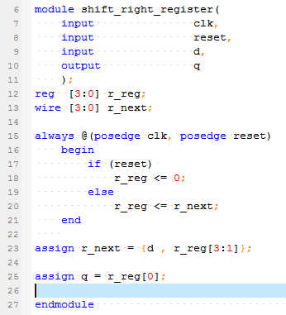
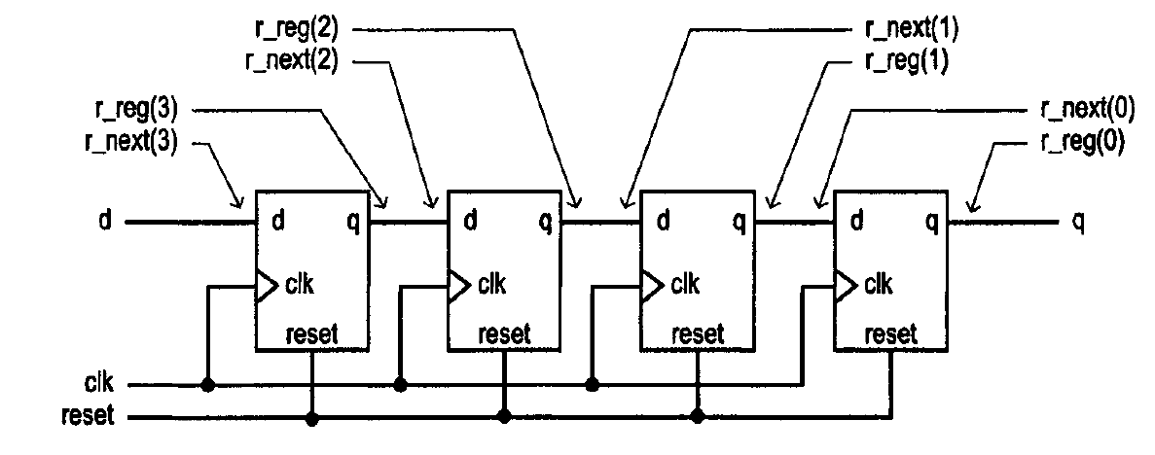
4-bit Shift Right Register

Slide 10
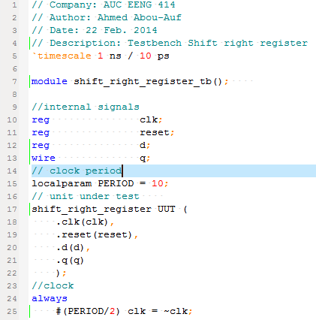
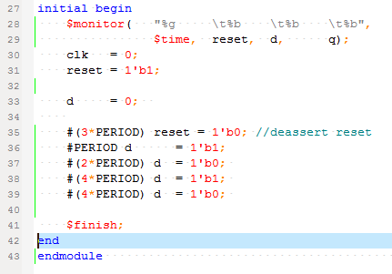
4-bit Shift Right Register: Testbench

Slide 11
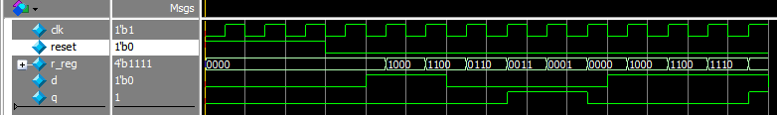
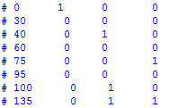
4-bit Shift Right Register: simulation

Slide 12
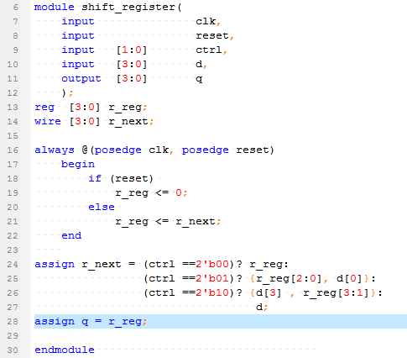
Universal Shift Register
ctrl operation
00 pause
01 shift left
10 shift right
11 parallel load

Slide 13
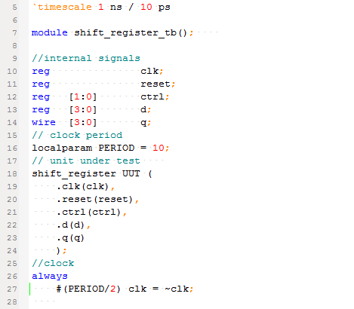
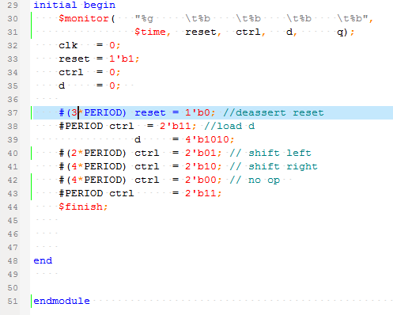
Universal Shift Register: Testbench

Slide 14
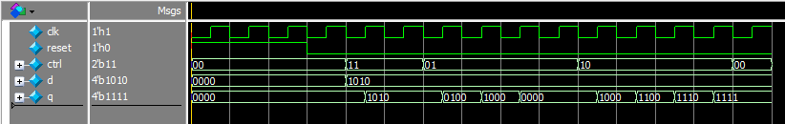
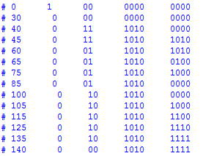
Universal Shift Register: simulation
ctrl operation
00 pause
01 shift left
10 shift right
11 parallel load

Slide 15
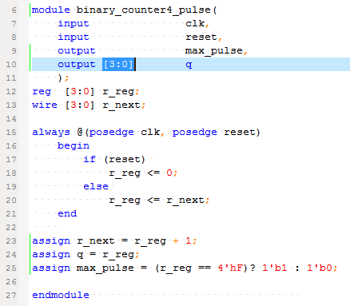
Free-running binary counter

Slide 16

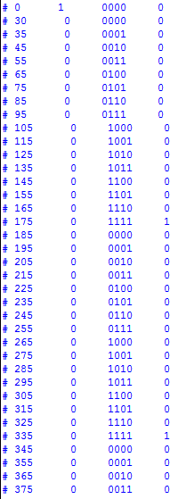
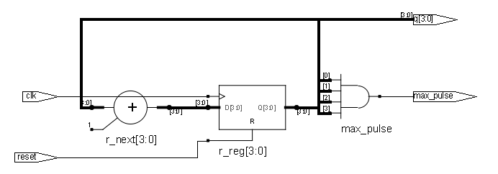
Free-running binary counter

Slide 17
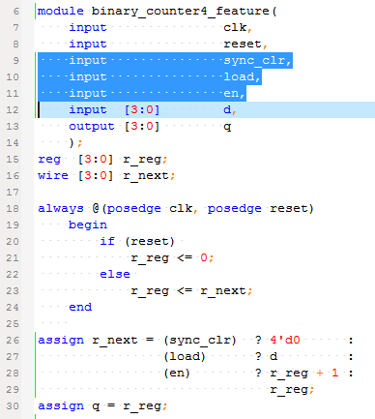
Binary counter with bells & whistles

Slide 18
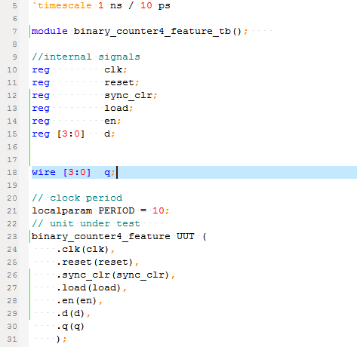
Binary counter with features: testbench

Slide 19
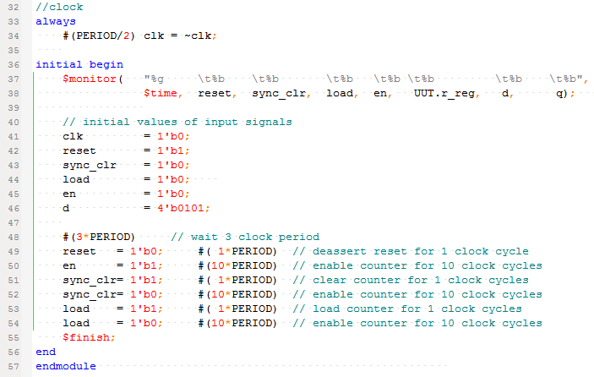
Binary counter with features: testbench

Slide 20
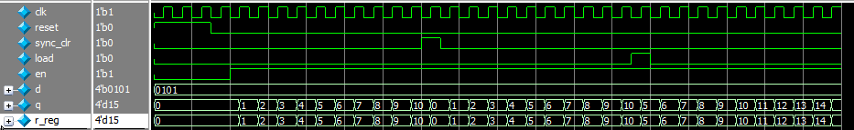
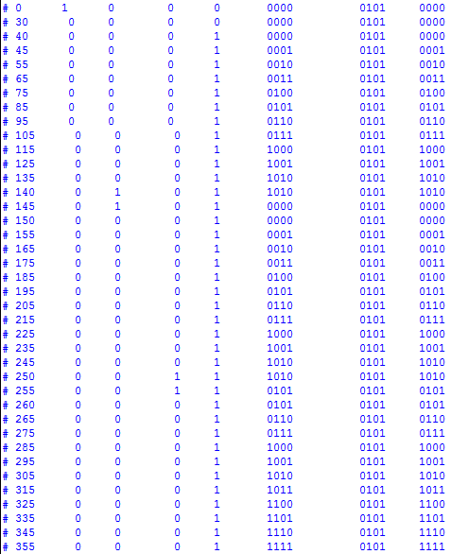
Binary counter—testbench

Slide 21
Example
4-word register file w/ 1 write port and two read ports
Register array:
4 registers each of 16 bits
Each register has an enable signal
Write decoding circuit:
0000 if wr_en is 0
1 bit asserted according to w_addr if wr_en is 1
Read circuit:
A mux for each read port

Slide 22
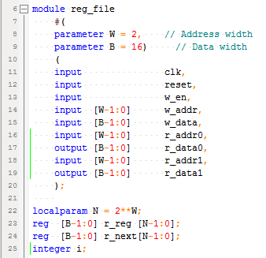
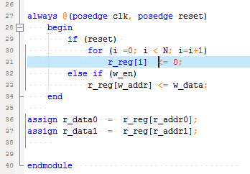
Register file

Slide 23
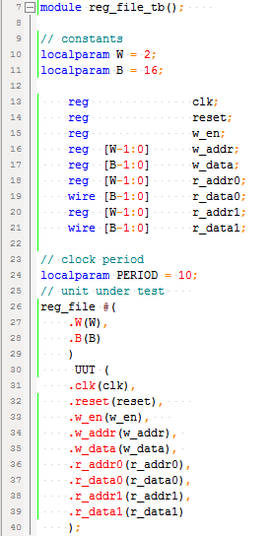
Register file: testbench

Slide 24
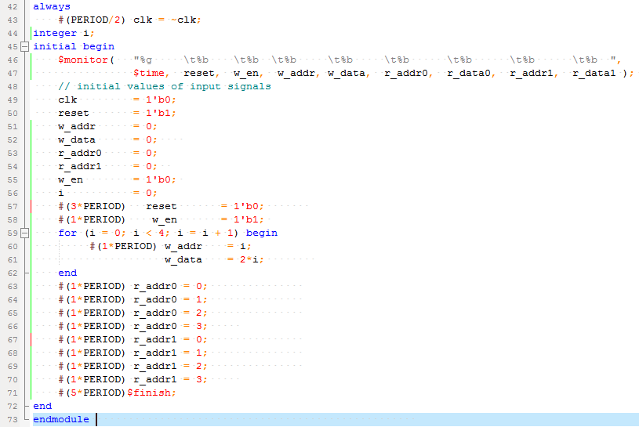
Register file: testbench

Slide 25
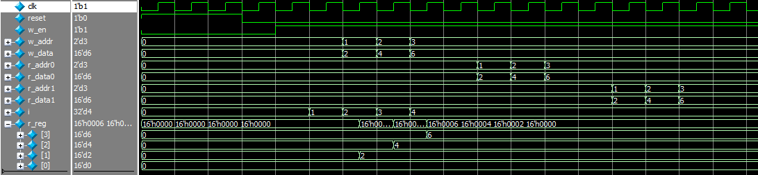
Register file: simulation

