Slide 1

SAHM KHAYAAL

Slide 2

Project by
Hossam Walid Mohamed Saeed
Aml Rashwan Ahmed Gharieb
Khaled Mohamed Kareem Essam
Ahmed Atef Helmy

Slide 3
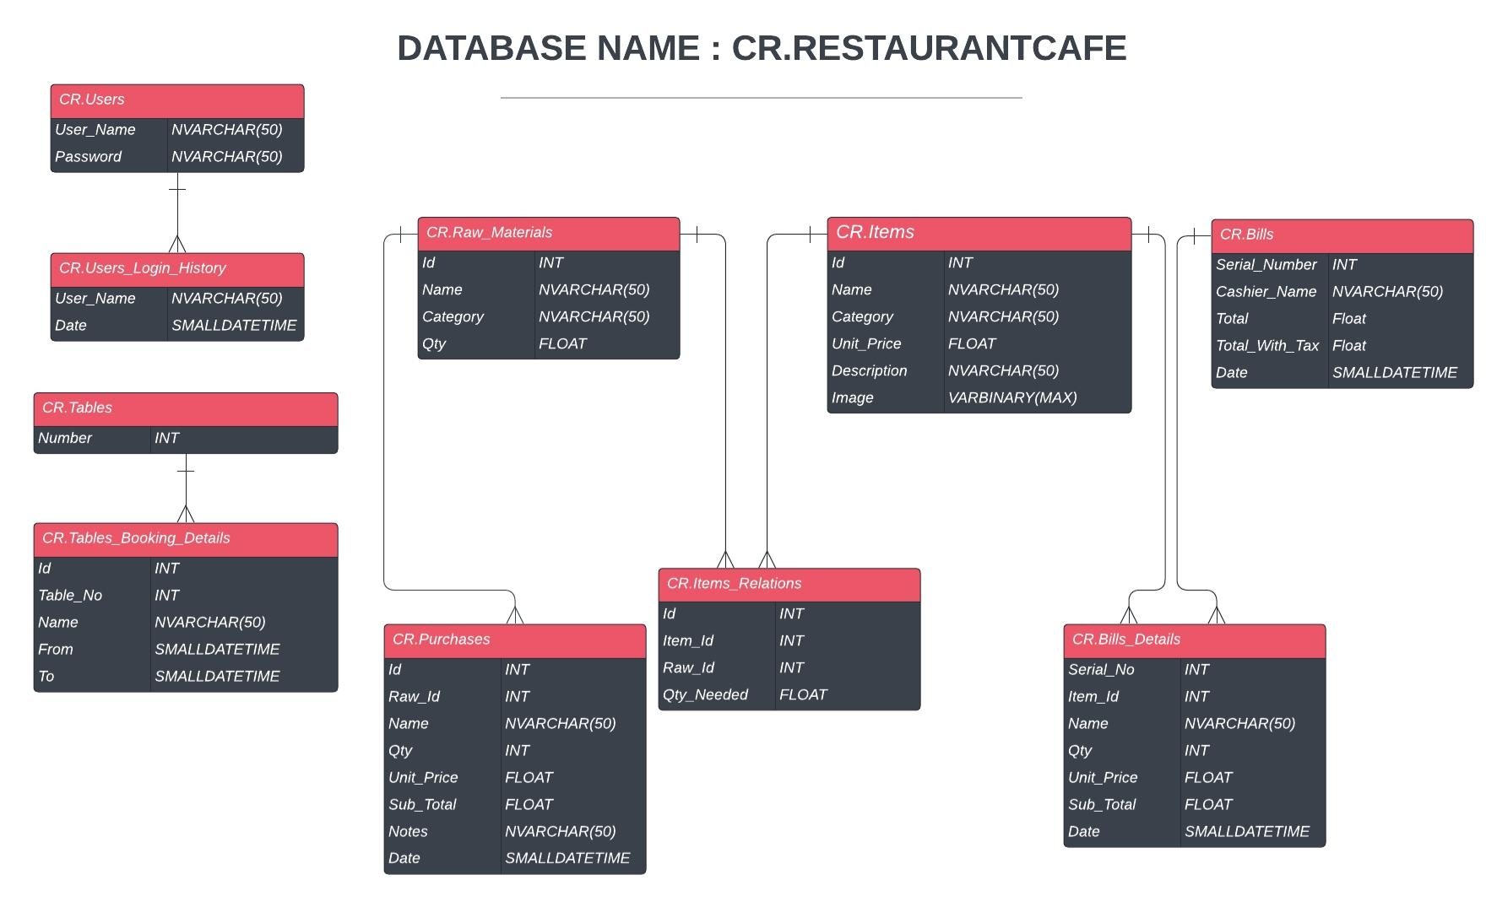

Slide 4
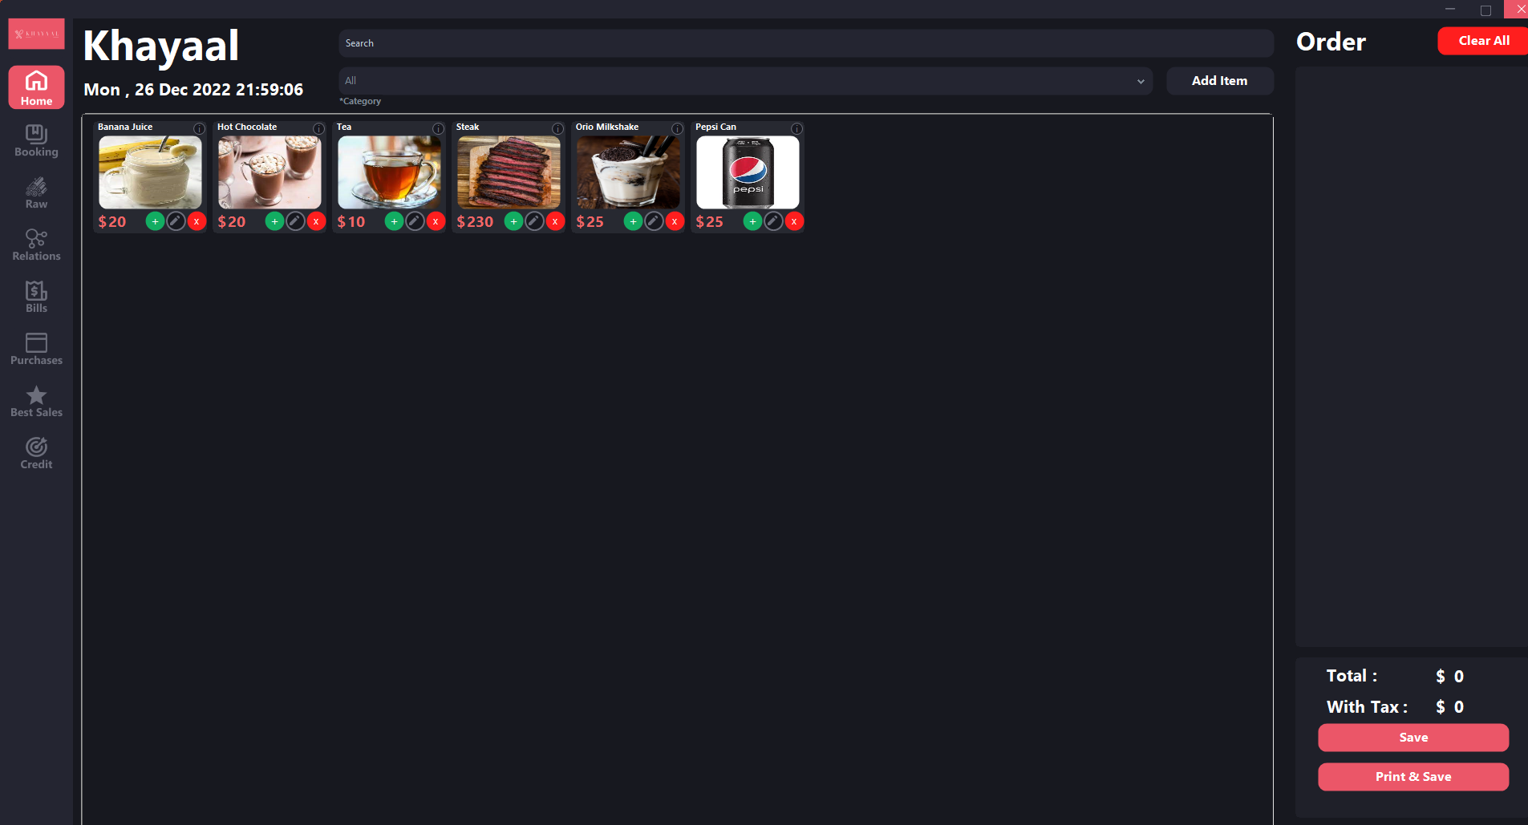

Slide 5
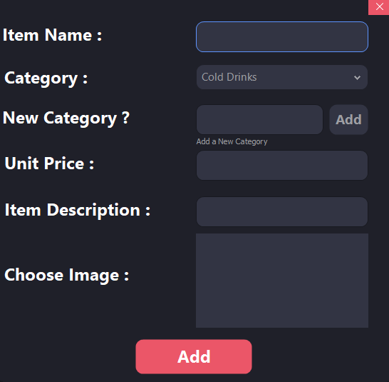
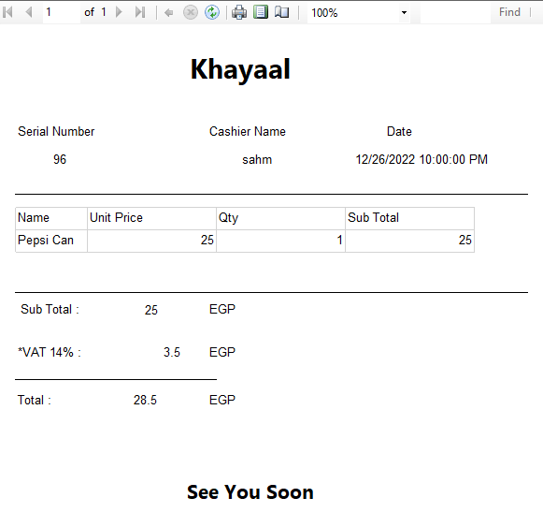

Slide 6
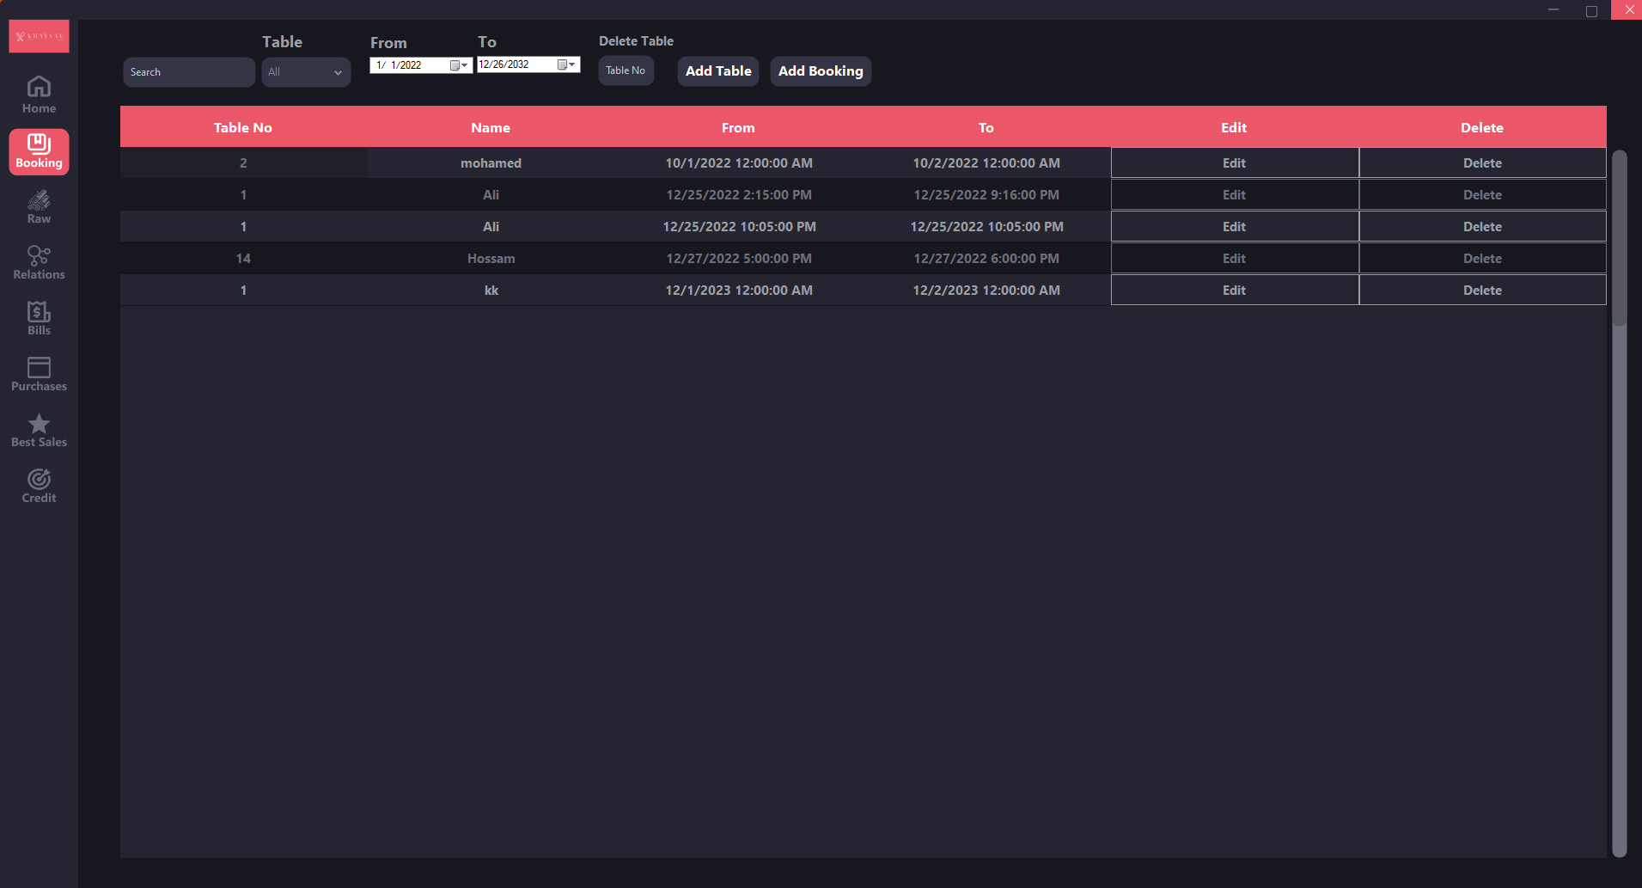

Slide 7
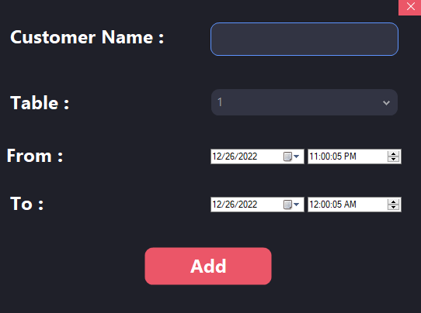

Slide 8
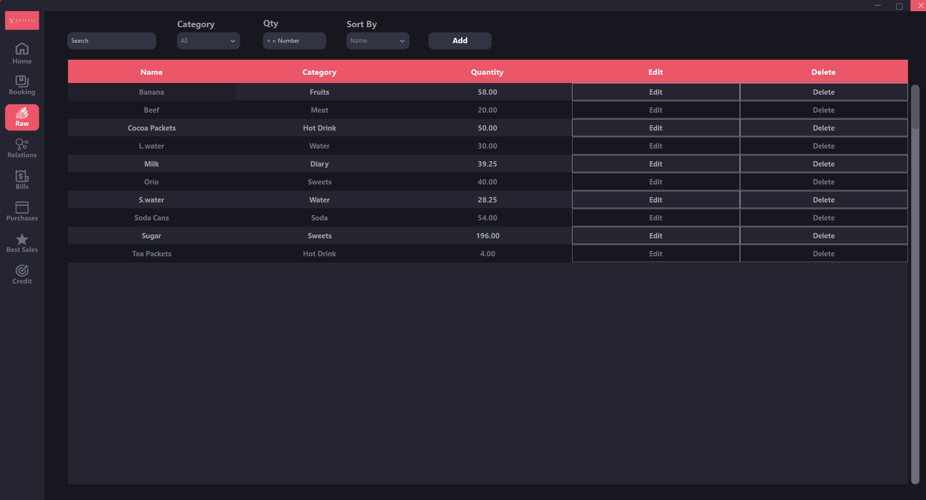

Slide 9
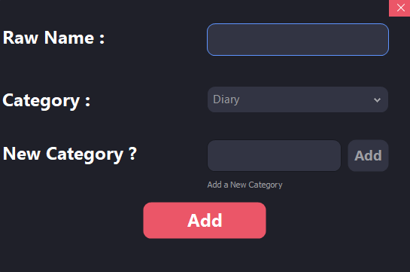

Slide 10
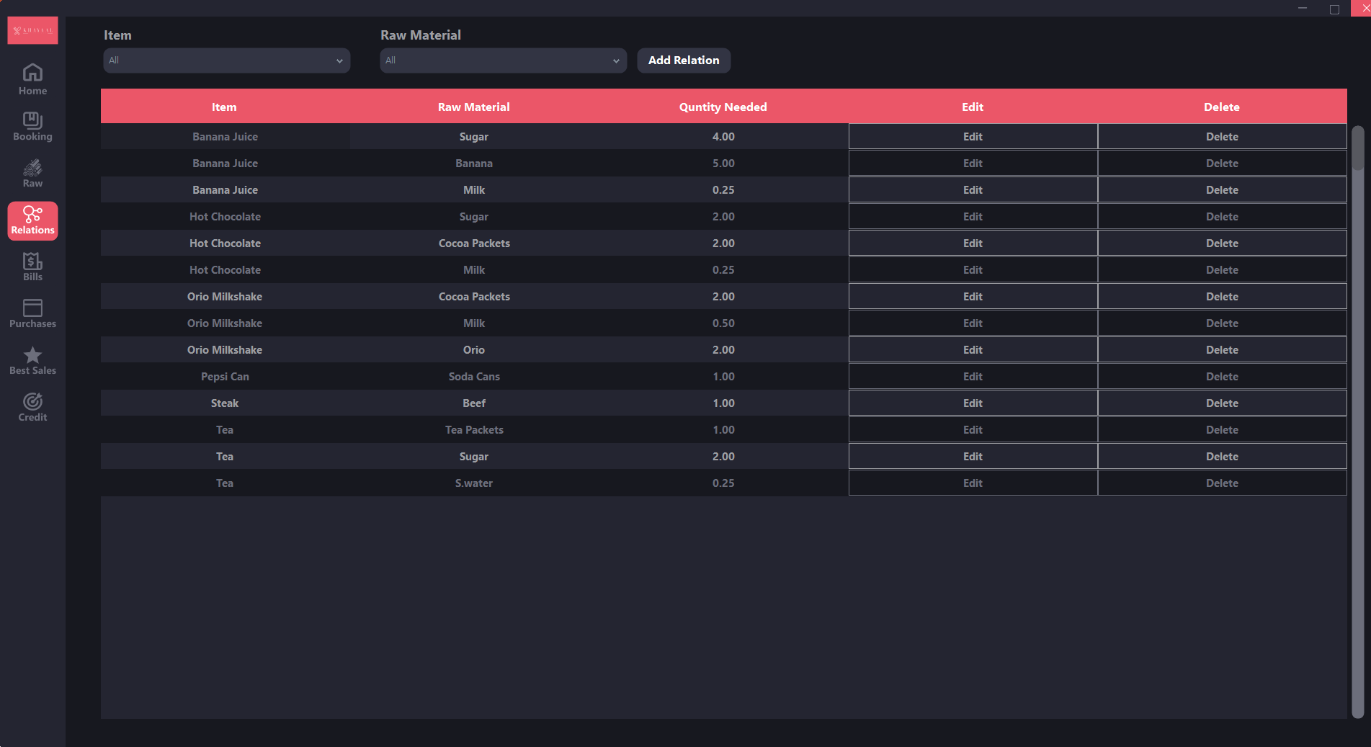

Slide 11
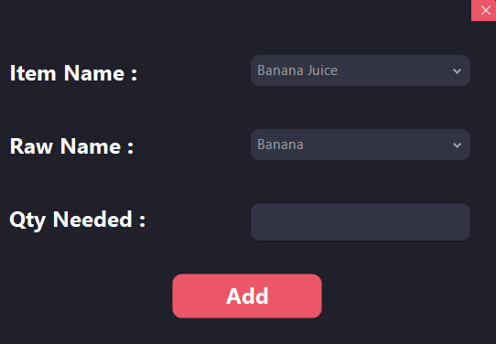

Slide 12
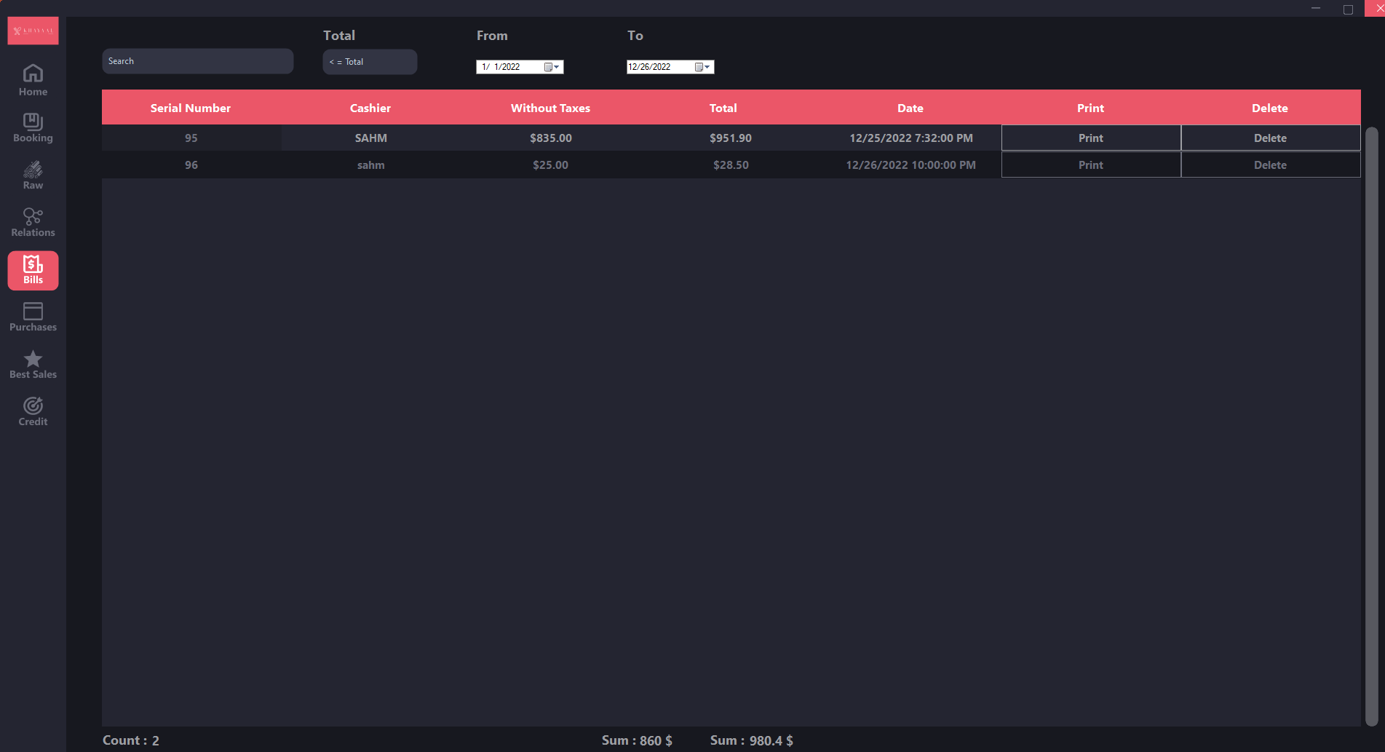

Slide 13
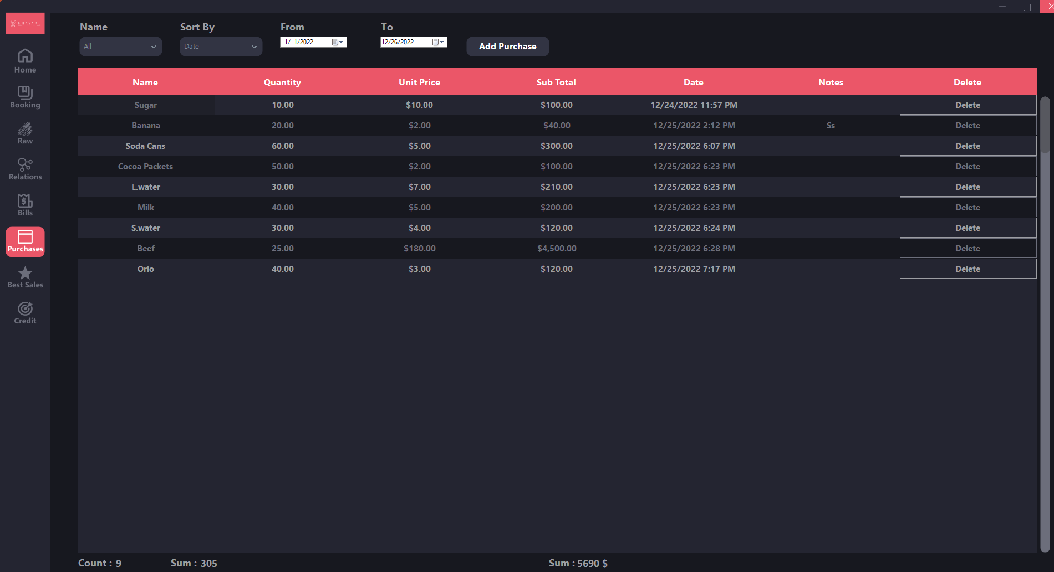

Slide 14
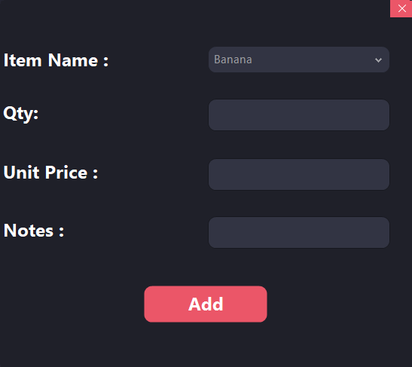

Slide 15
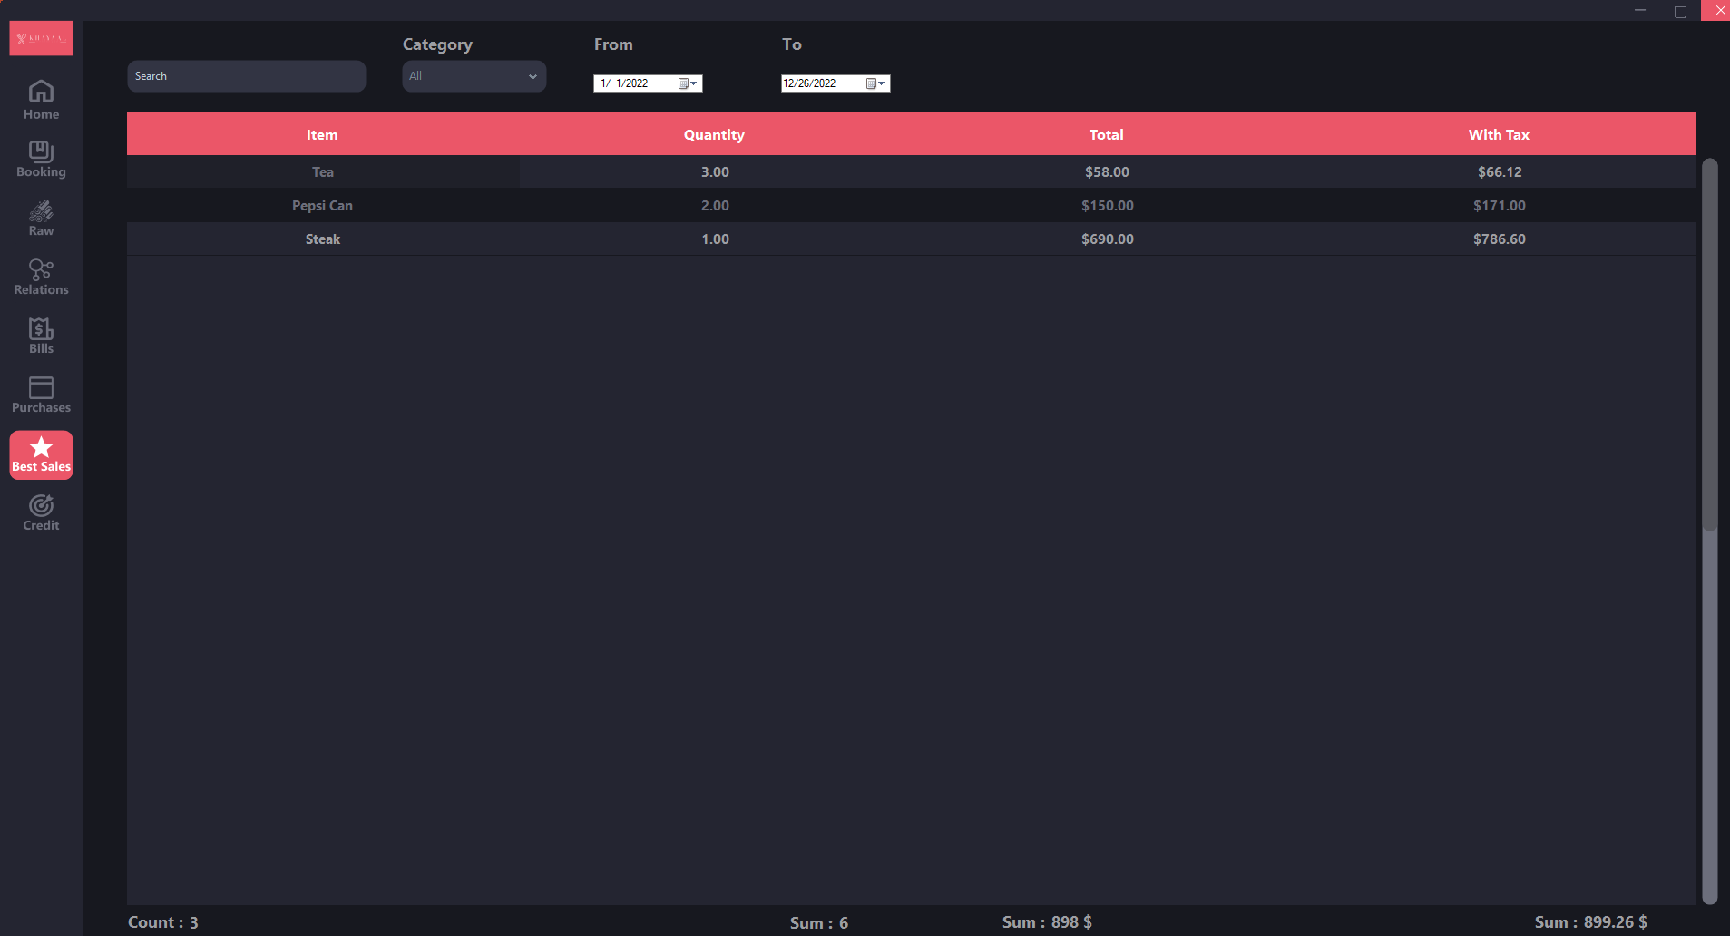

Slide 16
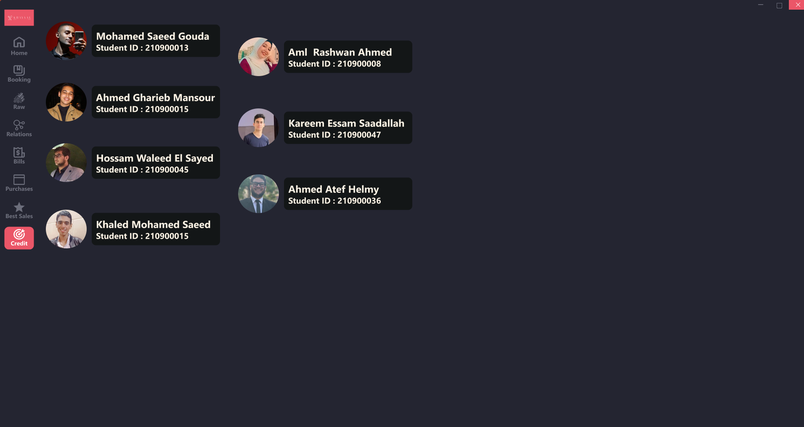

Slide 17
Report

Slide 18
About Khayaal Restaurant:
Khayaal was a coincidence mixed with a bit of passion for food and cooking, So we
looked at the known systems for restaurants and we wanted to make a new one that is
easy to use, fast and looks good.
About Khayaal Name:
About the name it has a funny story, So us as team SAHM everyone of us wanted
different name, So we decided to use a roulette to choose the name and Khayaal was it.

Slide 19
Programming Language Used:
1-C#
2-SQL
UI Used:
1-WinForms
2-Guna 2
3-Bunifu
Programs Used:
1-Visual Studio 2022
2-Microsoft SQL Server
Design Planning:
1- Figma
Team Work:
1-GitHub
Videos & Photos:
1-DaVinci Resolve 18
2-PhotoGimp
3-Krita

Slide 20

THANKS

