Slide 1
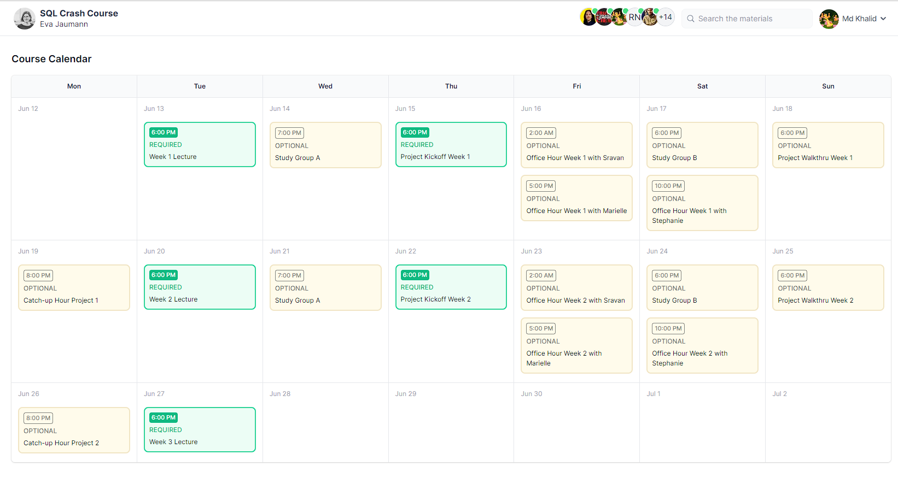

Slide 2

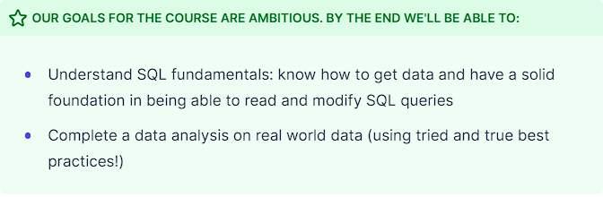
Welcome
Eva Jaumann

Slide 3

Build out and launch Airbnb in Sydney, Australia
Starting now: you are the General manager for the Sydney area at Airbnb. Your job is to build out and launch Airbnb in Sydney, Australia. We'll be analyzing real data from the different listings that we've onboarded so far, occupancy rates, and making decisions on how to grow the platform in the city.

Slide 4
Week 1
Welcome to your first week of learning SQL!
By the end of this week, you'll be familiar with:
SQL + Databases
Querying data: SELECT
Filtering data: WHERE
Missing data: NULL values
At the end, you'll combine these skills to help launch Airbnb in Sydney, Australia.
To make sure you're ready for the project, we recommend this schedule:
Tuesday: Join us for live lecture 👩🏻‍🏫 (8am PST)
Tuesday: Work through SQL Basics and Querying Data sections
Wednesday: Work through Filtering Data and Missing Data sections
Thursday: Join us for Project Kickoff 🎉 (8am PST)
Friday-Sunday: Finish up project

Slide 5
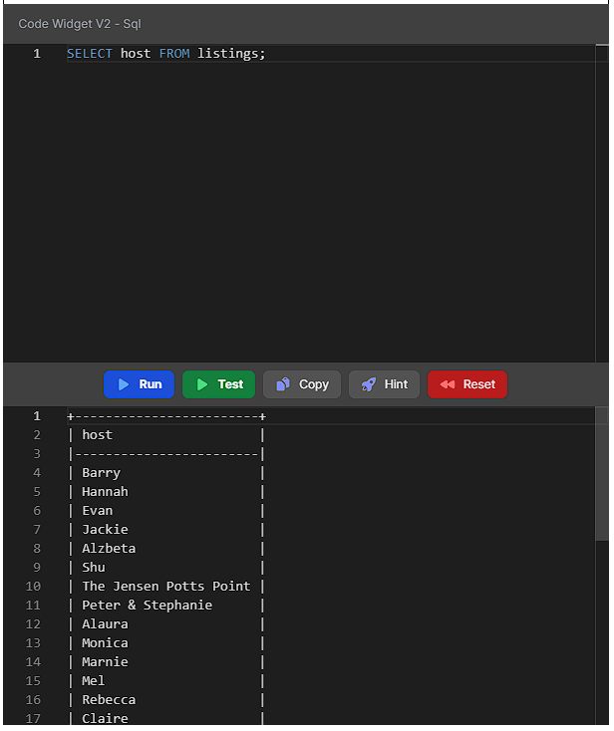
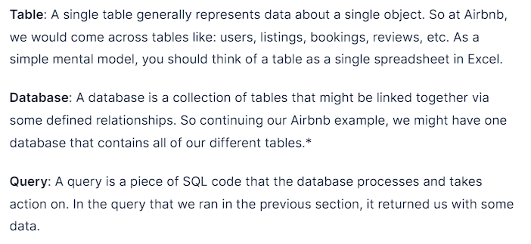
Let's get our first query under our belt!!
For this class we're using a database called SQLite

Slide 6
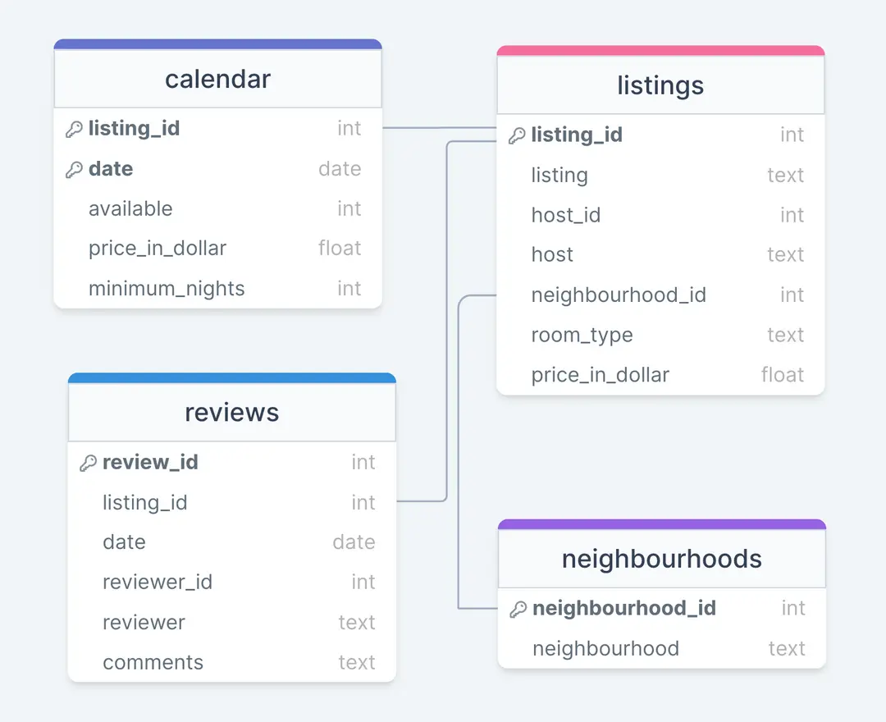
Inside a SQL Database
Table Schemas - Columns and Rows
The structure of a table is described by its schema - the schema is the name of the table and two pieces of information about each column in the table:
Name of the column
Data type of the column (integer, text, date, etc.)
Data types refer to the set of valid values a column can take. There are many data types supported in SQL, but let's look at three for illustration purposes:
Integer refers to whole numbers such as -23, 36, and 0.
Text refers to a string or an array of characters.
Date refers to a representation of a date, such as 1/1/2022.
For example, the table corresponding to listings in the Airbnb database has some columns like listing_id of type integer and listing of type text. In this example, listing_id is a unique integer identifier corresponding to a listing in the database, listing is a text data type that is the name of the listing.
The 4 different tables in our mini Airbnb database
*Note: In reality, Airbnb is a complex product with a lot more nuance, but we'll keep it simple here to make it easy to understand and focus on learning.

Slide 7
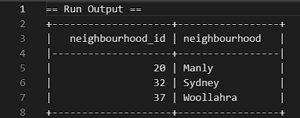
Exercise: Querying Data
PART 1: Sydney - the neighbourhoods that form it.
Write a query that gets all the data from the neighbourhoods table
Answer : SELECT * FROM neighbourhoods;

Slide 8
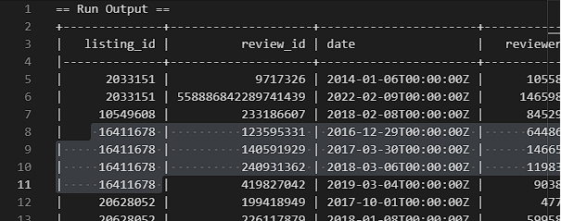
Exercise: Querying Data
PART 2: Popularity contest
Write a query that gets all the data from the reviews table and sort it in the ascending order of listing_id. Now manually count how many reviews we have for listing listing_id "16411678".
Answer : count of "16411678" = 4
SELECT * FROM reviews ORDER BY listing_id ASC;

Slide 9
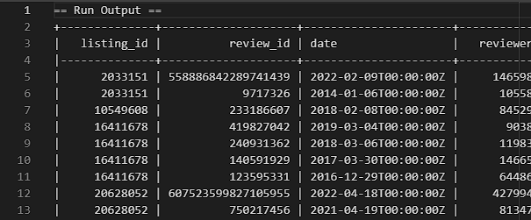
Exercise: Querying Data
PART 3: Also, sort by Date
We want to sort the data by both listing_id and date. We need it to be in ascending order of listing order and in descending order of date.
Answer :
SELECT * FROM reviews ORDER BY listing_id ASC, date DESC;

Slide 10
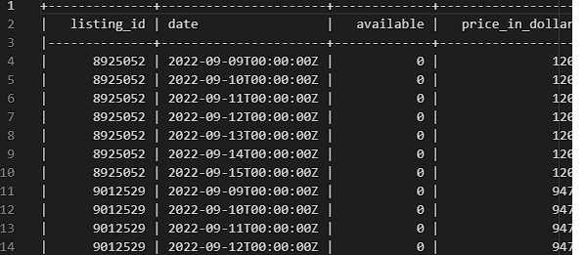
Exercise: Querying Data
PART 4: Let's just take a quick peek to get a sense of the data...
retrieve the calendar table, but limit the number of rows to 15 entries.
Answer :
SELECT * FROM calendar LIMIT 15;

Slide 11
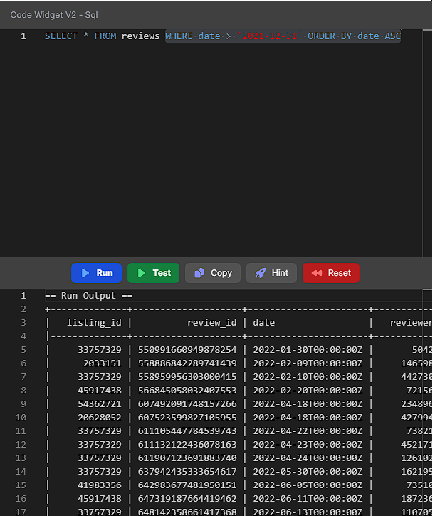
Filtering Data using ‘WHERE’
Used when we want to find information that meets a certain criterion.
Eg: Get all the listings that are a private room
SELECT * FROM listings WHERE room_type='Private room';
WHERE price_in_dollar < 300;
WHERE bedrooms >= 2;
WHERE neighbourhood_id=20;
WHERE date < '2019-06-16';
WHERE date > '2021-12-31' ORDER BY date ASC

Slide 12
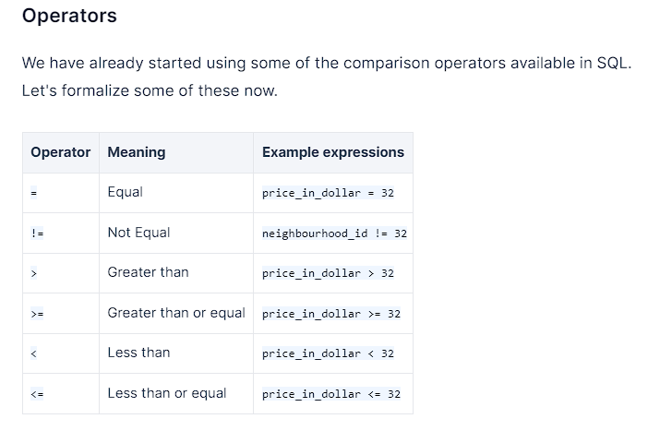
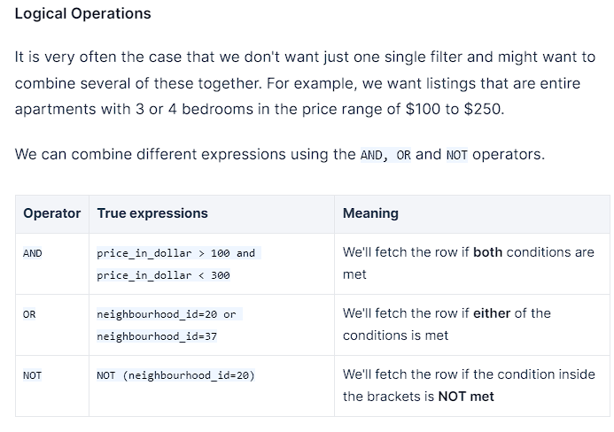
Filtering Data using operators and logical statements

Slide 13
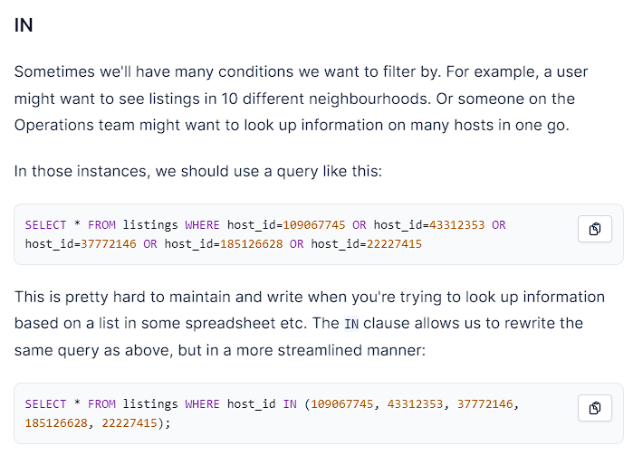
Filtering Data using ‘IN’

Slide 14
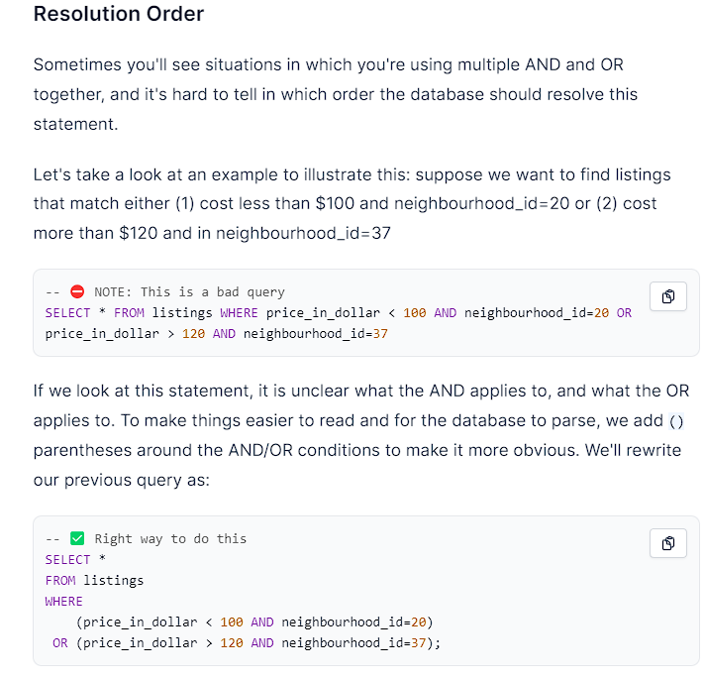

Slide 15
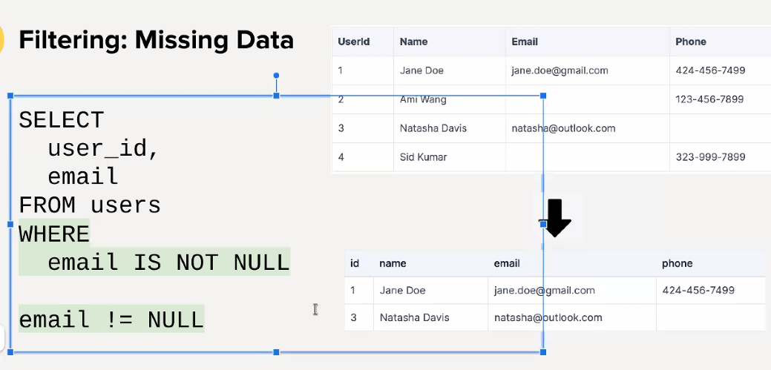

Slide 16
