Slide 1
AI BASED DIABETES PREDICTION SYSTEM
SUBMITTED BY
KHALID T – 7100211060016
DEPARTMENT OF ELECTRONICS AND COMMUNICATION ENGINEERING
ANNA UNIVERSITY REGIONAL CAMPUS COIMBATORE

Slide 2
PROBLEM STATEMENT
To Develop an AI-powered diabetes prediction system that leverages machine learning algorithms to analyze medical data and predict the likelihood of an individual developing diabetes, providing early risk assessment and personalized preventive measures. Diabetes is a complex disease that requires constant monitoring and management. So AI based predictive system can help healthcare providers identify patients at risk and provide early intervention to prevent complications.

Slide 3
PROBLEM DEFINITION:
The problem is to build an AI-powered diabetes prediction system that uses machine learning algorithms to analyze medical data and
predict the likelihood of an individual developing diabetes.
The system aims to provide early risk assessment and personalized preventive measures, allowing individuals to take proactive actions to manage their health.

Slide 4
DESIGN THINKING APPROACH
Data Collection:
We need a dataset containing medical features such as glucose levels, blood pressure, BMI, etc., along with information about whether the individual has diabetes or not.
Data Preprocessing:
The medical data needs to be cleaned, normalized, and prepared for training machine learning models.

Slide 5
DESIGN THINKING APPROACH
3.Feature Selection:
We will select relevant features that can impact diabetes risk prediction
Create new features or transform existing ones to capture relevant information. For example, you might calculate a patient's average blood sugar level over time or derive features related to insulin sensitivity.
4. Model Selection:
We can experiment with various machine learning algorithms like Logistic Regression, Random Forest, and Gradient Boosting.

Slide 6
DESIGN THINKING APPROACH
5. Evaluation:
Monitor system performance: Continuously assess the AI model's accuracy and update it as needed.
Gather feedback: Seek feedback from users and healthcare providers to make improvements.
We will evaluate the model's performance using metrics like accuracy, precision, recall, F1-score, and ROC-AUC.
6. Iterative Improvement:
We will fine-tune the model parameters and explore techniques like feature engineering to enhance prediction accuracy.

Slide 7
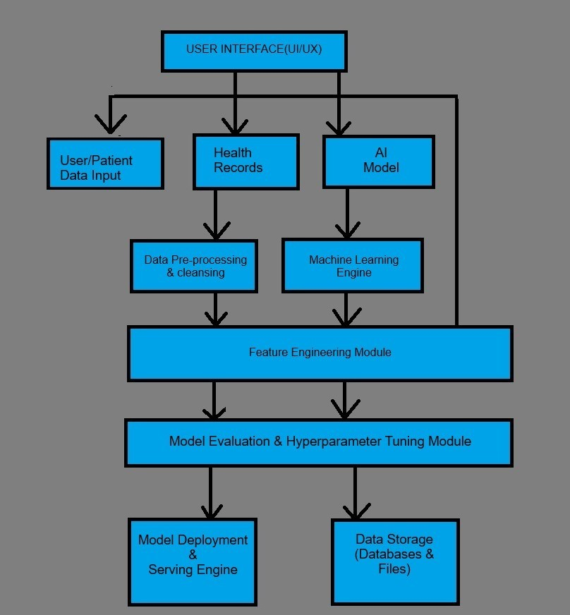
SYSTEM ARCHITECTURE:

Slide 8
SYSTEM ARCHITECTURE
User Interface (UI/UX): This is the front-end component that allows users, including healthcare providers and patients, to interact with the system. It may include dashboards, forms, and visualizations for data input and result presentation.
User/Patient Data Input: Users provide data related to their health, including medical history, lifestyle, and clinical measurements, which serve as input to the system.
Health Records: This component stores and manages electronic health records (EHRs) and patient data. It plays a crucial role in providing historical context for predictions.
AI Model: This is the heart of the system, where machine learning models are developed and trained using historical health data. The AI model predicts diabetes risk based on the input data.
Data Preprocessing & Cleansing: Data preprocessing involves cleaning and transforming raw data into a format suitable for machine learning. This step includes handling missing values, scaling, and encoding categorical variables.

Slide 9
SYSTEM ARCHITECTURE
Feature Engineering Module: Feature engineering involves selecting and creating relevant features that can improve the model's predictive accuracy. This module may include domain-specific knowledge.
Model Evaluation & Hyperparameter Tuning: After training, the AI model needs evaluation and optimization. This module assesses the model's performance and adjusts hyperparameters as needed.
Model Deployment & Serving: Once the model is ready, it is deployed for real-time predictions. This component handles incoming data and serves predictions to the user interface.
Data Storage (Database & Files): This is where both the input data and model-related data are stored. It includes databases for EHRs and file storage for model checkpoints and data.

Slide 10
CONCLUSION
The AI-based diabetes prediction system is a proactive solution to the problem of late diabetes diagnosis.
By applying a design thinking approach, we have developed a system that leverages advanced AI techniques to predict diabetes risk early, enabling timely interventions and personalized healthcare.
This system has the potential to improve the lives of individuals at risk of diabetes and enhance the efficiency of healthcare delivery.
Early diagnosis is the key to better managing diabetes and reducing its long-term complications, and our AI system is a step forward in achieving this goal.

