Slide 1
Introduction And Comparison Of 3 Well Known Relational RDBMS (MySQL, PostgreSQL and SQL SERVER)
Getting started with Presenting each of the RDBMS and their functionalities

Slide 2
MySQL
MySQL happens to be one of the most popular databases, according to DB Engines Ranking. It’s a definite leader among SQL solutions, used by Google, LinkedIn, Amazon, Netflix, Twitter, and others. MySQL popularity has been growing a lot because teams increasingly prefer open-source solutions instead of commercial ones. Discuss the functionality of relational database management systems.
The database solution is developed by Oracle and has additional paid tools; the core functionality can be accessed for free.
MySQL is written in C++; database management is done with Structured Query Language

Slide 3
PostgreSQL
A tried-and-proven relational database that is known for supporting a lot of data types, intuitive storage of schema-less data, and rich functionality. Some developers go even as far as to claim that it’s the most advanced open-source database on the market. We wouldn’t go that far, but it’s definitely a highly universal solution. It allows you to input, manage, organize and retrieve data quickly.
open-source
Is written in C
Notes:
Data is the most important part of a database.

Slide 4
SQL Server
Unlike PostgreSQL vs MySQL, SQL Server is a commercial solution. It’s preferred by companies who are dealing with large traffic workloads on a regular basis. It’s also considered to be one of the most compatible systems with Windows services.
The SQL Server infrastructure includes a lot of additional tools, like reporting services, integration systems, and analytics. For companies that manage multiple teams, these tools make a big difference in day-to-day work.
the database has a free edition for developers and small businesses but only supports 1 processor, 1GB of maximum memory used by the database engine and 10GB maximum database size.
Notes:
Every table is broken up into smaller entities called fields. The fields in the table are: name, email, created_at, updated_at.
A field is a column in a table that is designed to maintain specific information about every record in the table.
A record, also called a row of data, is each individual entry that exists in a table. For example there are (2) records in the table.
A column is a vertical entity in a table that contains all information associated with a specific field in a table. For example, Name represents the name of the user.

Slide 5
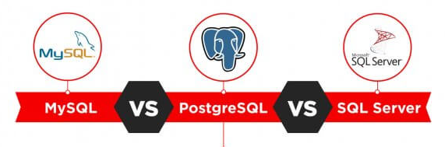
Side-by-side Comparison
In this comparison, we’ll take a look at the functionality of the three most popular SQL databases, examine their use cases, respective advantages, and disadvantages. Firstly, we’ll start by exploring the in-depth functionality.

Slide 6
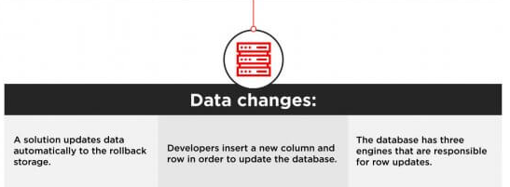
Data Changes
Among these three, SQL Server offers perhaps the most flexibility and efficiency, because it allows monitoring updated rows and columns, collecting errors, and automating the process. The difference between SQL Server and MySQL and PostgreSQL lies mainly in customizing the positions – SQL Server offers a lot more than others.

Slide 7
Defragmentation
When developers update different parts of an SQL database, the changes occur at different points of the systems and can be hard to read, track, and manage. Therefore, maintenance should include defragmentation – the process of unifying the updated database by assigning indexes, revisiting the structure, and creating new pages. The database frees up the disk space that is not used properly so that a database can run faster.

Slide 8
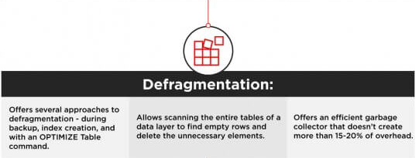
Defragmentation
Overall, MySQL and SQL Server offer more of defragmentation methods that Postgresql does. They consume less CPU and provide more flexible settings.
Notes:
Today’s advanced RDBMS is actually much more than data, they also manage data, restricting the kind of data that can go into the system, and facilitating getting data out of the system.

Slide 9
Data Queries
Here, we take a look at how the systems cache and process user requests, what approaches they take in storing data, and how developers can manage it.
Buffer Pool
Some systems call a buffer to pull cache, but regardless of terminology, our goal is to summarize the algorithms that systems use to process user queries and maintain connections.

Slide 10
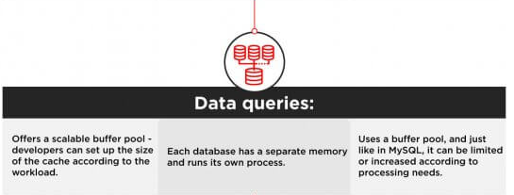
Data Queries
If your priority is to save computing resources and storage, choose flexible solutions: the choice will be between MySQL vs SQL Server. However, if you prefer clear organization and long-term order, PostgreSQL, with its isolated approach, might be a better fit.

Slide 11
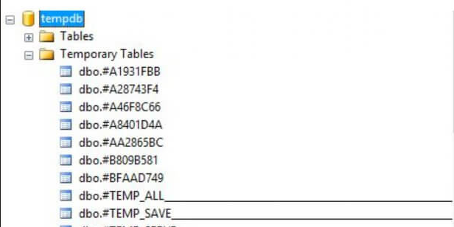
Temporary Tables
Temporary tables allow storing intermediate results from complex procedures and branched business logic. If you need some information only to power the next process, it doesn’t make sense to store it in a regular table. Temporary tables improve database performance and organization by separating intermediary data from the essential information.

Slide 12
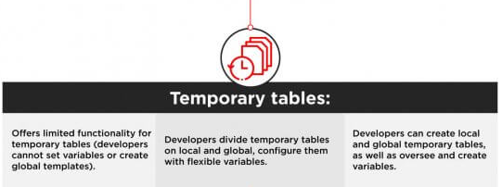
Temporary Tables
Temporary tables are essential for applications with complicated business logic. If your software runs a lot of complex processes, you will need to store multiple intermediary results. Having rich customization functionality will often be necessary throughout the development process.

Slide 13
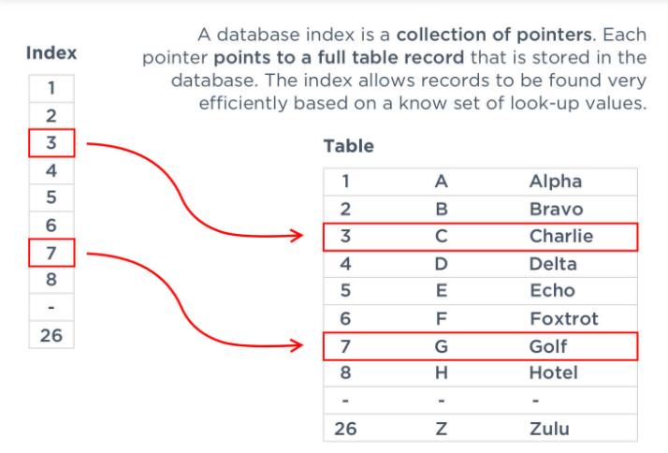
Indexes
The way a database handles indexes is essential because they are used to locate data without searching for a particular row. Indexes can refer to multiple rows and columns. You can assign the same index to files, located in the different places in the database, and collect all these pieces with a single search,
In this comparison, we evaluated the way indexes are created in every solution, the support of multiple-index searches, and multi-column indexes, as well as partial ones.

Slide 14
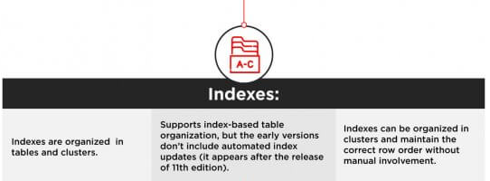
Indexes
Having flexible index settings allows looking up information faster and organizing multiple data simultaneously.

Slide 15
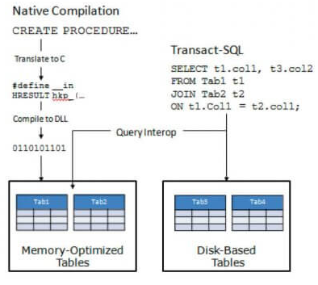
Memory-Optimized Tables
Memory-optimized tables are mainly known as a SQL Server concept, but they also exist in other database management solutions. Such a table is stored in active memory and on the disk space in a simplified way. To increase the transaction speed, the application can simply access data directly on the disk, without blocking concurrent transactions. For processes that happen on a regular basis and usually require a lot of time, a memory-optimized table can be a solution to improve database performance.

Slide 16

Memory-Optimized Tables
As expected, memory-optimized tables are best set up in MySQL – it’s basically their native approach. It’s not an essential database feature, but still, a good way to improve performance.

Slide 17
JSON Support
The use of JSON files allows developers to store non-numeric data and achieve faster performance. JSON documents don’t have to be parsed, which contributes to much higher processing speed. They are easily readable and accessible, which is why JSON support simplifies maintenance. JSON files are mostly used in non-relational databases, but lately, SQL solutions have supported this format as well.

Slide 18
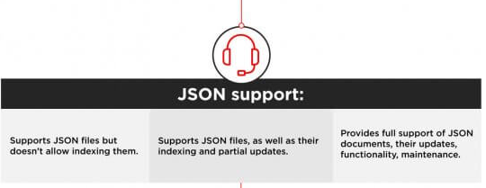
JSON Support
Overall, all three solutions are pretty universal and offer a lot of functionality for non-standard data types. MySQL, however, puts multiple limitations for JSON files, but other than that, it’s highly compatible with advanced data.

Slide 19
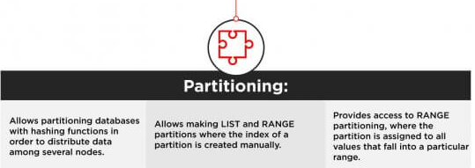
Partitioning
Replacing is easier in NoSQL databases because they support horizontal scaling rather than vertical – increasing the number of locations rather than the size of a single one. Still, it’s possible to distribute data among different compartments even in SQL solutions, even if it’s slightly less efficient.

Slide 20
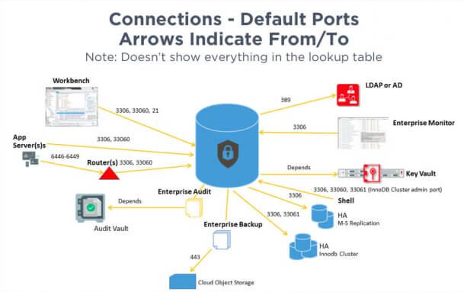
MySQL Ecosystem
The database ecosystem is important because it defines the frequency of updates, the availability of learning resources, the demand on the market, and the tool’s long-term legacy.
MySQL is a part of the Oracle ecosystem. It’s the biggest SQL database on the market with a large open-source community. Developers can either purchase commercial add-ons, developed by the Oracle team or use freeware installations. You will easily find tools for database management, monitoring, optimization, and learning. The database itself is easy to install – all you have to do is pretty much download the installer.
MySQL has been a reliable database solution for 25 years, and statistics don’t pinpoint at any sights of its decline. It looks like MySQL will keep holding a leading position not only among SQL tools but also among all the databases in general.

Slide 21
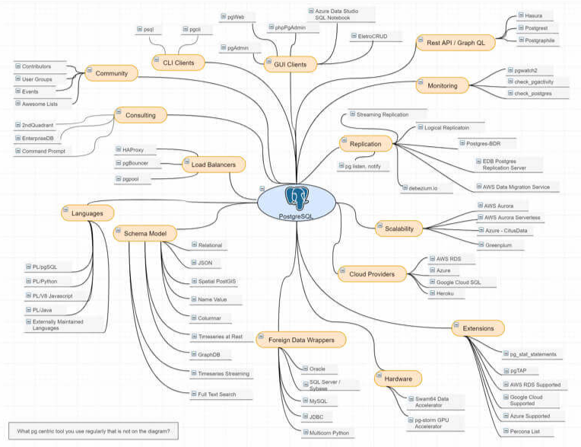
Postgresql Ecosystem
The Postgresql community offers a lot of tools for software scaling and optimization. You can find add-ons by your industry – take a look at the full list on the official page. The integrations allow developers to perform clustering, integrating AI, collaborating, tracking issues, improving object mapping, and cover many other essential features.
Some developers point out that Postgresql’s installation process is slightly complicated – you can take a look at its official tutorial. Unlike MySQL, which can run right away, Postgresql requires additional installations.

Slide 22
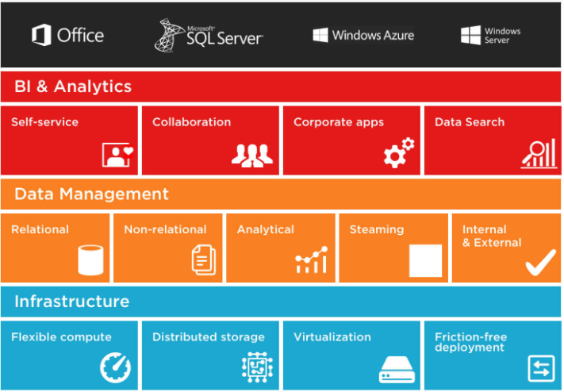
SQL Server Ecosystem
SQL Server is highly compatible with Windows and all Microsoft OS and tools. If you are working with Windows, SQL server is definitely the best option on the market. Users of the database receive access to many additional instruments that cover server monitoring (Navicat Monitor), data analysis, parsing (SQL Parser), and safety management software (DBHawk).
SQL Server ecosystem is oriented towards large infrastructures. It’s more expensive than open-source competitors, but at the end of the day, users get access to frequently updated official ecosystem and active customer support.
What is the difference between SQL and MySQL? MySQL is an open-source database, whereas SQL Server is a commercial one. MySQL is more popular, but SQL Server comes close

Slide 23
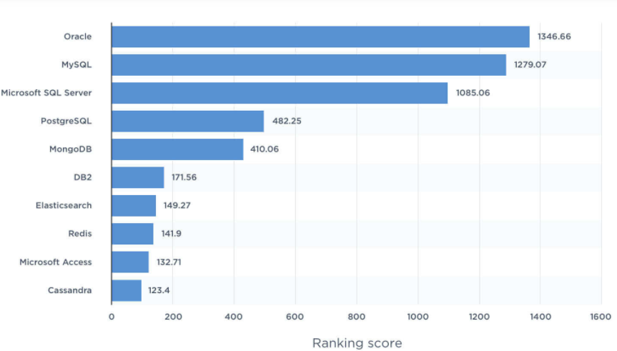
Popularity
For a start, we analyzed the DB Engines ratings of every compared engine. The leader is MySQL, with second place as the most popular database and second most popular relational solution. SQL Server takes third place, while PostgreSQL is ranked fourth.
The statistics by Statista shows the same tendency. MySQL is ranked second, leaving the leading position to Oracle, the most popular DBMS today. SQL Server follows with a slim difference, whereas Postgresql, which comes right after, is a lot less recognized.

Slide 24
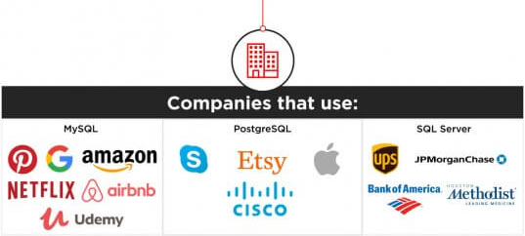
Popularity
MySQL, therefore, is the most demanded database on the market, which means finding competent teams, learning resources, reusable libraries, and ready add-ons will be easy. So, if you are choosing between SQL Server vs MySQL in terms of market trends, the latter is a better choice.
SQL Server is a go-to choice for large enterprises that have vast business logic and handle multiple applications simultaneously. Teams that prioritize efficiency and reliability over scalability and costs typically choose this database. It’s a common option for “traditional” industries – finances, security, manufacturing, and others.

Slide 25
Conclusion
The choice between the three most popular databases ultimately boils down to the comparison of the functionality, use cases, and ecosystems. Companies that prioritize flexibility, cost-efficiency, and innovation usually choose open-source solutions. They can be integrated with multiple free add-ons, have active user communities, and are continuously updated.
For corporations that prefer traditional commercial solutions, software like SQL Server backed up by a big corporation and compatible with an extensive infrastructure, is a better bet. They have access to constant technical support, personalized assistance, and professional management tools.
If you are considering a database for your project, getting a team of experts who will help you define the criteria and narrow down the options is probably the best idea. You can always get in touch with our database developers – we will create a tech stack for your product and share our development experience.

