Slide 1
Example Deck
A generic starting point for markdown-source presentations

Slide 2
A bullet slide is just a heading and a list
Each ## Heading starts a new slide at slide-level: 2
Keep one idea per slide; write the title as a claim, not a label
Put the narrative in speaker notes, not on the slide
Notes:
Speaker notes live in a ::: {.notes} block and never appear on the slide. This deck is the toolkit’s rendering smoke test — if it builds, your environment can render presentations.

Slide 3
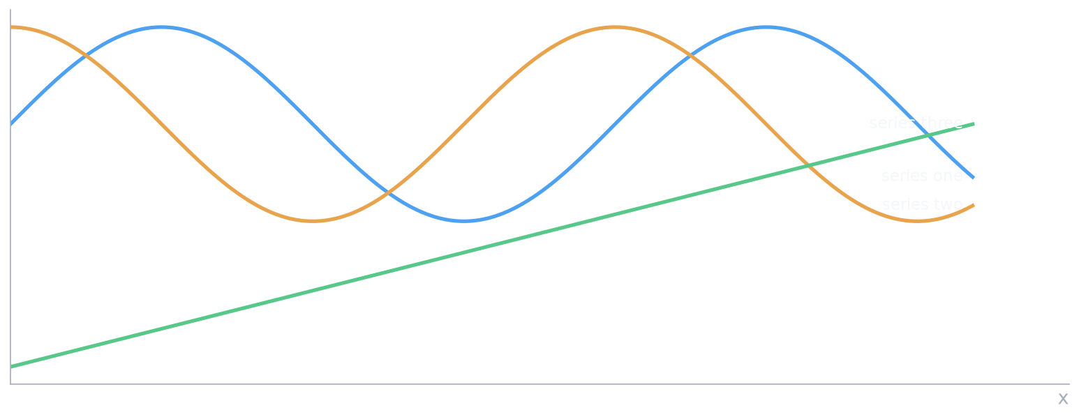
Figures come from executable Python chunks
Notes:
The chunk renders through deck_mpl.use(), which applies the palette and emits a transparent PNG that composites on the slide ground. Swap the palette in assets/deck_mpl.py for your brand.

Slide 4
Code blocks carry syntax highlighting
# rendered with the deck-code highlight theme render() { quarto render deck.qmd --to pptx }
Fenced code blocks pick up highlight-style from the front matter
Monospace font is set by monofont
Notes:
The highlight theme is a Skylighting KDE-format JSON file. Colors here are a generic terminal palette — edit themes/deck-code.theme to taste.

Slide 5
Tables render natively
Element | Front-matter key | Notes
Template | reference-doc | your .pptx with masters and layouts
Code colors | highlight-style | a .theme file
Mono font | monofont | e.g. Consolas
Notes:
Keep a table OR bullets on a slide, not both — pandoc splits a slide that carries a table and a list into two slides. This slide keeps its list in the notes for that reason.

