Slide 1

TEAM MEMBERS NAME & ID NO. | 1.MD FAHIM SHAHORIAR TITU [1812497042] 2.KHALILUR RAHMAN [1811835042] 3.AHSANUL HABIB [1822041042]
SUBMITTED TO | A K M BAHALUL HAQUE
DEPARTMENT | ECE
SECTION | 05
COURSE | CSE327
ASSIGNMENT | Project Report
PROJECT NAME | LAUNDRY MANAGEMENT
DATE | 24.05.2021

Slide 2
Introduction
Purpose of this course:
To identify an engineering and/or computing problem, build appropriate platform/software to solve the problem in a systematic way with given constraints of resources, budget, time etc.
To form project group to develop a product or solve engineering problem, be responsible and exercise leadership for fulfilling project goal.
To write proposal and completed project reports, to manage develop realizable timeline for a successful completion of project in a multidisciplinary team.

Slide 3
Why we select this topic:
Time is of the essence.
Market demand.
Time-saving.
How our project help us to learn the course objective :
In our project have Practical - usable outcome.
Other available products.
Involve a theory and have demonstration Simulation.

Slide 4
Project Planning
Feature:
Laundry List : Customer delivery confirmation.
Laundry category : A fixed price for each dress category per KG.
Supply list: Needed items for cleaning fabrics.
Inventory: The list of products. Here shows which elements are available or not.
Report: All customer, service data will be saved here. Admin can find specific data by filtering and also can print the data.
User control: This platform work to change or manipulate the user action or position in this webpage.
Task Divide:
Khalilur Rahman: Front End
Md Fahim Shahoriar: Web server+Application Logic
Ahsanul Habib: File System+Database

Slide 5
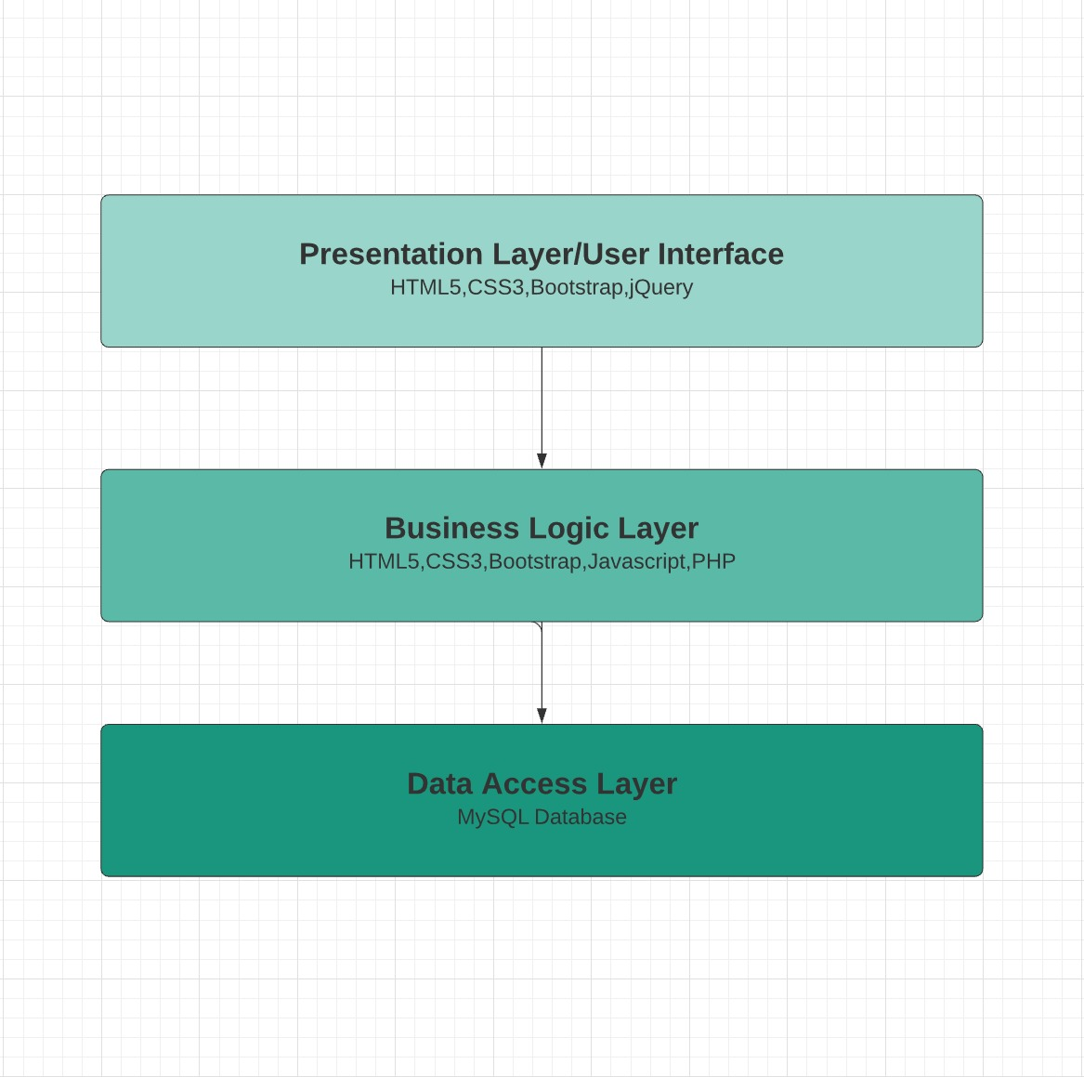
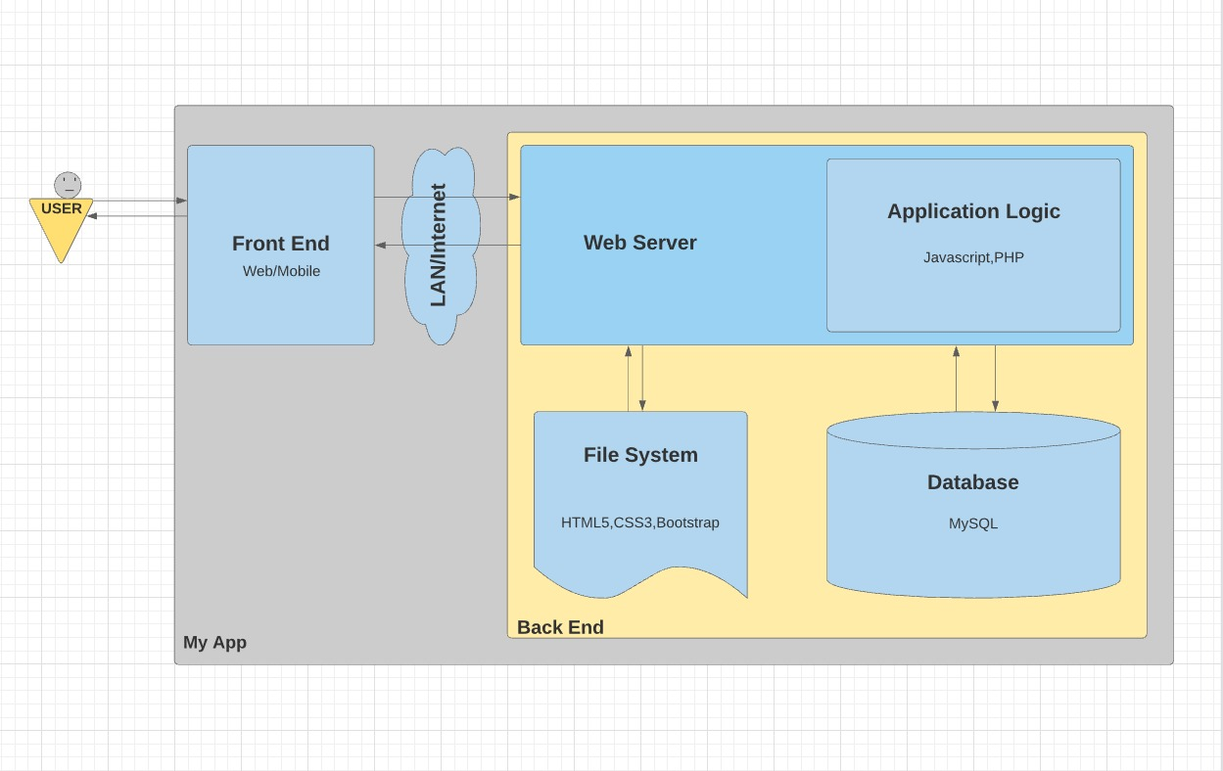
Architecture Diagram: Diagrammatic representation of the three tier architectural design of our web application:

Slide 6
Technology :
Frontend=html5,css3,bootstrap,jquery.
Backend=html5,css3,bootstrap,javaScript.
Development languages= php, database, MySQL.
One server=Xampp(software).

Slide 7
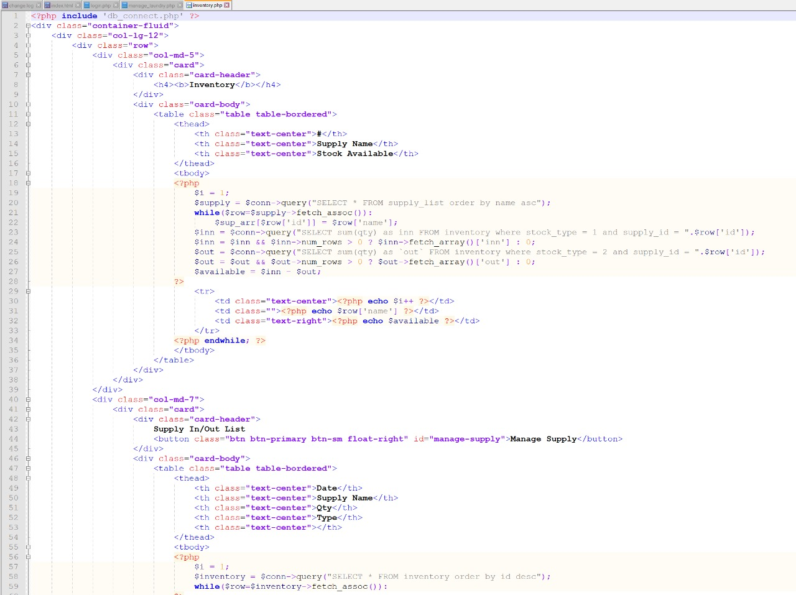
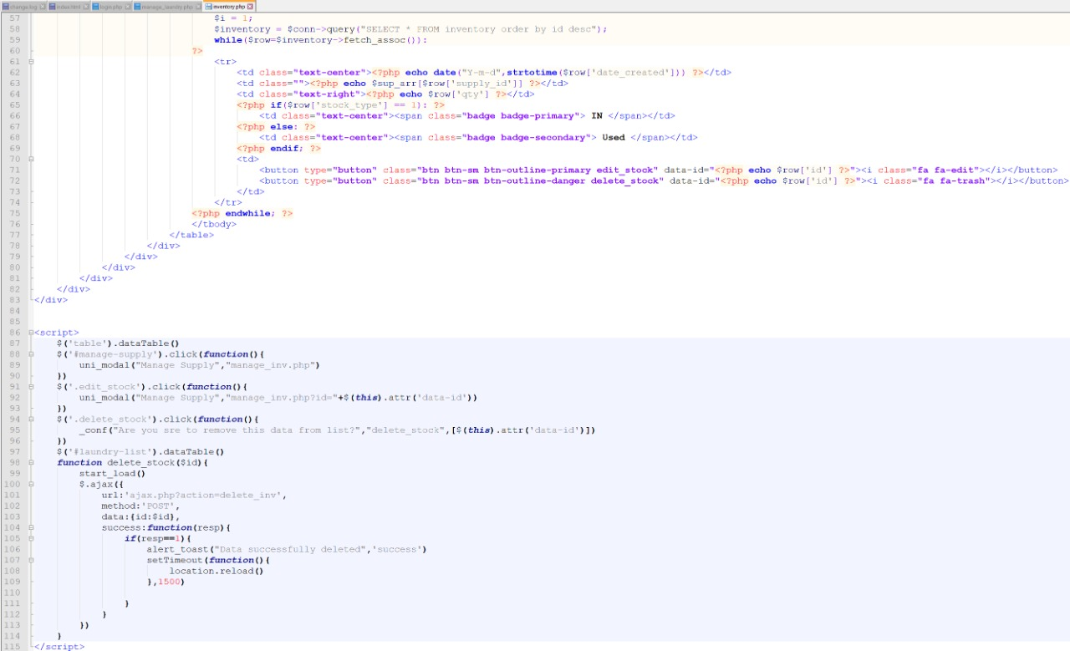
Implementation Code implementation : inventory.php

Slide 8
Challenges faced and solutions made
We are facing login problem for using Xammp. If we run our project in different version of xammp that time our project isn’t run. Now we are trying to buy a domain host to solve this problem.
We were having trouble in table, in Action part. Edit and delete button isn’t work properly. But after logout it work. But We fixed it.
In inventory it was showing mathematical problems in supply in/out list. For this reason in inventory chart it shows wrong data. We are working on it. We are trying to fixe it before to present our project.

Slide 9
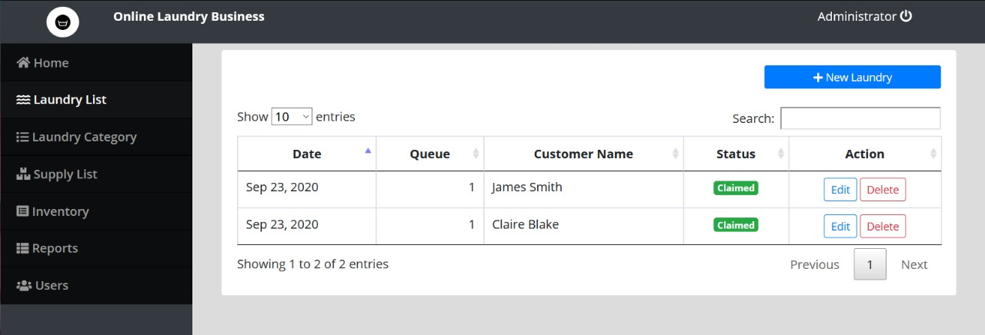
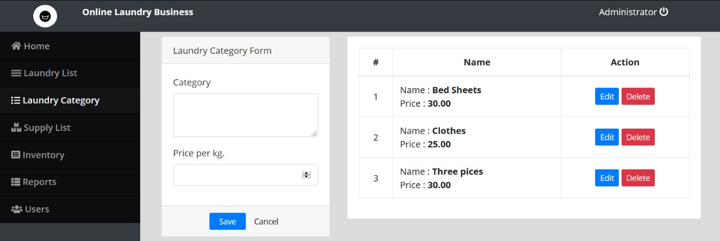
UI Presentation
Laundry List
Laundry Category

Slide 10
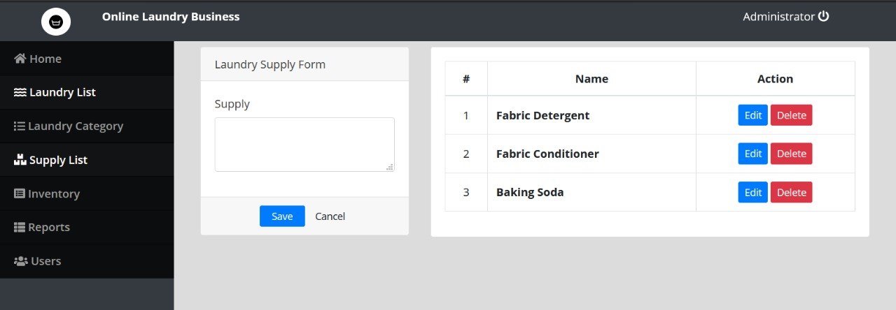
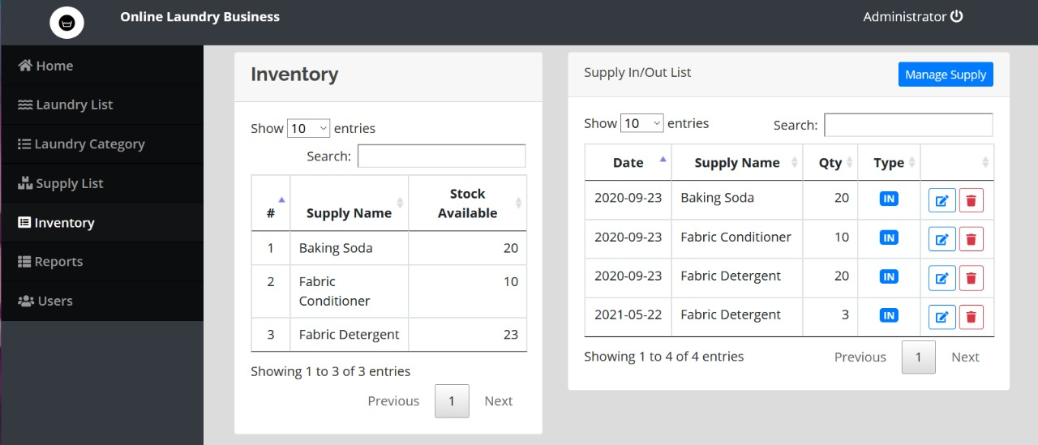
Supply List
Inventory

Slide 11
Conclusion:
Goal we have achieved
We are able to complete our project as much as possible. And also our project work smoothly(successfully). We give our full effort but we were not did extra curricular things in our project; the reason is our creativity of lacking. We are going to develop it further in future.
Further development plan
Develop it for the various operating system(OS).
Make it as much as user friendly for android operating system.
Try to connect with Facebook.
Addition Some creative Feature.

