Slide 1



MediTrack Database
A complete digital solution for small clinics to manage patients, appointments and billing
Kaliphile Papiyana
Image by Drew Robb : https://www.datamation.com/big-data/top-database-challenges/
01

Slide 2


Challenges Facing Small Clinics
🗂️ Patient records lost in paper files
📅 Double-bookings from manual
scheduling
💊 No system to track prescriptions/lab
tests
💸 Billing errors costing 15% revenue
(WHO data)
⏳ Nurses waste 2+ hours daily on admin
work
https://www.furniture-work.co.uk/blog/top-tips-for-setting-up-a-home-filing-system
10

Slide 3
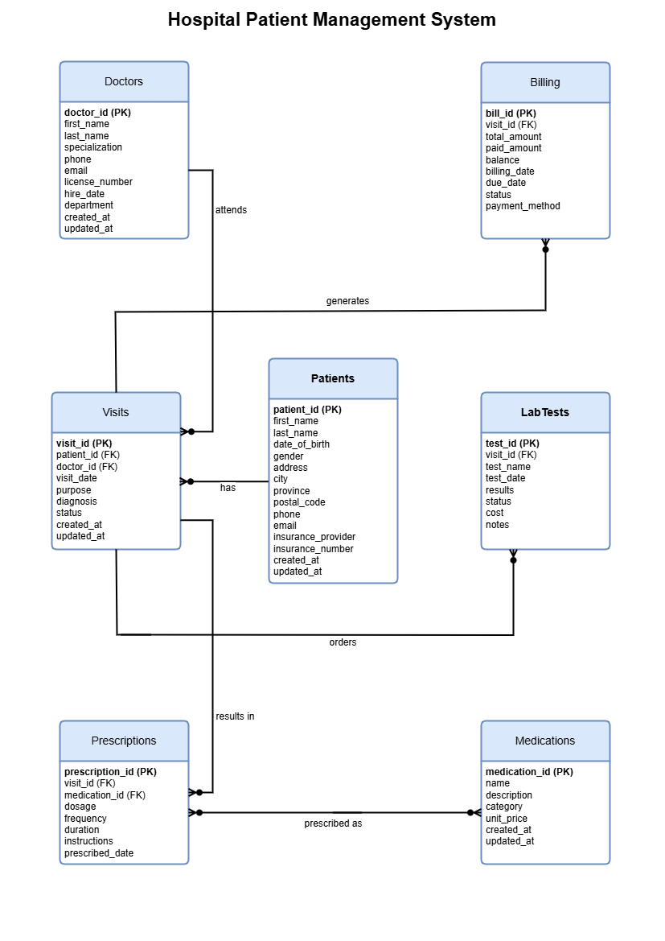

Our MySQL Database Solution
✔️ All-in-one digital patient records
✔️ Automated appointment scheduling
✔️ Prescription/lab test tracking
✔️ Error-proof billing system
✔️ Works offline – no internet needed
06

Slide 4

Product
Patient Management: Store demographics, insurance, medical history
Doctor Scheduler: View/edit appointments in real-time
Prescription Tracker: Link medications to patient visits
Billing Module: Auto-calculate costs with audit trail
04

Slide 5


Target Market
58%
Doctors report prescription tracking as their top challenge.
72%
Public clinics still use paper records
R2.1 billion
Lost annually to billing errors in private healthcare.
14

Slide 6
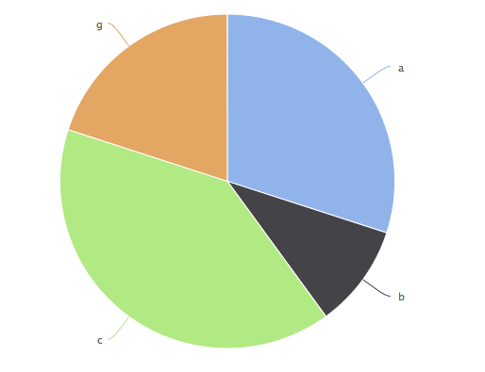
Market Size
Private GP Practices
The platform targets:
Private GP Practices
Specialist Clinics
Dental/Physio Centres
Public-Private Partners
Specialist Clinics
15%
25%
55%
5%
Public-Private Partners
Dental/Physio Centres
Sources: HPCSA 2024 register, DHIS, BHF 2023 survey

Slide 7
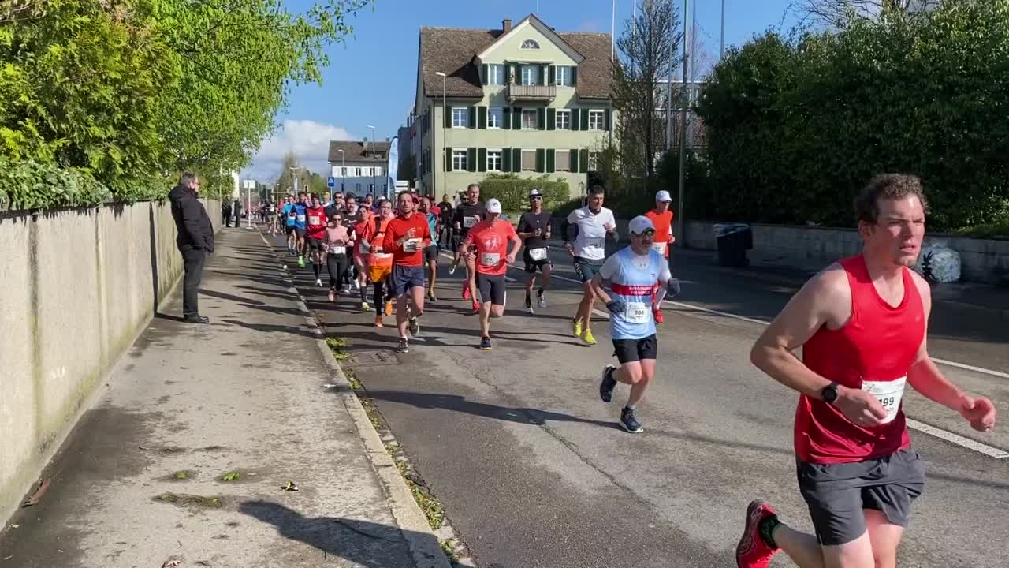
Competitors
Mention your competitors, and also say ehy you’re different.
Allegra Hospital Software
CareCross E-Clinic
MediBill Express
23

Slide 8

Competitive Advantage
What makes us unique?
1. SA Load-Shedding Proof
Unlike cloud competitors, works 100% offline (no internet needed)
Auto-syncs when power returns
2.💰 60% More Affordable
One-time payment
No monthly fees or hidden costs
3.⏱️ All-in-One & Easy Setup
Combines billing + prescriptions + lab tracking
Ready in 1 day (vs. 6-month setups for complex systems)

Slide 9
Project Traction
Tasks
Month 1
Month 2
Month 3
Month 4
Database Design (ERD)
Core Tables Built
Beta Testing
Pilot Clinic Launch
Full Release
23

Slide 10

Business Model
Monetization
Software Licenses
One-time purchase (clinic-specific pricing)
Premium Add-Ons
Billing analytics module
NHI compliance package
Recurring Revenue
Annual support contracts
Priority update subscriptions
Profit Margins
Base System: 60% margin
Add-Ons: 65-70% margin
Support Services: 70% margin
23

Slide 11
Go To Market
Offer free pilot to 3 local clinics
Partner with medical schools for referrals
Facebook ads targeting clinic owners

Slide 12



Social Impact
🩺 SDG 3: Better health systems 📚 SDG 4: Trains staff on digital tools 💻 SDG 9: Accessible healthcare tech

Slide 13
Our Ask
Seeking R20000 seed funding to:
Purchase a demo laptop (R12000)
Run local clinic ads (R3000)
Fund pilot installations (R5000)
This funding should sustain operations for 1 year

Slide 14

Team Members
KALIPHILE PAPIYANA
Founder/Director

Slide 15




Thank you!
Contact Us:
📧 khaliphilepapiyana7@gmail.com
LinkedIn
https://www.linkedin.com/in/kaliphile-papiyana-b84985264/
17

