Slide 1
Data Science courses on udemy.com: comparative analysis
Short data study to help deciding on hosting your course in data science

Slide 2
preliminary research
No fees to get in except for 3% administrative processing fee
Revenue share model - udemy and instructor share equally on sales
Udemy advertises for you
taken from:
https://support.udemy.com/hc/en-us/articles/229605008-Instructor-Revenue-Share#:~:text=There%20is%20no%20fee%20to,paid%20courses%20as%20you%20like

Slide 3
urls used for the study:
https://www.udemy.com/courses/search/?courseLabel=7892&lang=en&q=probability+and+statistics&sort=relevance&src=sac
https://www.udemy.com/courses/search/?courseLabel=5336&lang=en&q=r+&sort=relevance&src=ukw’

Slide 4
Statistics courses data
154 courses – initial yield
132 courses after dropping the duplicates
Explored ratings & prices with the inclusion of votes number for the course

Slide 5
R_programming courses data
128 courses – initial yield
117 courses after dropping the duplicates
Explored ratings & prices with the inclusion of votes number for the course

Slide 6
Combined data count: worthy findings
249 courses in total
Instructors hosting multiple courses:
Packt Publishing 17 Michael Jordan 3
Bogdan Anastasiei 6 Kirill Eremenko SuperDataScience Team 3
Geoffrey Hubona Ph.D. 10 Sai Acuity Institute of Learning Pvt Ltd Enabling Learning Through Insight! 3
Geoffrey Hubona Ph.D. 10 Abubble bee 2
Laura Roberts 6 Oak Academy 2 Minerva Singh 2
Bogdan Anastasiei 6 ExcelR Solutions 2
R-Tutorials Training 5 Jose Portilla 2
Diego Fernandez 4
Sumit Saha (Ph.D) 4
Gopal Prasad Malakar 4
Easylearning guru 4
Luc Zio 4
Antonie van Voorden 4
Quantitative Specialists 4

Slide 7
A few courses repeat in both categories:
 | courses | instructor | num_voters | price | rating | topic
20 | Statistics in R - The R Language for Statistic... | R-Tutorials Training | 262 | 12.99 | 4.5 | R_programming
93 | Statistics in R - The R Language for Statistic... | R-Tutorials Training | 262 | 12.99 | 4.5 | Statistics

Slide 8
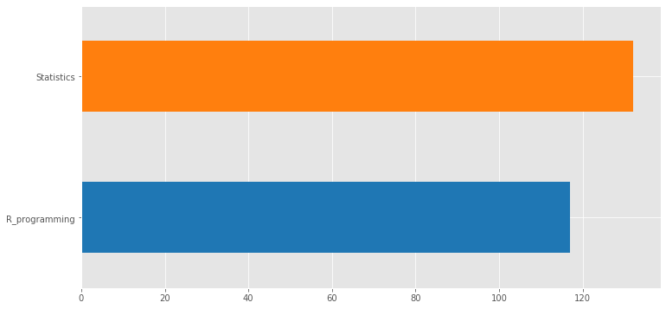
Depiction of total courses by topic:

Slide 9
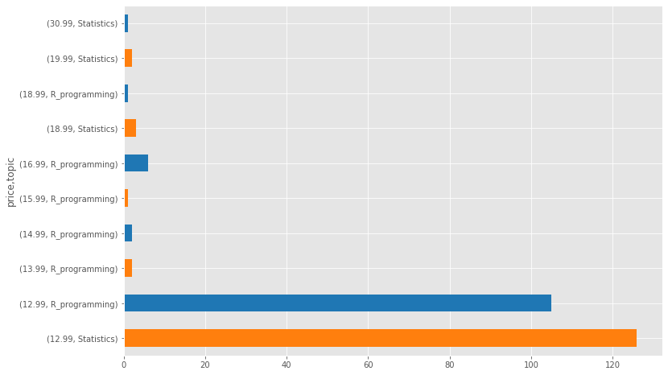
Pricing by topic
price topic
12.99 Statistics 126
R_programming 105
13.99 R_programming 2
14.99 R_programming 2
15.99 R_programming 1
16.99 R_programming 6
18.99 Statistics 3
R_programming 1
19.99 Statistics 2
30.99 Statistics 1

Slide 10
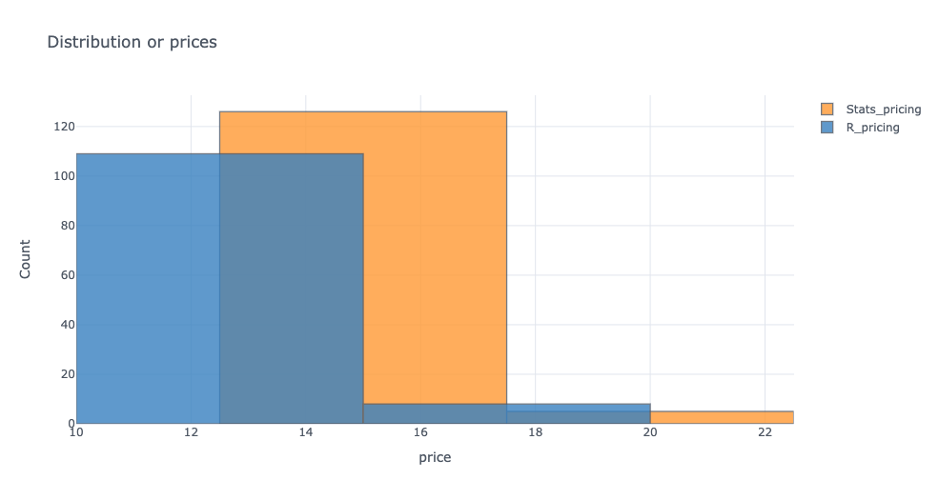
Pricing for Statistics and R programming closely compared

Slide 11
Conclusions on pricing analysis
Statistics courses priced higher:
126 courses in Statistics are priced from $13 to $17
Compared to
109 courses in R programming priced from $10 to $15
Overall Statistics courses yield more dollar amount (with inclusion of a few little higher priced coursed in both categories)

Slide 12
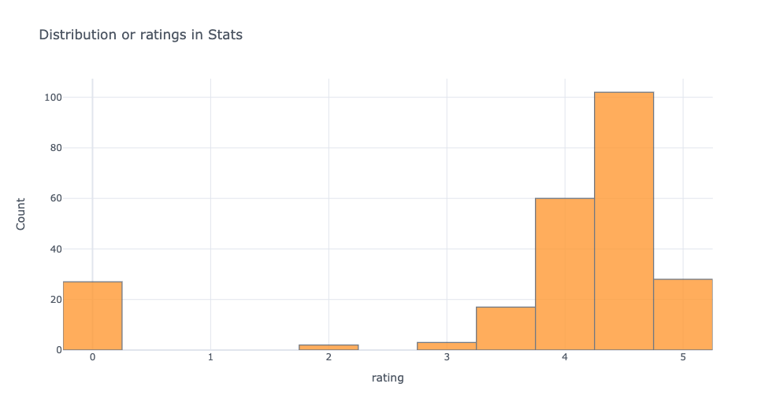
Ratings for Statistics

Slide 13
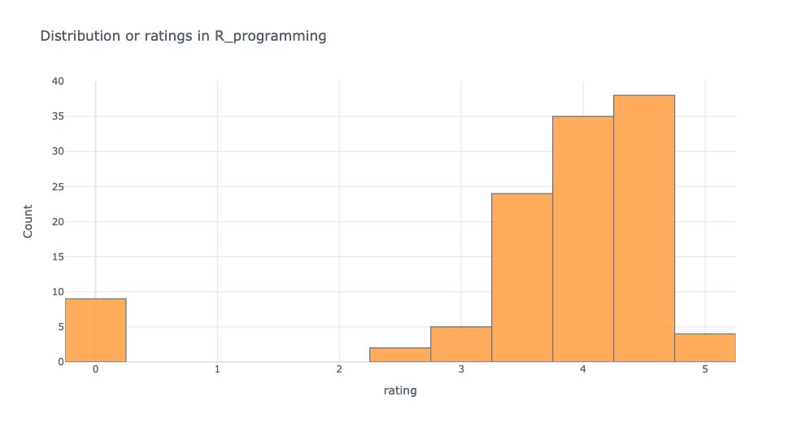
Ratings for R programming

Slide 14
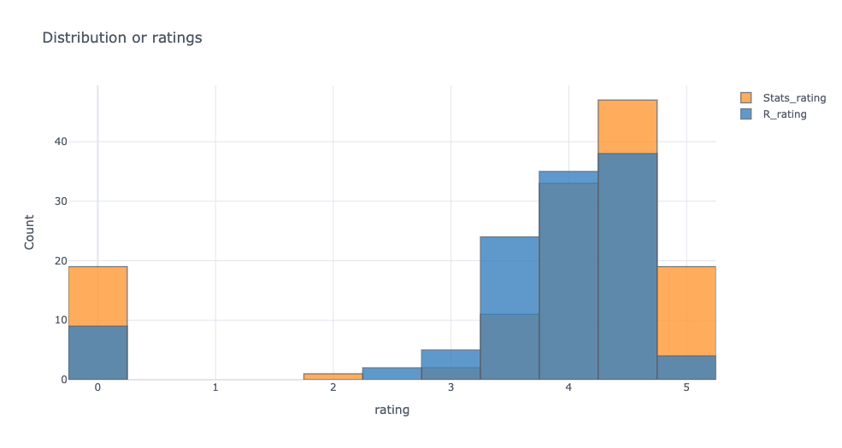
Ratings for Statistics and R programming compared

Slide 15
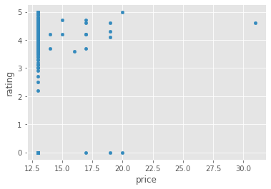
Price and Rating correlation: very little if any

Slide 16
Conclusions on ratings analysis
Ratings for Statistics courses are less dispersed. Students mostly go for high or low, very few are in between
19 courses rated. 4.8 – 5.2
19 rated below 3.0
Ratings for R programming are distributed more evenly. There are no extremes: fewer high and low ratings.
R programming only 4 rated 4.8 – 5.2.
9 rated below 3.0

Slide 17
Marketing tips based on findings and website analysis
Free short course offerings in R programming to build initial client base on how to download R and manage your directories
Advertise as All Levels
Fun fact: real course prices exposed after scraping. A course offered for $124.99 was scraped as a $20 course.

