Slide 1
Data Science courses on udemy.com: comparative analysis
Short data study to help deciding on hosting your course in data science

Slide 2
Preliminary Research Why Udemy?
No fees to get in except for 3% administrative processing fee
Revenue share model - Udemy and instructor share equally on sales
Udemy advertises for you free of charge
taken from:
support.udemy.com/hc/en-us/articles/229605008-Instructor-Revenue-Share#:~:text=There%20is%20no%20fee%20to,paid%20courses%20as%20you%20like
Article on best Udemy instructors and their courses – four out of top five instructors teach data science:
https://listemall.com/top-most-popular-udemy-instructors-2019/
(I have zero affiliation with Udemy)

Slide 3
Which courses to host and How to price them
We’ll look into:
Python
Statistics
R programming
All three filtered for Data Science and Language

Slide 4
urls used for the study are for Statistics and R programming
www.udemy.com/courses/search/?courseLabel=7892&lang=en&q=probability+and+statistics&sort=relevance&src=sac
www.udemy.com/courses/search/?courseLabel=5336&lang=en&q=r+&sort=relevance&src=ukw

Slide 5
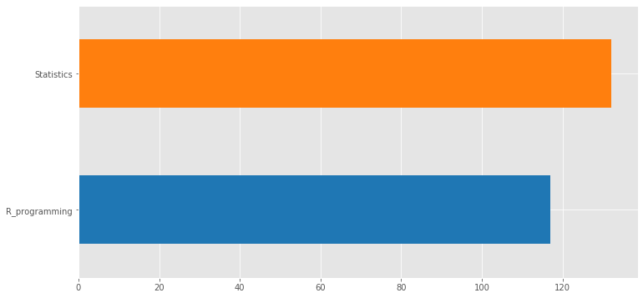
249 courses by topic hosted by 162 instructors
154 courses – initial yield
132
128 courses – initial yield
117

Slide 6
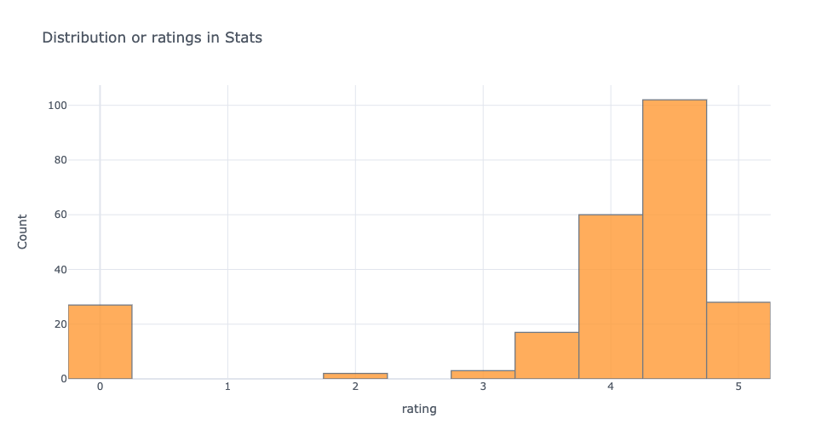
Ratings for Statistics
4.3 4.7
3.8
4.2

Slide 7
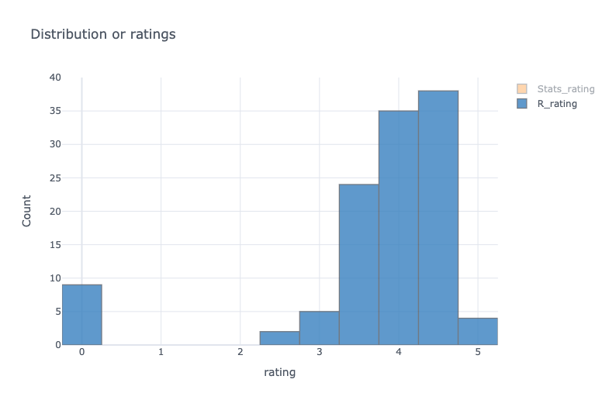
Ratings for R programming
3.9
4.3
3.2
3.7
3.8 4.2

Slide 8
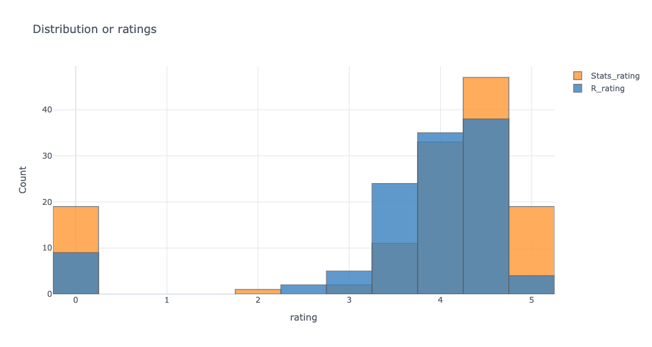
Ratings for Statistics and R programming compared

Slide 9
Conclusions on ratings analysis
Ratings for Statistics courses are less dispersed. Students mostly rate for either high or low
Statistics courses 19 rated 4.8 – 5.2
102 4.3 – 4.7
60 3.8 – 4.2
17 3.3 – 3.7
19 rated below 2.0
Ratings for R programming are distributed more evenly. No extremes
R programming 4 rated 4.8 – 5.2.
38 rated 3.9 - 4.3
34 rated 3.8 - 4.2
24 rated 3.2 – 3.7
9 rated below 2.0

Slide 10
Topic by Popularity
R programming – 117 courses
Number of Voters: R programming 72986
Statistics – 132 courses
Number of Voters: Statistics 52931

Slide 11
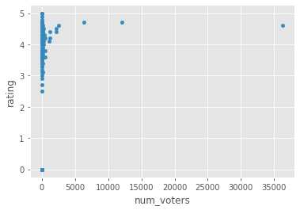
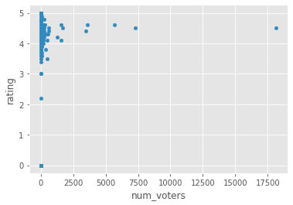
Rating and Number of Voters correlation: very little if any
Number of Voters: R programming 72986
Number of Voters: Statistics 52931
R programming Statistics
Correlation = 0.10

Slide 12
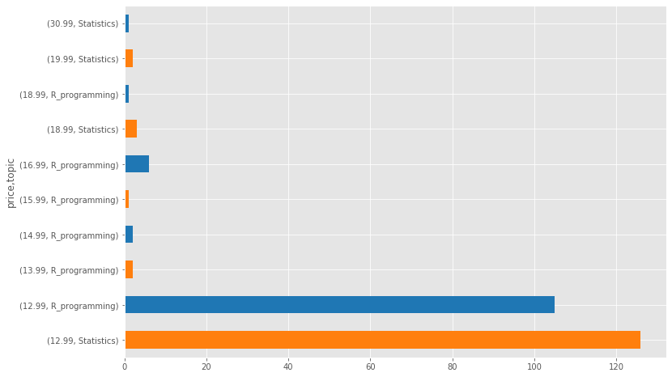
Pricing by topic
price topic
12.99 Statistics 126
R_programming 105
13.99 R_programming 2
14.99 R_programming 2
15.99 R_programming 1
16.99 R_programming 6
18.99 Statistics 3
R_programming 1
19.99 Statistics 2
30.99 Statistics 1

Slide 13
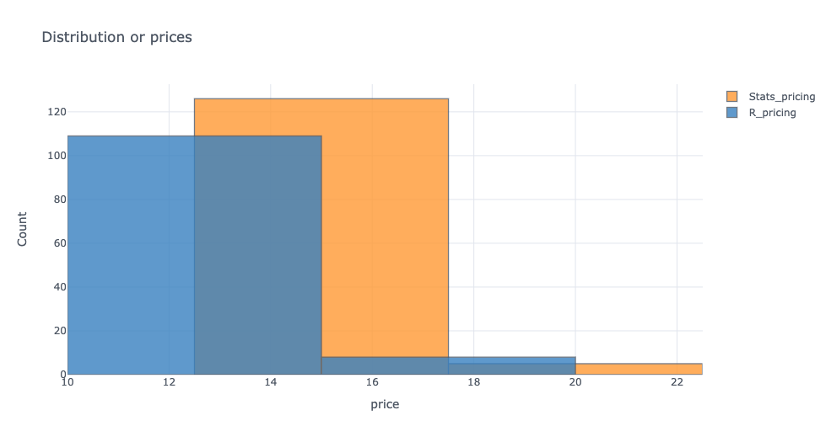
Pricing for Statistics and R programming closely compared
$13 to $17
$10 to $15

Slide 14
Conclusions on pricing analysis
Statistics courses priced higher:
126 courses in Statistics are priced from $13 to $17
Compared to
109 courses in R programming priced from $10 to $15
Overall R programming courses yield more dollar amount on Udemy

Slide 15
The outlier priced $30.99 is doing well
courses | instructor | # of voters | price | rating | topic
Become a Probability & Statistics Master | Krista King | 5669 | $30.99 | 4.6 | Statistics

Slide 16
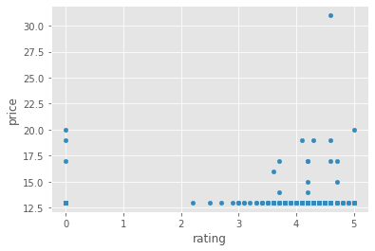
Price and Rating correlation: less than little
correlation = -0.02
Correlation = -0.02

Slide 17
Marketing tips based on findings and website analysis
Free short course offerings in R programming to build initial client base on how to download R and manage your directories
Advertise as “All Levels”
Host multiple courses if possible: 162 instructors host multiple courses 76 of their courses rated > 4.2

