Slide 1

Technology and Education: Computers, Software, and the Internet
Based on Bulman & Fairlie, NBER By: Khamidov Mirzakalonboy id:474561

Slide 2
Education Production Function
Achievement depends on
Student background (income, prior performance)
School resources
Computer/Internet access (ICT)
Teacher time vs. Computer-assisted instruction (CAI)
Notes:
Introduce the paper, authors, and core question.

Slide 3
Data Sources
OECD PISA (2012): Global student computer/Internet access.
European Commission (2012): EU school technology survey.
US NCES & Census Bureau: Historical ICT adoption.
RCTs and Policy Evaluations: Israel, Netherlands, Peru, India, USA.
Notes:
Explain trade-offs and the ambiguity in theory.

Slide 4
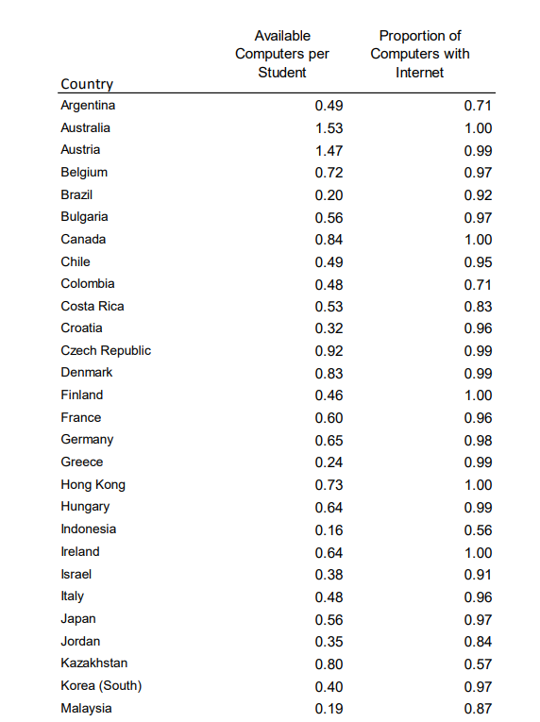
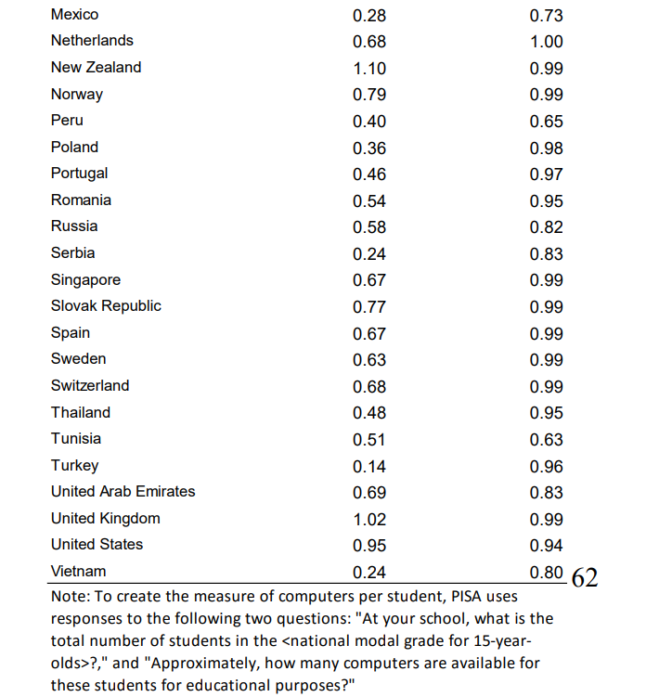
Global School Access (PISA)
Notes:
Explain Table 1 and 2 from paper showing global access.

Slide 5
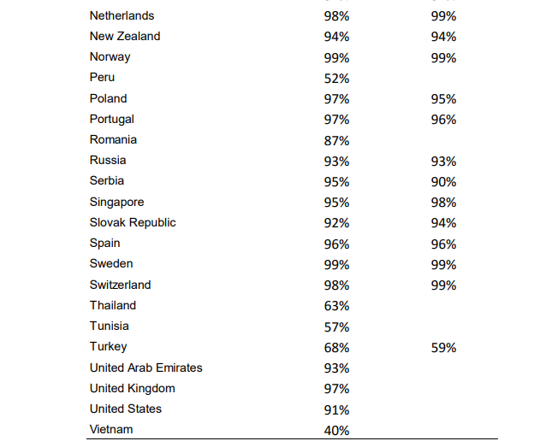
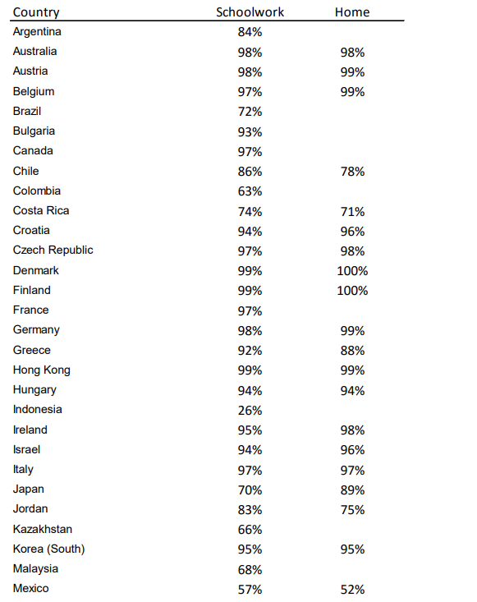
Household access to computers & Internet
Notes:
Interpretation: Digital divide persists across income and race.

Slide 6
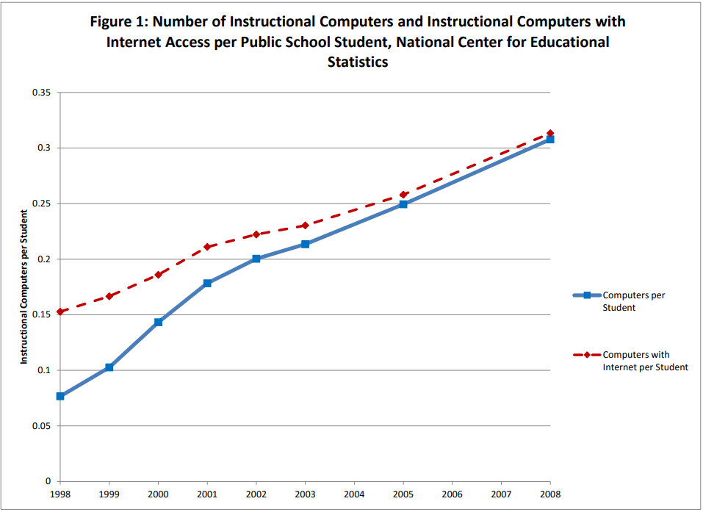
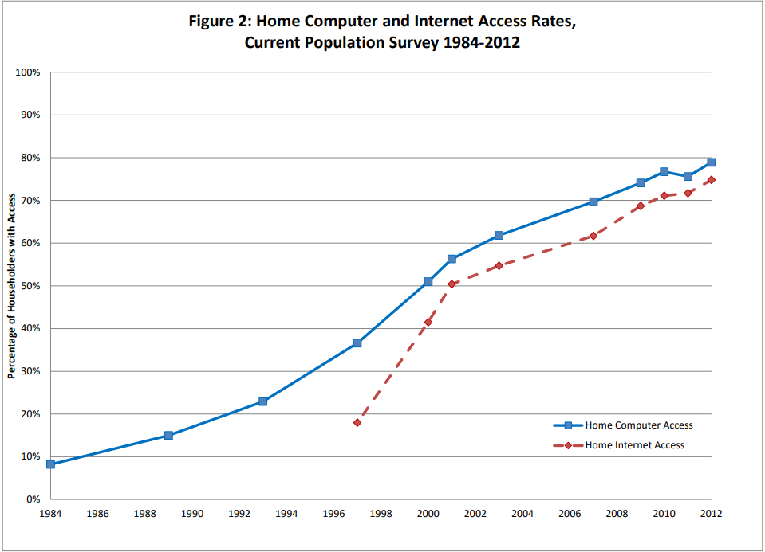
Computers per student (1984–2008) and home Internet adoption (1984–2012)

Slide 7
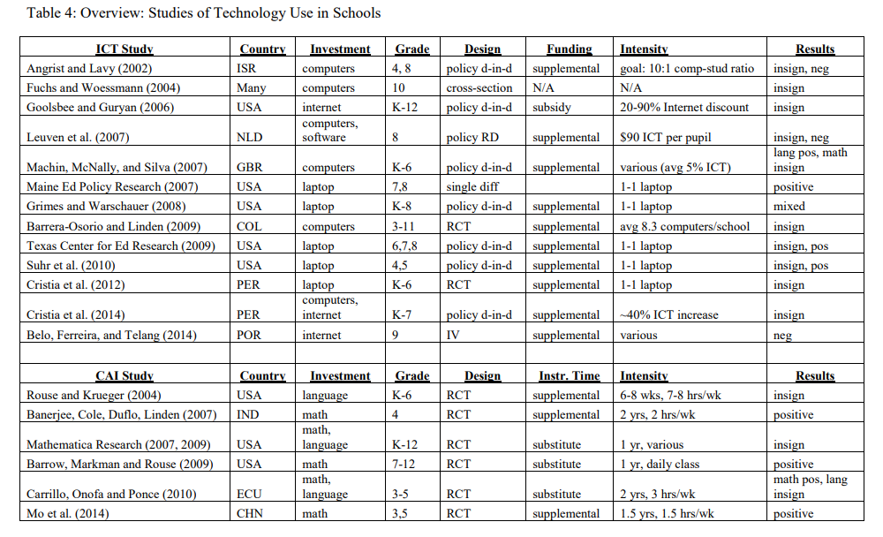
Evidence from ICT Investments in Schools
Notes:
Discuss main results from Tables 4 & 5.

Slide 8
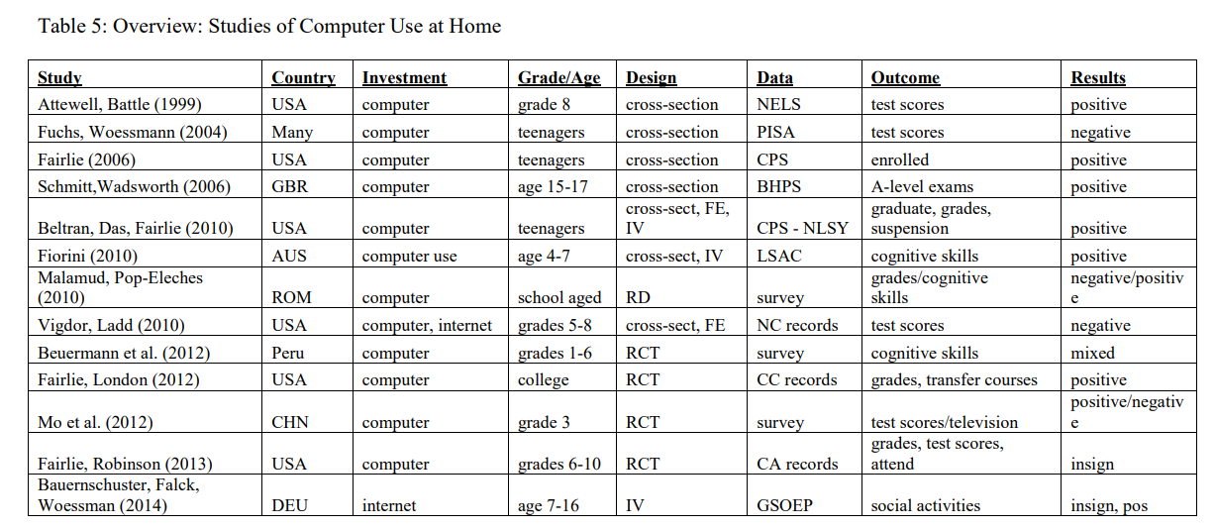
Evidence from Computer-Assisted Instruction (CAI)
Notes:
Summarize authors' view.

Slide 9
Authors’ Results & Conclusion
ICT → weak or no effects on test scores.
CAI works sometimes, mainly in math & developing countries.
Home computers not a guaranteed benefit.
Digital divide persists.
Notes:
Present updated reflection contrasting 2016 and 2025.

Slide 10
My Conclusion
After COVID-19, ICT became essential for remote learning.
AI (ChatGPT, adaptive learning tools) now provides personalized tutoring.
Digital divide is shrinking, but quality of use still matters.
ICT is now a foundation of education, not just a supplement.

