Slide 1
Personal Financial Management System
by: Khamidov Mirzakalonboy id:474561

Slide 2
My Personal Financial Management System is designed to make managing your finances effortless. This Python-based project helps you keep track of your income and expenses, categorize your transactions, and organize your income sources. With data stored securely in an SQLite database, you can easily add, view, edit, and delete your financial records. Plus, the system generates insightful reports for a clear analysis of your finances.

Slide 3
Pages
User Authentication
Expense Management
Income Management
Database Management
Reporting and Analysis(static and graphical version)

Slide 4

Technology Stack
Python
SQLite
Streamlit
Pandas
Vscode
Jupyter notebook
Sqlitestudio

Slide 5


Slide 6
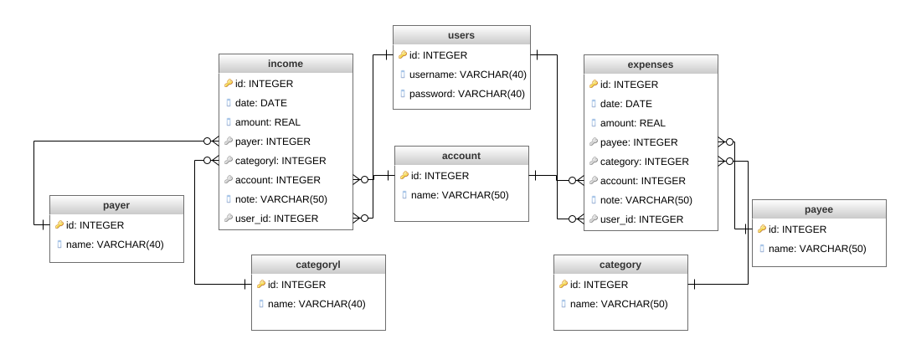
Database Schema

Slide 7
Libraries
Streamlit
st.set_page_config() for configures the page layout, title, and icon.
st.dataframe() for displaying a Pandas DataFrame in a table format
st.markdown() for customizing HTML/CSS styling and content rendering.
st.success() and st.error() to display success or error messages
Pandas
pd.DataFrame() for creates a DataFrame from query results, which is a table-like structure with rows and columns.
df.to_csv() for exporting data from a DataFrame to a CSV file
pd.read_sql_query() for reading SQL query results into a DataFrame.
Subprocess
subprocess.run() Runs an external process or command. In the code, it's used to run the specified Python files after exporting data.
sys.executable() Returns the path of the Python interpreter, which is used to run Python scripts in a subprocess.

Slide 8
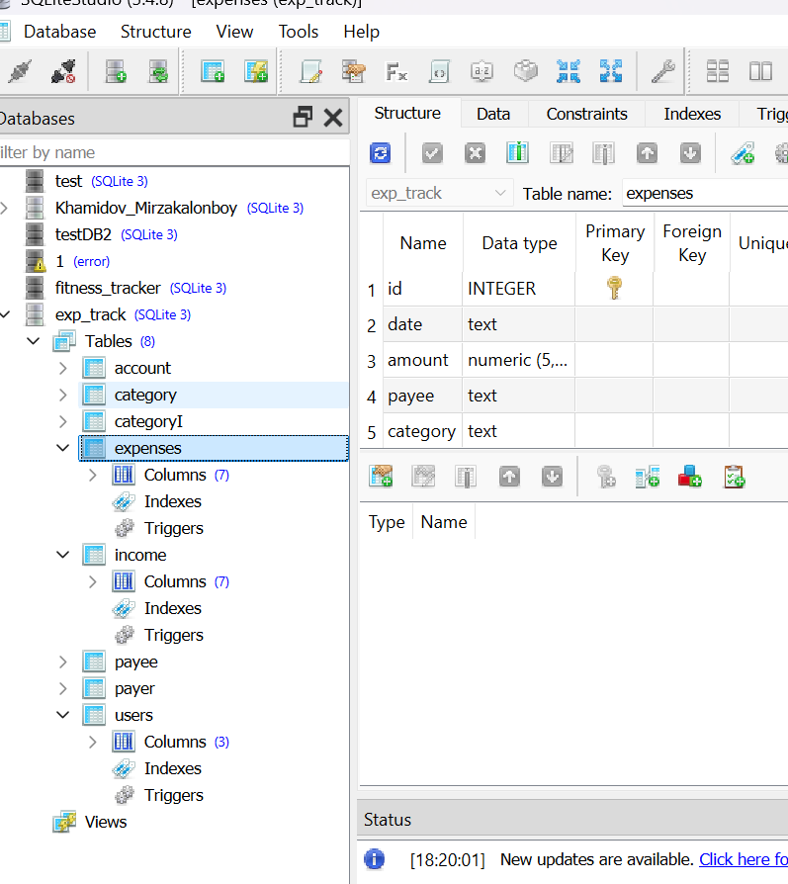
Queries and database in Sqlitestudio
Insertion Queries
To add new records to the tables
Selection Queries
To retrieve data from the tables
Deletion Queries
To remove records from the tables.
Update Queries
To modify existing records in the tables
Aggregation and Analysis Queries
To aggregate data and perform analysis

Slide 9
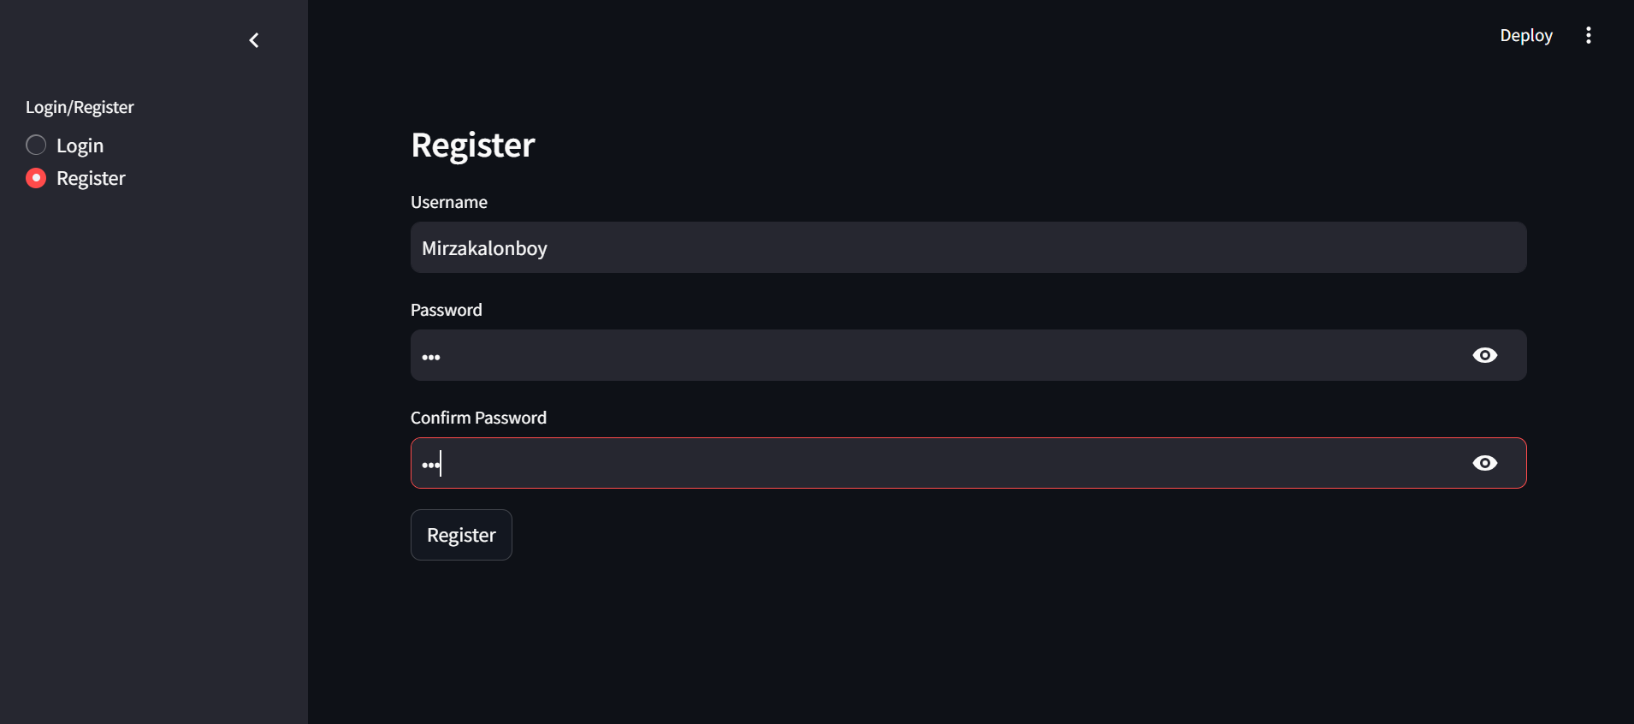
User authenticatin log in and registration

Slide 10
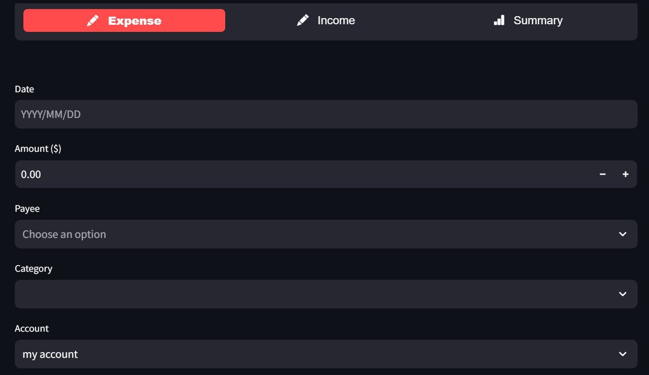
Main page

Slide 11

Editing and saving new details

Slide 12
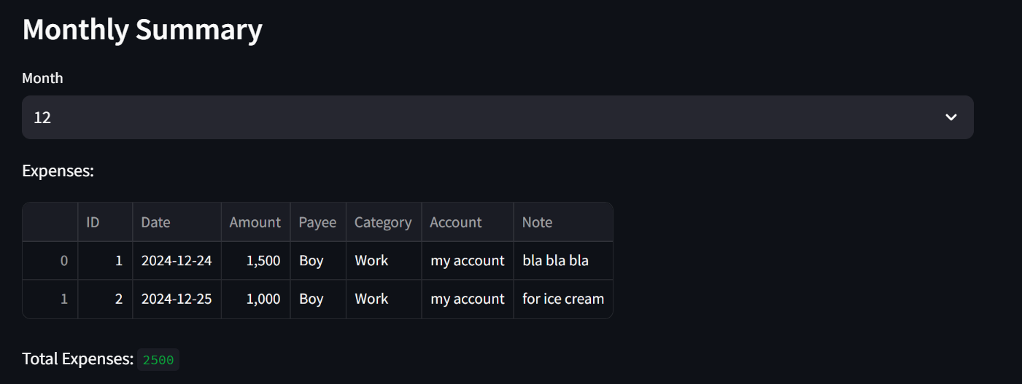
Monthly summary

Slide 13
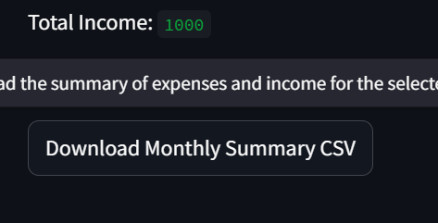
Downloading summary as a CSV file

Slide 14
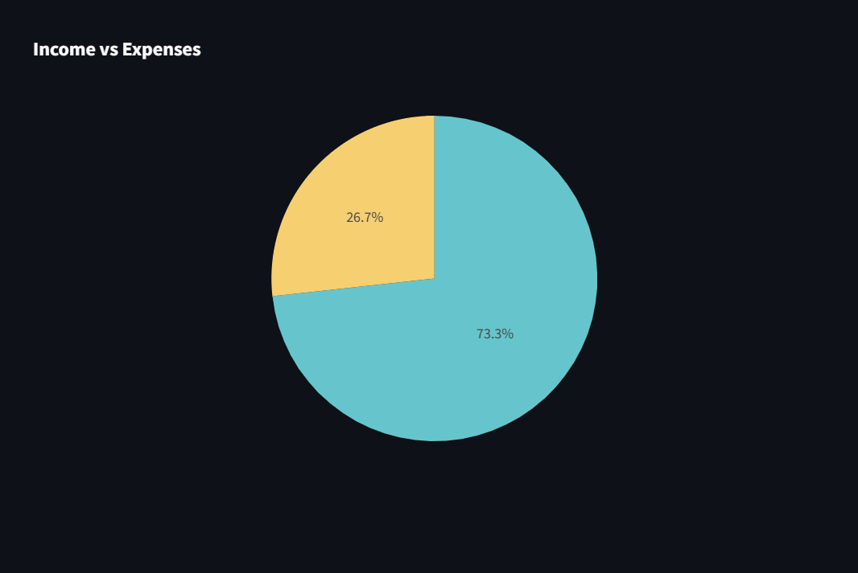
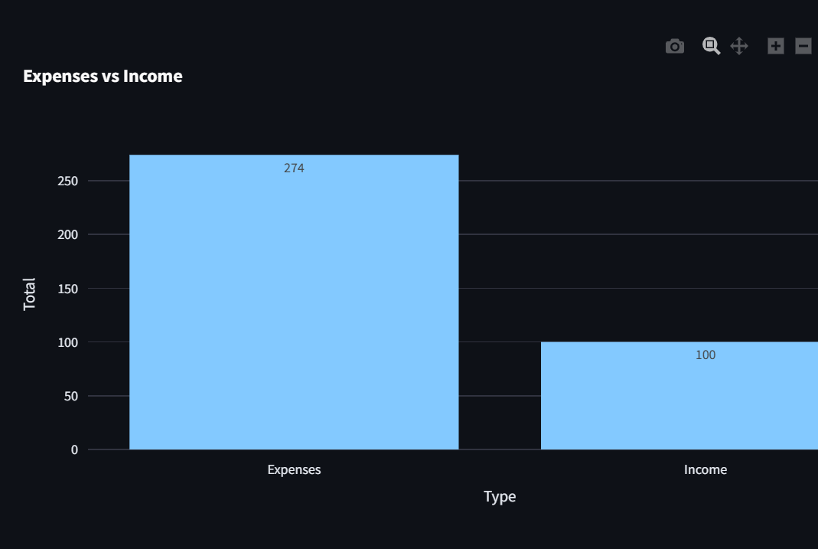
Visual summary

