Slide 1




79%
of Filipino 15-year-old students scored
below basic proficiency in mathematics.
Source: OECD · PISA 2025, Philippines (2026) · Below Level 2 in mathematics
Notes:
OECD’s PISA 2025 Philippines country note, published 8 September 2026, reports that 21% of participating Filipino 15-year-old students attained at least Level 2 in mathematics. The slide uses the complement: 100% − 21% = 79% below Level 2, the baseline proficiency threshold. The statistic describes school students represented by PISA, not all Filipinos. Source: https://www.oecd.org/en/publications/pisa-2025-results-volume-i-country-notes_2d4ff9ea-en/philippines_3699b9d5-en.html

Slide 2
Dunlo turns discovery into practice
A short-form learning feed with a clear path into Khan Academy.
Easy to start
Clear to continue
Young learners can start with one idea
in a familiar, scrollable feed.
Each idea points to a matching
Khan Academy exercise.
Try an interactive model or Khan clip.
Make a prediction and see why.
Return to Dunlo for a fresh question.
Save the idea to revisit later.
The familiar feed opens the door. Connected practice gives that curiosity somewhere to go.
02
Notes:
Dunlo connects short-form interactive discovery to Khan Academy practice. The feed offers a familiar starting point for young learners used to mobile content, while each idea has a clear continuation into practice and review.

Slide 3
How one discovery becomes a learning session
1
2
3
4
Choose one
short idea
Predict, then
see why
Practise with
Khan Academy
Answer a fresh
question in Dunlo
One topic stays connected across the feed, Khan practice and later review.
Learning design: IES practice guide (2007).
03
Notes:
The four connected steps are choosing one short idea, making a prediction and seeing an explanation, practising the matching skill on Khan Academy, and answering a fresh question in Dunlo. Learning design source: https://ies.ed.gov/ncee/wwc/practiceguide/1

Slide 4
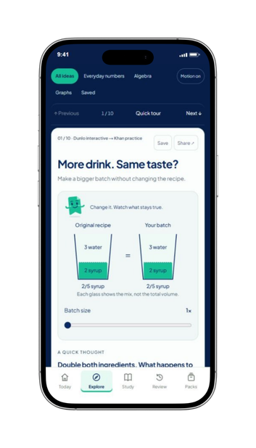
Short-form content. Active learning.
For learners used to mobile feeds,
Dunlo makes one idea easy to start.
Scroll. Try. Keep going.
Move a slider or watch a focused Khan clip.
Make a prediction and get an explanation.
Follow the idea into a matching Khan exercise.
Save it for a fresh question later.
Explore the working feed · dunlo.vercel.app/explore
04
Notes:
Dunlo offers a scrollable feed of original interactive models and focused, source-labelled Khan Academy video segments. Each item connects to a prediction, explanation, matching Khan exercise and later questions. Working feed: https://dunlo.vercel.app/explore

Slide 5
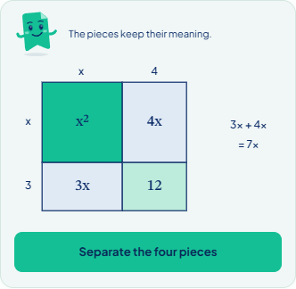
Make the relationship visible
Example: move the four areas to see why the middle terms combine.
FOUR AREAS
x² + 3x + 4x + 12
Each part keeps its meaning.
COMBINE
3x + 4x = 7x
The middle terms belong together.
RESULT
x² + 7x + 12
Then try a different question.
Original Dunlo interactive · Learning design: Chi & Wylie (2014), ICAP framework
05
Notes:
The four positive areas are x squared, 3x, 4x and 12. Combining the middle terms gives 7x. The picture uses x = 5. The next assessment uses another example.

Slide 6
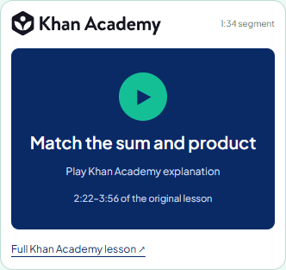
Khan Academy, right in the feed
FACTORING · 1 MIN 34 SEC
One focused clip.
A clear next step.
The original Khan video plays in the feed.
Learners can open the full lesson,
then practise the same skill on Khan.
Source: Khan Academy · Factoring quadratics · 2:22–3:56
06
Notes:
The feed uses original Khan Academy video with a focused range, visible source and a link to the full lesson. The factoring example is 2:22–3:56. Source: https://www.khanacademy.org/math/algebra/x2f8bb11595b61c86:quadratics-multiplying-factoring/x2f8bb11595b61c86:factor-quadratics-intro/v/factoring-simple-quadratic-expression

Slide 7
Useful help when a step is difficult
1
2
3
A short question
finds the missing step
A worked example
explains that step
A new question
checks independent use
Learners can choose “learn first” or check what they already know.
Worked examples guide the attempt; a different question checks what the learner can do next.
See the recovery example
07
Notes:
A short check helps choose support. The learner works through the explanation and then tries another question. They can choose to learn first.

Slide 8


Try the complete journey
Explore an idea, open Khan practice,
and return for a fresh question.
Try Dunlo
dunlo.vercel.app
Scan to explore
Explore freely, or bring your current learning goal.
08
Notes:
Invite the reader to the main Dunlo site at https://dunlo.vercel.app/. The QR pixels, QR image hyperlink, Try Dunlo button and readable URL all use the main site. From there they can open Explore or continue studying.

Slide 9

Khan learning has a clear continuation
The same idea connects discovery, practice and review.
IDEA
LEARN
KHAN
TRY
REVISIT
Discover or bring
a learning goal
Open a Khan clip
or explanation
Practise the
relevant exercise
Return to a fresh
independent question
Keep the idea for
a later session
Your place is saved when you open Khan practice.
Khan sources are labelled. Completion reports and fresh answers stay separate.
09
Notes:
Khan Academy has a visible role: explanation, relevant exercise and continuation. Resource opens, learner reports and fresh independent answers are distinct.

Slide 10
A useful reason to return
Today
Later
Save a discovery.
Use it on a fresh question.
Revisit the idea.
Try it in another situation.
Saved ideas and later questions turn a quick visit into a path back.
Learning design: recalling an idea and spacing practice · Carpenter, Pan & Butler (2022)
10
Notes:
Saved ideas and the reviewer provide a reason to return. A later question uses a different situation. Retrieval research: https://pubmed.ncbi.nlm.nih.gov/23576743/

Slide 11
Start with public access
PUBLIC LAUNCH
NO DUNLO ACCOUNT NEEDED
Open an idea
Share an idea
Public topic links will let learners
open an idea without a Dunlo account.
Save and share a specific challenge
to give someone a useful starting point.
Launch with short demo posts
Link each post to the matching idea
Start online through public sharing; future school or community use can extend this model.
11
Notes:
The launch starts with direct public access and shared item links. Public demonstrations and topic pages introduce the experience. No school access is assumed.

Slide 12
A practical launch and growth plan
NOV 2026
Review content
and launch publicly
DEC 2026–FEB 2027
Gather feedback
and refine the flow
MAR 2027
Evaluate use
and plan continuation
Expand through reviewed learning sequences
Each new topic will include an interactive or clip, a matching Khan activity,
worked support and fresh questions.
Track which ideas learners open, where they stop and how fresh answers change.
Next extensions: more subjects, reviewed Filipino content and original offline mini-packs.
12
Notes:
November 2026: review content and launch publicly. December 2026 through February 2027: gather voluntary feedback, review where learners stop and refine the flow. March 2027: evaluate use and plan continuation. Future content sequences will include an interactive or clip, matching Khan activity, support and fresh questions. Expansion priorities are more subjects, reviewed Filipino content and original offline mini-packs.

Slide 13
Free learning. A plan for continuity.
PHP 100,000
Allocation
PHP
Content review
30,000
60%
Access & usability
18,000
Evaluation
12,000
Operations & hosting
12,000
Interactive production
12,000
Content review,
access and evaluation
Localization review
8,000
Launch materials
3,000
Contingency
5,000
Seek support for free delivery and maintenance.
Total
100,000
Implementation budget · Planning allocations; funding not secured
13
Notes:
The implementation planning total is PHP 100,000. Content review, access/usability and evaluation total PHP 60,000. Funding has not been secured. Source: https://github.com/KhanAcademy-Backtrack/KhanAcademy-Backtrack-Demo/blob/main/docs/BUSINESS_AND_SUSTAINABILITY.md

Slide 14
Turn curiosity into progress.
Dunlo uses short-form discovery to bring learners into Khan practice,
then helps them apply the idea and return to it.
Explore Dunlo · dunlo.vercel.app
Matthew Labrador · Paul Recio · Harry Gomez
Coach: Justin Mesias · University of the Philippines Manila
14
Notes:
Dunlo connects short-form discovery to Khan Academy practice, independent application and later review. Explore the working product at https://dunlo.vercel.app/. Team: Matthew Labrador, Paul Recio and Harry Gomez. Coach: Justin Mesias. University of the Philippines Manila.

Slide 15
Research behind the learning design
Dunlosky et al. (2013)
Improving students’ learning with effective
learning techniques. PSPI, 14(1).
Atkinson, Renkl & Merrill (2003)
Transitioning from studying examples
to solving problems.
Journal of Educational Psychology, 95(4).
Carpenter, Pan & Butler (2022)
The science of effective learning with spacing
and retrieval practice. Nature Reviews Psychology.
Chi & Wylie (2014)
The ICAP framework: linking cognitive
engagement to active learning outcomes.
Educational Psychologist, 49(4).
Yang et al. (2021)
Testing (quizzing) boosts classroom learning:
a systematic and meta-analytic review.
Psychological Bulletin, 147(4).
Tversky, Morrison & Bétrancourt (2002)
Animation: can it facilitate?
International Journal of
Human-Computer Studies, 57(4).
Szpunar, Khan & Schacter (2013) · Interpolated memory tests reduce mind wandering
and improve learning of online lectures. PNAS, 110(16).
15
Notes:
Learning research references are linked directly from each visible entry. IES (2007) is also linked on slide 3. Khan Academy’s original lesson is credited on slide 6. These sources inform the learning design; no product-specific trial outcomes are claimed.

