Slide 1

Empowering teachers
Elevating Teaching, Simplifying Assessment. Team FOLD

Slide 2

Teachers
Time Constraint
Multifaceted Responsibilities
Balancing Act
Pressure to Perform

Slide 3
Make it easier
Assessing exams
Streamlining tasks
Communicating with parents
Improving students performance

Slide 4
Make it effective
Identify students having difficulty learning
Maintaining consistency and fairness
Time saving
Informed Decision-Making
Positive Impact on Student Achievement

Slide 5

Empowering Teachers
We empower teachers to efficiently digitize their assessments, providing them with the capability to track and retrieve student performance data effortlessly.

Slide 6
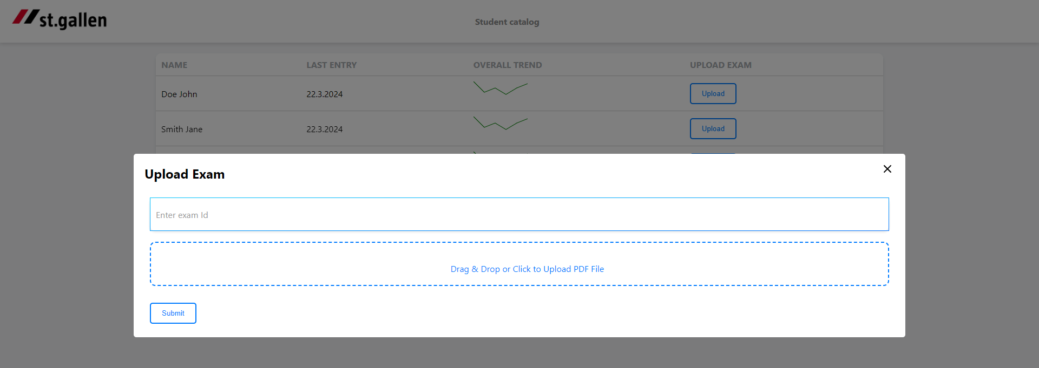
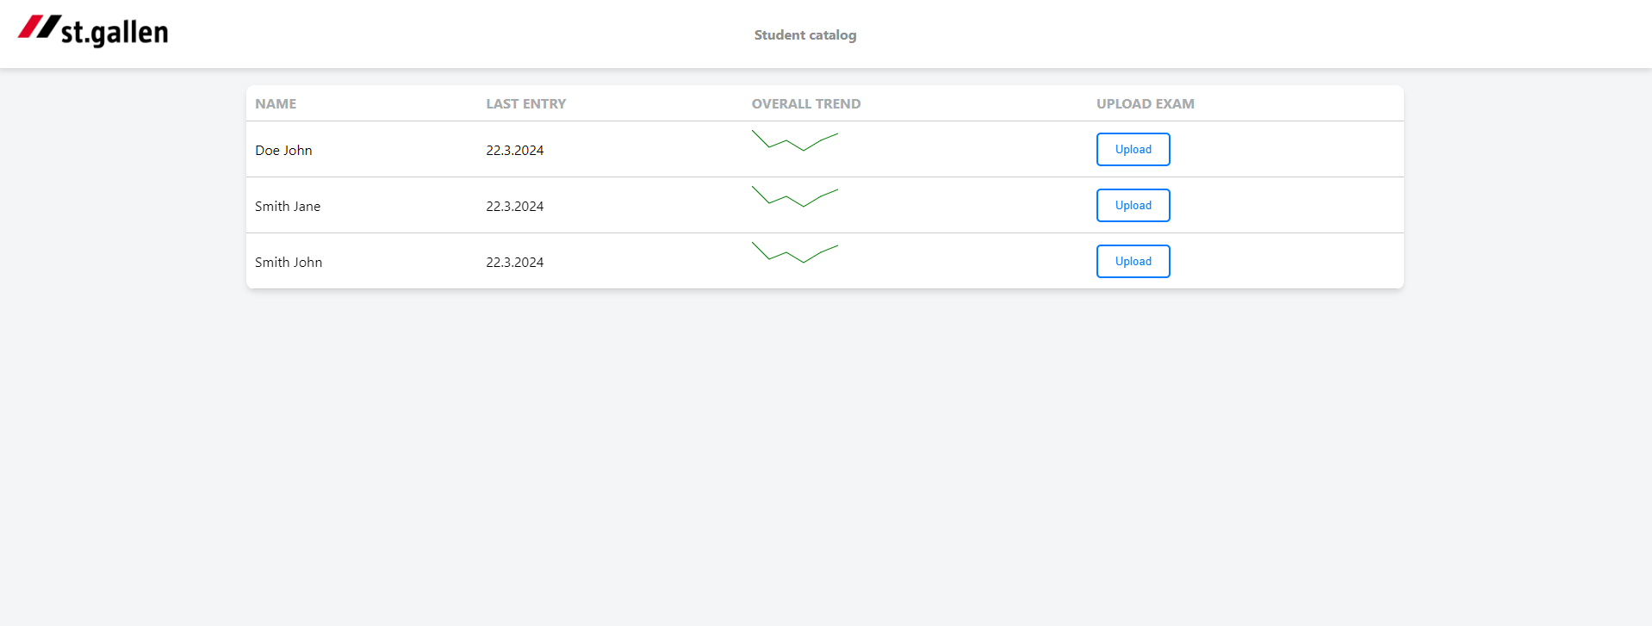
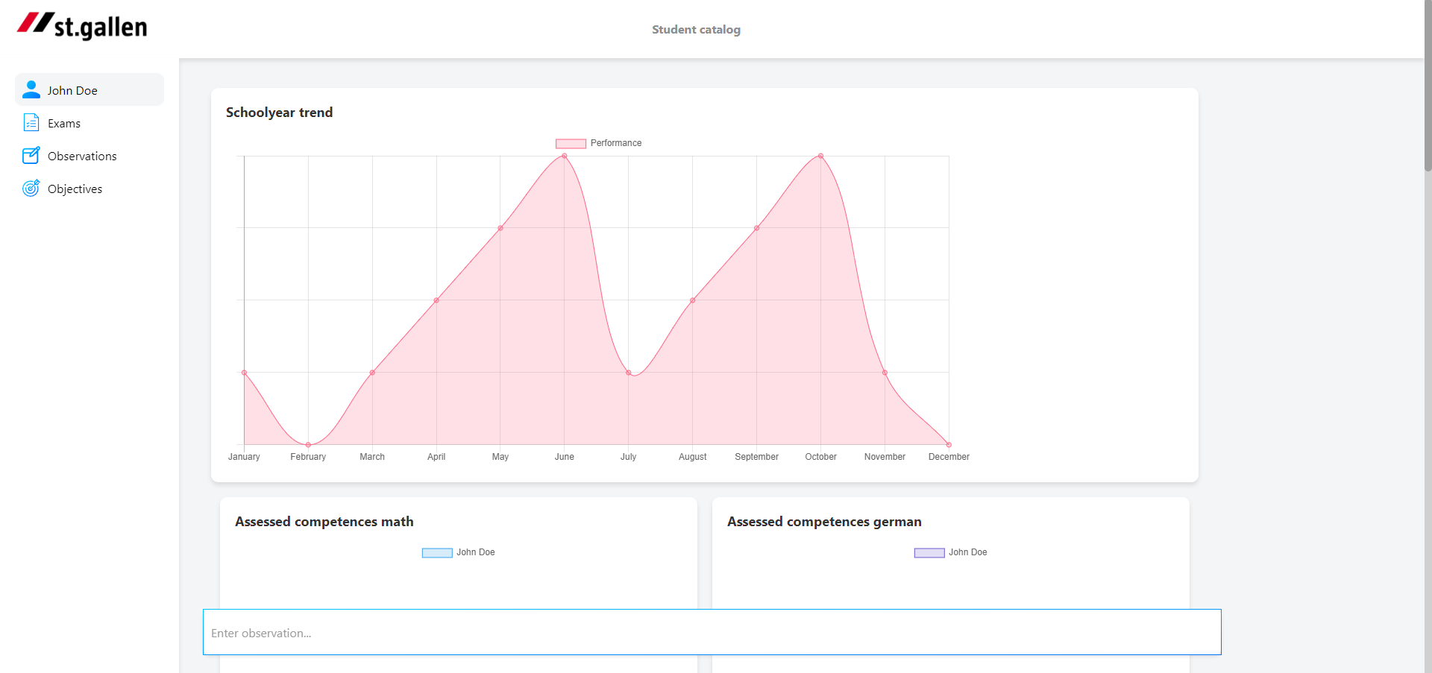
Seamlessness
Upload of exams
Quick view of student performance trends
Easy to use navigation design
Full student overview through one click

Slide 7
Automating through LLMs
Automatic scanning and algorithmic interpretation of standardized assessment grid
Deriving exam information to craft valuable insights for the present and past
Continuous analysis of observations during lessons

Slide 8
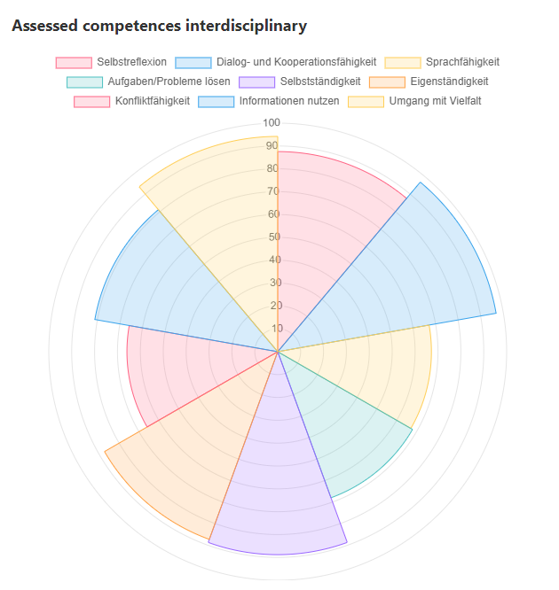
Presented data
Student performance data over past months
Analysis of Student Performance Trends in Math and German Competencies
Interdisciplinary Assessment Through Cumulative Data

