Slide 1

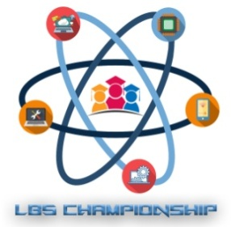

Theme : AI Project Title : Home Automation
 | LBS Championship 2020-21 (Round – I)
In association with Institute Innovation Cell (IIC)
Group Members:
Shreya Kate(EXTC, V)
Nafees Akhter(EXTC, V)
Maaroof Merchant(EXTC, V)
Khan Md. Ayan(EXTC,V)

Slide 2
Problem Statement
Home automation is still at the stage of infancy.
It is done on a smaller scale right now as home automation is still not introduced in markets as a comfort product yet.
Great strides can be made in its aesthetics while IoT can play a much more central role.

Slide 3
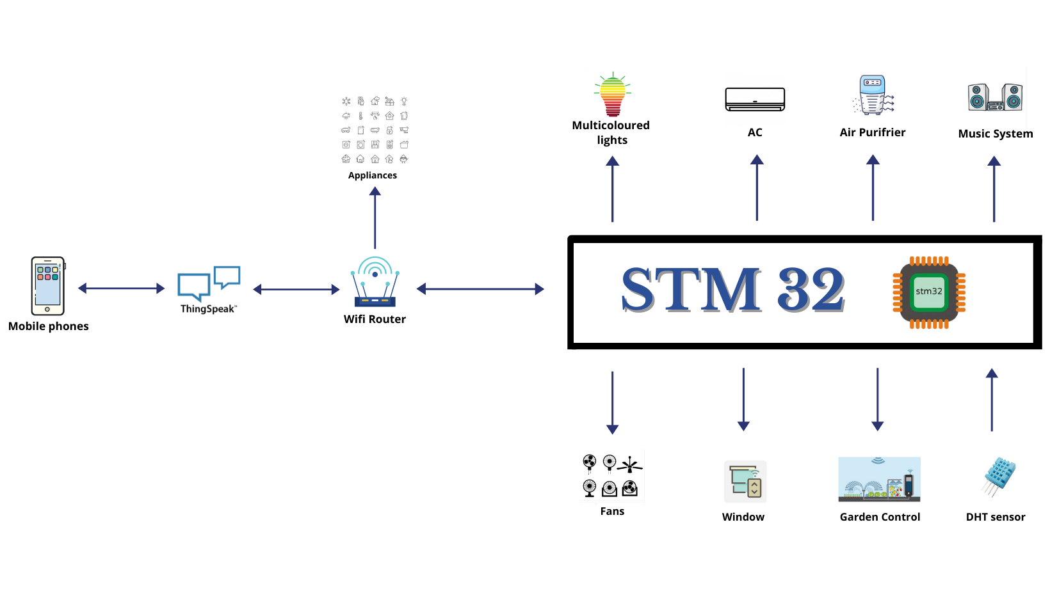
Proposed Solution

Slide 4
Comparison with Existing System
Pros | Cons
People are shifting from using conventional buttons to using remotes to control their lights and fans. Smart speakers are used to control the music system, integrated with apps like Spotify and Amazon music app they bring great comfort to listening music. | These haven’t been integrated yet. The functionality is very limited. You can’t control these devices from your phone or away from house. They don’t have the aesthetics to convince people into buying these.

Slide 5
Proposed Solution
Integrating multi color lights, air conditioners, air regulators, fans, windows and the music system.
An app to control everything, it will have a special themes tab, in which different themes can be set and configured to set the room temperature, lighting, fan’s speed and whether the windows should be opened/ closed.
User can create manual themes that can be set.
Track user’s location.

Slide 6
Benefits to Our Society
Home automation is bound to be a game changer in the business world.
As home automation is all about connecting various devices, it can make everything work efficiently and reduce energy consumption.
In such trying times these little comforts soothe our mental health and helps society on the whole to navigate these times a little more light headed than when it began.

