Slide 1
TextSum
Introduction
Automatic text summarization is the task of producing a concise and fluent summary while preserving key information content and overall meaning, we identify the important sentences or phrases from the original text and extract only those from the text.
It is used to help generalized the many Complicated paragraph that convert it into Simple and easy to comprehension.
Then this application we will be building will help you set up a simple solution for your challenge. We will call this app TextSum Web App.

Slide 2
Problem Statement
The purpose of this project is to reduce the load for people to read the entire content which is time-consuming.
To provide the benefit, which it the entire Summary rather than reading whole document/book/etc.

Slide 3
Data Preprocessing
There are two NLP package is used :
1) SpaCy :
Data are the real-time data that using pre-trained(pipeline) model “en_core_web_sm” to preprocess the data.
en_core_web_sm - is a small English pipeline trained on written web text (blogs, news, comments), that includes vocabulary, vectors, syntax and entities.
It can compare which algorithm has a more accurate prediction as well as which is time-efficient.
The Algorithm is same for both but package are different one is done by SpaCy and other is done by NLTK package.
With this we compare both package/model perform.
Both Spacy & NLTK pre-processing are same, so for code explanation see NTLK slide.

Slide 4
2) NLTK
nltk_summarization.py file explained below.
As both model use real-time data to predict.
From this we have use NLTK,Corpus,stopwords and other module to create this model.
In this file, it take raw text for text cleaning part then remove the stopwords.
we first store all the English stop words from the nltk library into a stopwords variable. Next, we loop through all the sentences and then corresponding words to first check if they are stop words.
If not, we proceed to check whether the words exist in word-frequence dictionary i.e. word_frequencies, or not. If the word is encountered for the first time, it is added to the dictionary as a key and its value is set to 1. Otherwise, if the word previously exists in the dictionary, its value is simply updated by 1.
Finally, to find the weighted frequency, we can simply divide the number of occurances of all the words by the frequency of the most occurring word.
we first create an empty sentence_scores dictionary. The keys of this dictionary will be the sentences themselves and the values will be the corresponding scores of the sentences. Next, we loop through each sentence in the sentence_list and tokenize the sentence into words.
We then check if the word exists in the word_frequencies dictionary. This check is performed since we created the sentence_list list from the article_text object; on the other hand, the word frequencies were calculated using the formatted_article_text object, which doesn't contain any stop words, numbers, etc.

Slide 5
We do not want very long sentences in the summary, therefore, we calculate the score for only sentences with less than 30 words. Next, we check whether the sentence exists in the sentence_scores dictionary or not.
If the sentence doesn't exist, we add it to the sentence_scores dictionary as a key and assign it the weighted frequency of the first word in the sentence, as its value.
On the contrary, if the sentence exists in the dictionary, we simply add the weighted frequency of the word to the existing value.
we have the sentence_scores dictionary that contains sentences with their corresponding score. To summarize the article, we can take top 7 sentences with the highest scores

Slide 6
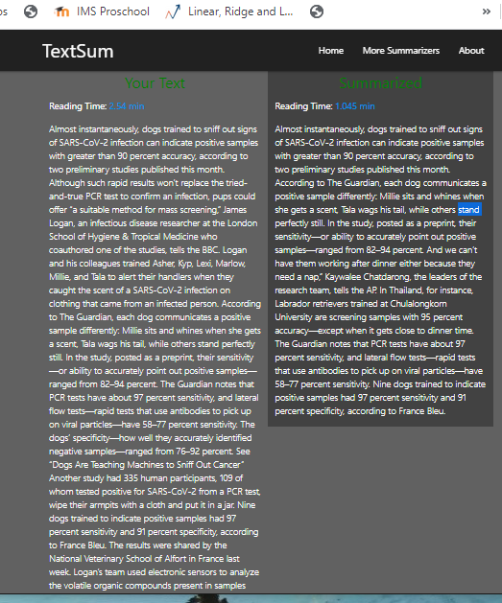
Working
In this project user can summarize whole website links
as well as, if user want summarize only few paragraph.
1) Summarize with Article
Article link

Slide 7
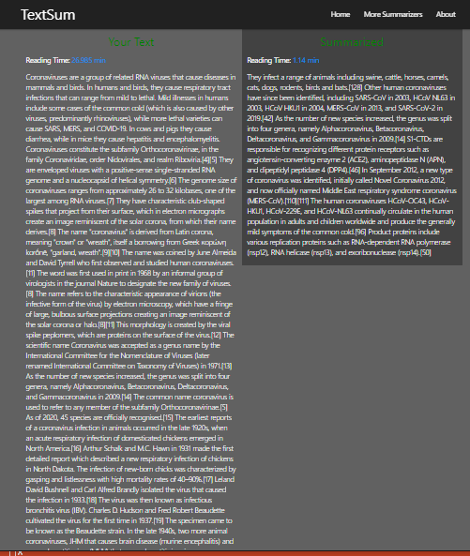
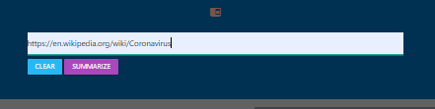
Summarize using website links.

Slide 8
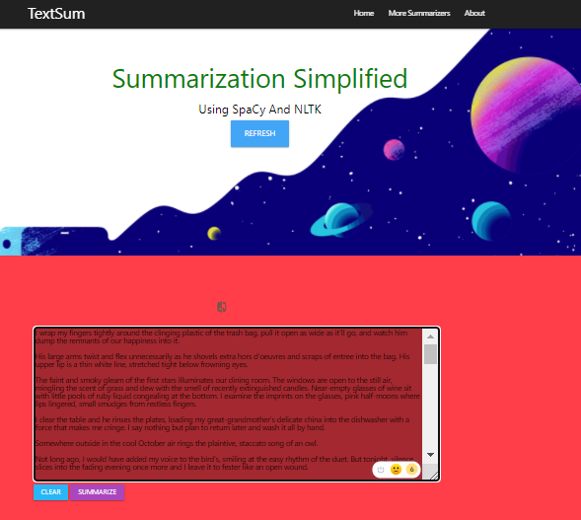
Comprasion between SpaCy & NLTK
This application used to see which algorithm/model is accurate & time saver.
We also see the time taken by both to summarize the article/story.
The example used in this is short story of “What’s Left”.

Slide 9
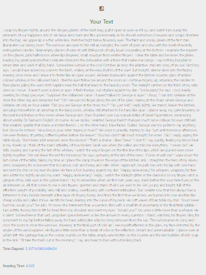
Spacy Summarizer
Your Text

Slide 10
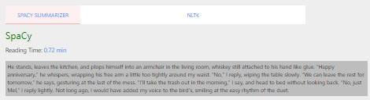
Applying SpaCy on text to predict

Slide 11
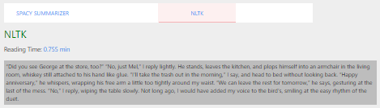
Applying NLTK on Text

Slide 12
THANK YOU

