Slide 1
WD76 Mini Project 1
Category: Travel Blog Website
July 24, 2023
Presented By: Chanrado C. Quiambao

Slide 2
1Travel
1Bataan = Symbol of the state the meaning of the Official Seal of Bataan . (Official)
1Travel = Symbol of the provincial tourism of Bataan. (Fictional)
1Travel have a partnership with the Provincial Government of Bataan or 1Bataan related in tourism. The number 1 mission of the partnership is to boost the tourism in the Province of Bataan. (Fictional)
1Travel is for the people who wants to go to vacation at the sametime the location is near to the NCR and other tourist destination in Central Luzon.
The user’s can expect special promos in our website, and make accomodations transactions in our website with our tiedup hotels and resorts in Bataan.
1Travel number 1 aim is to give a once in a lifetime experience with our guest during there vacation.

Slide 3
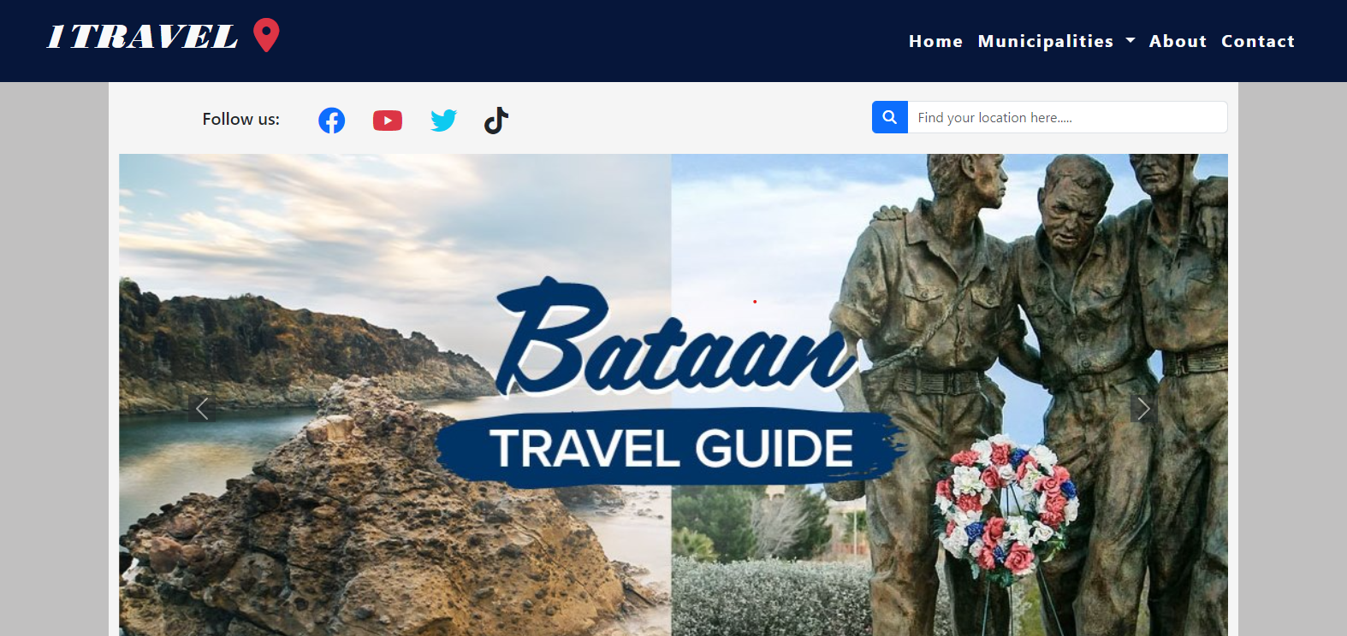
For the appearance of my home page, I choose to use the same color that the Province of Bataan are using on their official website.

Slide 4
Color:
(RGB 24 45 76)
(RGB 100 91 90)
(Bootsrap”PRIMARY”)
(Bootsrap”LIGHT”)
Font:
Bodoni MT Black
Bootstrap Default Font
For the color I use 4 types of color, RGB 24 45 76, RGB 100 91 90, PRIMARY & LIGHT
For font I use 2 types of font stye Bodoni MT Black & Bootstrap Default

Slide 5
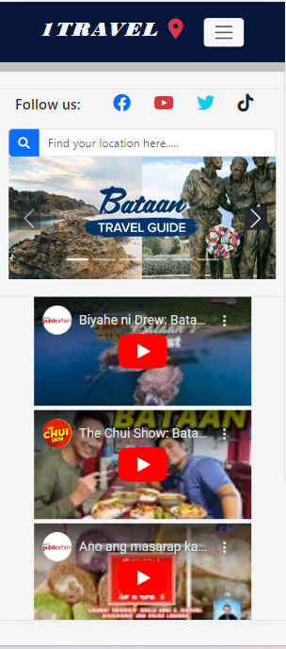
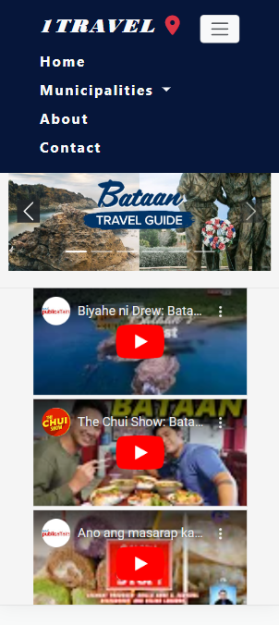
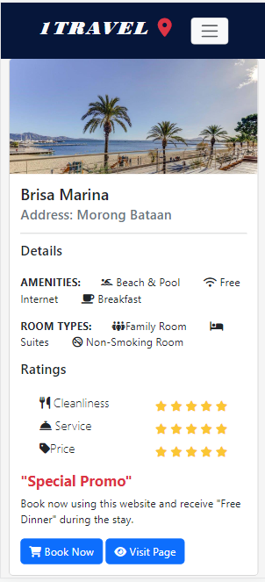
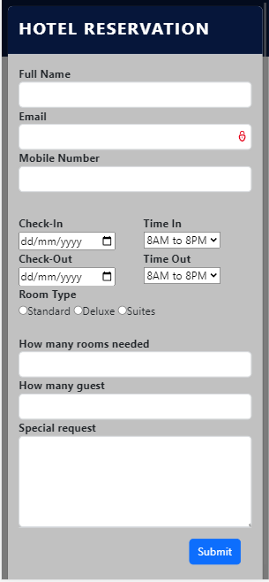
RESPONSIVENESS OF THE WEBSITE

