Slide 1



Slide 2
Introduction
Apache Spark is a unified computing engine and a set of libraries for parallel data processing.
Distributed, Highly scalable, In-memory data analytics system.
Why In-memory system is needed ?

Slide 3
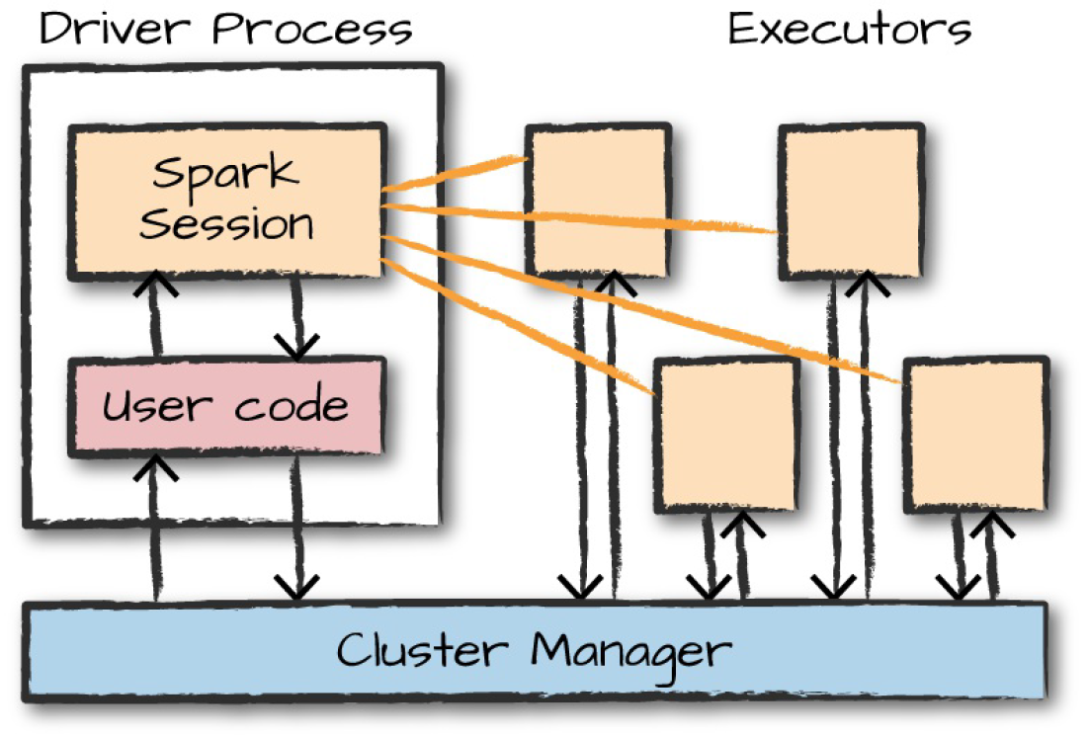
Spark’s Concepts
Spark Application –
High Level Architecture

Slide 4
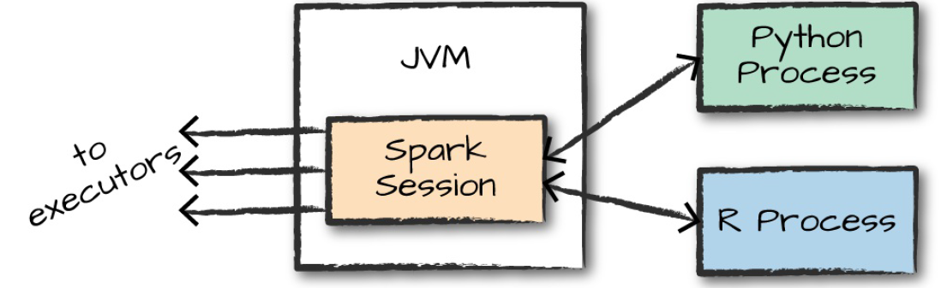
Spark’s Concepts
Spark’s Language API
Scala, Java, Python, SQL, R.

Slide 5
Spark’s Concepts
Spark Session – the driver process
Data Frames
Most common structured API
RDD (Resilient Distributed Datasets
Partitions
Transformations
Narrow transformation
Wide transformation
Lazy Evaluation
Actions

Slide 6
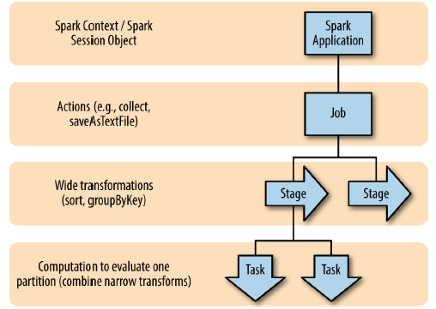
Anatomy of a Spark Job

Slide 7
Anatomy of a Spark Job
Execution details
Pipelining
Shuffle persistence

Slide 8
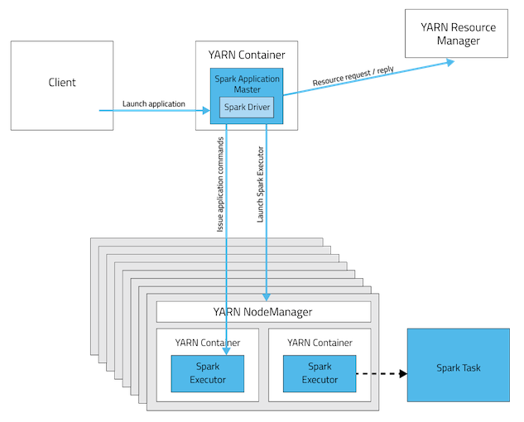
Spark on Yarn
Cluster Deployment Mode

Slide 9
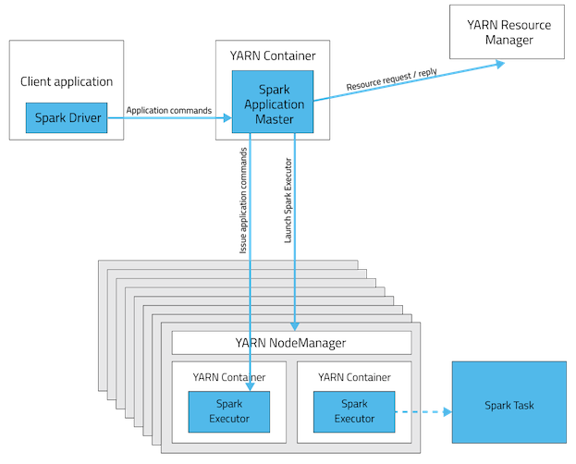
Spark on Yarn
Client Deployment Mode

Slide 10
Configurations
Dynamic Executor Allocation
Benefit
Limitation

Slide 11
Hive on Spark
 | Memory | CPU
Hive on Spark | Minimum: 16 GB Recommended: 32 GB for larger data sizes Individual executor heaps should be no larger than 16 GB so machines with more RAM can use multiple executors. | Minimum: 4 cores Recommended: 8 cores for larger data sizes

Slide 12
Thank you

