Slide 1

Employee Attrition Analysis
Green Destinations Travel Agency
Prepared by - Aman Khan

Slide 2
Table of contents
01
02
03
04
Attrition by Age
Attrition Rate Overview
Attrition by Years at Company
Attrition by Monthly Income

Slide 3
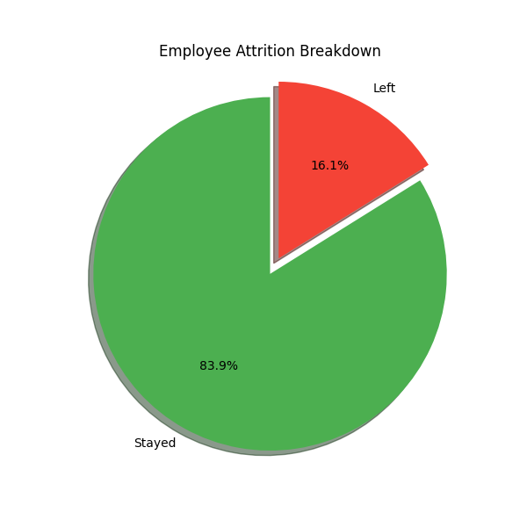
01
Attrition Rate Overview

Slide 4
Green Destinations has a total of 1,470 employees.
237 employees have left the company over the recorded period.
This results in an attrition rate of 16.12%.
The majority of the workforce (84%) has remained.
While not alarming, the attrition rate is worth monitoring to avoid future talent gaps.
Metrics | Value
Total Employees | 1,470
Employee Who Left | 237
Employee Who Stay | 1,233
Attrition Rate | 16.12%

Slide 5
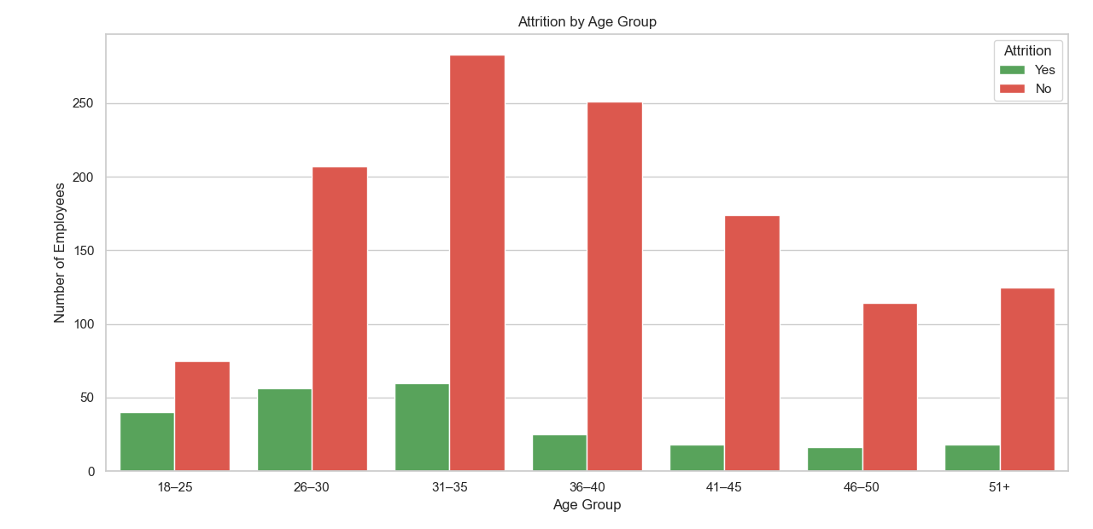
Attrition by Age
02
Younger employees (under 35) have the highest attrition rate.
Attrition tends to decrease with age and experience.
May indicate dissatisfaction, lack of growth opportunities, or job exploration in early careers.
Suggests the need for early-career engagement and support.

Slide 6
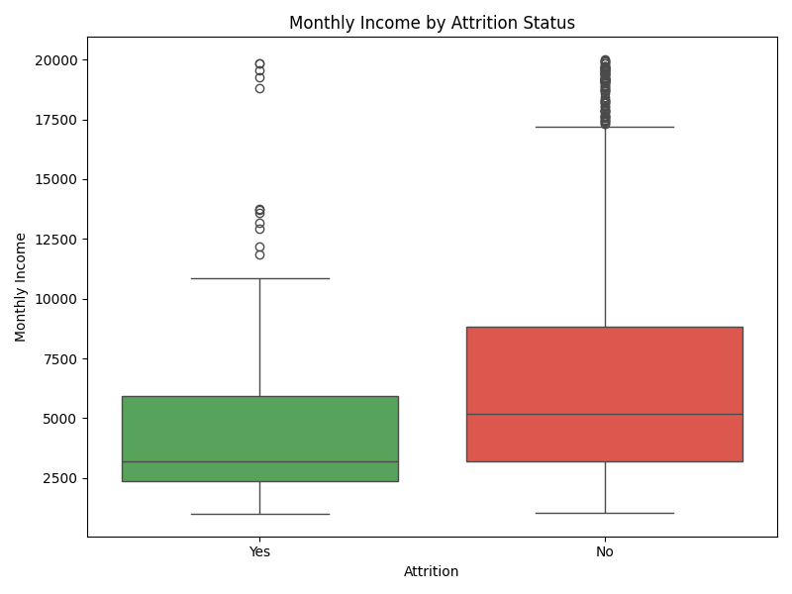
Attrition by Monthly Income
03
• Employees who left to earn less than those who stayed.
• The median income of attrited employees is significantly lower.
• Very few high earners have left the company.
• Suggests income may influence employee retention and satisfaction.

Slide 7
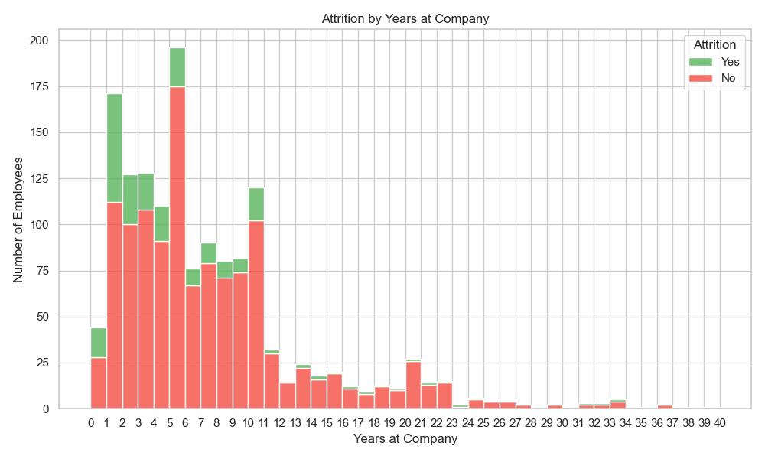
Attrition by Years at Company
04

Slide 8
Brief Analysis
The highest attrition occurs within the first 1–3 years of employment, with a noticeable spike at year 1 and year 2.
Attrition significantly drops after year 4 and becomes minimal beyond year 6.
This suggests that most employees who stay past the early years are likely to remain long-term. It emphasizes the need for stronger onboarding, engagement, and support programs during the initial employment period.

Slide 9
Key Recommendation
Improve Onboarding Experience for New Hires
Why? Your analysis shows that most employees leave within their first 1–3 years — especially in year 1.
What to say / include:
Design a structured onboarding plan with mentorship, training, and regular check-ins.
Help new hires feel connected to the company culture and mission from day one.
Provide clarity on roles, expectations, and growth paths early.

Slide 10
2. Offer Competitive Salaries in High-Turnover Roles
Why? The data showed lower-income employees have a significantly higher attrition rate.
What to say / include:
Review salary benchmarks for roles with high exit rates.
Consider performance-based incentives, bonuses, or benefits.
Conduct a compensation review every 6–12 months.
3. Conduct Stay Interviews and Employee Feedback Sessions
Why? Instead of waiting for exit interviews, "stay interviews" help uncover issues before employees decide to leave.
What to say / include:
Schedule regular 1:1s with employees to understand satisfaction, motivation, and blockers.
Ask questions like: “What keeps you here?” and “What would make you leave?”
Use the insights to proactively address concerns and improve morale.

Slide 11
Conclusion
• Green Destinations is experiencing notable attrition, especially among new, younger, and lower-income employees.
• Key factors influencing attrition include age, tenure, and monthly income.
• Early intervention strategies like onboarding, competitive pay, and feedback mechanisms can help reduce turnover.
• Data-driven decision-making can empower HR to improve employee satisfaction and retention.

