Slide 1

Gender-Based Hate Comment Detection with NLP
Team-04
Members:
Atikur Rahman - 20301440
Nabila Islam Borno - 20301117
Ashfiqun Ahmed Miftah - 20301249
Gazi Asif Imtiaz - 20301616

Slide 2
Introduction
Gender-based hate comments
Targeted individuals
Methods to detect hate comments using NLP

Slide 3
What is Gender-Based Hate Comment Detection?
Gender-based hate comment detection refers to the process of identifying and flagging comments that express hatred or discrimination towards individuals based on their gender. These comments can range from subtle micro-aggressions to explicit threats of violence.

Slide 4

Why is Gender-Based Hate Comment Detection Important?
Combating online harassment
Promoting gender equality
Enhancing content moderation

Slide 5
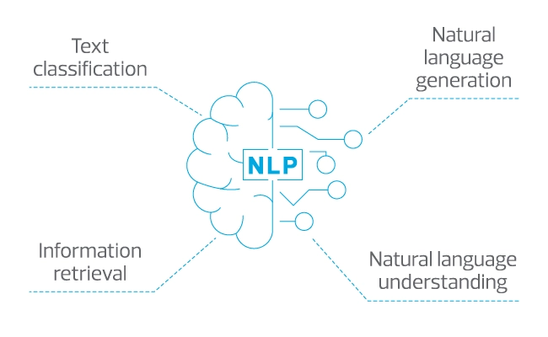
How Does NLP Help Detect Gender-Based Hate Comments?
Natural language processing (NLP) is a subfield of AI that focuses on the interaction between computers and human languages.
NLP has diverse applications, including sentiment analysis, speech recognition, and machine translation.
In gender-based hate comment detection, NLP algorithms can identify patterns and features in the language used by perpetrators.
NLP techniques can analyze word frequency, detect derogatory terms or slurs, identify sarcasm or irony, and determine the gender of the victim and perpetrator.

Slide 6
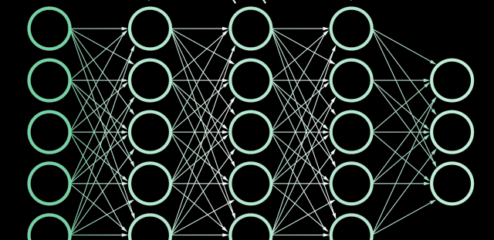
Gender-Based Hate Comment Detection Using Neural Network in NLP
The neural network is trained on a large dataset of gender-based hate comments and non-hate comments.
The model learns patterns and features that distinguish between hate and non-hate comments.
NLP techniques such as tokenization, word embeddings, and sequence modeling are employed to process and understand the textual content and context.
The neural network adjusts its internal parameters through iterative learning (backpropagation) to improve its accuracy in detecting gender-based hate comments.
Once trained, the model can classify new comments as hate or non-hate speech based on learned patterns and features.

Slide 7
Ideas for Future Work
Improve accuracy of gender identification in comments
Incorporate additional linguistic features.
Train the model on more diverse datasets.
Develop methods to detect intersectional hate comments
Expand the scope of models to analyze multiple identity markers (race, gender, etc.)
Consider intersectionality to address multiple marginalized identities.

Slide 8
Conclusion
Importance of gender-based hate comment detection
Goal of creating safe and respectful online spaces
Focus on research and development

