Slide 1
Cyclistic case study

Slide 2
Business task
Analyze data to show the differences of how annual members and casual riders use Cyclistic bikes.

Slide 3
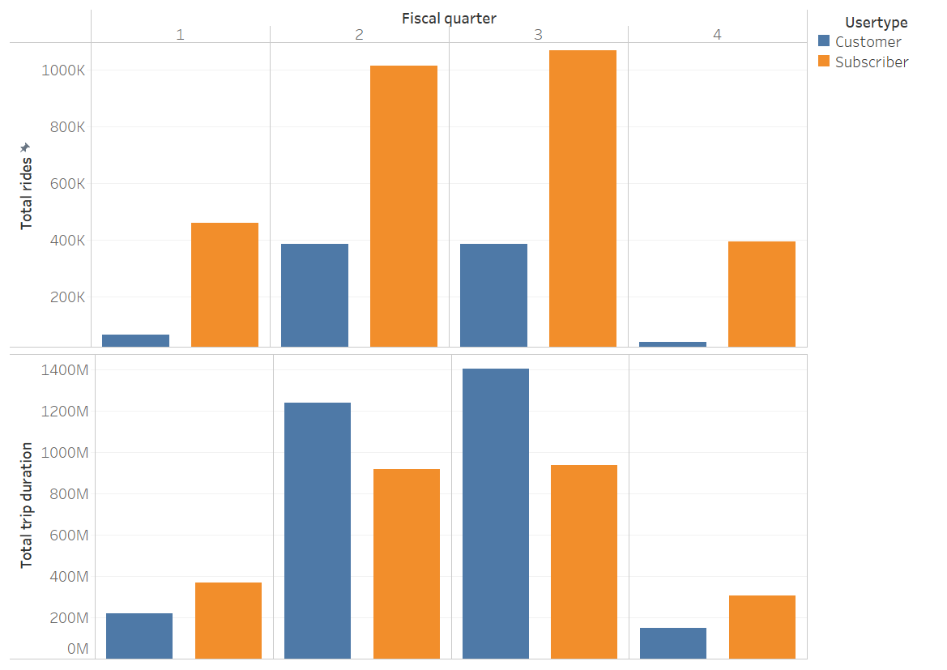
Subscribers took significantly more rides per quarter.
Customers had longer trip durations, peaking in Quarter 3.
→ Subscribers commute, while customers ride for leisure/exercise.

Slide 4
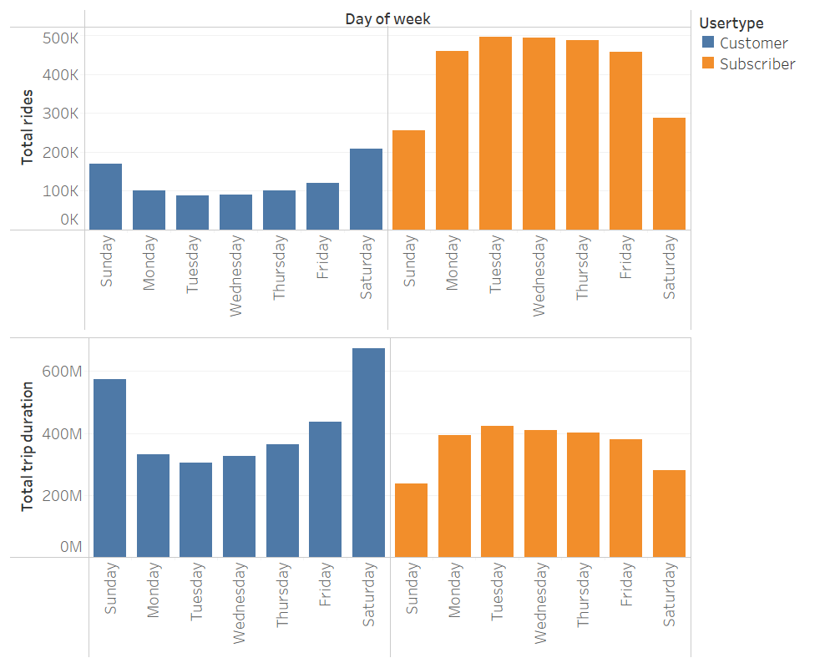
Subscribers ride more on weekdays, mainly for commuting, with fewer rides on weekends.
Customers ride more on weekends for leisure and take longer rides throughout the week, likely for exercise on weekdays.
Subscribers have steady weekday durations, while customers prioritize ride length.

Slide 5
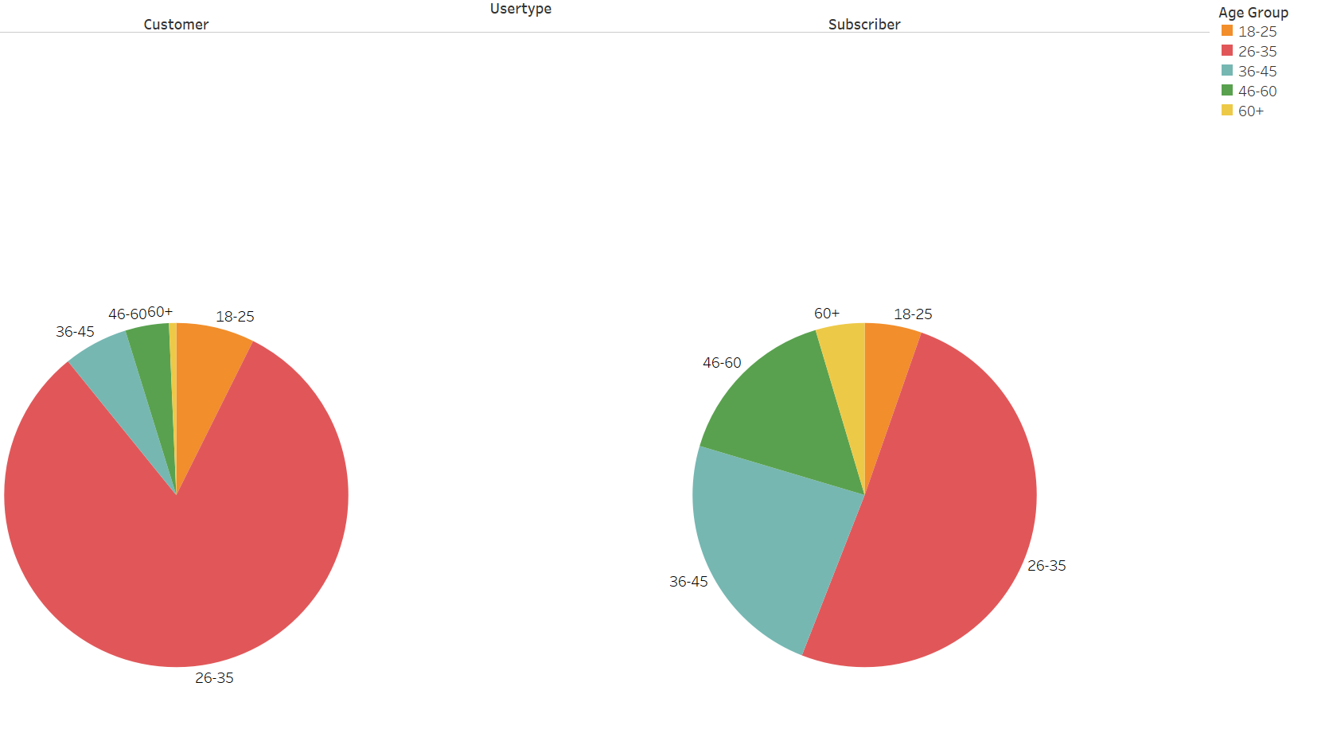
AGE
The 26-35 age group dominates, with 81% of customers but only 50.5% of subscribers.

Slide 6
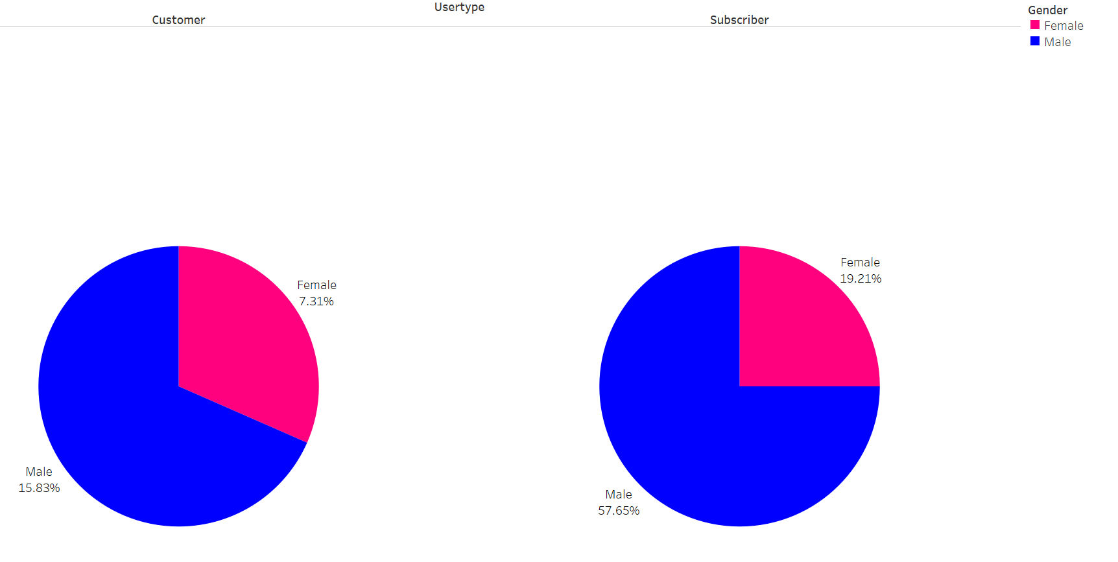
GENDER
Female subscribers are 7% fewer than female customers.

Slide 7
Recommendations
Annual plan for weekday commuters (5 days a week).
Annual plan for regular exercisers and promoting it.
Apply discount on women special days to attract more women subcribers
Rewards for Frequent Riders

