Slide 1



Sentiment Analysis An experiment on CNN and LSTM models
Ta Gia Khang
khang.ta1902@hcmut.edu.vn

Slide 2
Agenda
Motivation and Problem Description
Background: LSTMs and CNNs
Methodologies: Data preprocessing and experiments
Experiment Result and Observation
Conclusion

Slide 3
Motivation and Problem Description

Slide 4
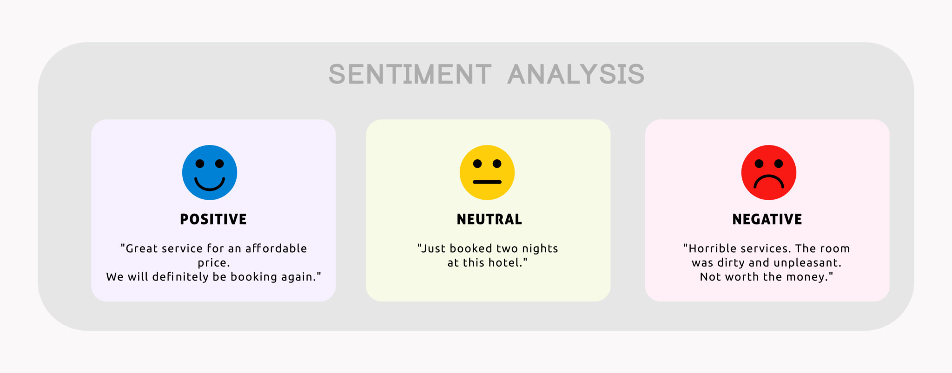
Motivation
The evolution of social media platforms and blogs led to an abundance of comments and reviews on everyday activities
Need to learn from the customer opinion (text mining)

Slide 5
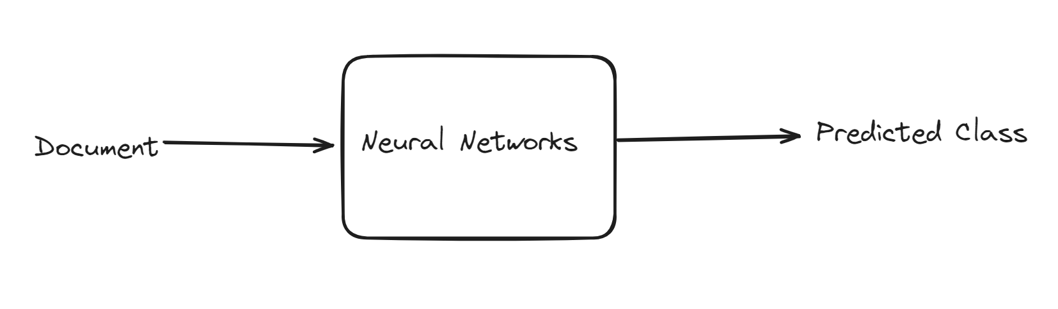
Problem Description
Sentiment Analysis is a Text Classification problem:
• Input: a sentence (document). • Output: the emotional class of that sentence.
→ We can try to use ANNs for this task
→ If only able to use LSTM and CNN, what is the best architecture for this task?

Slide 6
Background: LSTMs and CNNs

Slide 7
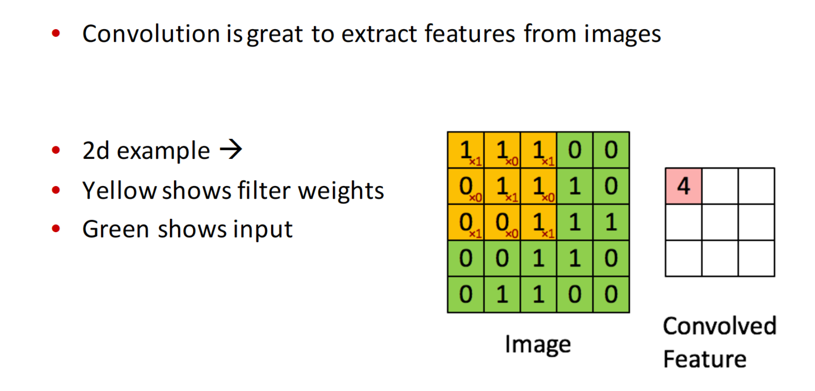
Convolution for feature extraction

Slide 8
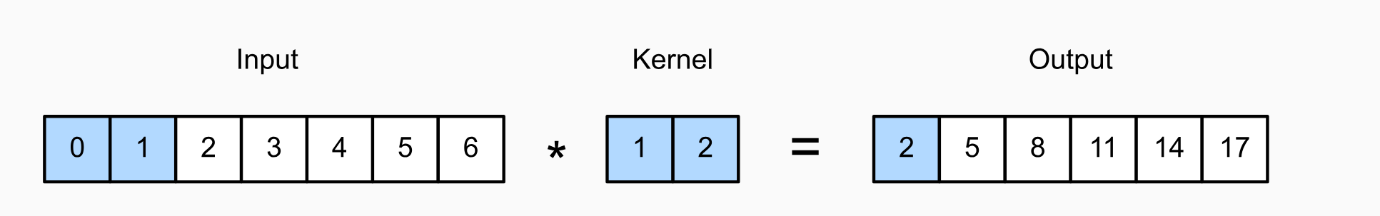
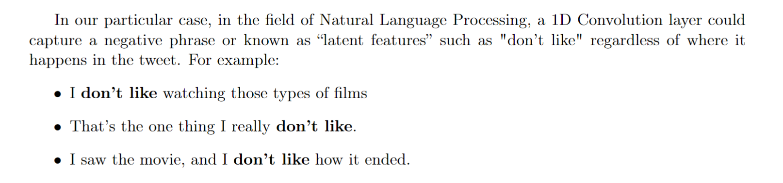
Convolution for feature extraction
Example for 1D: One-dimensional cross-correlation operation. The shaded portions are the first output element as well as the input and kernel tensor elements used for the output computation: 0x1+1x2=2

Slide 9
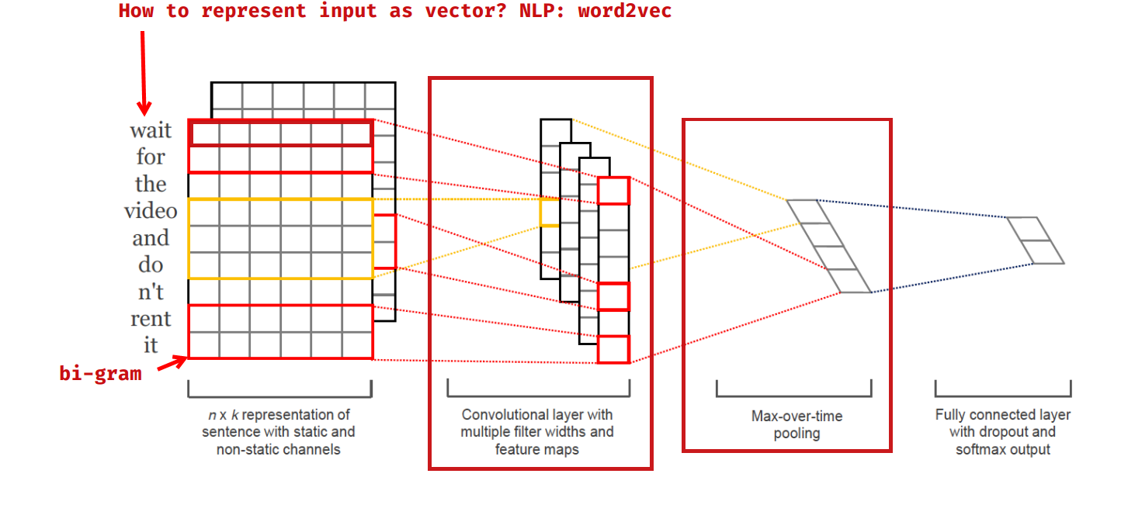
Convolution for feature extraction
In practice, more than one Conv1D filter is used in a layer in order to capture more latent features from our samples.
A general architecture of using multiple filter of Convolution layer in neural network

Slide 10
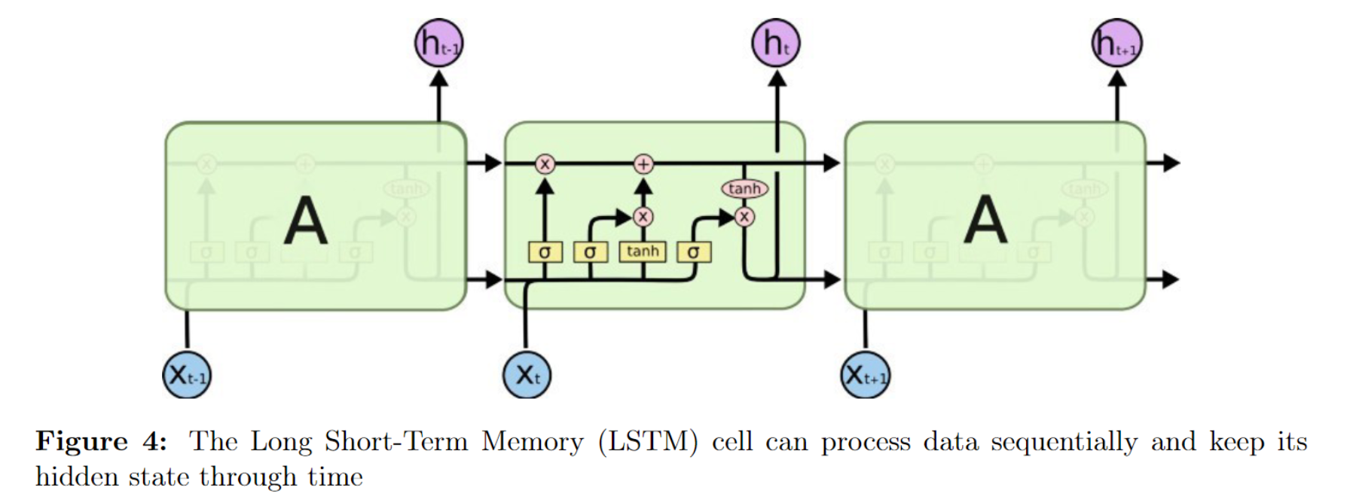
LSTMs for sequential data
- Long-Short Term Memory (LSTMs) is a type of recurrent neural network that has a memory that "remembers" previous data from the input and makes decisions based on that knowledge.
- These networks are more directly suited for written data inputs, since each word in a sentence has meaning based on the surrounding words (previous and upcoming words).
﻿Ralf C. Staudemeyer, Eric Rothstein Morris I. (2019). Understanding LSTM -- a tutorial into Long Short-Term Memory Recurrent Neural Networks

Slide 11
LSTMs for sequential data
“Used to really like Samsung, but now discovered that Samsung’s screen quality is deteriorating, so feeling a bit bored.”
→ The LSTM could learn that sentiments expressed towards the end of a sentence mean more than those expressed at the start.

Slide 12
Methodologies: Data preprocessing and Experiments

Slide 13
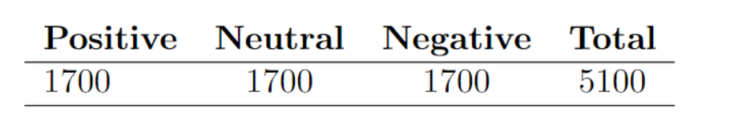
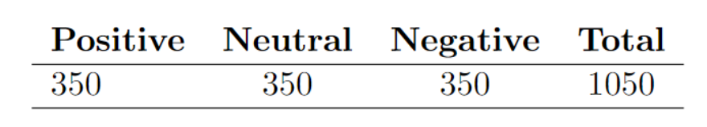
Dataset
- Using the dataset of the VLSP Contest, which include many comments for technology devices in social network.
- Each comment is labeled with one emotional class which is -1, 0, 1 for Negative, Neutral and Positive.
Training set:
Test set:

Slide 14
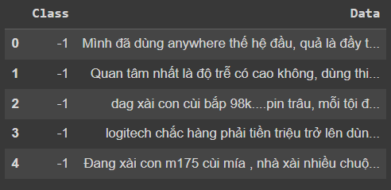
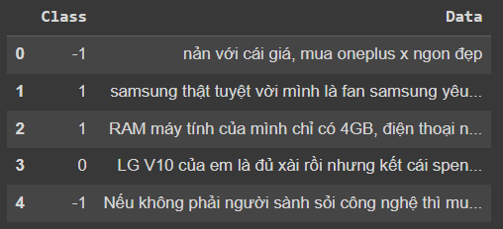
Data Preprocessing
Data distribution:
The initial dataset cannot be used immediately because the data distribution is not good (group each label together), so we had done one more step: Shuffle the dataset using Sklearn shuffle function to create random distribution of data.
→ Avoid overfitting

Slide 15
Data Preprocessing
Vectorize the label
Change label into one-hot vector: Initially our class is in the set of -1, 0, 1, for computation purpose, we change each value into one-hot vector, which is easier to compute loss later.
-1 → [1, 0, 0]
0 → [0, 1, 0]
1 → [0, 0, 1]

Slide 16
Data Preprocessing
3. Document Tokenize
We used PyVi, a crucial package specifically designed for processing Vietnamese text data.
Chose ViTokenizer as our Tokenizer for this experiment.
4. Word Embedding (W2vec)
Used the given vi-model-CBOW with EMBEDDING DIMENSION = 400.
This is achieved by placing semantically similar words closer in the vector space, thereby allowing algorithms to understand and leverage these semantic relationships.

Slide 17
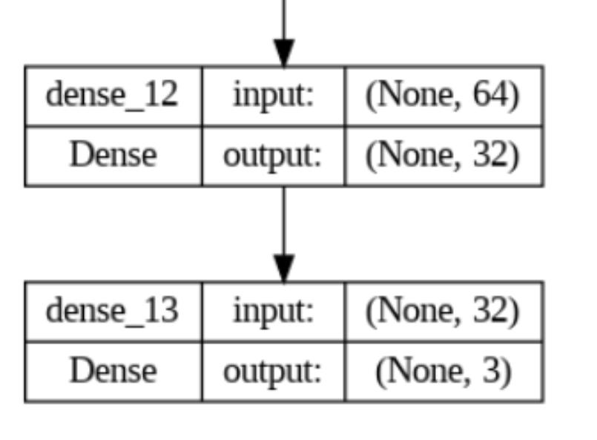
Classification Head
Involves one hidden layers, each with 32 units, and employed the ReLU activation function.
The output layer consists of three units, activated by Softmax. Additionally, to prevent overfitting, we applied L2 regularization with a coefficient of 0.01 to each layer.

Slide 18
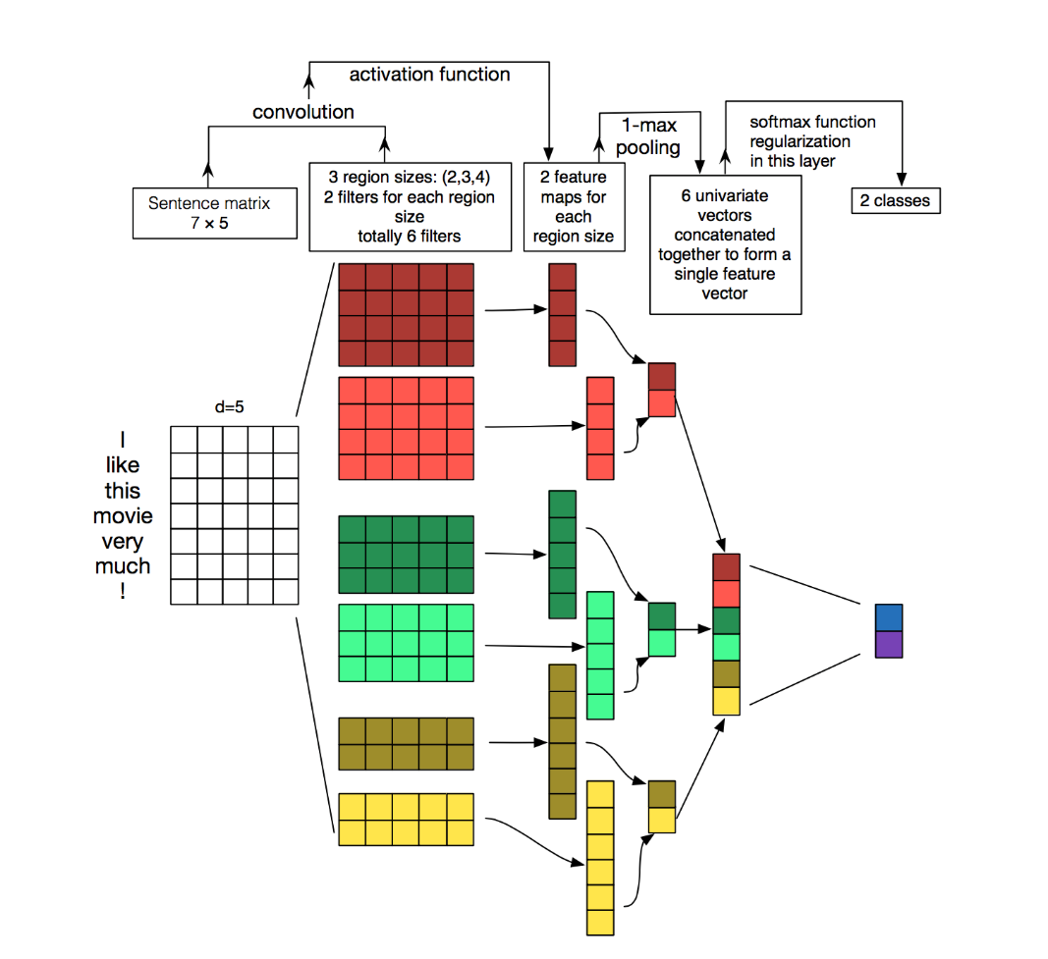
CNN Architecture
Use multiple filter in a layer, and use multiple filter size
output

Slide 19
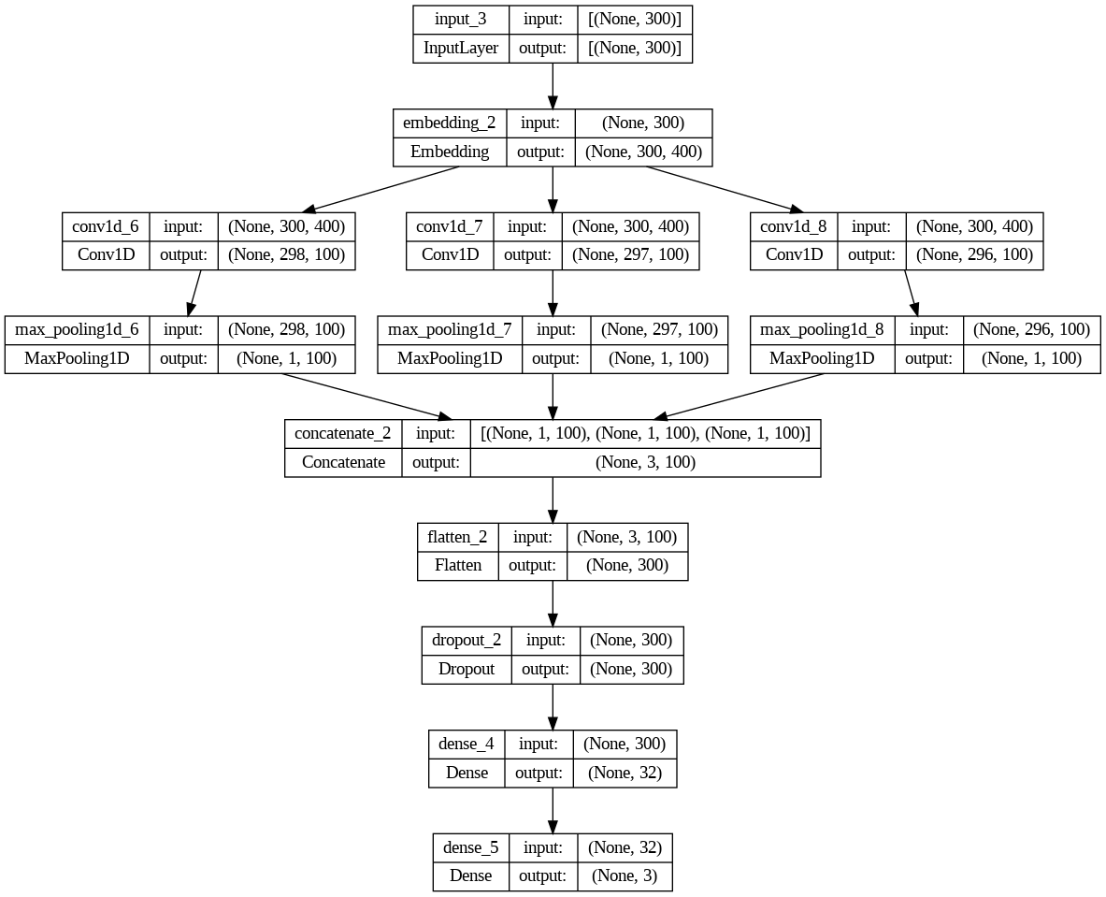
CNN Architecture
Implemented Architecture in TensorFlow:

Slide 20
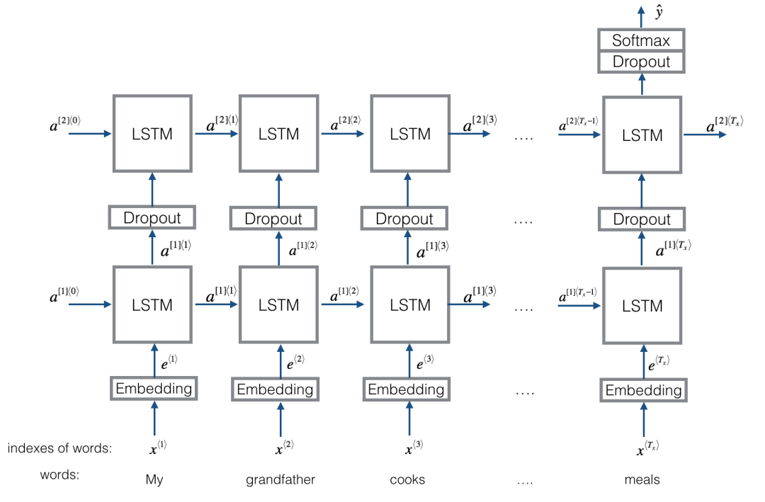
LSTM Architecture
•Proposed Architecture:

Slide 21
LSTM Architecture
Modify: Use Bidirectional LSTM
• The main advantage of a bidirectional LSTM is that it can learn positional features from both side.
• The disadvantage of a bidirectional LSTM is that it needs more parameter and compute take more time.

Slide 22
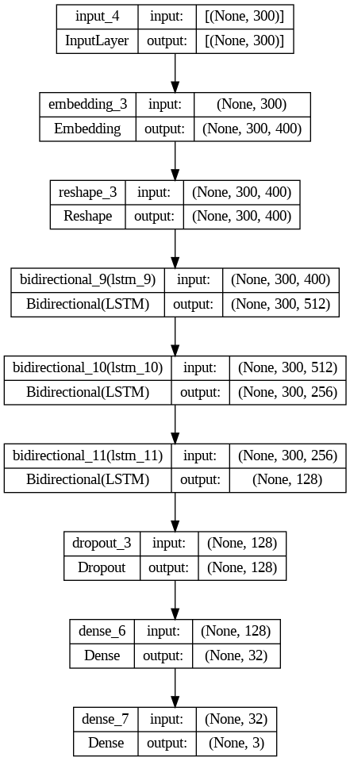
LSTM Architecture
Implemented Architecture in TensorFlow:

Slide 23
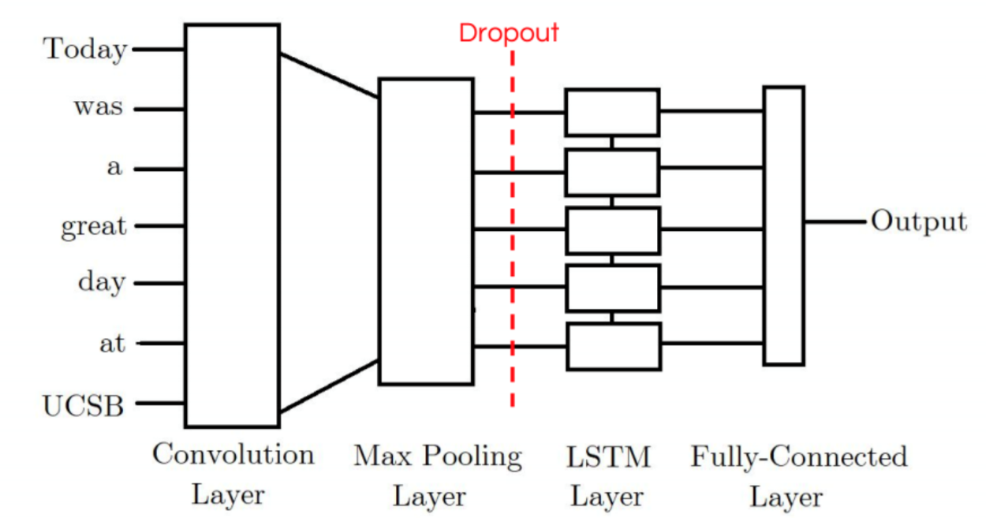
CNN-LSTM Architecture (1)
Simple CNN-LSTM model: Use one Conv1D layer with MaxPooling and LSTM layer

Slide 24
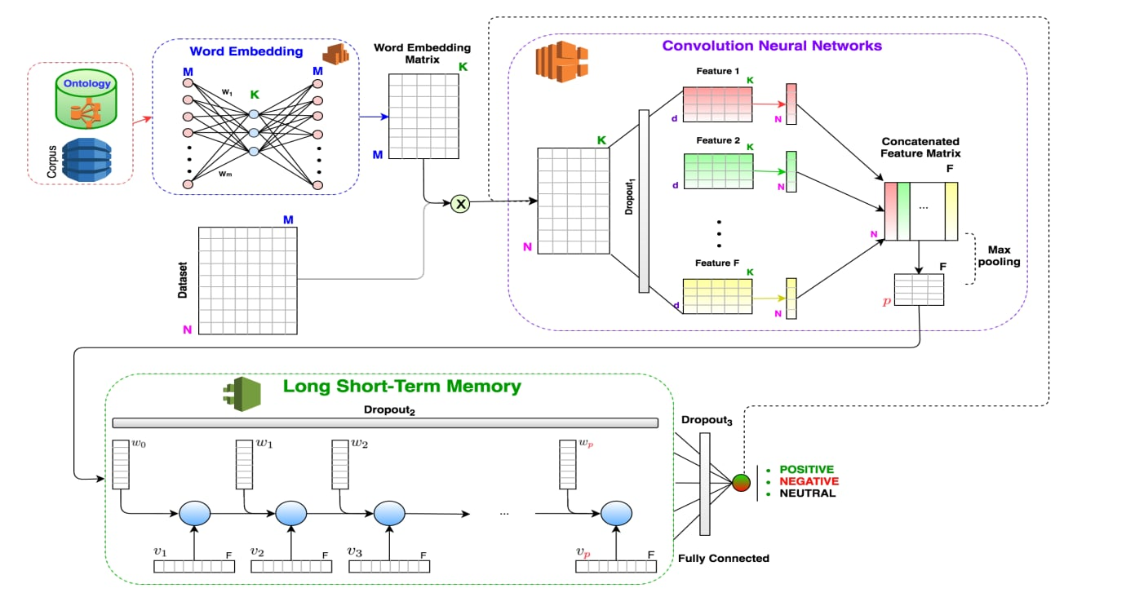
CNN-LSTM Architecture (2)
Use architecture from CNN-only Model

Slide 25
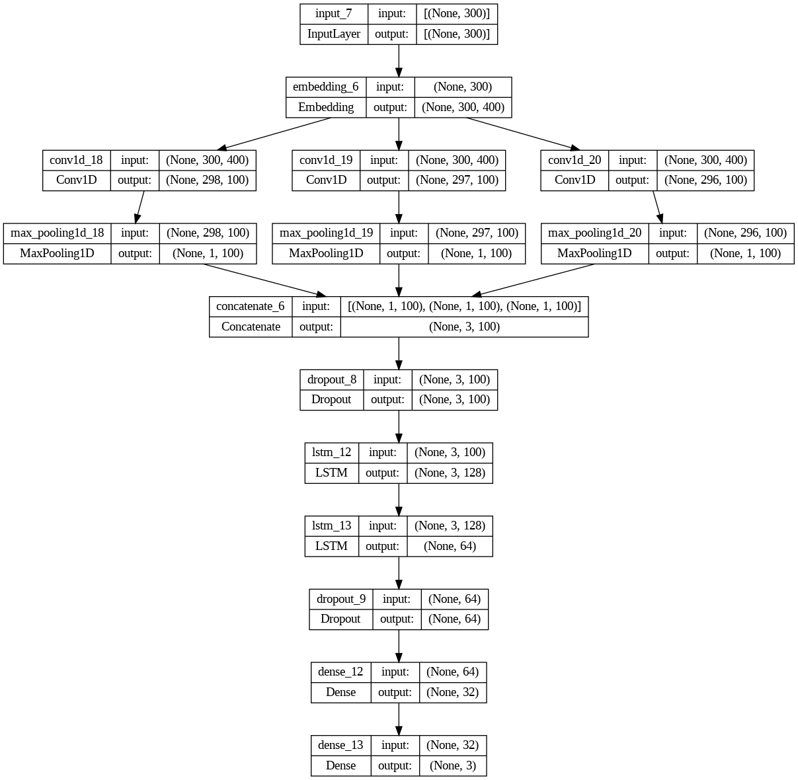
CNN-LSTM Architecture (2)

Slide 26
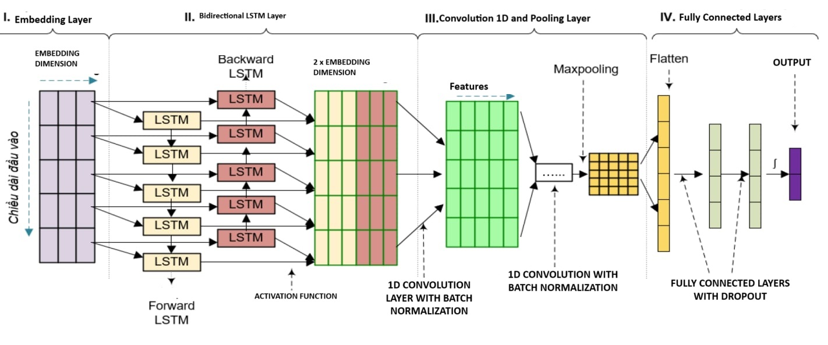
LSTM-CNN Architecture

Slide 27
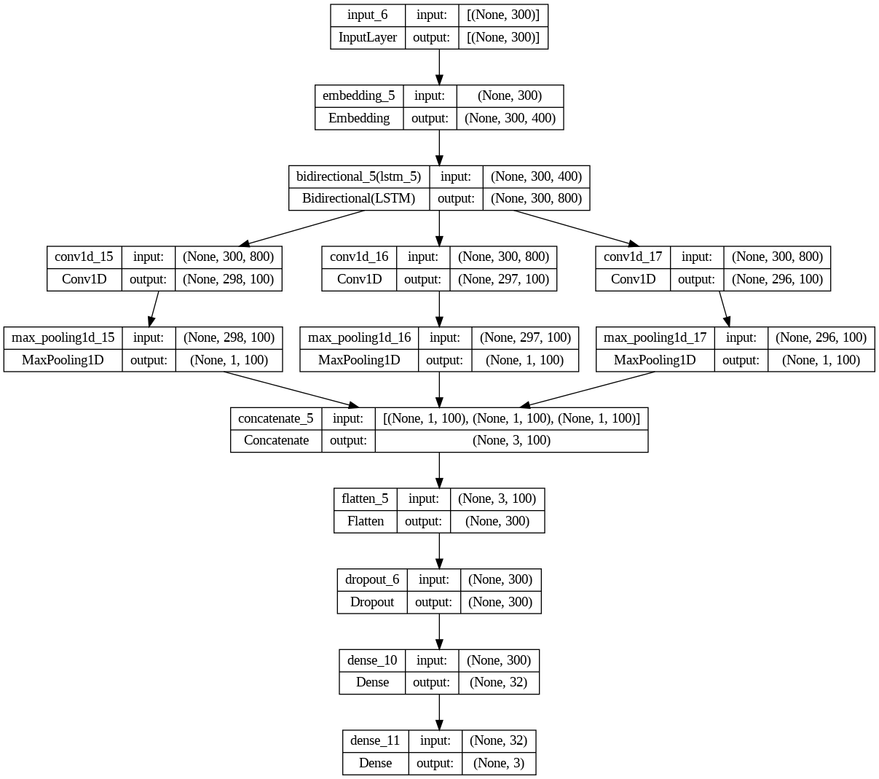
LSTM-CNN Architecture

Slide 28
Experimental Result

Slide 29
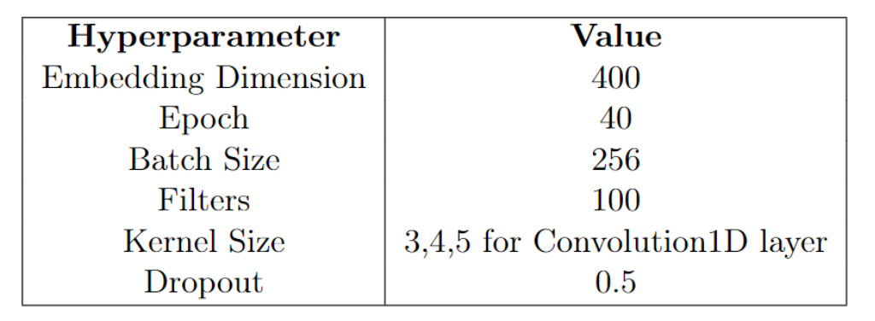
Environment Setup

Slide 30
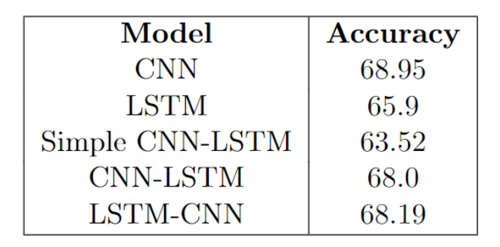
Evaluation

Slide 31
Observation

Slide 32
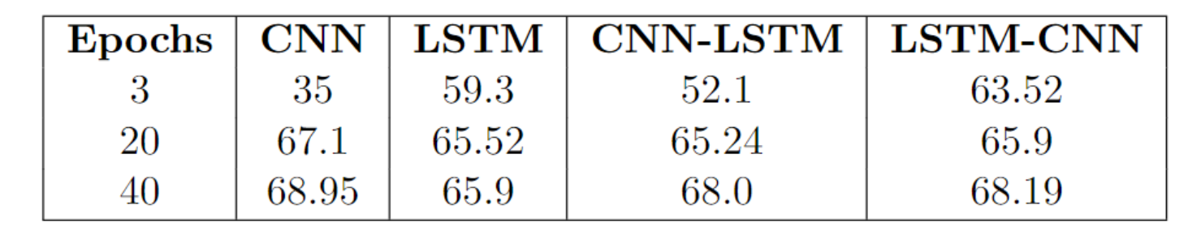
Learning rates
• CNN and CNN-LSTM model need more epoch to learn and overfit less quickly, as opposed to LSTM and LSTM-CNN models.

Slide 33
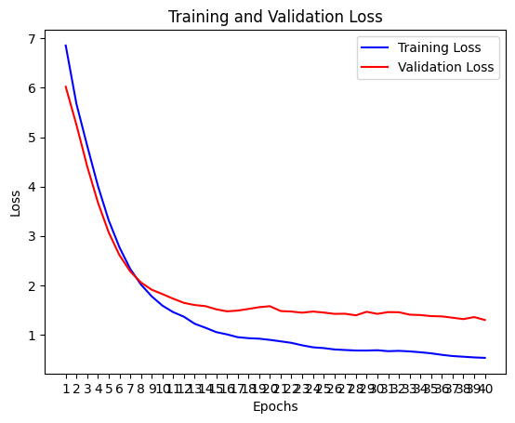
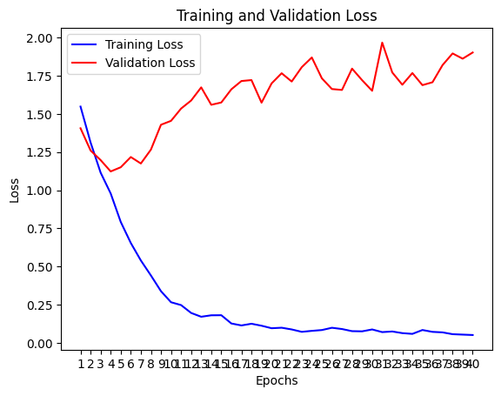
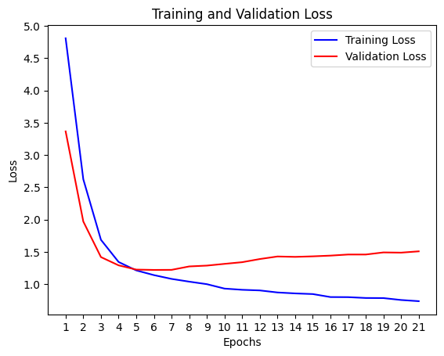
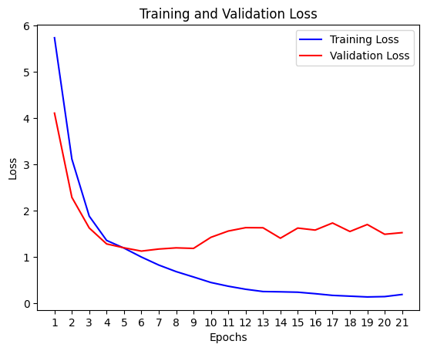
Learning rates
CNN
LSTM
CNN-LSTM
LSTM-CNN

Slide 34
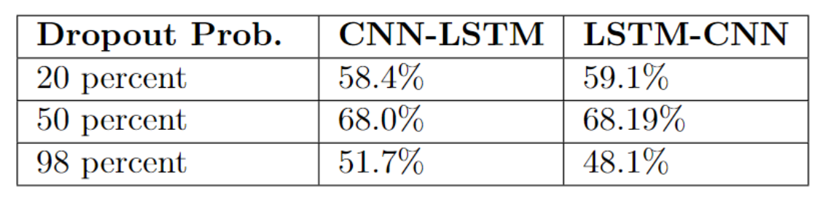
Drop rates
It is important to add a Dropout layer after any Convolutional layer in both CNN-LSTM and LSTM-CNN model to enhance better result.

Slide 35
Conclusion

Slide 36
Thank you Thank you for listening!

