Slide 1
WEB PROGRAMMING 1
Javascript
GREENWICH UNIVERSITY
Author: Sang Do

Slide 2
Outline
What is Javascript?
Samples
Javascript basic
Exercises

Slide 3
What is Javascript?
Javascript is not Java
A programming language that runs in the browser only (front-end)
No compilation

Slide 4
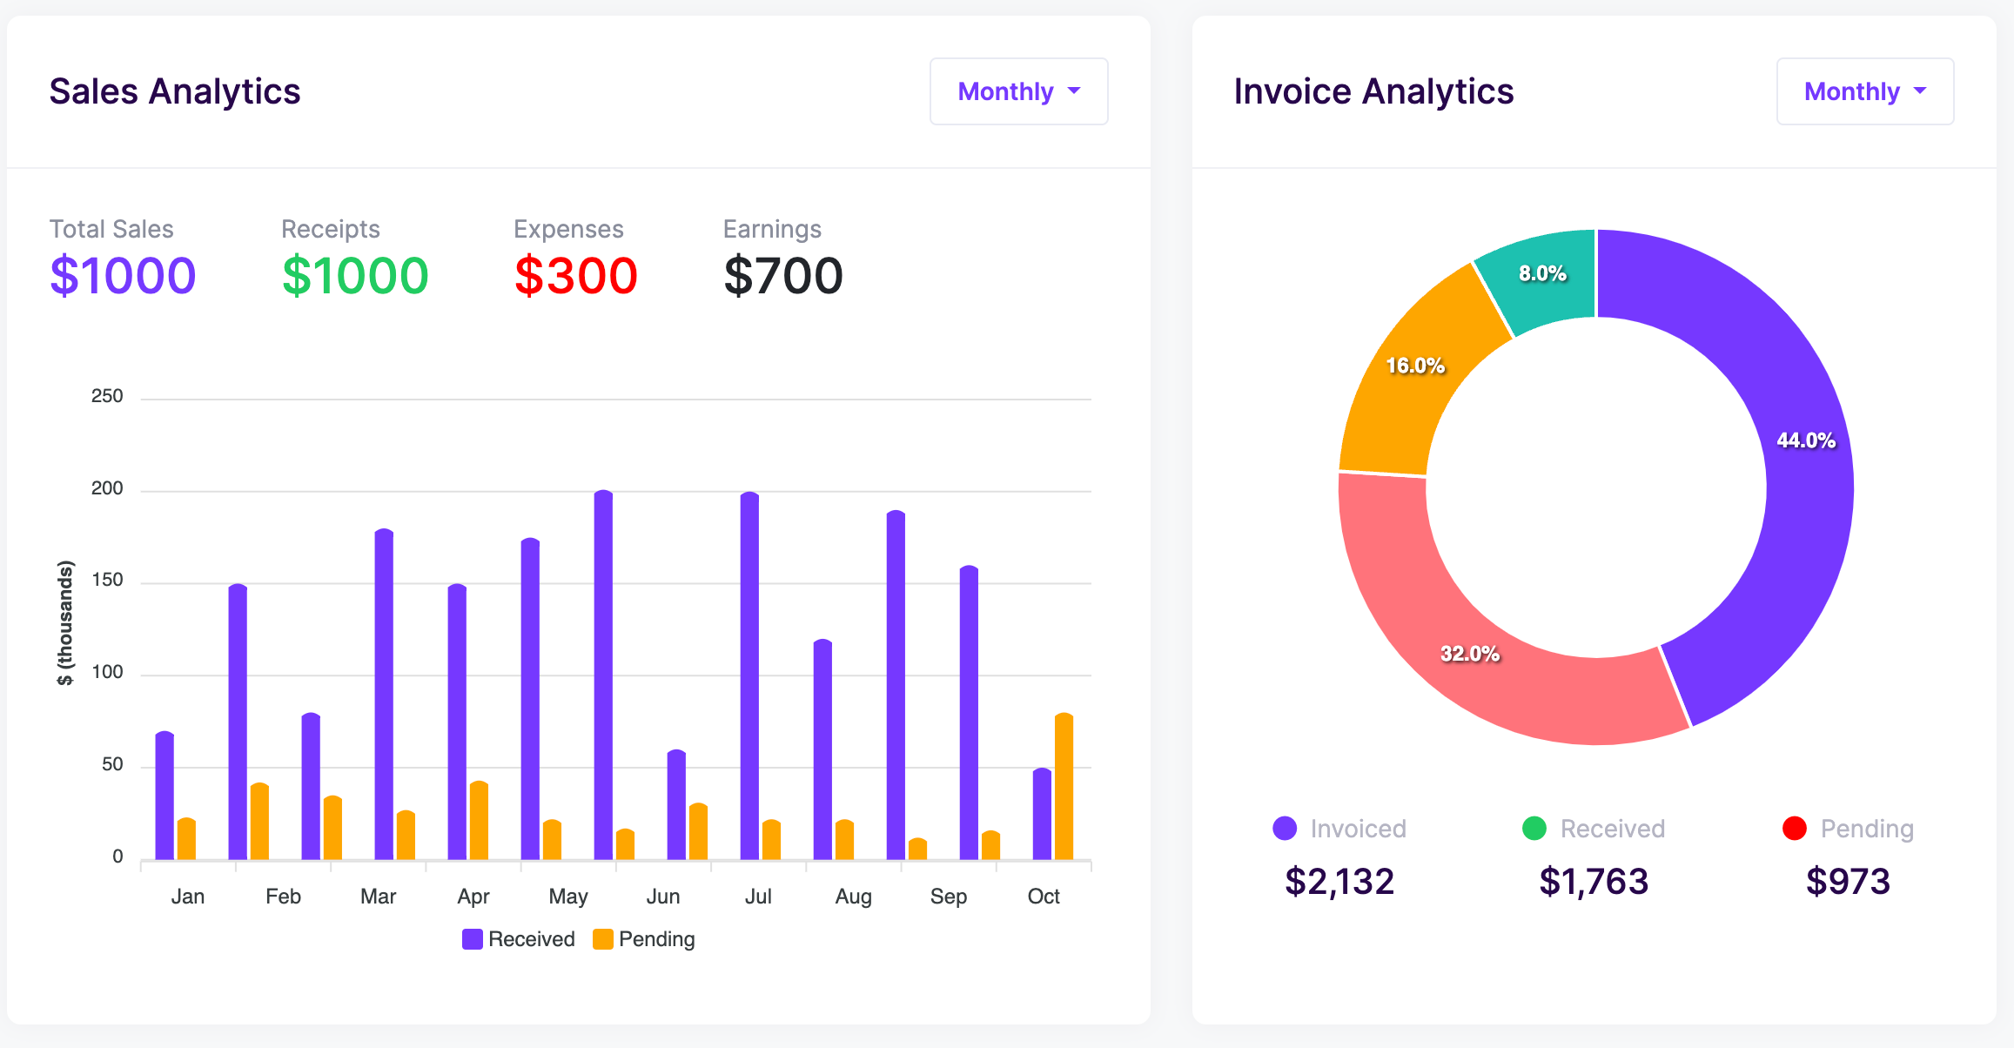
Samples: Calculate statistics

Slide 5
Samples: Animation
https://www.w3schools.com/js/tryit.asp?filename=tryjs_dom_animate_3
https://javascript.info/task/animate-ball
https://javascript.info/article/js-animation/move/

Slide 6
Samples: Form validation
https://codepen.io/Tracy4work/pen/BaqGgqm?editors=1000

Slide 7
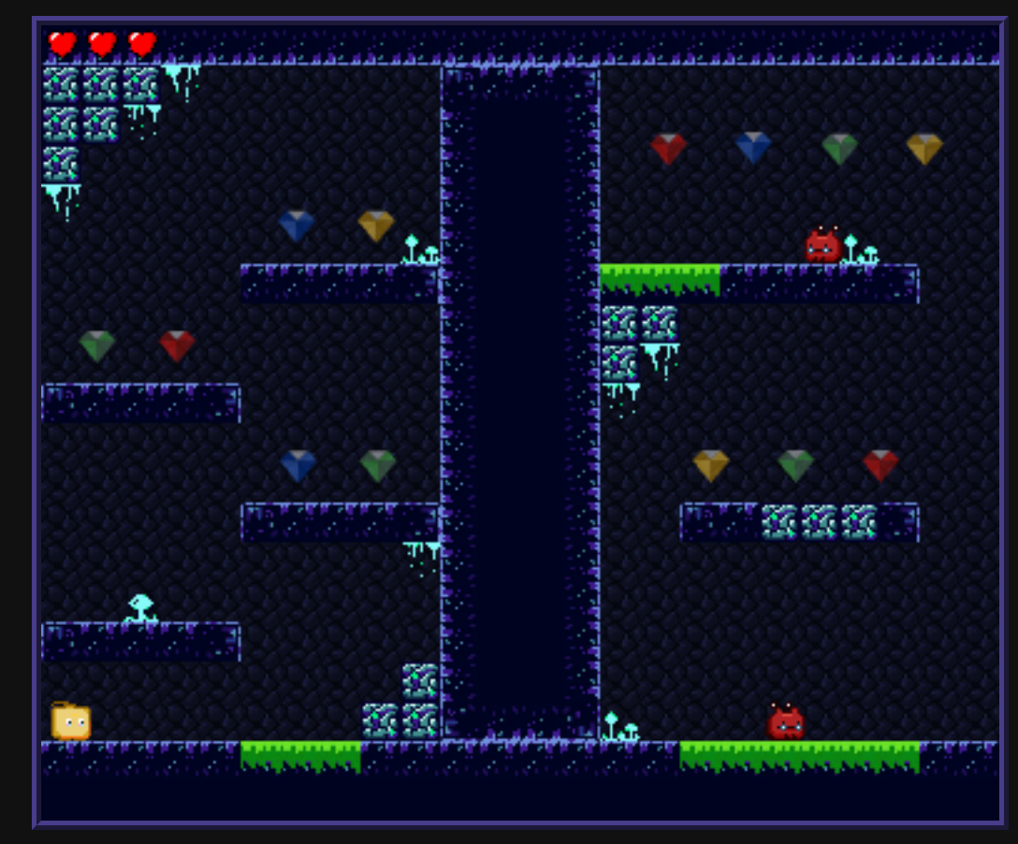
Samples: Online games
https://github.com/proyecto26/awesome-jsgames
https://js13kgames.com/games/triangle-back-to-home/index.html
https://js13kgames.com/games/racer/index.html

Slide 8
Javascript basic
Variables
Conditional statement
Loop
Arrays
Function
Log

Slide 9
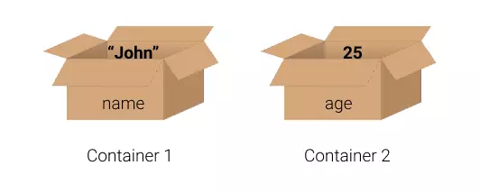
Variables
Purpose: store the values
Example:
var name = ‘John’;
var age = 25;
var my_hobbies = [‘football’, ‘swimming’, ‘boxing’];

Slide 10
Conditional statement
to execute a block if a condition is true
if (condition) { // block of code to be executed if the condition is TRUE } else {
//condition is FALSE
}
Example:
if (my_age > 18) { print(‘I can drink beer’); } else {
print(‘I cannot drink alcohol’);
}

Slide 11
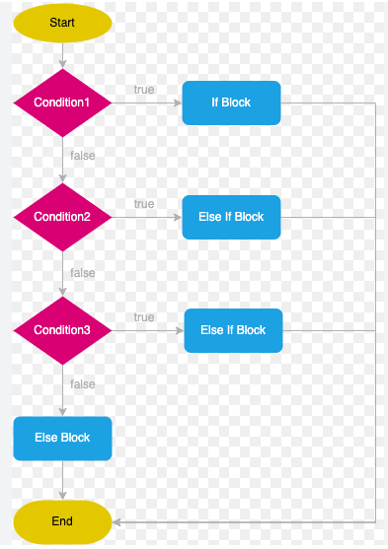
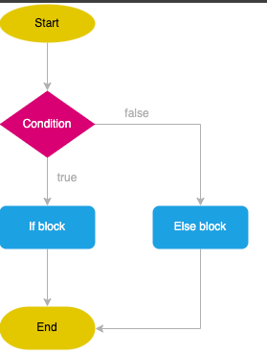
Conditional statement (cont.)

Slide 12
Conditional statement (cont.)
Unlimited different conditions:
if (the_current_temperature > 37 ) { print(‘It is too hot’); } else if (the_current_temperature > 18 ) {
print(‘It is cool’);
} else {
print(’It is too cold’)
}

Slide 13
Loop
Do the same stask over and over again
for (var i = 0; i < 5; i++) {
//execute this block 5 times text = "The number is " + i + "<br>"; }
while (i<7) {
//execute this block 7 times text += "The number is " + i + "<br>";
i = i + 1; }

Slide 14
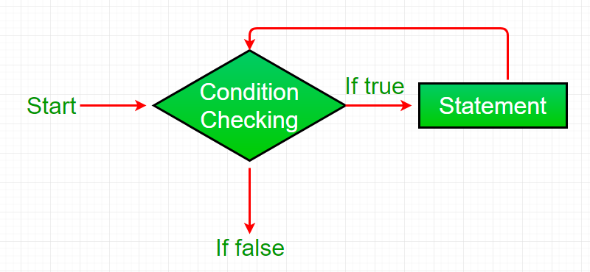
Loop

Slide 15
Array
A variable which contains many similar items which have different values
var my_assets = [‘iphone’, ‘laptop’, ‘keyboard’];
var my_cars = [‘bmw’, ‘honda’, ‘huyndai’];
Access an item by index
my_cars[0] -> ‘bmw’
my_cars[1] -> ‘honda’

Slide 16
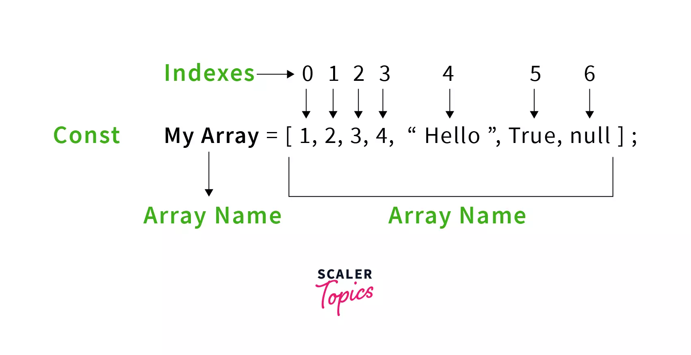
Array

Slide 17
Function
A function is a block of code to execute a particular task
Can be called any time by any one
function calculate_sum(a, b){
return a + b;
}
var sum_me = calculate_sum(5, 2);
console.log(sum_me) -> 7

Slide 18
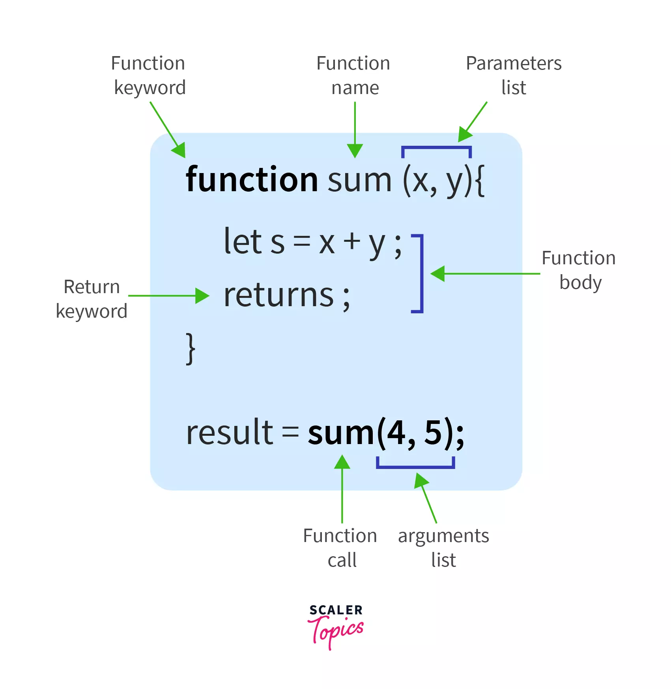
Function

Slide 19
Control HTML elements
Change HTML contents:
https://www.w3schools.com/jsref/dom_obj_all.asp
Change HTML attributes:
https://www.w3schools.com/jsref/dom_obj_attributes.asp
Change HTML styles:
https://www.w3schools.com/jsref/dom_obj_style.asp
Show/hide HTML elements
Reference: js_basic.html

Slide 20
Selector
myElement = document.getElementById("id01");
<img id=“id01” src=“…”/>
myElement = document.getElementByClassName(”cls91");
<img class=“cls91” src=“…”/>

Slide 21
Practice
1) calculate rectangular X x Y
2) print *
3) drag and drop
4) press key & image move
5) clock
6) slider
7) column chart
Sample source: Week 2
https://drive.google.com/drive/u/1/folders/1FexI9VCtXANjsDoAZEb8h7nZ5TRbPOxv

