Slide 1
WEB PROGRAMMING 2
Vue.js
GREENWICH UNIVERSITY
Author: Sang Do

Slide 2
Outline
What is Vue.js?
Structure
Examples
Vue Directories
Exercises

Slide 3
What is Vue.js?
Vue is a Javascript framework
Run in front end
Written in Javascript
Render components seamlessly without refreshing the page
No compilation

Slide 4
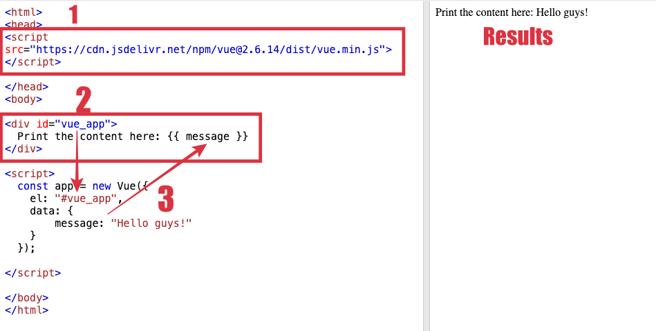
Structure
Inject framework
Define Vue component
Define Vue variables/data

Slide 5
Vue Directories
Vue directories are special HTML attributes with prefix v-
Connect between HTML components and Vue instance to create dynamic UX
v-bind
v-show
v-if
v-for
v-on
v-model

Slide 6
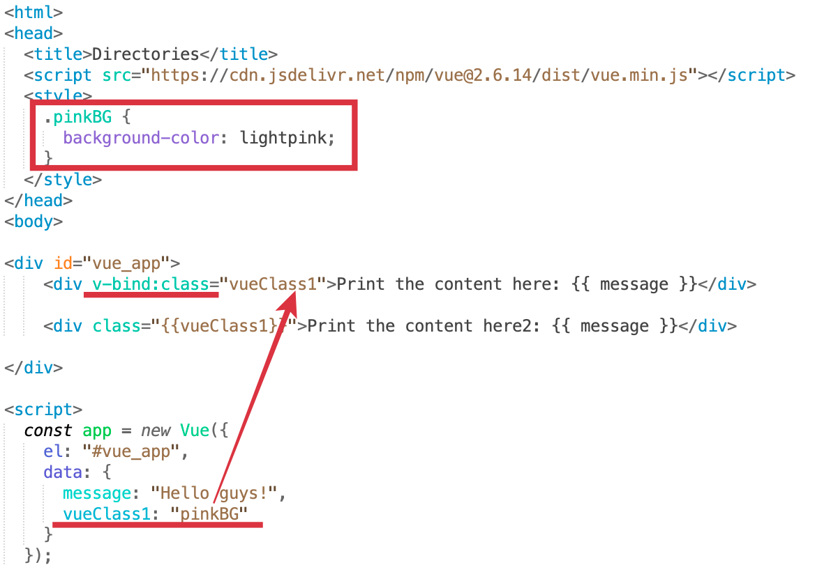
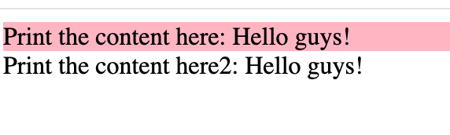
v-bind
Why content in line 2 not working???

Slide 7
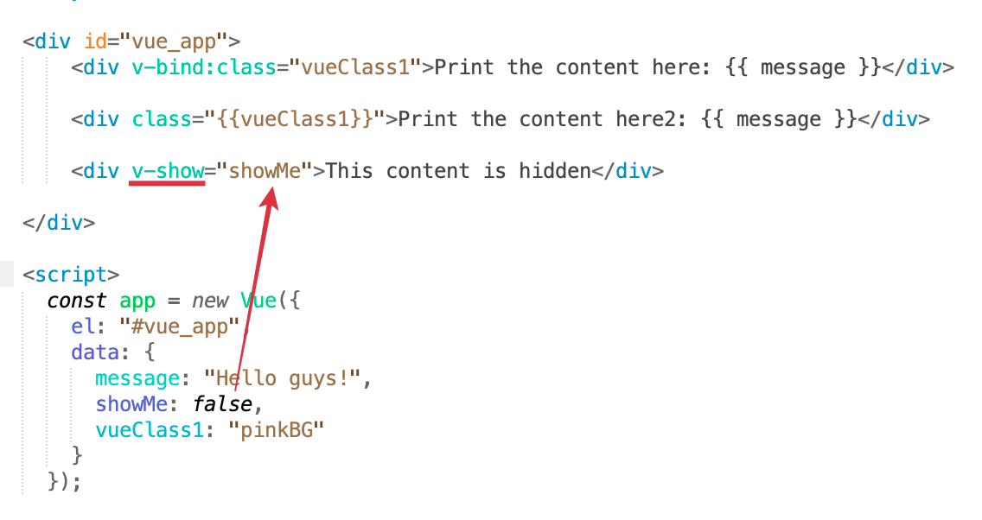
v-show
try to change the value to true?

Slide 8
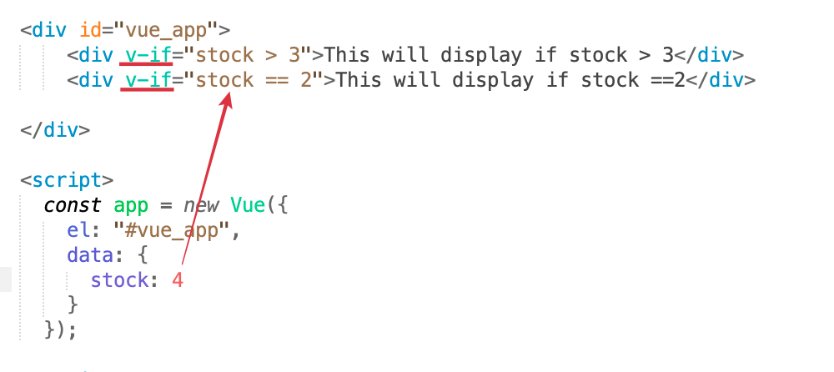
v-if
Try to change value here

Slide 9
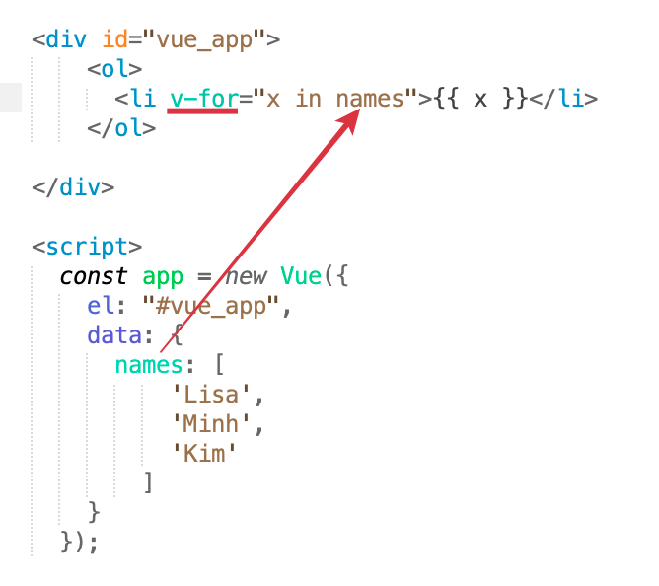
v_for
Auto loop all items

Slide 10
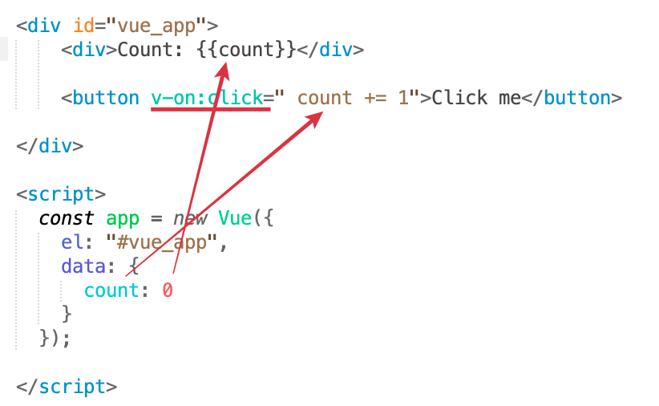
v_on
Bind the event “onClick”

Slide 11
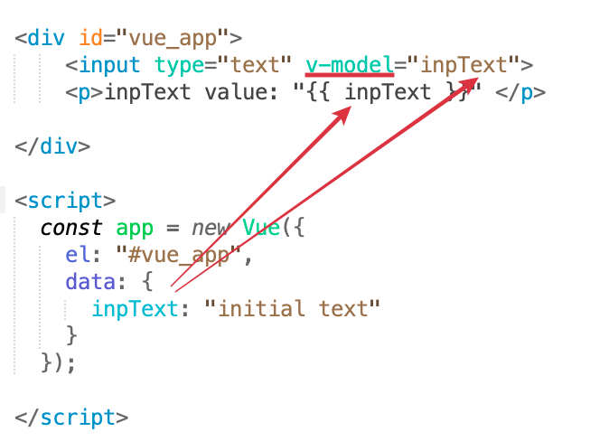
v_model
Auto link value

Slide 12
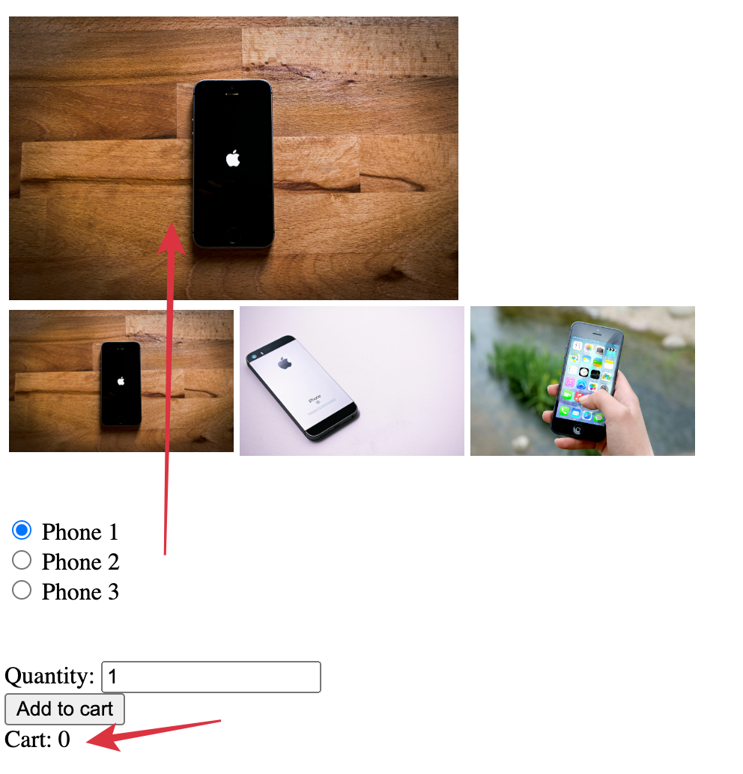
Exercise 1
1. Change the image when select option
2. Increase the number when click Add to Cart

Slide 13
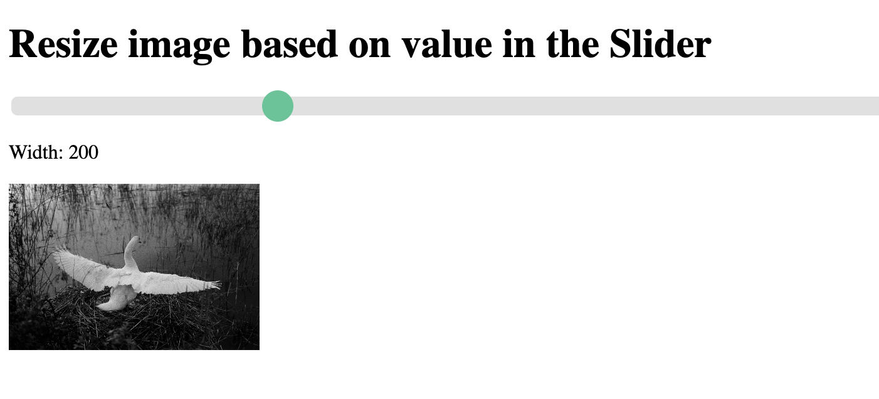
Exercise 2

Slide 14
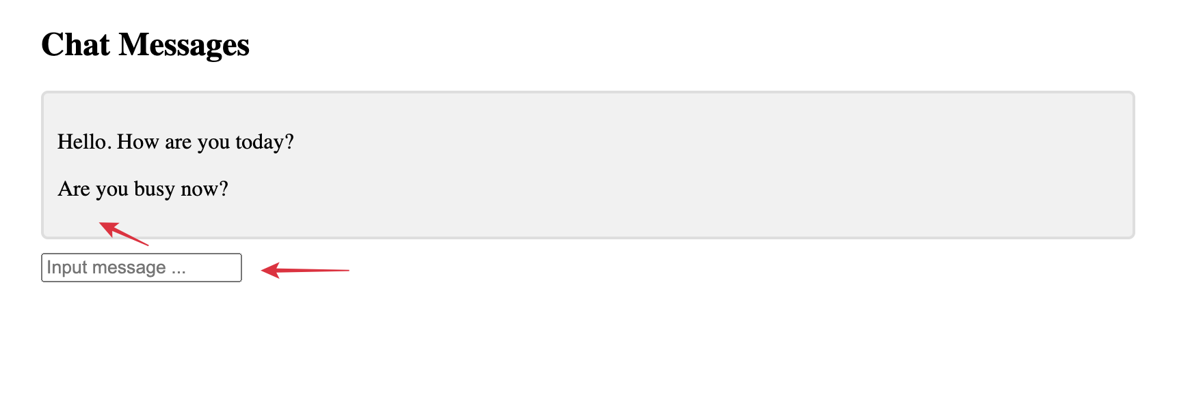
Exercise 3
Input the message, then press Enter, new message must be
appended into the chat screen.

Slide 15
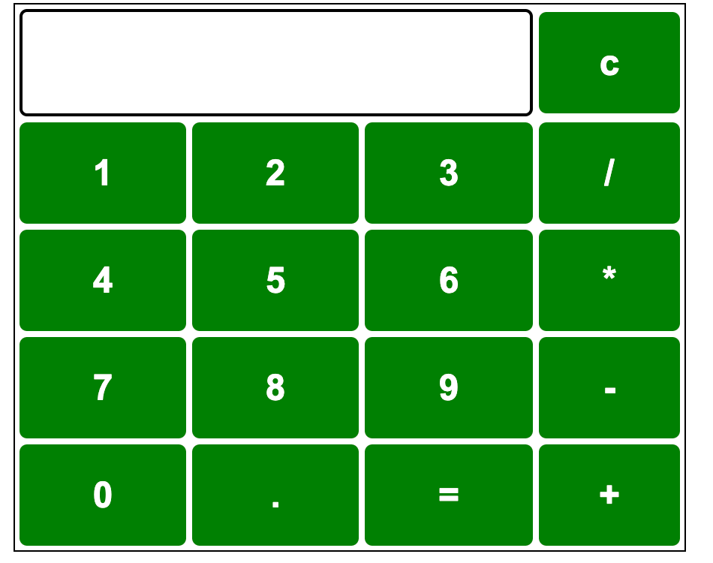
Homework

