Slide 1
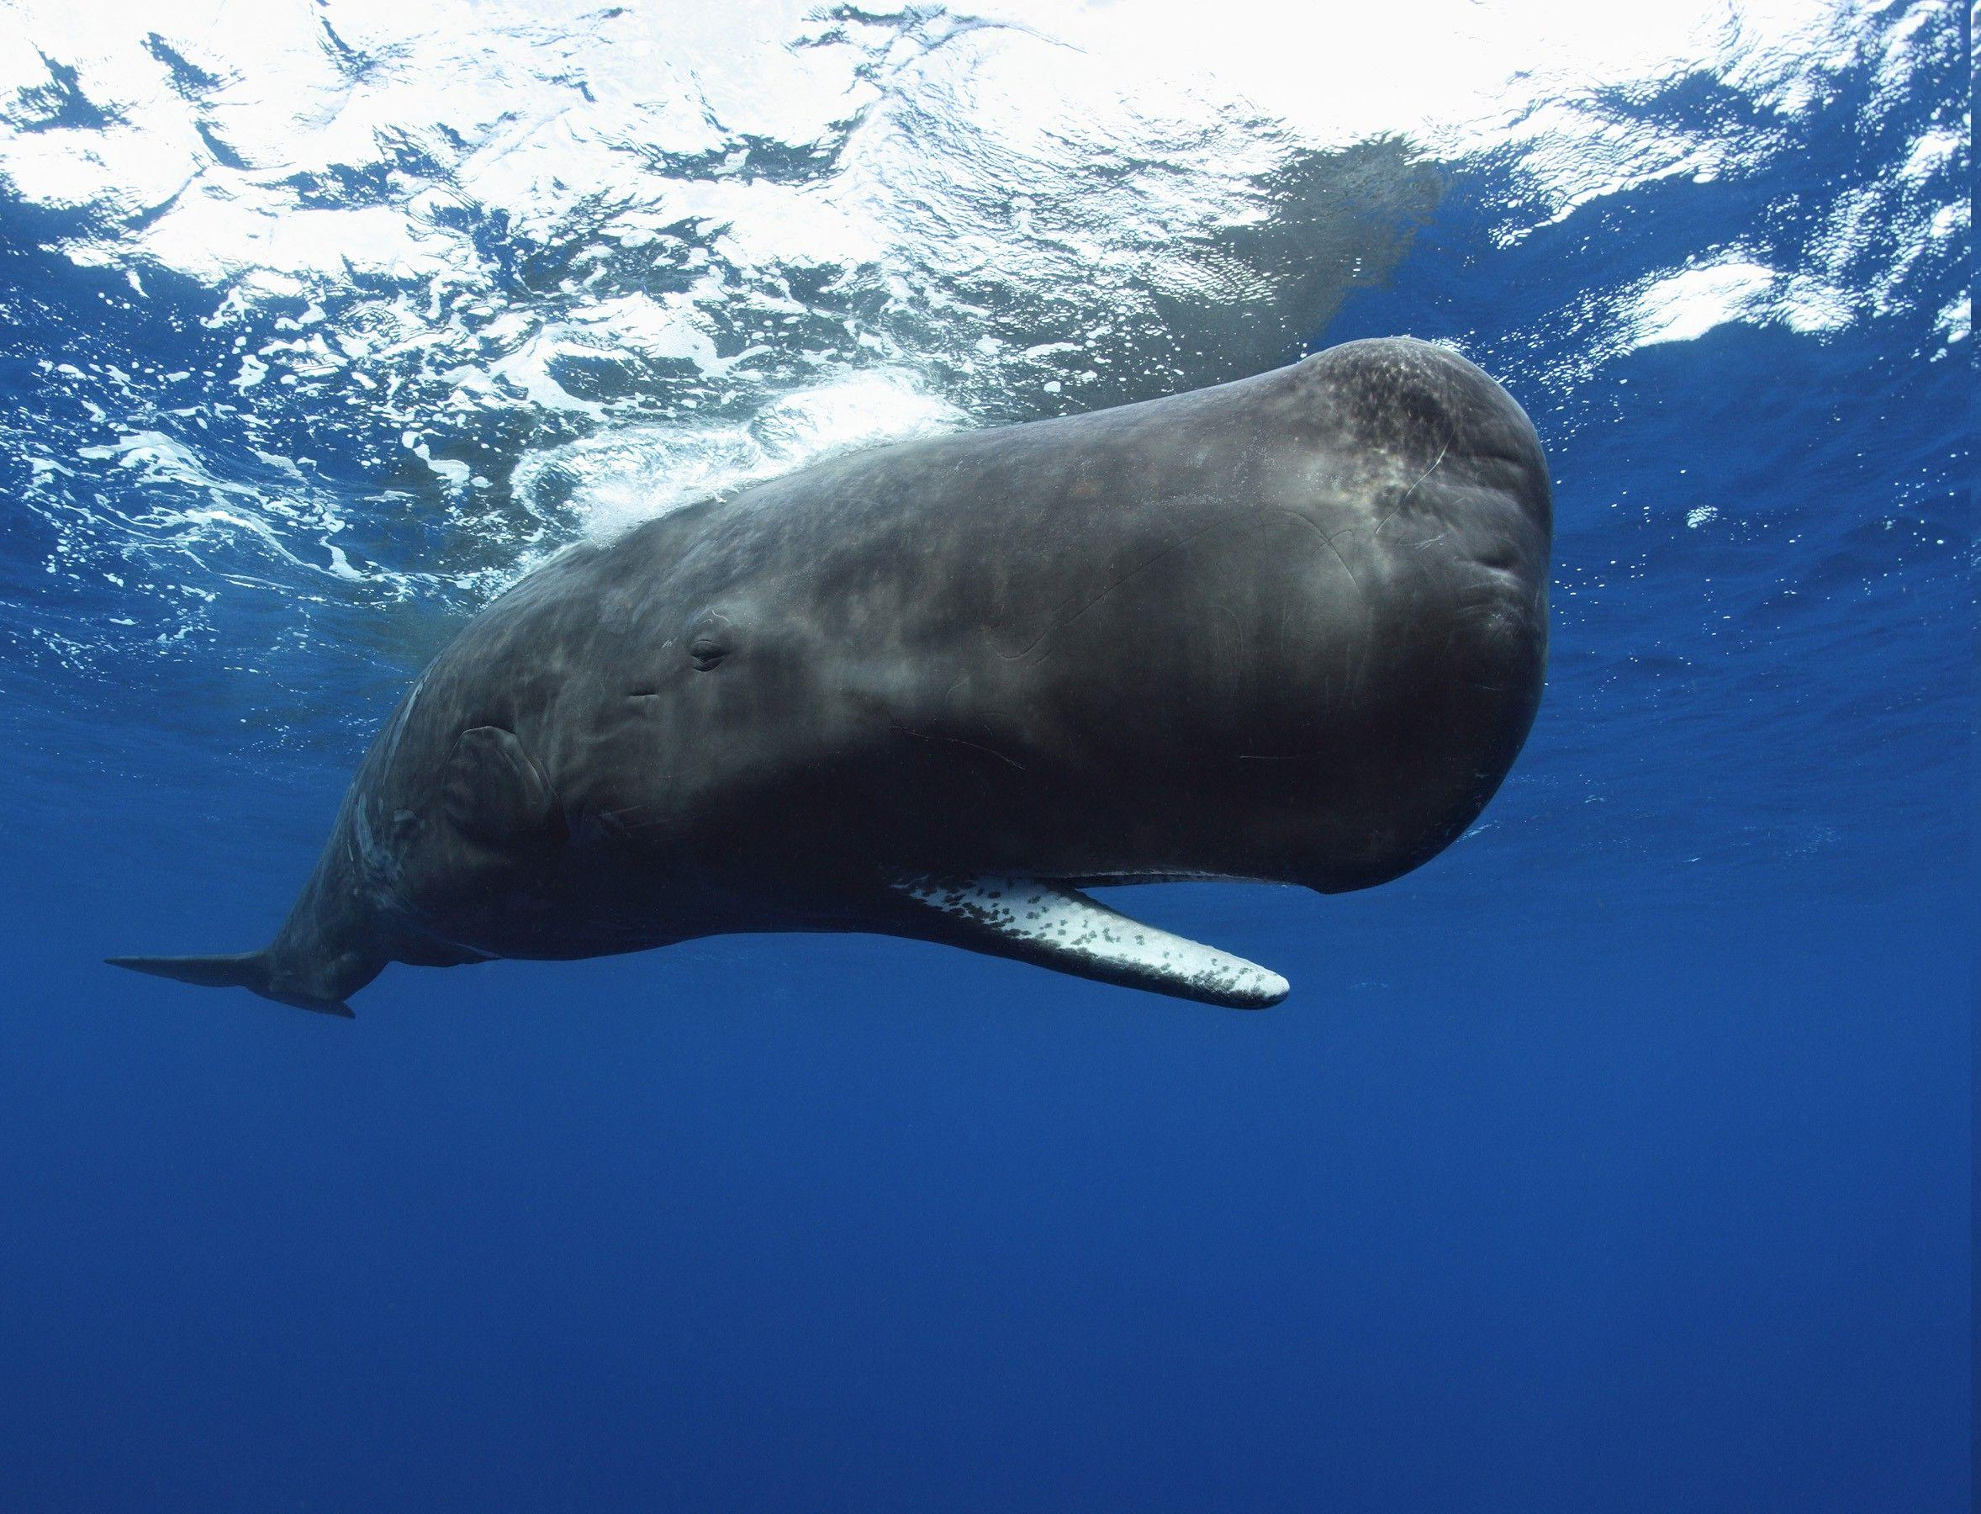
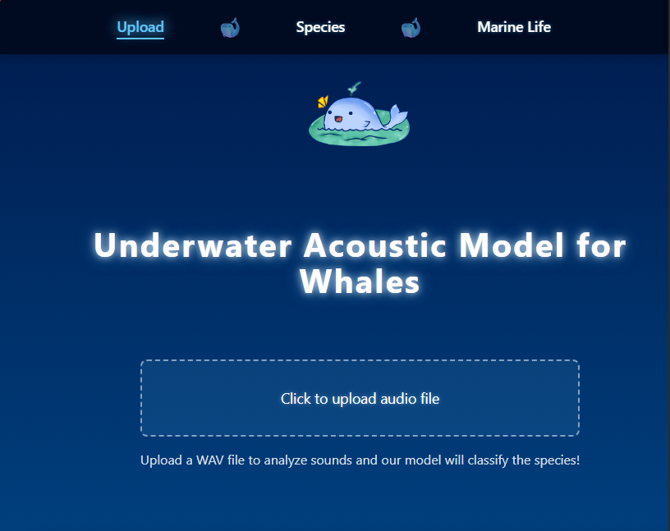
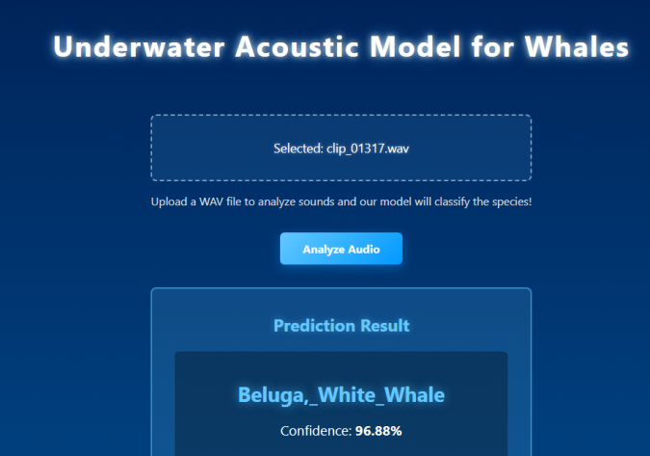
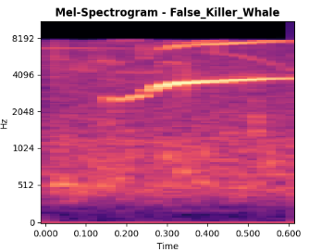
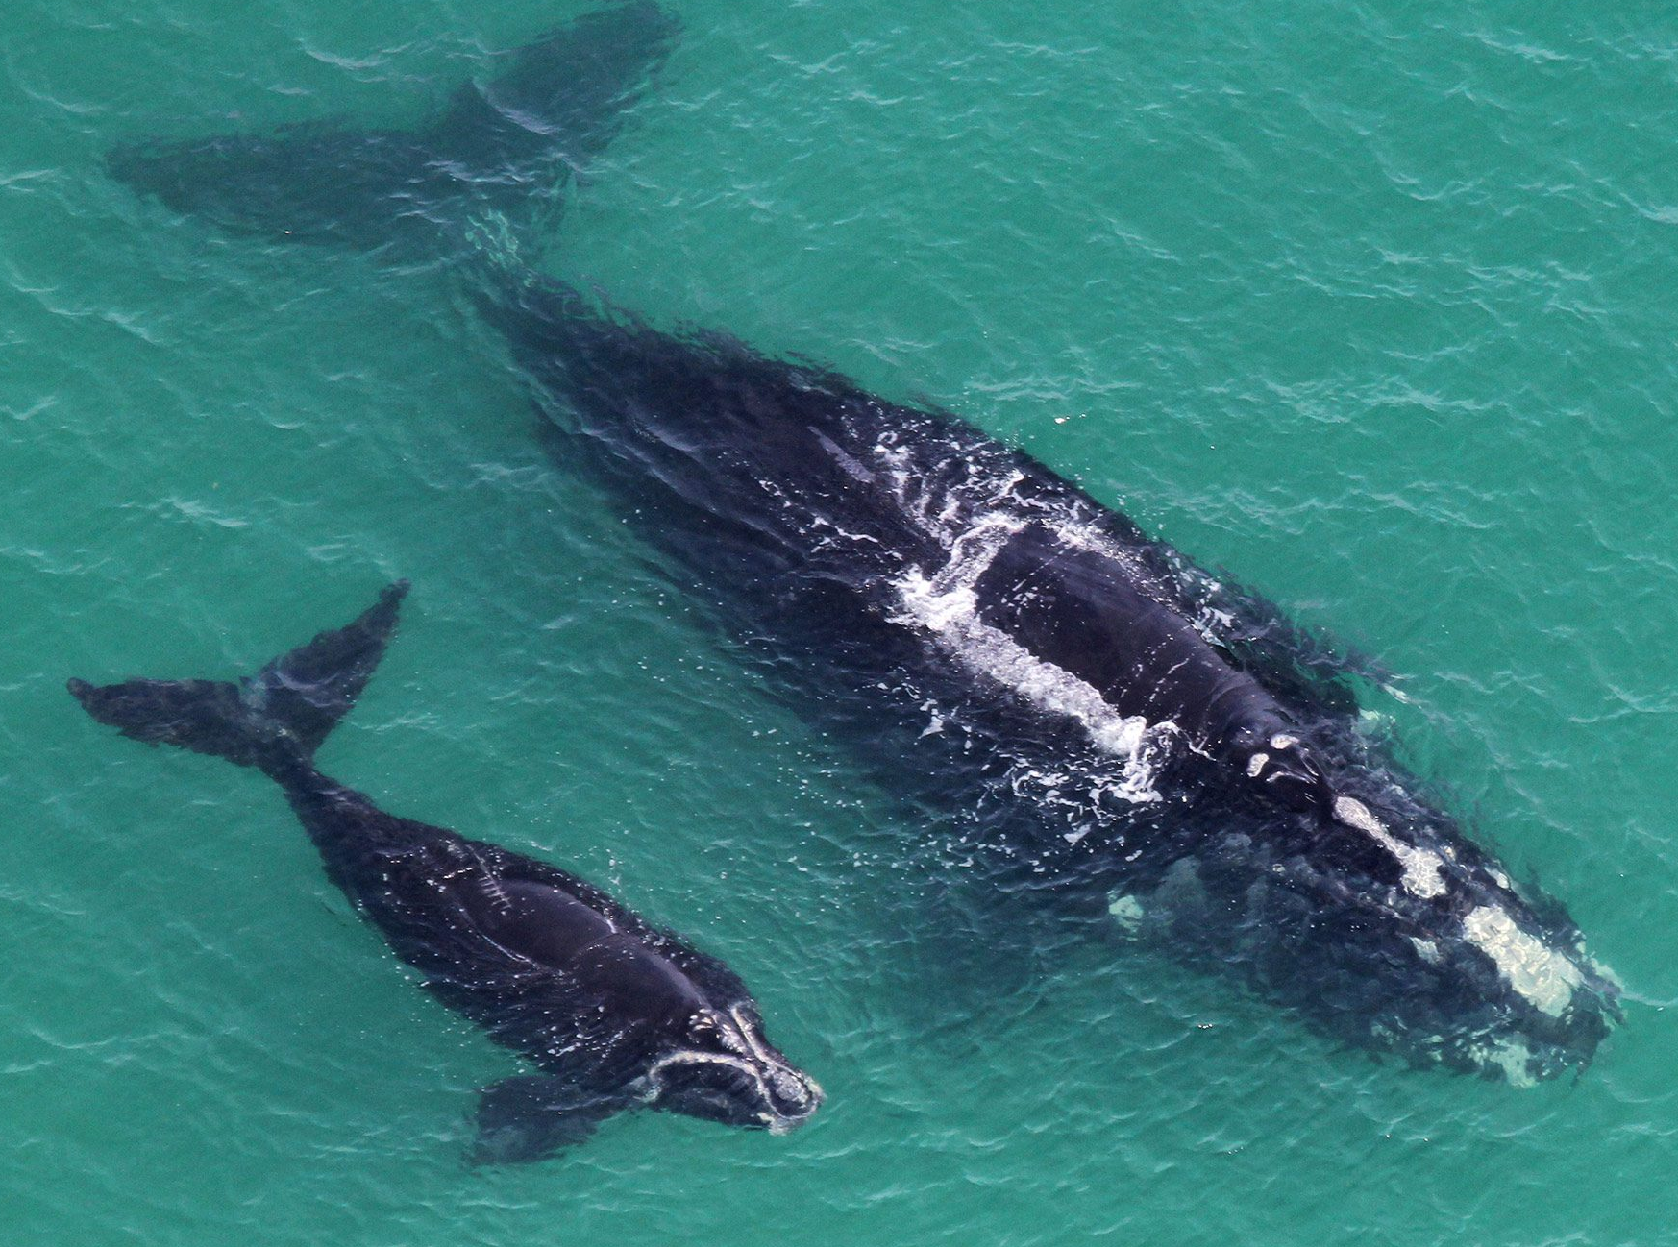
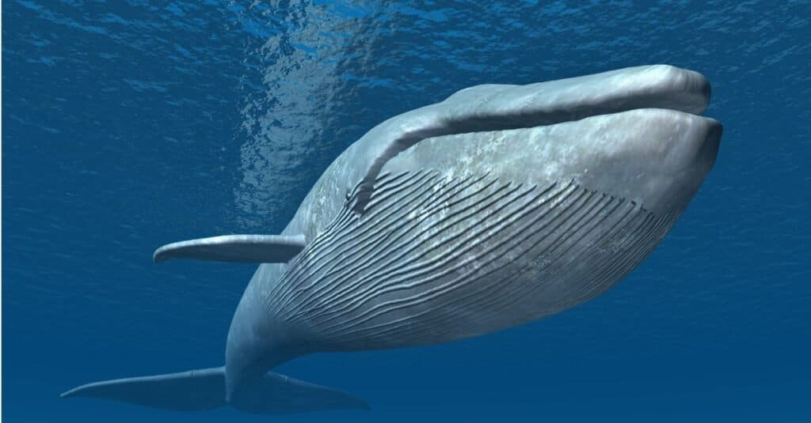
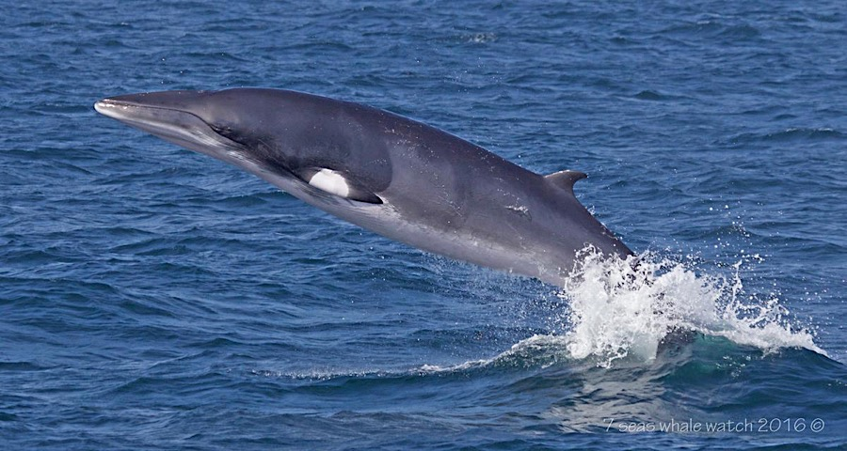
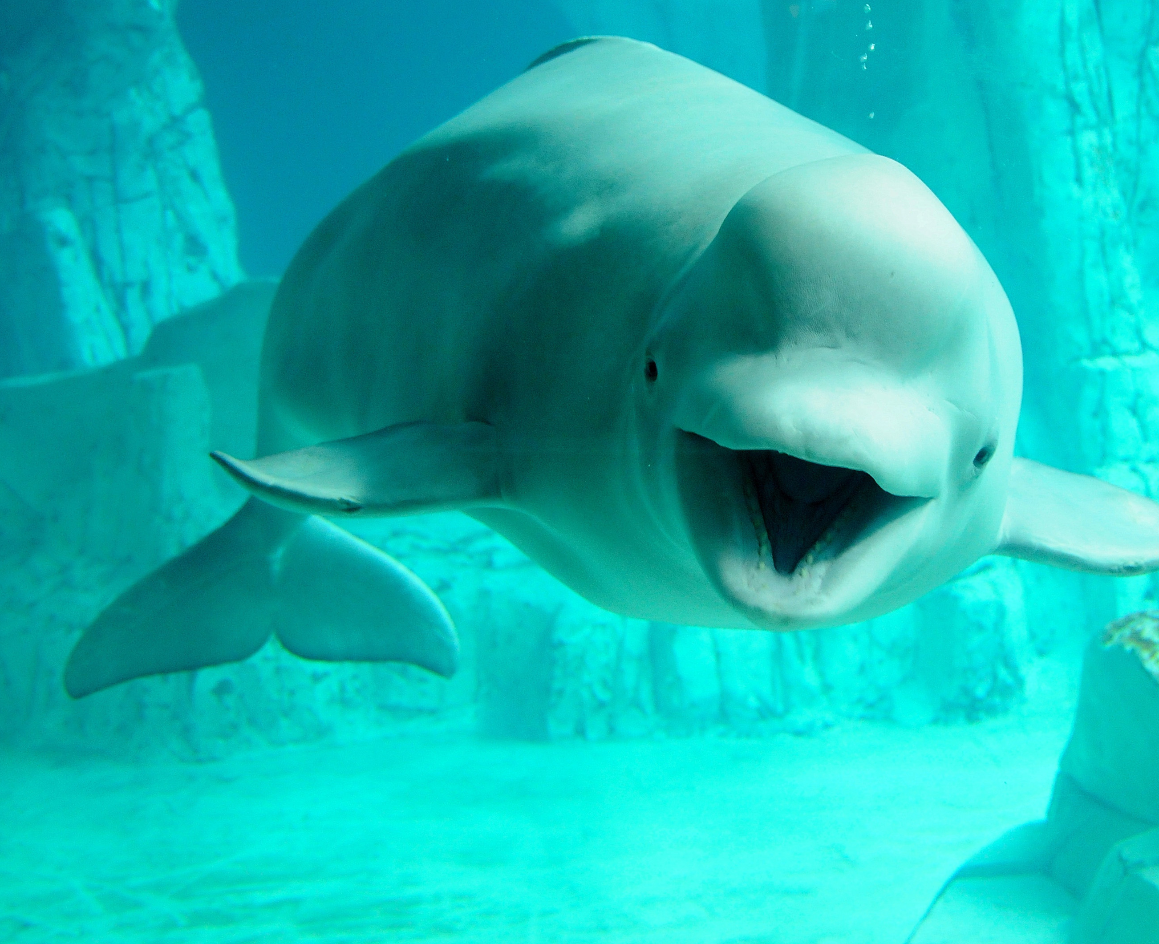
Underwater Acoustic Model for Whale Species
Team Members
Faculty Course Facilitator
EGN 4952C
Electrical Engineering & Computer Science
Ace Bowen Eoin Nash Fahima Aziz Khang Vinh Doan
Dr. Waseem Asghar
Project Advisor
#10
Sponsored by: Dr. Ali Ibrahim
Problem Statement
To conserve whales, we must understand them. So, to enable deeper insights into whale behaviors and social structures we strive to develop a computational system to recognize and group whale sounds together automatically. The creation of this system will help with identifying disruptions caused by human activity, reduce labor and costs for marine researchers, and allow for early detection of possible endangered species.
Results
We developed a multi-CNN model that converts whale audio into spectrograms and classifies species based on learned acoustic patterns. The system was trained on labeled whale datasets and designed to account for underwater background noise. When audio is uploaded through the frontend, the model processes the input and outputs the predicted whale species, demonstrating a complete end-to-end classification pipeline.
Conclusions & Impact
This project shows how deep learning and acoustic analysis can support marine conservation. By automating whale sound classification, we reduce manual effort and enable scalable monitoring of ocean soundscapes. With further refinement and expanded datasets, this system can contribute to real-time species tracking and long-term conservation efforts.

