Slide 1
Hexagonal
Design

Slide 2
CONTENT
What is Hexagonal Architecture Design?
Why we use it ?
How can we apply Hexagonal Architecture Design to SpringBoot Project ?
Development flow with BDD and TDD ?
What could we do more when the testing reach 100% ?

Slide 3
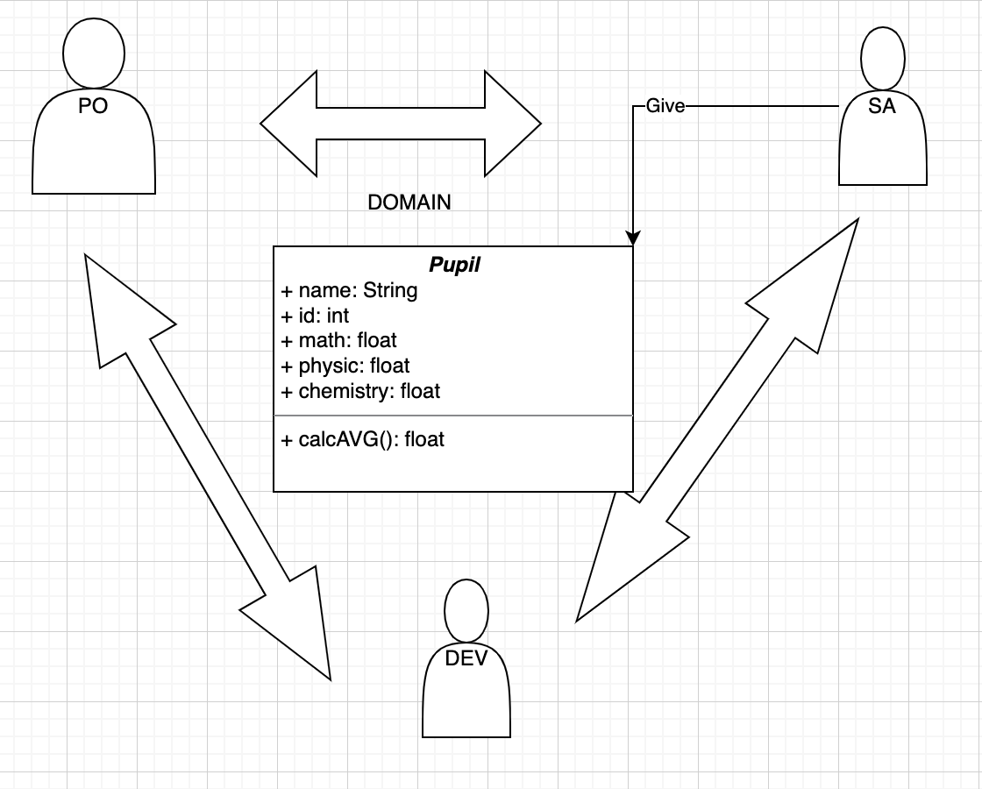
CONTEXT

Slide 4
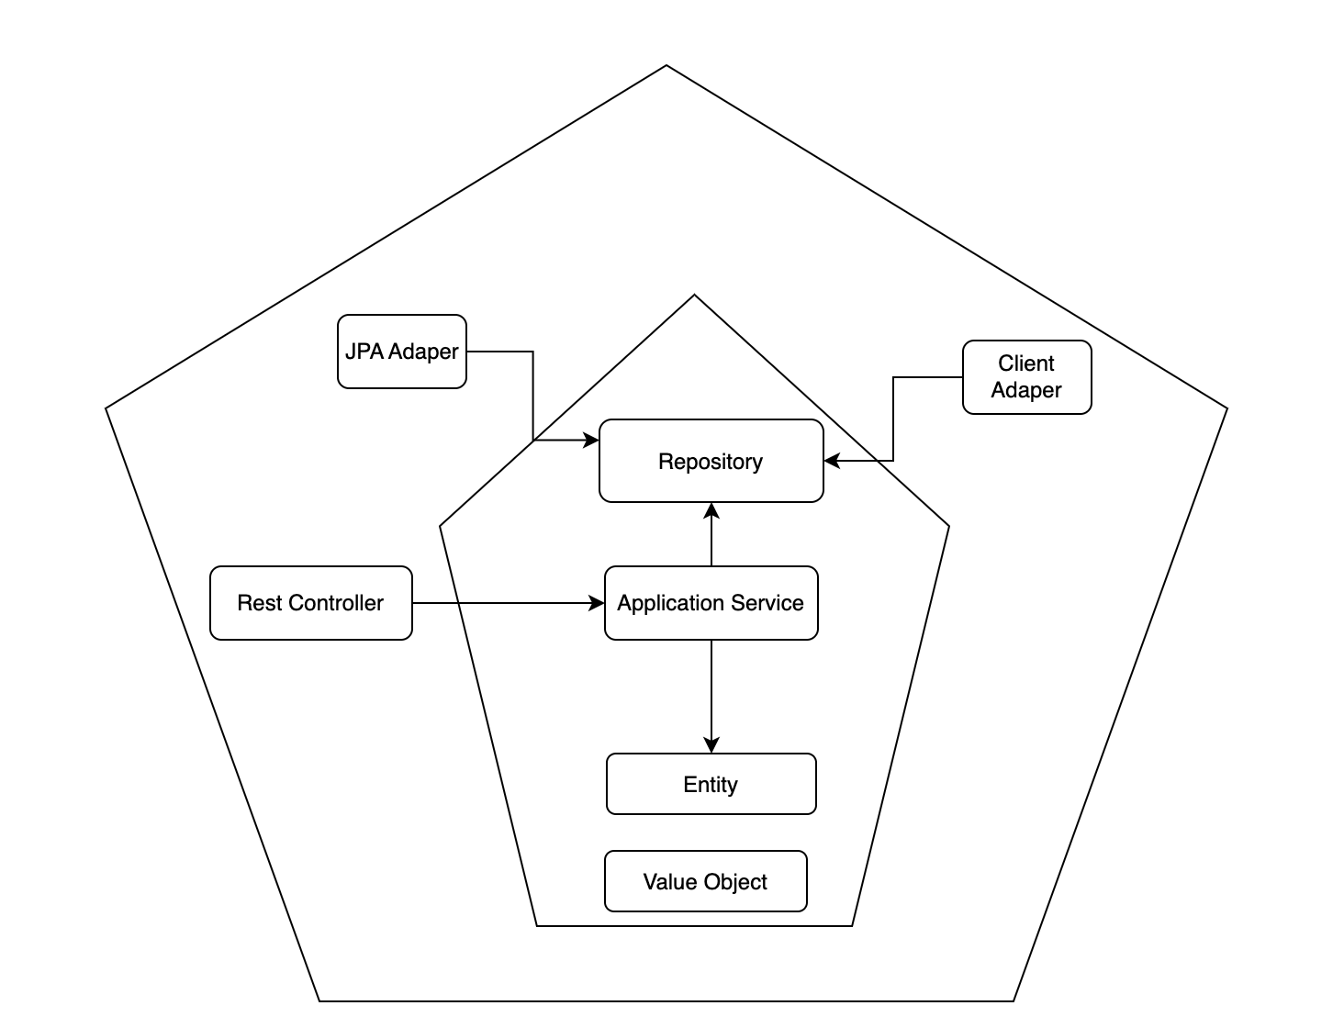
Hexagonal Architecture Design
A Pattern
Domain driven design (DDD)(The Book 2)
SA provide DDD
Focus on business logic
Ports vs Adapters
Easy to replace an adapter
Not use 3rd library in Domain Object

Slide 5

SHOOL API PROJECT
- Modules:
+ Bootstrap
+ Domain
+ Presentation
+ Mapper
+ DTO
+ DB(in bootstrap module)
- Infrastructure is hidden with the other accept bootstrap module
- School Application API
- Link: API

Slide 6
Project Structure
- Module
- High module not depend on low module
- Visible and Invisible

Slide 7
Testing Level
Unit test(Every Module)
Integration test (Only on bootstrap)
Pact Test(Only on bootstrap)
BDD + TDD(Only on bootstrap)
PIT test(Every Module)

Slide 8
PACT
- Contract testing
For: Microservices….

Slide 9
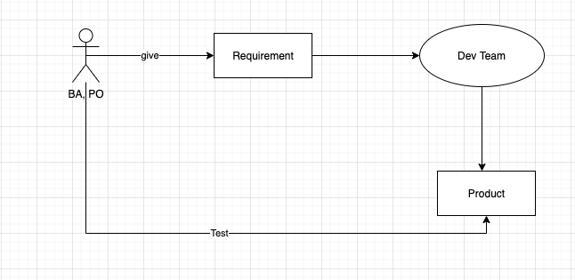
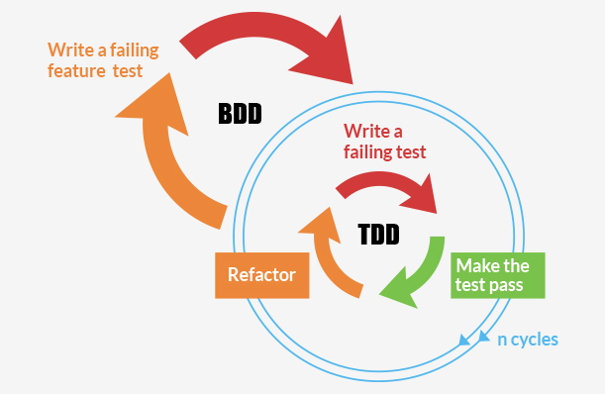
BDD
- Behavior Driven Development
- Reduce gap between BA vs DEV
- Development flow

Slide 10
TDD
- Testing first
- Fill the code later

Slide 11
PIT Mutation Testing
- Pitest
- mvn test-compile org.pitest:pitest-maven:mutationCoverage
- Check “target/pit-reports/YYYYMMDDHHMI”

Slide 12
Open Question
- Could we use repository in Controller Layer
- Could we use Hibernate Library in Controller Layer
- Use Kafka Consumer and Producer

Slide 13
Q&A

