Slide 1
269200
Web Programming Language
Dr. Ken Cosh
Week 1
(Introduction)

Slide 2
And So It Begins…
Principle of web application, web application workflow, Languages for web programming, Database-driven websites, authentication and sessions, testing and debugging

Slide 3
When it ends…
You should;
  Have an understanding of the importance of web technologies
  Be able to design and build websites
  Be able to build static and dynamic webpages
  Integrate websites with databases
  Develop basic applications using a variety of internet programming languages
  But in reality it can be much, much more…

Slide 4
Assessment
In Class Assignments = 50%
Midterm Exam = 20%
Final Exam = 30%

Slide 5
Where is it heading?
Web Designer
Web Developer
Web Architect
Web Entrepreneur
Other titles:
  Content Manager
  Administrator
  Online Community Administrator
  Strategic Planner
  SEO Expert

Slide 6
What languages?
HTML
CSS
PHP
MySQL
XML
RSS
JQuery
Ajax
Frameworks

Slide 7
What is Web Programming?
Web programming is used to build:
web pages
web sites
web applications

Slide 8
What is Web Programming?
Web Page
A document containing text and graphics created with HTML that is part of a group of hypertext documents or resources that can be accessed through a web browser on the internet.

Slide 9
What is Web Programming?
Web Site
A collection of related web pages found at a single address.
A URL serves as the top-level address of a Web site and points to that Web site's home page. That page serves as a reference point, containing pointers to additional HTML pages or links to other Web sites.

Slide 10
What is Web Programming?
Web Application
A web application is a set of web pages that are generated in response to user requests.
The Internet has many different types of web applications, such as
  search engines
  online stores
  auctions
  news sites
  games, etc

Slide 11
Intro to Web Programming
Hypertext Markup Language, or HTML, is the language that the web browser converts into the web pages of a web application.
Hypertext Transfer Protocol, or HTTP, is the protocol that web browsers and web servers use to communicate.

Slide 12
Intro to Web Programming
Types of web pages:
static web page
dynamic web page
  client-side scripting
  server-side scripting

Slide 13
Intro to Web Programming
Static Web Pages
A static web page is an HTML document that’s stored in a file and does not change in response to user input. Static web pages have a filename with an extension of .htm or .html

Slide 14
Intro to Web Programming
Dynamic Web Pages
A dynamic web page is an HTML document that’s generated by a web application. Often, the web page changes according to parameters that are sent to the web application by the web browser.

Slide 15
How static web pages work
The process begins when a web browser requests a web page - by entering a web address into the browser’s Address box or clicking a link.
The web browser sends an HTTP request to the web site’s server.
When the web server receives an HTTP request it retrieves the requested HTML file from disk and sends the file back to the browser - an HTTP response.
The browser receives the HTTP response, it formats and displays the HTML document.

Slide 16
How dynamic web pages work
A dynamic web page changes based on the parameters that are sent to the web application from another page.
The web application generates the HTML for a new web page and sends it back to the browser.
  example: search engine

Slide 17
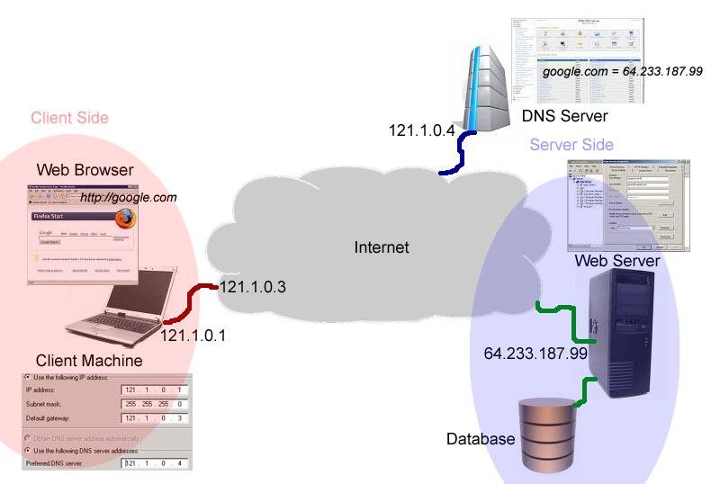
How the web works!

Slide 18
Server-side scripting:
PHP Hypertext Preprocessor (PHP)‏
Java server pages (JSP)‏
Active server pages (ASP)‏
Ruby on Rails
ColdFusion
Escapade (ESP)‏
Perl

Slide 19
Client-side scripting:
JavaScript
VBScript

Slide 20
Differences between client and server-side:
Client-side scripts have greater access to the information and functions available on the user's browser.
Server-side scripts have greater access to the information and functions available on the server.
Server-side scripts require that an interpreter is installed on the server.
Client-side scripts do not require additional software on the server but they require that the user's web browser understands the scripting language (browser compatibility problems)‏

Slide 21
Benefits of Web Technologies
Q. What are the benefits of using web technologies to build applications?
(compared to traditional client/server applications or desktop applications)‏

Slide 22
Benefits of Web Technologies
Less Expensive Infrastructure:
  Since every desktop can be equipped with a free browser, the users only need inexpensive, low maintenance computers that run the browser software.
Rapid Software Distribution:
  Thanks to the web, there is no need to distribute new software to any of the client browsers. Once programs are updated on the server, users can instantly see the changes the next time they load the page into their browser. Troubleshooting is also improved since most issues can be investigated and resolved on the server.

Slide 23
Benefits of Web Technologies
Low Network Usage:
  In a web environment, the client application (browser) doesn't access the database over the network to retrieve or update the data. The browser only sends instructions to the server with as much information as necessary to execute the server program. The server software is responsible for communicating with and retrieving any content from the database and composing the page to be sent back to the client; there is no need to exchange large amounts of data.
Platform Independence:
  Most web applications can be accessed through a variety of web browsers like Internet Explorer, Firefox, etc. Web browsers exist for virtually any operating system. Since they receive only the HTML document it is irrelevant if the document is being viewed on Windows, Linux/UNIX, Mac, or any other system. Web applications are accessible through wireless internet devices .

Slide 24
Challenges of Web Technologies
Q. What are the challenges of using web technologies to build applications?
(compared to traditional client/server applications or desktop applications)‏

Slide 25
Challenges of Web Technologies
Security Risks:
  Utilizing the web exposes the company's network to new security risks and programming vulnerabilities that can expose private data to the public.
Browser Compatibility:
  Unfortunately, the competition between web browsers has resulted in many differences in supported standards, thus creating confusion between users, and more importantly, compatibility issues with web applications. You have to test your web application with several browser versions, on several operating systems.

