Slide 1
EE136 • MACHINE LEARNING FOR WIRELESS COMMUNICATIONS
Topic 1: Comprehensive Model Benchmark
Tier 1: Classical Machine Learning (Random Forest vs. RBF-SVM)
Automatic Modulation Classification (AMC) on 18 Domain Features Across 8 Modulation Schemes
• DATASET: 96,000 Bursts (Train 70% / Val 15% / Test 15%)
• INPUT: 18 Invariant Physical Features (HOC + Welch PSD + PAPR)
• MODELS: Random Forest (200 Trees) & Support Vector Machine (RBF, C=10)
• CHANNELS: AWGN & Rayleigh 3-Tap Fading (-10 dB to +18 dB)

Slide 2
TOPIC 01 • DOMAIN FEATURE EXTRACTION & PIPELINE
Feature Distillation: Raw Baseband to 18 Invariant Domain Features
Raw I/Q Dimension Reduction
Input Burst: 128 complex baseband samples r[n] = I[n] + jQ[n] (256 raw real values).
Vulnerability: Raw I/Q suffers high variance under random channel phase rotation θ and AWGN.
14x Compression: Condenses 256 dimensions down to 18 robust domain statistical invariants.
Zero Data Leakage: StandardScaler parameters (mean μ, std σ) computed solely on 67,200 Train bursts. Never exposed to Test split.
18 Physical Feature Taxonomy
Higher-Order Cumulants (9): C20, C21, C40, C41, C42, C60, C61, C62, C63. Insensitive to Gaussian noise; isolates constellation rotational symmetries.
Phase Invariance (C40): BPSK (|C40|=2.0) and QPSK (|C40|=1.0) decouple cleanly. M>=8 PSK converge to |C40|=0.
Envelope & PAPR (2): sigma_aa (std dev of envelope) and PAPR (Peak-to-Average Power Ratio). Separates constant-envelope PSK from multi-amplitude QAM.
Welch PSD & Phase Stats (7): gamma_max, Kurt_psd, Skew_psd, H_psd, H_phase, sigma_ap, sigma_dp measure spectral concentration and angular spread.
Feature Invariance Power
Energy Normalization: All bursts RMS-scaled: r_norm[n] = r[n] / sqrt(1/L sum |r[k]|^2). Prevents trivial power-level cheating.
Phase Invariance: Cumulant magnitudes |C_pq| eliminate unknown phase offset e^(jθ) introduced by Rayleigh multipath.
Theoretical Ceiling: Cumulants up to 6th order cannot resolve 8PSK/16PSK/32PSK internal phase angles. Sets mathematical ceiling ~48.25%.
EE136: Machine Learning for Wireless Communications | Topic 1 • Classical Machine Learning
Slide 2 of 6

Slide 3
TOPIC 01 • ALGORITHM ARCHITECTURES & COMPLEXITY
Classical ML Specification: Random Forest (Bagging) vs. SVM (RBF)
Tier 1A: Random Forest Classifier (Ensemble Bagging)
Ensemble Structure: 200 decision trees (n_estimators=200), bootstrap sampling on 67,200 training instances.
Splitting Criterion: Gini Impurity with unconstrained depth (max_depth=None). Subsamples sqrt(18) ≈ 4 features at each split node.
Parameter Explosion: Deep trees grow without pruning -> 140,572,728 total decision parameters across 200 trees!
Model Checkpoint Size: 999.7 MB (.pkl file size). Severe RAM footprint when loaded into memory.
Training Complexity: Parallelized multi-core training (n_jobs=-1) completes in 121.03 s (~2.0 min on CPU).
Inference Speed: Fast execution: ~280 µs single-sample, 177 µs batched. Well within 5G frame budget (1.0 ms).
Tier 1B: Support Vector Machine (RBF Kernel)
Mathematical Formulation: Dual QP optimization finding maximum-margin separating hyperplanes in infinite-dimensional RKHS space.
Hyperparameters: Radial Basis Function (RBF) kernel: K(x, x') = exp(-gamma * ||x-x'||^2), Regularization C=10, gamma='scale' = 1/(18 * Var(X)).
Support Vector Count: 1,035,568 support vector coefficients (57,531 support vectors across 8 classes * 18 features).
Model Checkpoint Size: 14.96 MB (.pkl file size). 66x more compact than Random Forest on disk.
Training Bottleneck: Quadratic O(N^2) optimization on 67,200 bursts requires 1,788.23 s (~29.8 min CPU) — 15x slower to train!
Inference Latency Trap: Must compute kernel dot products against 57k vectors per sample -> ~9,700 µs (9.7 ms). Fails real-time 5G deadline (1.0 ms)!
EE136: Machine Learning for Wireless Communications | Topic 1 • Classical Machine Learning
Slide 3 of 6

Slide 4
TOPIC 01 • EMPIRICAL PROFILING & SYSTEM TRADE-OFFS
Classical ML System Profiling: Compute, Memory & Latency Dilemma
Metric / Specification | Random Forest (RF) | SVM (RBF Kernel) | Ratio (RF vs. SVM) | Engineering Impact
Training Duration (CPU) | 121.03 s (~2.0 min) | 1,788.23 s (~29.8 min) | SVM is 14.8x slower | RF enables rapid retraining on SDR nodes
Trainable Parameters | 140,572,728 tree nodes | 1,035,568 SV weights | RF has 135x more params | RF suffers severe parameter explosion
Checkpoint File Size | 999.7 MB (0.98 GB) | 14.96 MB (0.015 GB) | RF is 66x larger on disk | SVM fits on flash; RF requires large DRAM
Single-Burst Latency (B=1) | ~280 µs (0.28 ms) | ~9,700 µs (9.70 ms) | RF is 35x faster in infer. | RF satisfies 5G 1ms budget; SVM FAILS
Why We Drop SVM & Keep Random Forest in Production
Latency Violation: SVM latency (~9.7 ms) exceeds the 3GPP 5G NR TTI frame budget (1.0 ms) by 9.7x! Unusable for real-time SDR baseband.
Support Vector Drag: Evaluating 57,531 dual coefficients per burst creates severe computation bottlenecks without accuracy gain (SVM 33.8% vs RF 33.8%).
Random Forest: High Memory, But Fast Decision Speed
Instant Logic Trees: RF executes sequential threshold comparisons: if C40 <= -1.45 goto Left else goto Right. No matrix inversions!
Live Dashboard Integration: At ~280 µs latency, RF responds instantaneously on user clicks in the live demo deliverable.
EE136: Machine Learning for Wireless Communications | Topic 1 • Classical Machine Learning
Slide 4 of 6

Slide 5
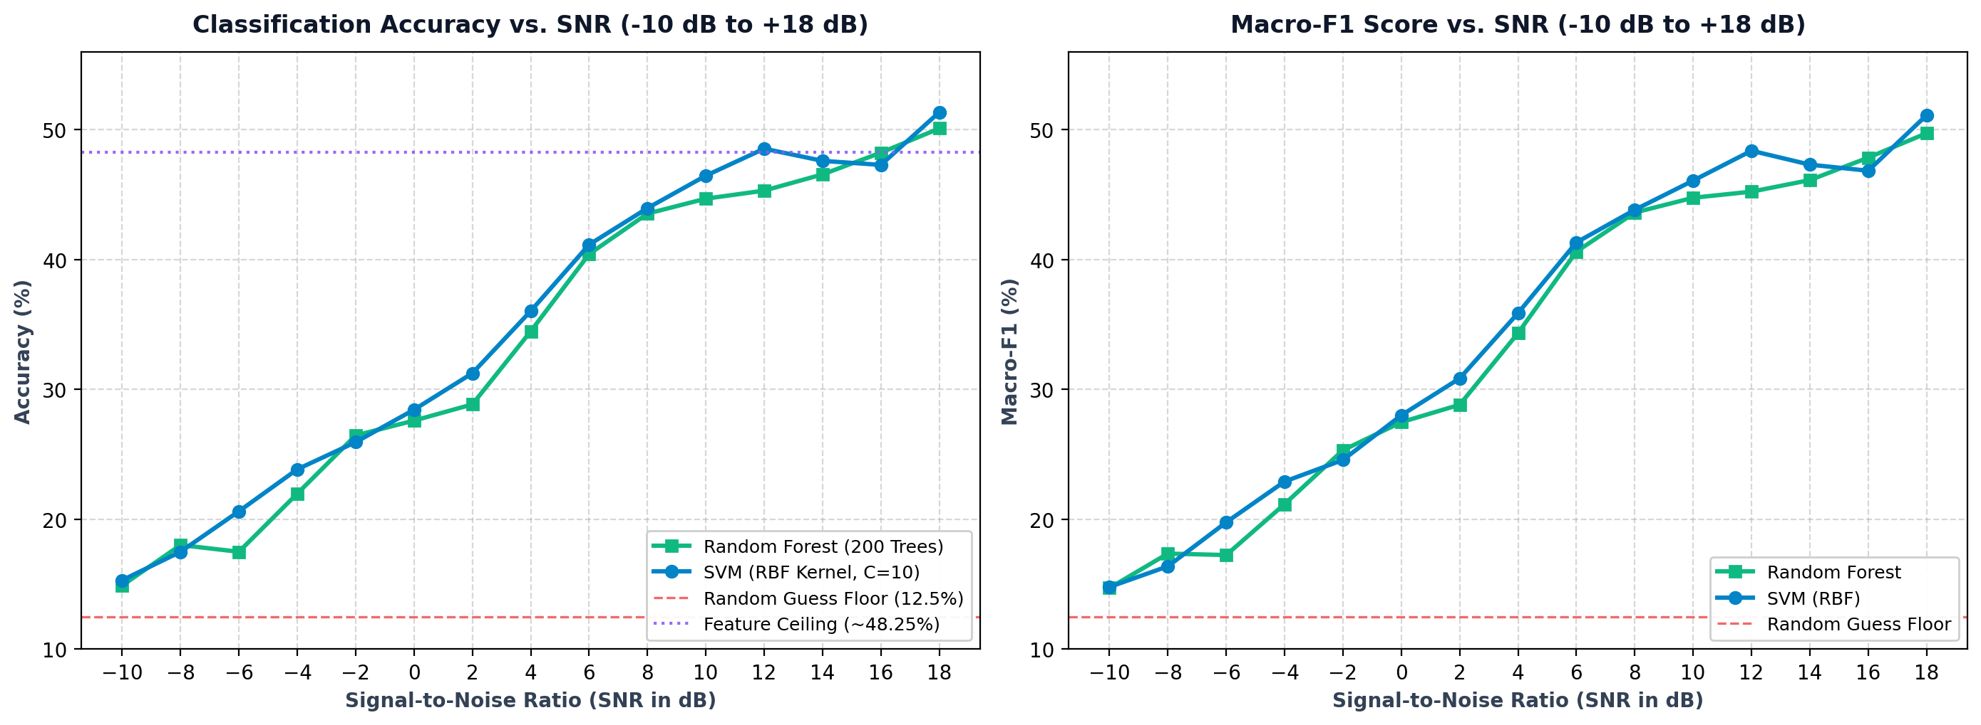
TOPIC 01 • STANDARDIZED BENCHMARK EVALUATION
Classical ML Performance: Accuracy & Macro-F1 Across 15 Calibrated SNRs
SNR Regime Breakdown
Low SNR (-10 to -2 dB): Acc: 14.9% -> 26.5%. Dominated by AWGN noise floor. High noise variances heavily perturb high-order cumulants.
Steep Transition (0 to +6 dB): Acc jumps from 27.6% to 40.4%. BPSK and QPSK emerge with high precision. Signal power overcomes noise floor.
High-SNR Ceiling (+8 to +18 dB): Acc flattens near 48-51% (RF: 50.10%, SVM: 51.35%). Intra-group ambiguity between higher PSK and QAM sets a mathematical wall.
Macro-F1 Alignment: Macro-F1 tracks Accuracy within 0.5% across all 15 SNRs, confirming zero class bias on balanced test splits.
EE136: Machine Learning for Wireless Communications | Topic 1 • Classical Machine Learning
Slide 5 of 6

Slide 6
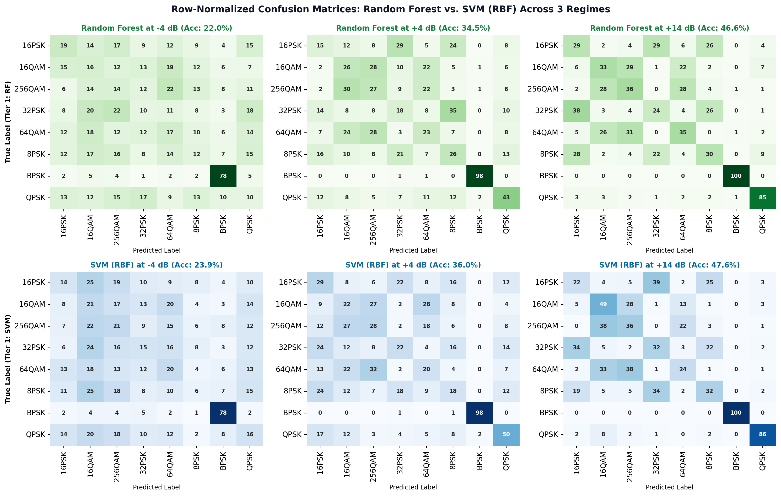
TOPIC 01 • ERROR DIAGNOSTICS & FEATURE IMPORTANCE
Classical ML Error Diagnostics: Confusion Matrices & Feature Ranking
Key Diagnostic Findings
Low SNR (-4 dB | ~22%): Severe off-diagonal noise scattering. Cumulant estimations fail; models guess almost uniformly across modulation families.
Mid SNR (+4 dB | ~35%): BPSK is recognized almost perfectly (~98%) via C40=-2.0. QPSK separates cleanly (~57%). Higher-order PSK/QAM remain heavily blurred.
High SNR (+14 dB | ~47%): Mathematical ceiling ceiling: 8PSK, 16PSK, and 32PSK cluster together at |C40|=0. Similarly, 16QAM, 64QAM, and 256QAM confuse each other.
Top Gini Features: 1. C40 (BPSK/QPSK divider)
2. C42 (energy variance)
3. PAPR (PSK vs QAM)
4. sigma_aa (envelope std)
5. H_phase (phase entropy)
EE136: Machine Learning for Wireless Communications | Topic 1 • Classical Machine Learning
Slide 6 of 6

