Slide 1
EE136 • MACHINE LEARNING FOR WIRELESS COMMUNICATIONS
Topic 1: Comprehensive Model Benchmark
Tier 2: 3-Layer Multilayer Perceptron (MLP)
Automatic Modulation Classification Across 8 Digital Modulation Schemes
Presenters: Hai Nguyen (EEEEIU22093) & Van Thao Minh (EEEEIU22097)
Instructor: Dr. Huynh Vo Trung Dung | Date: October 26, 2026
Scope: Baseband Physics, 18 Domain Features, MLP Optimization & Latency Profiling

Slide 2
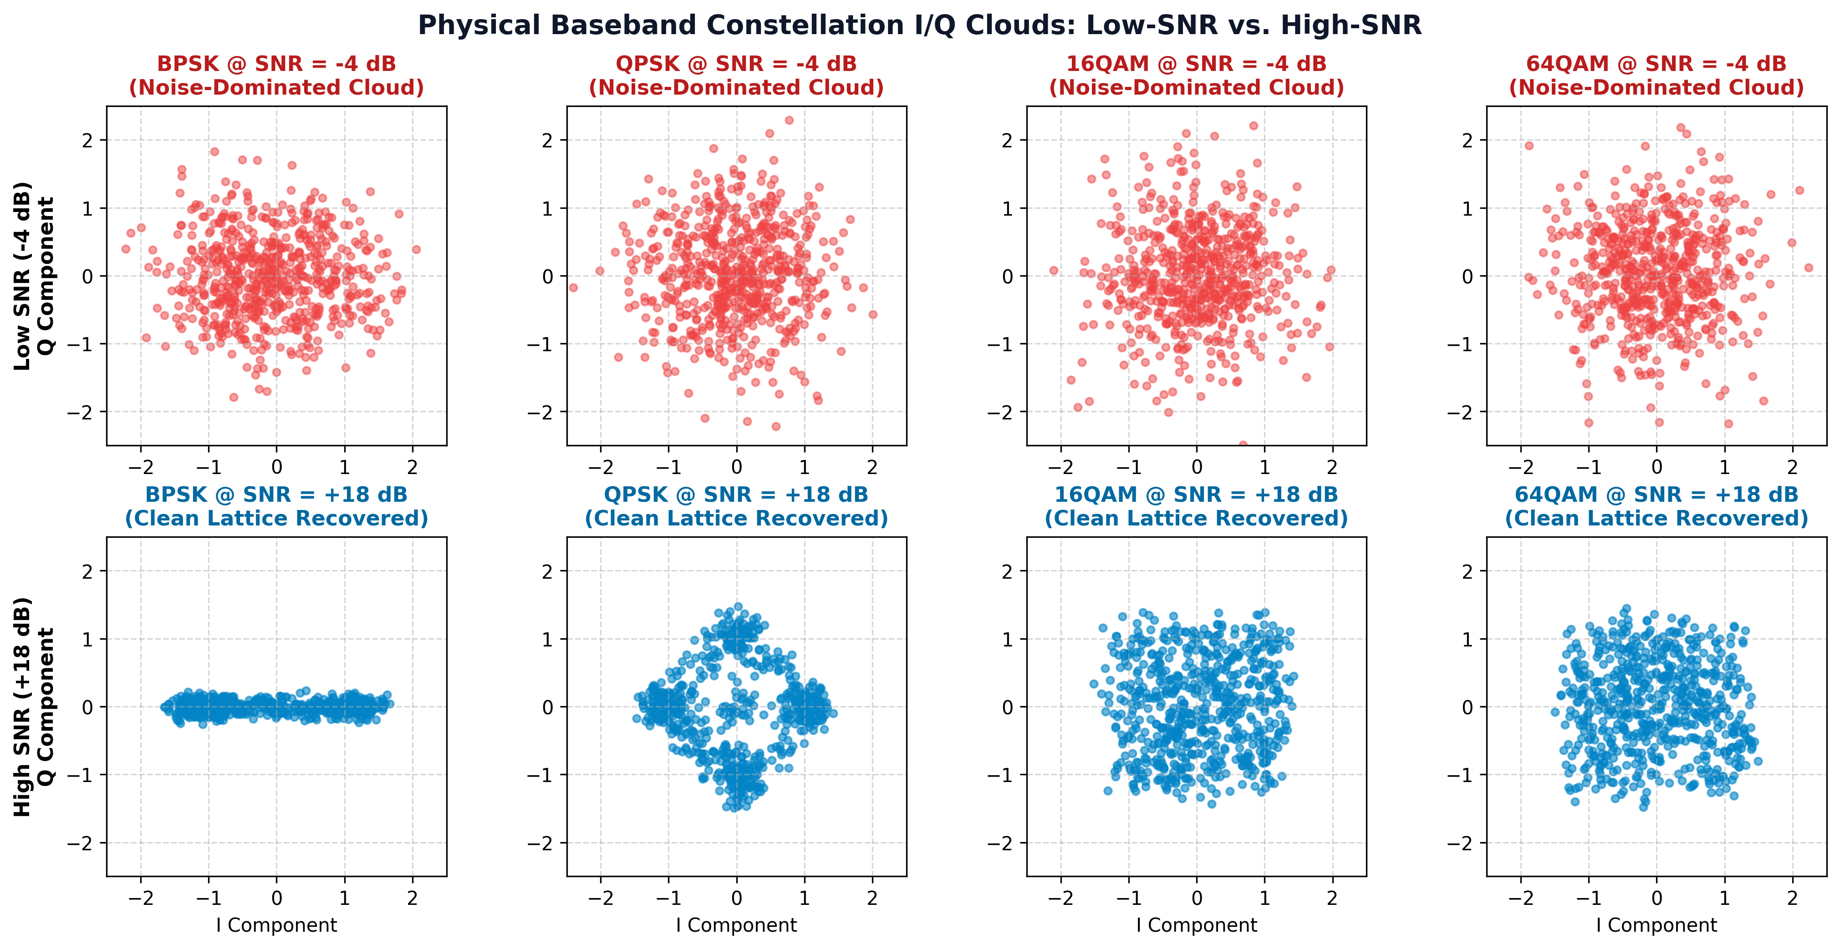
TOPIC 01 • PHYSICAL CHANNEL & BASEBAND MODELING
Baseband Physics: AMC Problem & Constellation Clouds
Physical Layer Problem
Task: Blindly classify modulation from 128 I/Q samples.
8 Classes: 5 PSK (BPSK..32PSK) + 3 QAM (16/64/256QAM).
Channel: AWGN + Rayleigh 3-Tap (-10 to +18 dB).
Challenge: Severe noise blur at low SNR (-4 dB).
EE136: Machine Learning for Wireless Communications | Capstone Mini-Project Brief
Slide 2 of 12

Slide 3
TOPIC 01 • DOMAIN FEATURE ENGINEERING PIPELINE
Feature Distillation: Raw I/Q to 18 Invariant Domain Features
Raw Baseband I/Q Burst
128 Complex Samples [2, 128]
1. Envelope & Amplitude (2 Features)
sigma_aa: Normalized amplitude std dev
PAPR: Separates constant-envelope PSK from QAM
In-Phase Component I[n]
128 Real Baseband Samples
────────────────────
Quadrature Component Q[n]
128 Imaginary Baseband Samples
14x
Compress
2. Higher-Order Cumulants — HOC (9 Features)
2nd & 4th Order (C20..C42): BPSK (|C40|=2), QPSK (|C40|=1)
6th Order (C60..C63): Power-normalized by C21^(order/2)
Why NOT Raw I/Q into MLP?
256 raw dimensions (high variance)
Vulnerable to phase rotation & AWGN
3. Welch PSD & Phase Stats (7 Features)
Spectral PSD (gamma_max, Kurt, Skew, H_psd)
Phase Spread (H_phase, sigma_ap, sigma_dp)
EE136: Machine Learning for Wireless Communications | Capstone Mini-Project Brief
Slide 3 of 12

Slide 4
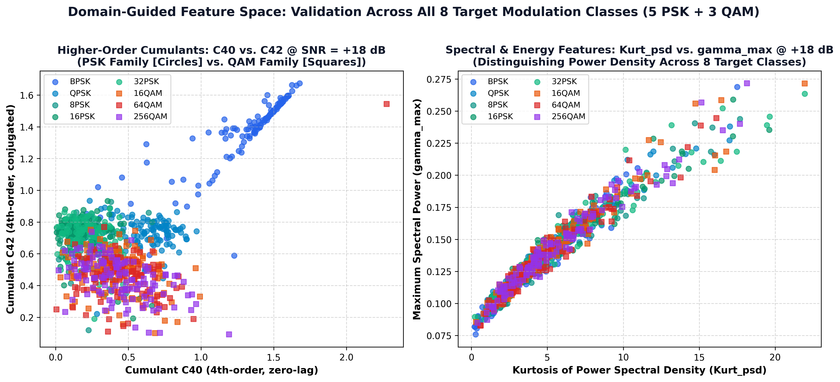
TOPIC 01 • FEATURE SPACE VALIDATION
Geometric Separability: Cumulants & Spectral Signatures
Cumulant Space (C40 vs. C42)
Low-Order PSK: BPSK (|C40|=2) & QPSK (|C40|=1) isolate cleanly.
High-Order PSK (8/16/32PSK): Cluster at |C40| = 0.
QAM Family (16/64/256QAM): Multi-ring square clusters.
Enables fast nonlinear partitioning by MLP.
EE136: Machine Learning for Wireless Communications | Capstone Mini-Project Brief
Slide 4 of 12

Slide 5
TOPIC 01 • NEURAL NETWORK SPECIFICATION
Model Architecture: 3-Layer Fully-Connected MLP Specification
Input Layer
18 Features
Hidden Layer 1
128 Neurons
Hidden Layer 2
64 Neurons
Output Layer
8 Classes
18 Scaled Values
StandardScaler
mu = 0, sigma = 1
Linear(18 -> 128)
BatchNorm1d
ReLU + Dropout(0.2)
Linear(128 -> 64)
BatchNorm1d
ReLU + Dropout(0.2)
Linear(64 -> 8)
Softmax Function
8 Class Probabilities
11,592 Trainable Parameters | 52.5 KB Checkpoint | 58.75s Training Time on CPU
Cross-Entropy Loss + L2 Decay (1e-4) | Adam Optimizer (lr = 0.001) | Batched Latency: 0.71 µs/burst (~36 µs Single-Sample)
EE136: Machine Learning for Wireless Communications | Capstone Mini-Project Brief
Slide 5 of 12

Slide 6
TOPIC 01 • MATHEMATICAL INFERENCE PIPELINE
Step-by-Step Example: How the Model Predicts a 16-QAM Signal
(Illustrative End-to-End Forward Pass: Raw Burst -> Normalized Features -> 3 Dense Layers -> Softmax Class Decision)
STEP 1: Extract
18 Features from Burst
STEP 2: Scale
StandardScaler
STEP 3: Forward
3 Dense Layers (W*x + b)
STEP 4: Decide
Softmax Probabilities
C40 (Cumulant): -0.68
Layer 1 (18 -> 128)
BatchNorm1d + ReLU
16-QAM
82%
z = (x - mu) / sigma
mu = 0, sigma = 1
C42 (Cumulant): +0.84
64-QAM
11%
Kurt_psd: 3.42
Layer 2 (128 -> 64)
BatchNorm1d + ReLU
QPSK
4%
gamma_max: 1.89
BPSK
2%
Transforms
Narrow Ravine
into Round Bowl
Others
1%
sigma_aa: 0.31
Layer 3 (64 -> 8)
Linear Logits (z1...z8)
PAPR: 2.15
ILLUSTRATIVE DECISION
16-QAM (82% Conf)
Prevents C42 from dominating!
Batched: 0.71 µs
Single: ~36 µs
Input: Vector x in R^18
EE136: Machine Learning for Wireless Communications | Capstone Mini-Project Brief
Slide 6 of 12

Slide 7
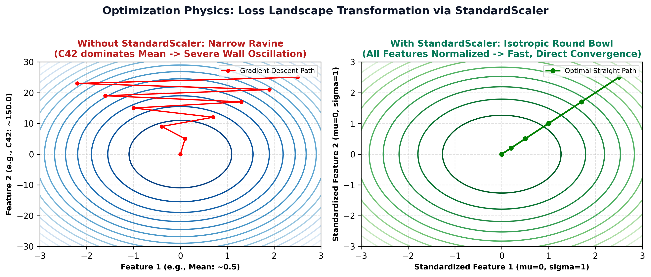
TOPIC 01 • OPTIMIZATION & FEATURE SCALING
Loss Landscapes: Narrow Ravine vs. Round Bowl
Feature Scaling Physics
Scale Disparity: Raw features span wildly different ranges.
Unscaled (Narrow Ravine): Gradients bounce across steep walls.
StandardScaler (Round Bowl): Zero mean, unit variance (fit on Train only) -> fast convergence.
EE136: Machine Learning for Wireless Communications | Capstone Mini-Project Brief
Slide 7 of 12

Slide 8
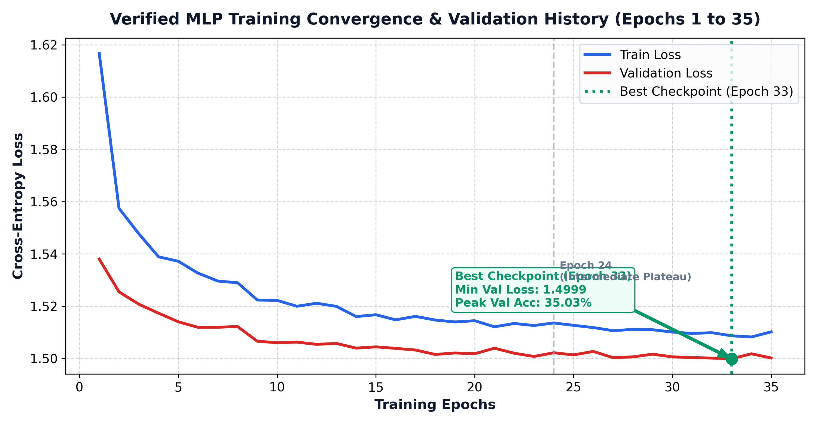
TOPIC 01 • TRAINING VERIFICATION & CHECKPOINTING
Training Convergence & Cross-Entropy Loss History
Training & Checkpointing
Loss: Cross-Entropy + L2 Decay (1e-4).
Optimizer: Adam (lr = 0.001, batch = 128, 35 epochs).
Best Checkpoint: Epoch 33 (Val Acc: 35.03%, Loss: 1.50).
Zero overfitting between Train & Validation curves.
EE136: Machine Learning for Wireless Communications | Capstone Mini-Project Brief
Slide 8 of 12

Slide 9
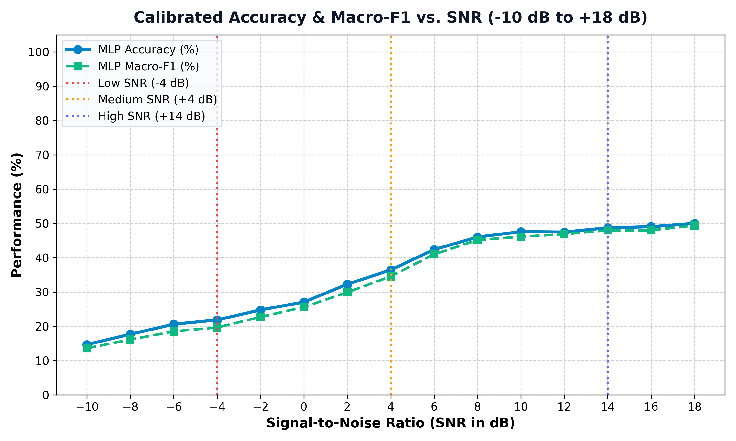
TOPIC 01 • STANDARDIZED EXPERIMENTAL EVALUATION
Operating-Condition Slicing: Accuracy vs. SNR (-10 to +18 dB)
SNR Regime Slicing (Week 03)
Low SNR (-10 to -2 dB): 14.7% -> 24.8% (noise floor).
Transition (0 to +6 dB): Jumps steeply to 42.4%.
High SNR (+8 to +18 dB): Plateaus at ~48.8% - 50.0%.
Ceiling Math (+14 dB):_x000B_ (1.0 BPSK + 0.86 QPSK + 1.0 PSK + 1.0 QAM) / 8 = 48.25% (Measured: 48.75%).
EE136: Machine Learning for Wireless Communications | Capstone Mini-Project Brief
Slide 9 of 12

Slide 10
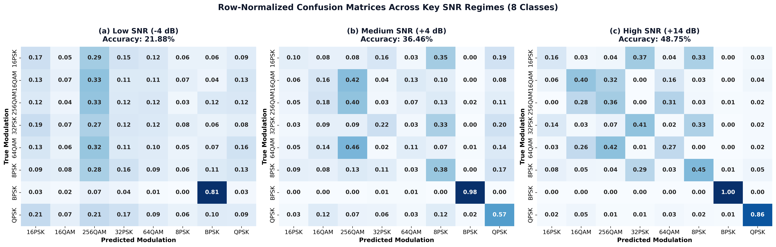
TOPIC 01 • ERROR DIAGNOSTICS & PER-CLASS SENSITIVITY
Confusion Matrix Diagnostics Across Key SNR Regimes
Confusion Matrix Regimes
Low SNR (-4 dB | 21.9%): Broad off-diagonal noise scatter.
Mid SNR (+4 dB | 36.5%): BPSK hits 98%, QPSK reaches 57%.
High SNR (+14 dB | 48.8%): BPSK 100%, QPSK 86%.
Block Confusion: Isolated within {8/16/32PSK} & {16/64/256QAM}.
EE136: Machine Learning for Wireless Communications | Capstone Mini-Project Brief
Slide 10 of 12

Slide 11
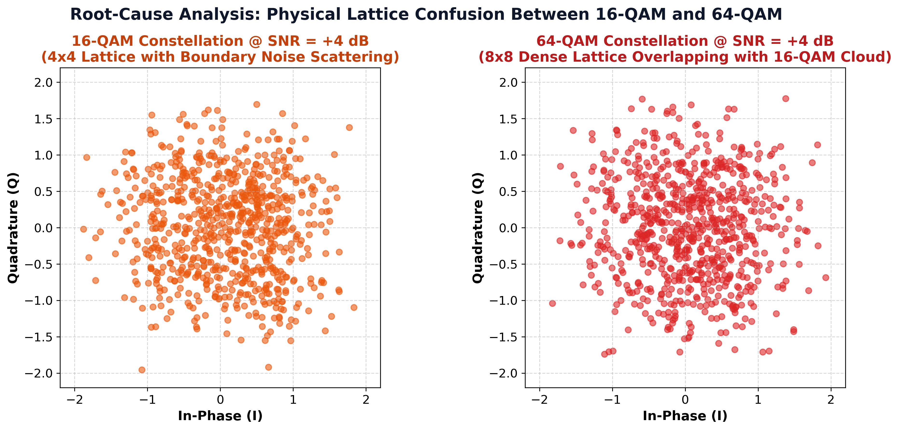
TOPIC 01 • WIRELESS ERROR ANALYSIS
Root-Cause Analysis: Feature Ceiling & QAM Lattice Overlap
Why ~49% Ceiling?
M>=8 PSK Limit: 8/16/32PSK share identical cumulants up to order 6 (|C40|=0).
Dense QAM Overlap: Short L=128 burst variance blurs 16/64/256QAM rings.
Conclusion: 18-feature limit, NOT an MLP flaw.
EE136: Machine Learning for Wireless Communications | Capstone Mini-Project Brief
Slide 11 of 12

Slide 12
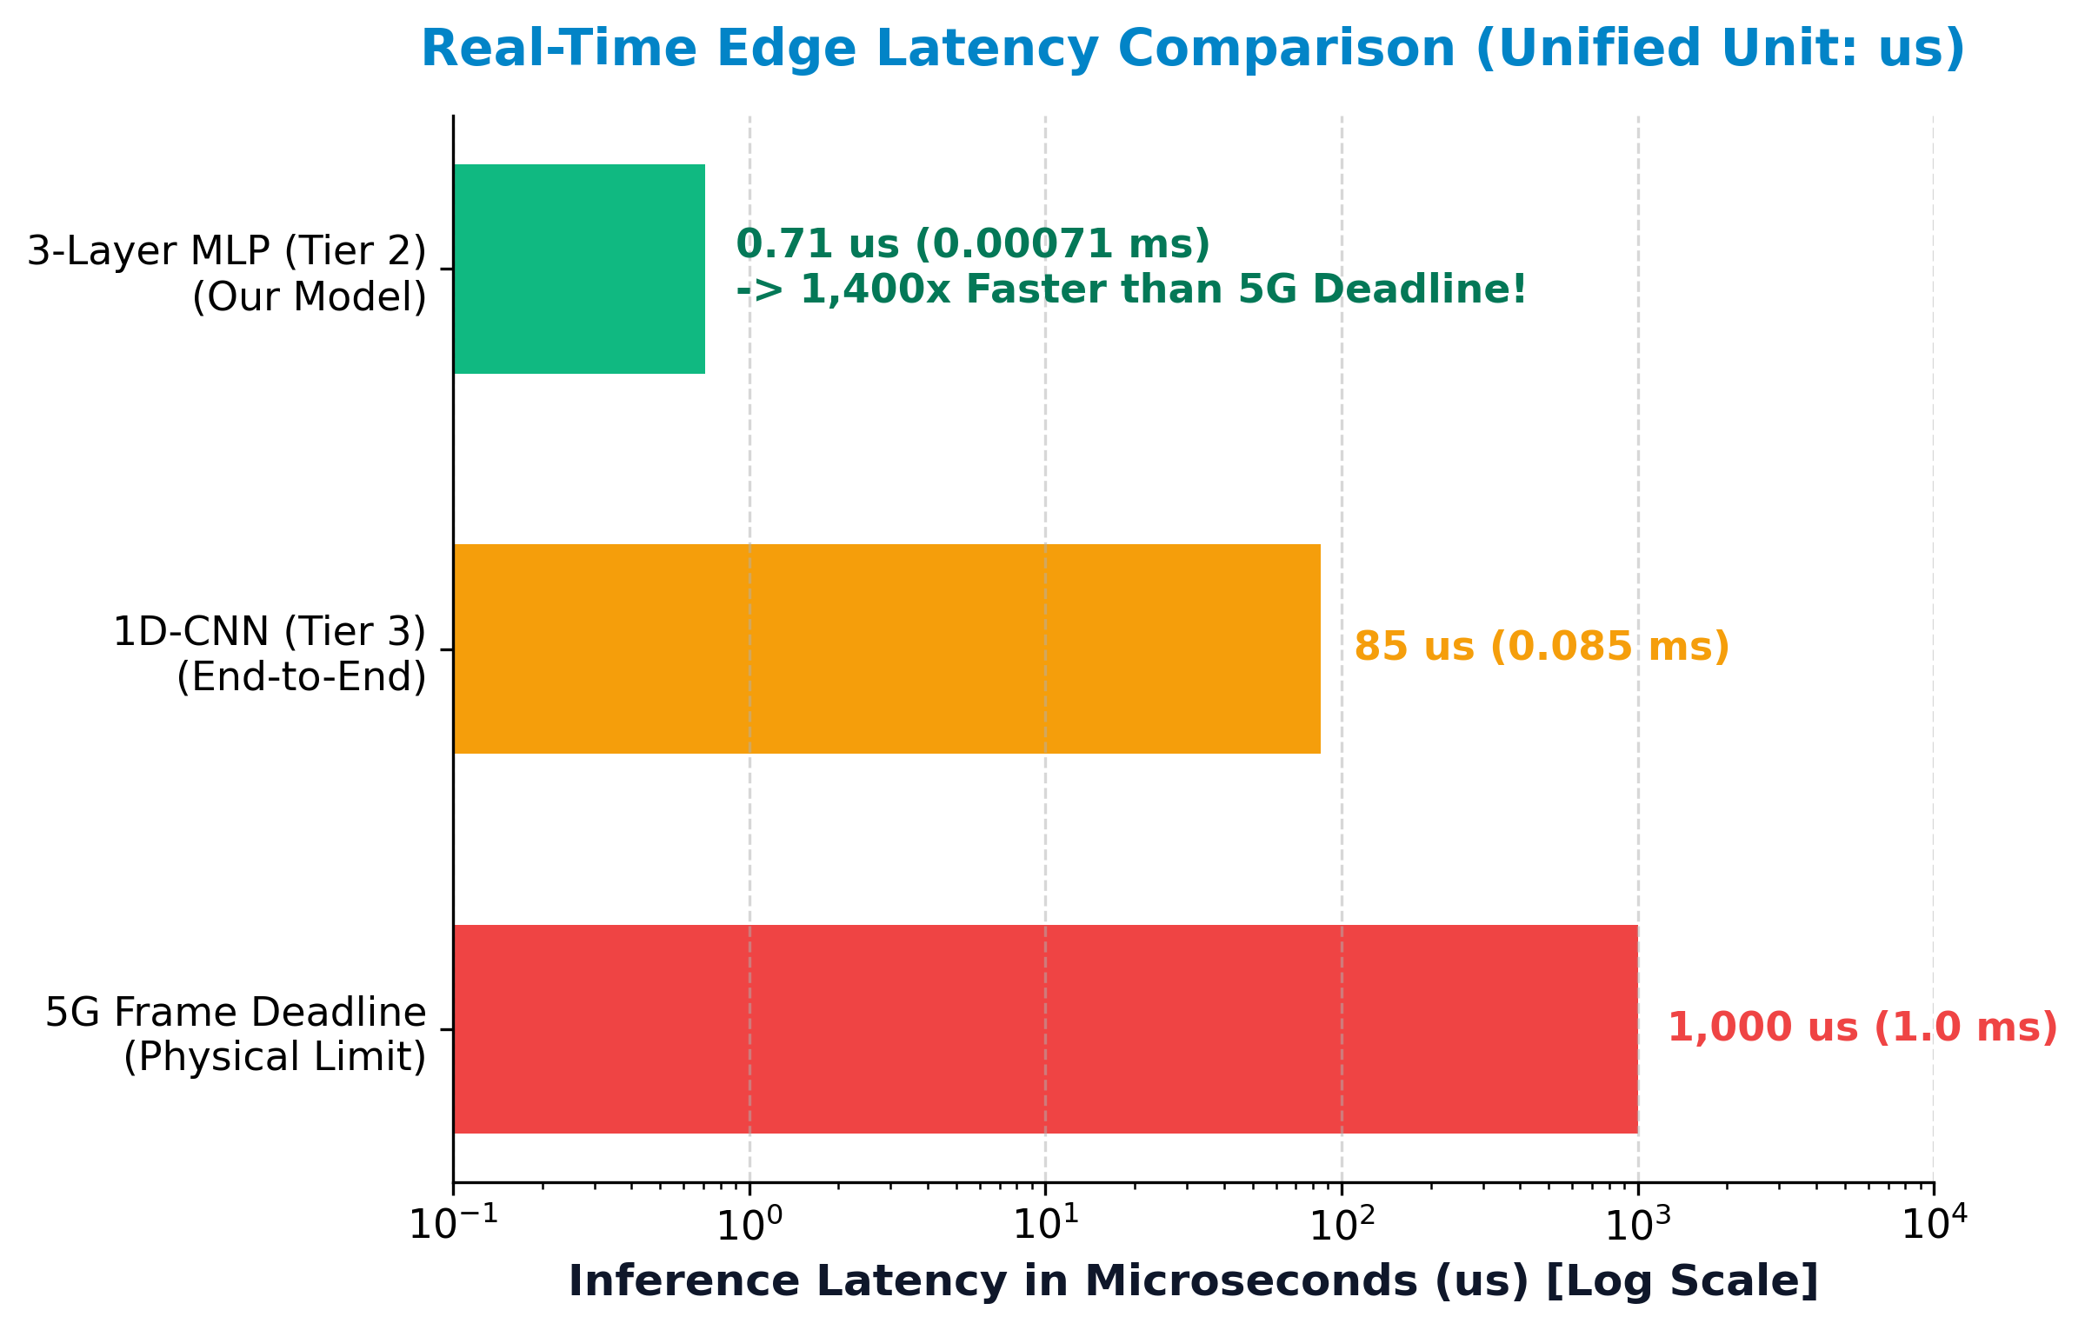
TOPIC 01 • EDGE DEPLOYMENT & MODELING TRADE-OFFS
Hardware Latency Profiling & Three-Tier Synthesis
Edge Deployment & Trade-Offs
5G Frame Deadline: 1,000 us (1.0 ms).
MLP Speed: 0.71 us (Batch) | ~36 us (Single) -> 1,400x faster than 5G deadline!
Tiny Footprint: 52.5 KB (11,592 params in L1 cache).
Trade-Off: Fastest for IoT edge; 1D-CNN needs raw I/Q + GPU.
EE136: Machine Learning for Wireless Communications | Capstone Mini-Project Brief
Slide 12 of 12

