Slide 1
TOPIC 01 • 1D CNN BENCHMARK
1D CNN Architecture & Training Setup
Raw 128-sample I/Q bursts | 8 digital modulation classes
THREE CONVOLUTION BLOCKS
MODEL CONFIGURATION
Training data
67,200 bursts
Input
Block 1
Block 2
Block 3
Output
Validation / test
14,400 each
2 × 128
2 → 32
32 → 64
64 → 128
8 classes
Batch size
256
Optimizer
Adam, LR = 0.001
Conv1D (k=5) + BatchNorm + ReLU + MaxPool(2) in each block
Criterion
Cross-entropy
AdaptiveAvgPool → Dropout (0.25) → Linear (8 outputs)
Parameters
53,224
Best epoch
28
EE136: Machine Learning for Wireless Communications | Topic 1 • 1D CNN
Slide 1 of 6

Slide 2
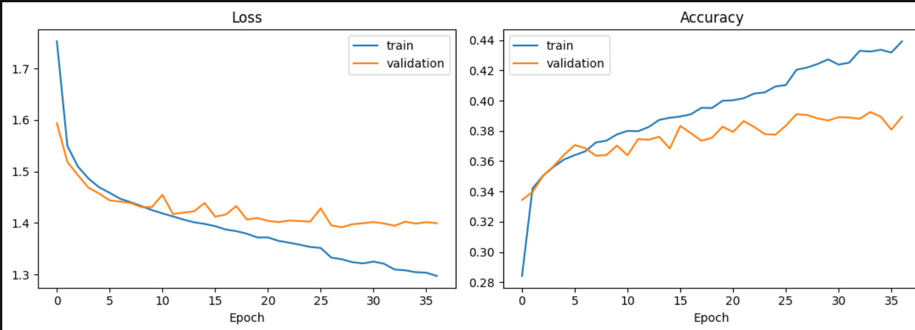
TOPIC 01 • 1D CNN BENCHMARK
Training Dynamics & Model Selection
Initial 30 epochs plus 7 additional epochs | Early stopping
TRAINING FINDINGS
• Validation loss flattens near 1.39–1.40.
• Training accuracy rises, but validation remains near 39%.
• Best checkpoint: epoch 28.
• Early stopping: epoch 37.
EE136: Machine Learning for Wireless Communications | Topic 1 • 1D CNN
Slide 2 of 6

Slide 3
TOPIC 01 • 1D CNN BENCHMARK
Test Results & Per-Class Performance
14,400 held-out test bursts | fixed split and 8 classes
TEST ACCURACY
MACRO-F1
MODEL SIZE
LATENCY / SAMPLE
39.22%
35.97%
0.213 MB
0.424 ms
PER-CLASS F1-SCORE
DIAGNOSTIC HIGHLIGHTS
BPSK
81%
• BPSK recognized most reliably (F1 = 0.81).
• 64QAM poorly identified (F1 = 0.05).
• Higher-order QAM/PSK classes remain difficult.
QPSK
53%
8PSK
35%
16QAM
35%
256QAM
33%
32PSK
31%
16PSK
14%
64QAM
5%
EE136: Machine Learning for Wireless Communications | Topic 1 • 1D CNN
Slide 3 of 6

Slide 4
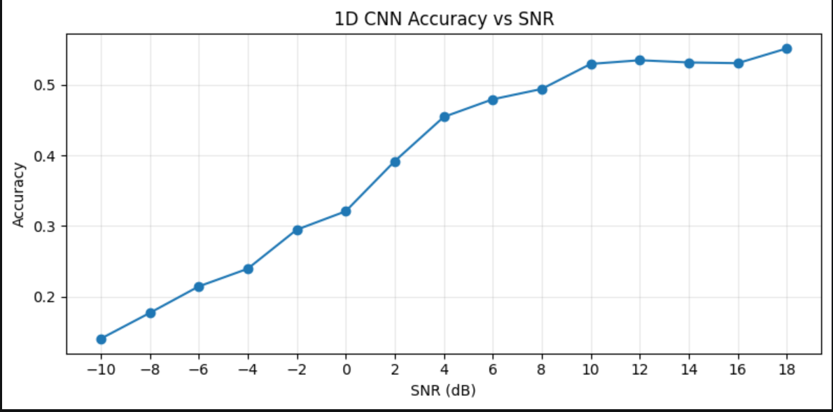
TOPIC 01 • 1D CNN BENCHMARK
Noise Robustness | Accuracy vs. SNR
15 calibrated SNR levels from −10 dB to +18 dB
SNR SNAPSHOTS
≈14%
−10 dB
53.13%
+14 dB
55.10%
+18 dB
EE136: Machine Learning for Wireless Communications | Topic 1 • 1D CNN
Slide 4 of 6

Slide 5
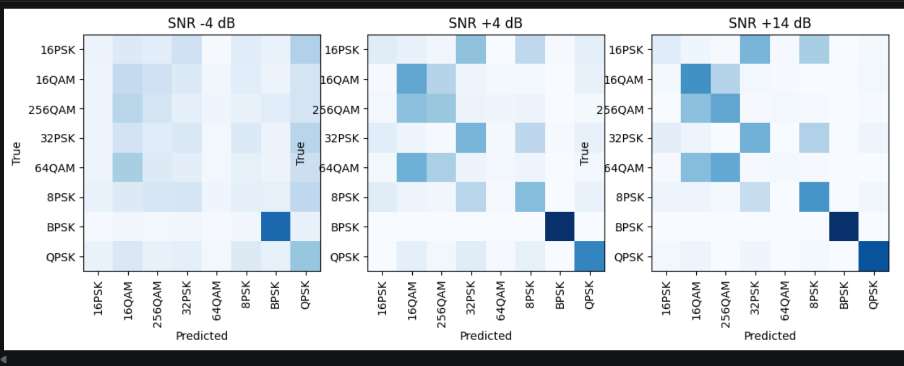
TOPIC 01 • 1D CNN BENCHMARK
Confusion Matrices & Failure Analysis
Row-normalized at −4 dB, +4 dB, and +14 dB
Low SNR: widespread confusion | High SNR: PSK/QAM ambiguity persists
EE136: Machine Learning for Wireless Communications | Topic 1 • 1D CNN
Slide 5 of 6

Slide 6
TOPIC 01 • 1D CNN BENCHMARK
Benchmark Handoff | Classical ML vs. MLP vs. 1D CNN
Model-specific results aligned for the final team comparison
METRIC
CLASSICAL ML
MLP
1D CNN
Input
18 features
18 features
Raw I/Q
Test accuracy
Pending
Pending
39.22%
Macro-F1
Pending
Pending
35.97%
Training time
Pending
Pending
Verify total
Parameter count
Model-specific
Pending
53,224
File size
Pending
Pending
0.213 MB
Latency / sample
Pending
Pending
0.424 ms
Overlay all three Accuracy–SNR curves using identical test splits and measurement settings.
EE136: Machine Learning for Wireless Communications | Topic 1 • 1D CNN
Slide 6 of 6

