Slide 1
EE136 • MACHINE LEARNING FOR WIRELESS COMMUNICATIONS
Topic 1: Comprehensive Model Benchmark
Classical ML vs. 3-Layer MLP vs. 1D CNN
Automatic Modulation Classification · Benchmark across 8 digital modulation classes
96,000
8
15
3
I/Q bursts
modulation classes
SNR operating points
model families

Slide 2
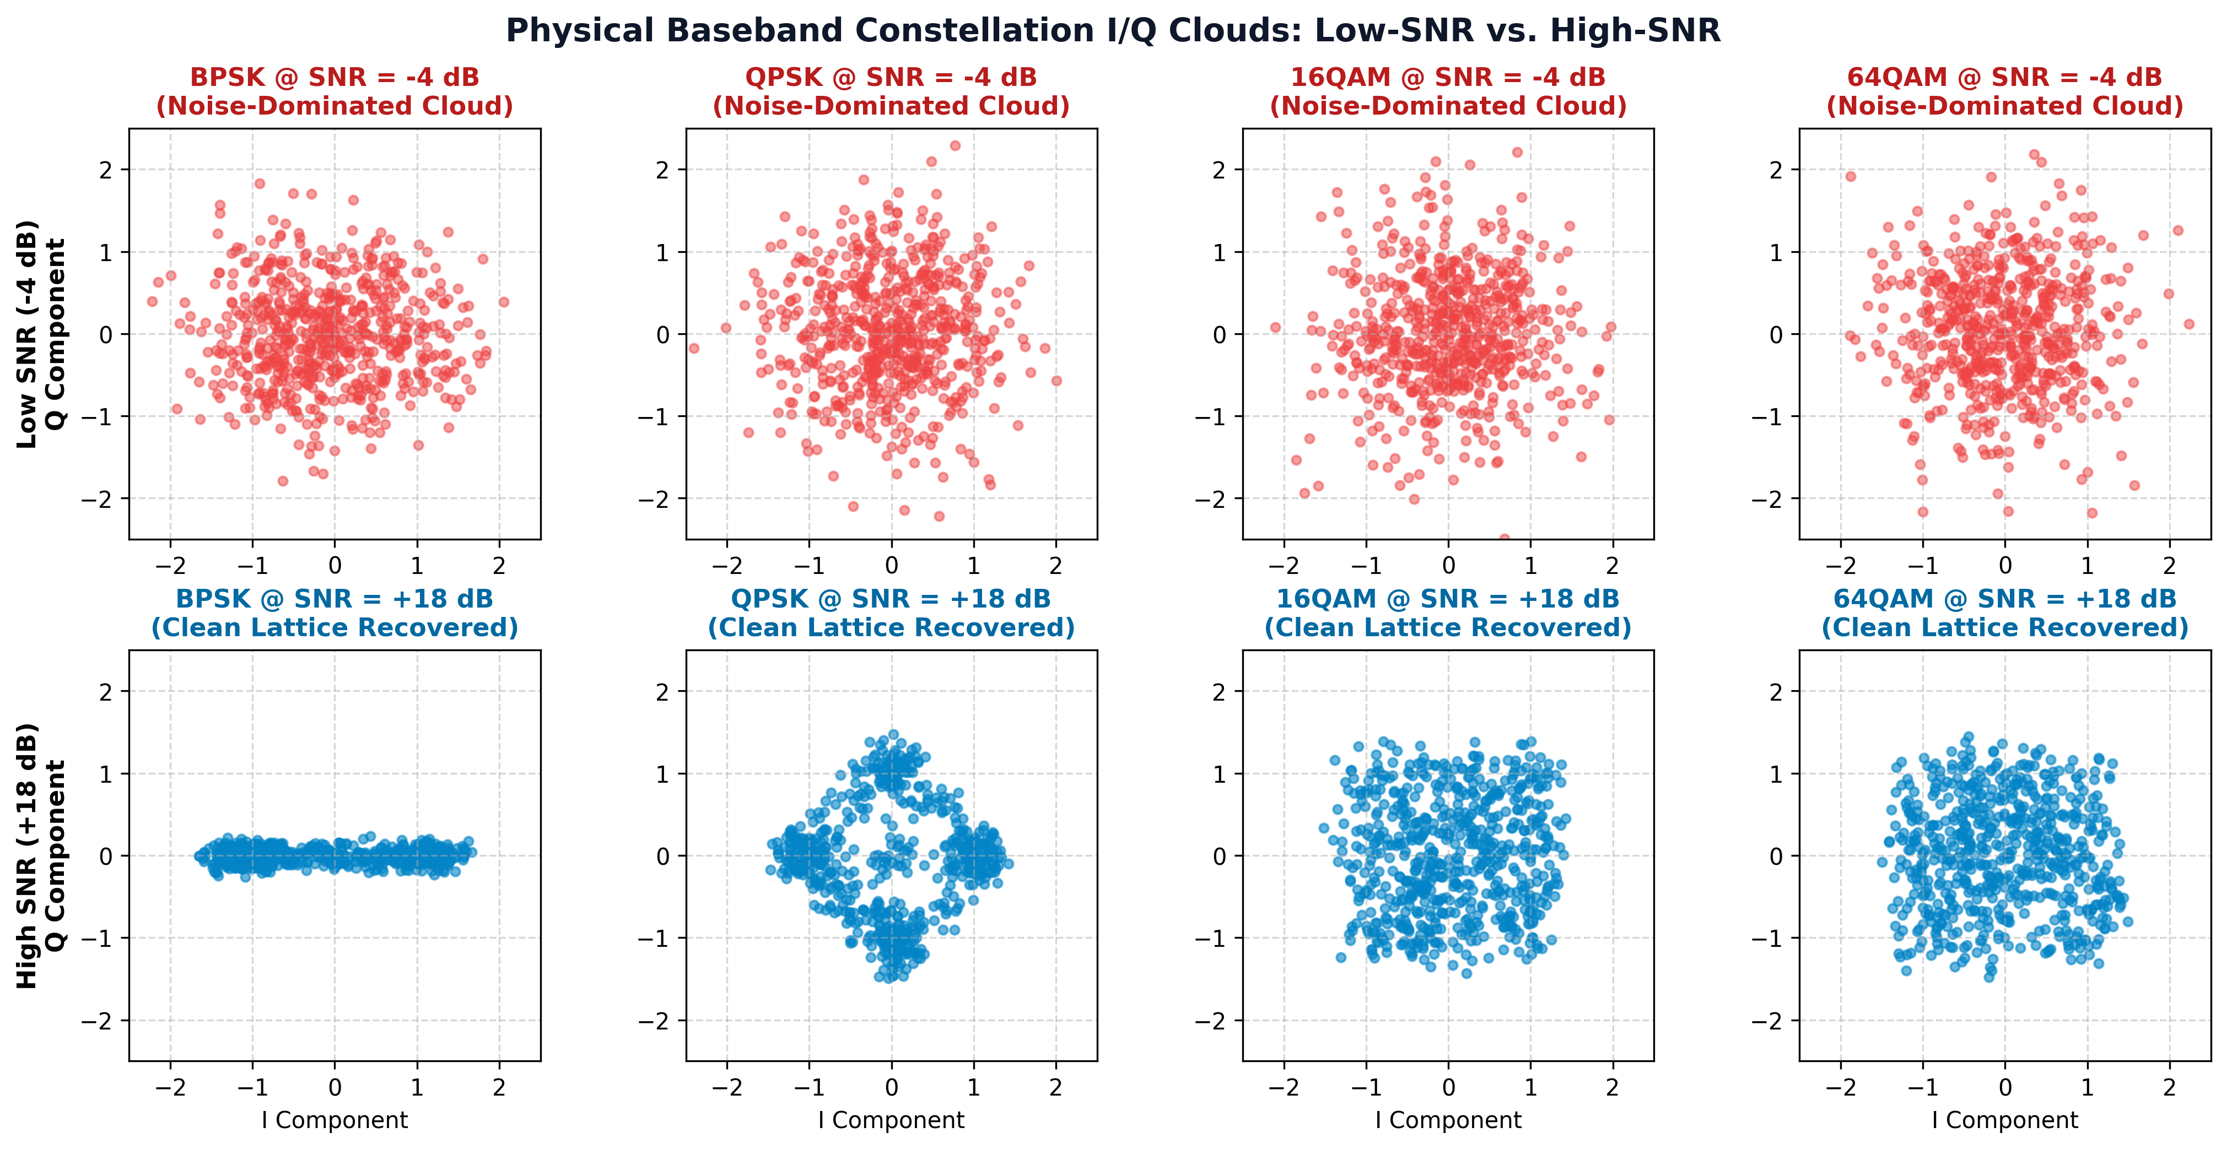
PART I • BASEBAND WIRELESS PHYSICS
Baseband Physics: AMC Problem & Constellation Clouds
Physical Layer Problem
INPUT: One short burst of 128 complex samples: r[n] = I[n] + jQ[n].
8 CLASSES: 5 PSK types (BPSK–32PSK) and 3 QAM types (16–256QAM).
CHANNELS: AWGN noise and Rayleigh 3-tap multipath fading.
LOW-SNR EFFECT: At −4 dB, constellation clouds strongly overlap; classification is difficult.
EE136: Machine Learning for Wireless Communications | Topic 1: Comprehensive Model Benchmark
Slide 2 of 19

Slide 3
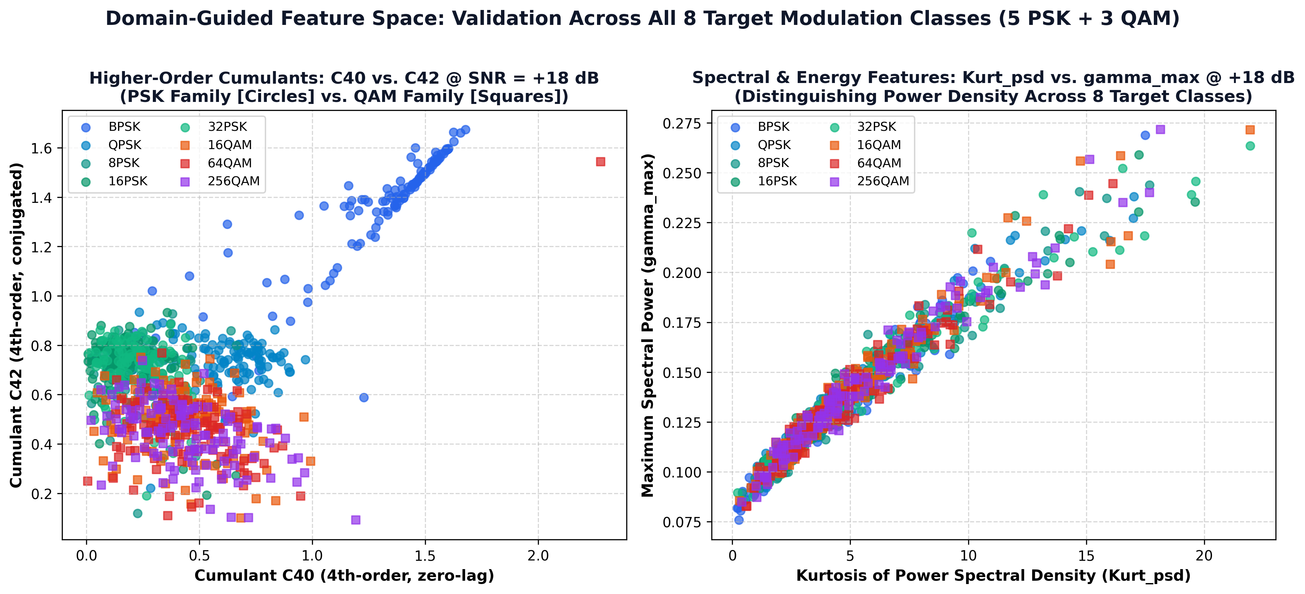
PART I • FEATURE ENGINEERING & LIMITATIONS
From Raw I/Q to 18 Features: Why Compare with CNN?
Raw I/Q → 18 Domain Features
INPUT: 128 complex samples = 256 real values.
FEATURE SET: 9 cumulants, 2 envelope/PAPR and 7 spectral/phase statistics.
LIMITATION: Higher-order PSK and QAM clusters overlap in feature space.
WHY 1D CNN?: It learns temporal patterns directly from raw I/Q rather than hand-crafted features.
EE136: Machine Learning for Wireless Communications | Topic 1: Comprehensive Model Benchmark
Slide 3 of 19

Slide 4
PART II • TIER 1: CLASSICAL MACHINE LEARNING
Tier 1 Architecture: Random Forest (Bagging) vs. SVM (RBF Kernel)
Random Forest · 200 Trees
METHOD: Bootstrap aggregation with Gini-impurity splits.
INPUT: 18 engineered features from 67,200 training bursts.
COMPLEXITY: ~140.6 million decision-tree nodes.
MODEL SIZE: 999.7 MB on disk.
TRAINING: 121.03 seconds on CPU.
INFERENCE: ~0.28 ms per burst: fast, but memory-heavy.
SVM · RBF Kernel
METHOD: Nonlinear maximum-margin classification.
KERNEL: RBF, C = 10, gamma = scale.
COMPLEXITY: 57,531 support vectors (~1.04M coefficients).
MODEL SIZE: 14.96 MB on disk.
TRAINING: 1,788.23 seconds on CPU.
INFERENCE: ~9.70 ms per burst: compact, but slower.
EE136: Machine Learning for Wireless Communications | Topic 1: Comprehensive Model Benchmark
Slide 4 of 19

Slide 5
PART II • TIER 1: CLASSICAL MACHINE LEARNING
Classical ML: Compute, Memory & Latency
Metric / Specification | Random Forest (RF) | SVM (RBF Kernel) | Comparison (RF vs. SVM) | Engineering Impact
Training Duration (CPU) | 121.03 s (~2.0 min) | 1,788.23 s (~29.8 min) | SVM is 14.8x slower | RF enables rapid retraining on SDR nodes
Trainable Parameters | 140,572,728 tree nodes | 1,035,568 SV weights | RF has 135x more params | RF suffers severe parameter explosion
Checkpoint File Size | 999.7 MB (0.98 GB) | 14.96 MB (0.015 GB) | RF is 66x larger on disk | SVM fits on flash; RF requires large DRAM
Single-Burst Latency (B=1) | ~280 µs (0.28 ms) | ~9,700 µs (9.70 ms) | RF is 35x faster in infer. | RF satisfies 5G 1ms budget; SVM FAILS
Why RF Is Favored over SVM
SVM BOTTLENECK: ~9.7 ms per burst versus ~0.28 ms for RF.
SAME ACCURACY: Both baselines achieve approximately 33.8% overall in this experiment.
DECISION: RF offers much faster inference, at a major memory cost.
RF: Fast Inference, Large Footprint
TREE LOOKUPS: Inference uses threshold comparisons rather than RBF kernel evaluations.
DASHBOARD: ~280 µs per burst suits interactive predictions.
TRADE-OFF: Nearly 1 GB checkpoint makes small-device deployment difficult.
EE136: Machine Learning for Wireless Communications | Topic 1: Comprehensive Model Benchmark
Slide 5 of 19

Slide 6
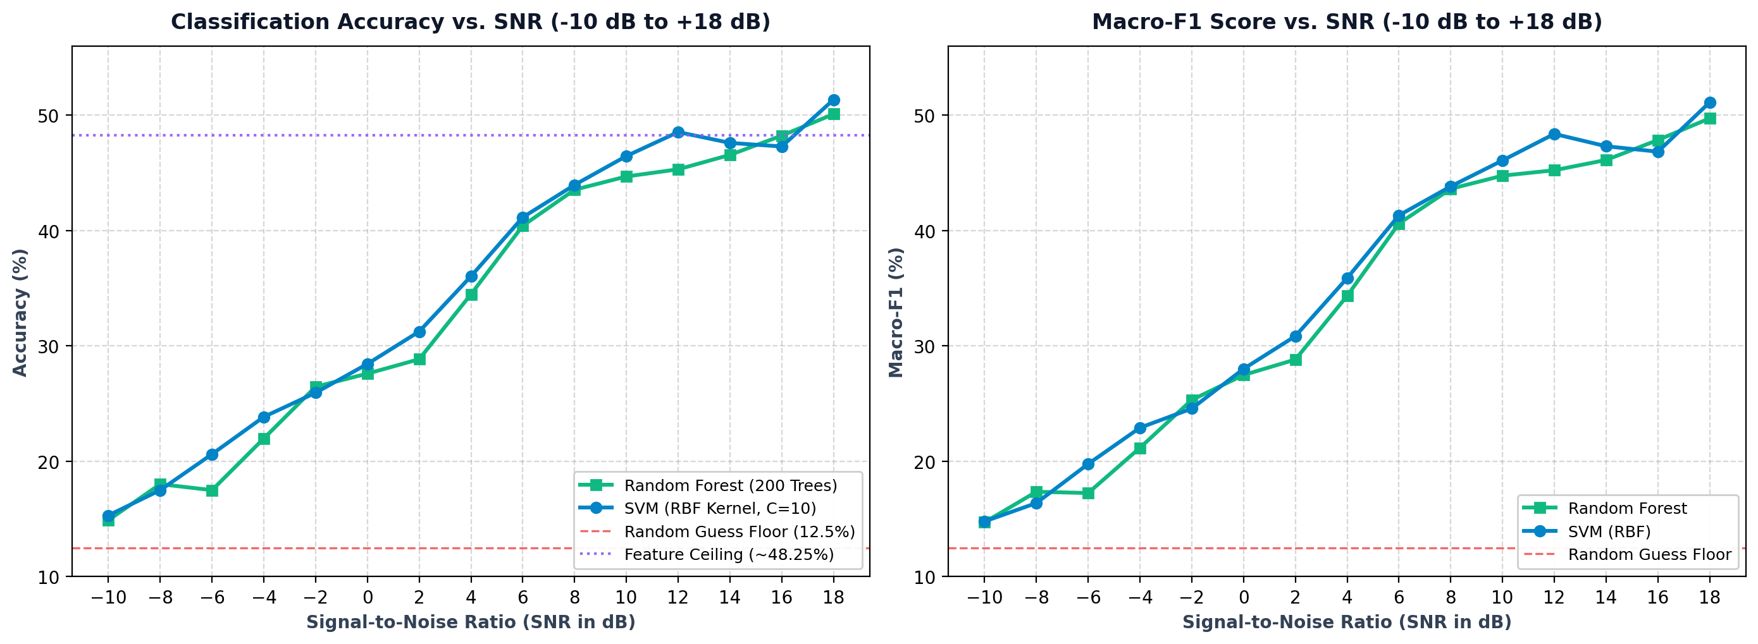
PART II • TIER 1: CLASSICAL MACHINE LEARNING
Classical ML: Accuracy & Macro-F1 vs. SNR
SNR Regime Breakdown
−10 to −2 dB: Accuracy rises ~15% → 27%; noise dominates feature estimates.
0 to +6 dB: RF accuracy improves to ~40% as the signal becomes clearer.
+8 to +18 dB: Performance flattens near 48–51%.
INTERPRETATION: Higher-order PSK and QAM classes remain hard to separate with 18 features.
EE136: Machine Learning for Wireless Communications | Topic 1: Comprehensive Model Benchmark
Slide 6 of 19

Slide 7
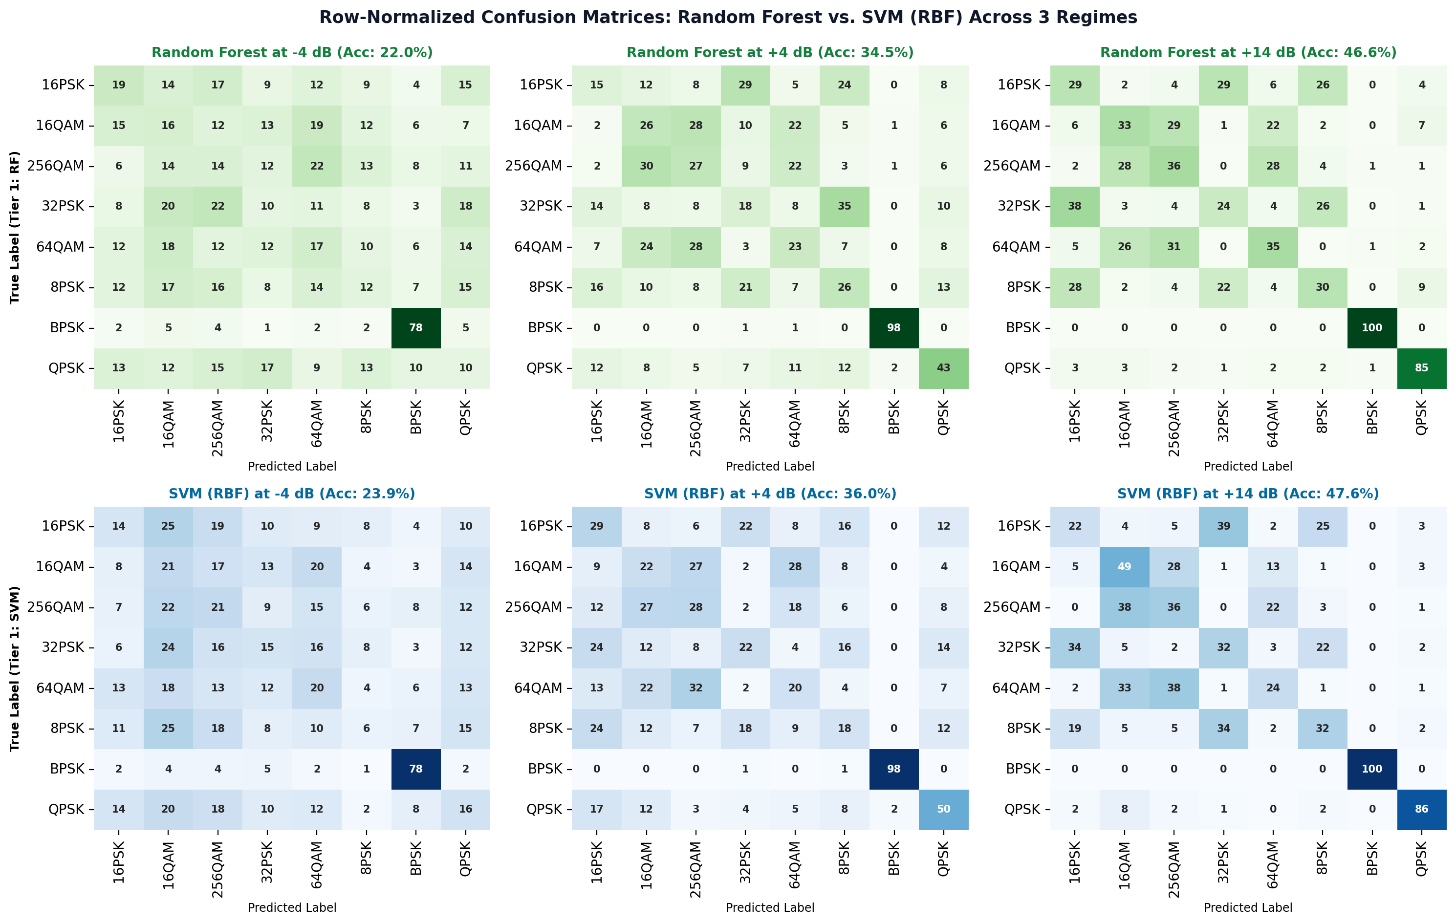
PART II • TIER 1: CLASSICAL MACHINE LEARNING
Classical ML: Confusion Matrices & Key Features
Class Confusion & Features
−4 dB: Noise scatters predictions across many classes.
+4 dB: BPSK separates strongly; high-order classes still mix.
+14 dB: 8/16/32PSK and QAM families remain confused.
TOP FEATURES: C40 · C42 · PAPR · amplitude spread · phase entropy.
EE136: Machine Learning for Wireless Communications | Topic 1: Comprehensive Model Benchmark
Slide 7 of 19

Slide 8
PART III • TIER 2: AUTOMATIC MODULATION CLASSIFICATION (3-LAYER MLP)
3-Layer MLP: Network Architecture
INPUT
18: engineered features
SCALE: StandardScaler
OUTPUT: 18 standardized values
HIDDEN LAYER 1
128: neurons
LINEAR: 18 → 128
ACTIVATE: BatchNorm + ReLU
REGULARIZE: Dropout 0.2
HIDDEN LAYER 2
64: neurons
LINEAR: 128 → 64
ACTIVATE: BatchNorm + ReLU
REGULARIZE: Dropout 0.2
OUTPUT
8: digital modulation schemes
LINEAR: 64 → 8
PREDICT: class probabilities
11,592 parameters • 52.5 KB checkpoint • 58.75 s CPU training
Adam (lr=0.001, batch=128) | BatchNorm + Dropout(0.2) + L2
EE136: Machine Learning for Wireless Communications | Topic 1: Comprehensive Model Benchmark
Slide 8 of 19

Slide 9
PART III • TIER 2: NEURAL NETWORK (3-LAYER MLP)
MLP Forward Pass: From Features to Prediction
01 · Extract
18 FEATURES:
From raw signal Higher-order cumulants, spectral and phase statistics.
EXAMPLES: C40, C42, Kurt_psd, PAPR.
RESULT: Input vector x ∈ ℝ¹⁸.
02 · Normalize
SCALER: z = (x − μ) / σ.
PURPOSE: Center features and place them on comparable numerical scales.
BENEFIT: More stable gradient-based learning.
03 · Forward
LAYER 1: 18 → 128, BN + ReLU.
LAYER 2: 128 → 64, BN + ReLU.
LAYER 3: 64 → 8 output logits.
04 · Predict
SOFTMAX: Turns eight logits into probabilities.
EXAMPLE: 16QAM 82% · 64QAM 11%.
OUTPUT: Highest-probability class is selected.
EE136: Machine Learning for Wireless Communications | Topic 1: Comprehensive Model Benchmark
Slide 9 of 19

Slide 10
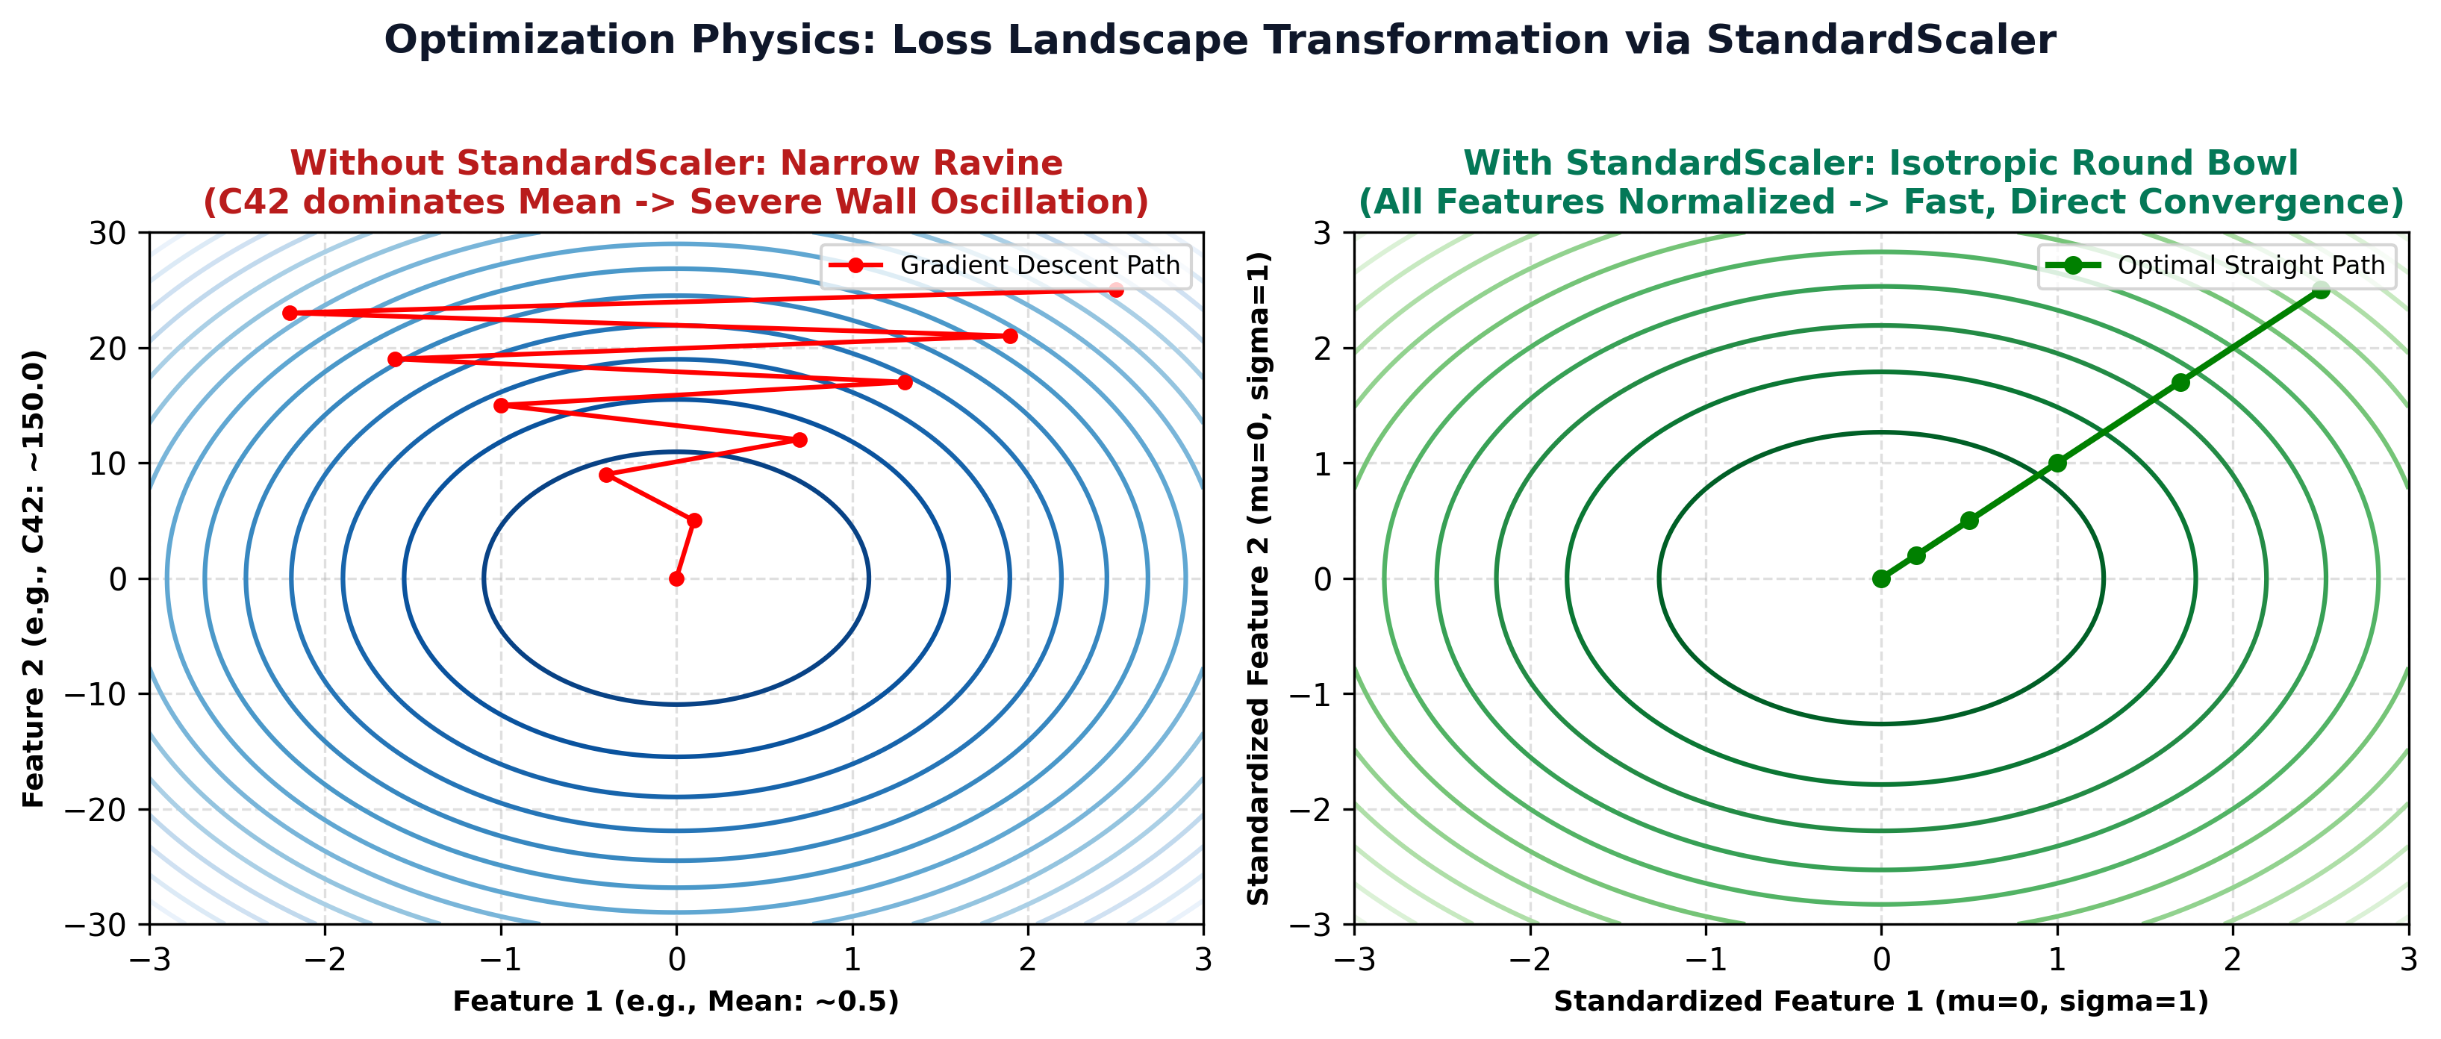
PART III • TIER 2: NEURAL NETWORK (3-LAYER MLP)
Loss Landscapes: Narrow Ravine vs. Round Bowl
Why Standardization Matters
MISMATCH: PAPR, cumulants and PSD features have different numerical scales.
UNSCALED: Optimization may oscillate across a steep, narrow loss landscape.
SCALED: z = (x − μ)/σ reduces scale imbalance.
BENEFIT: More stable optimization and faster convergence with Adam.
EE136: Machine Learning for Wireless Communications | Topic 1: Comprehensive Model Benchmark
Slide 10 of 19

Slide 11
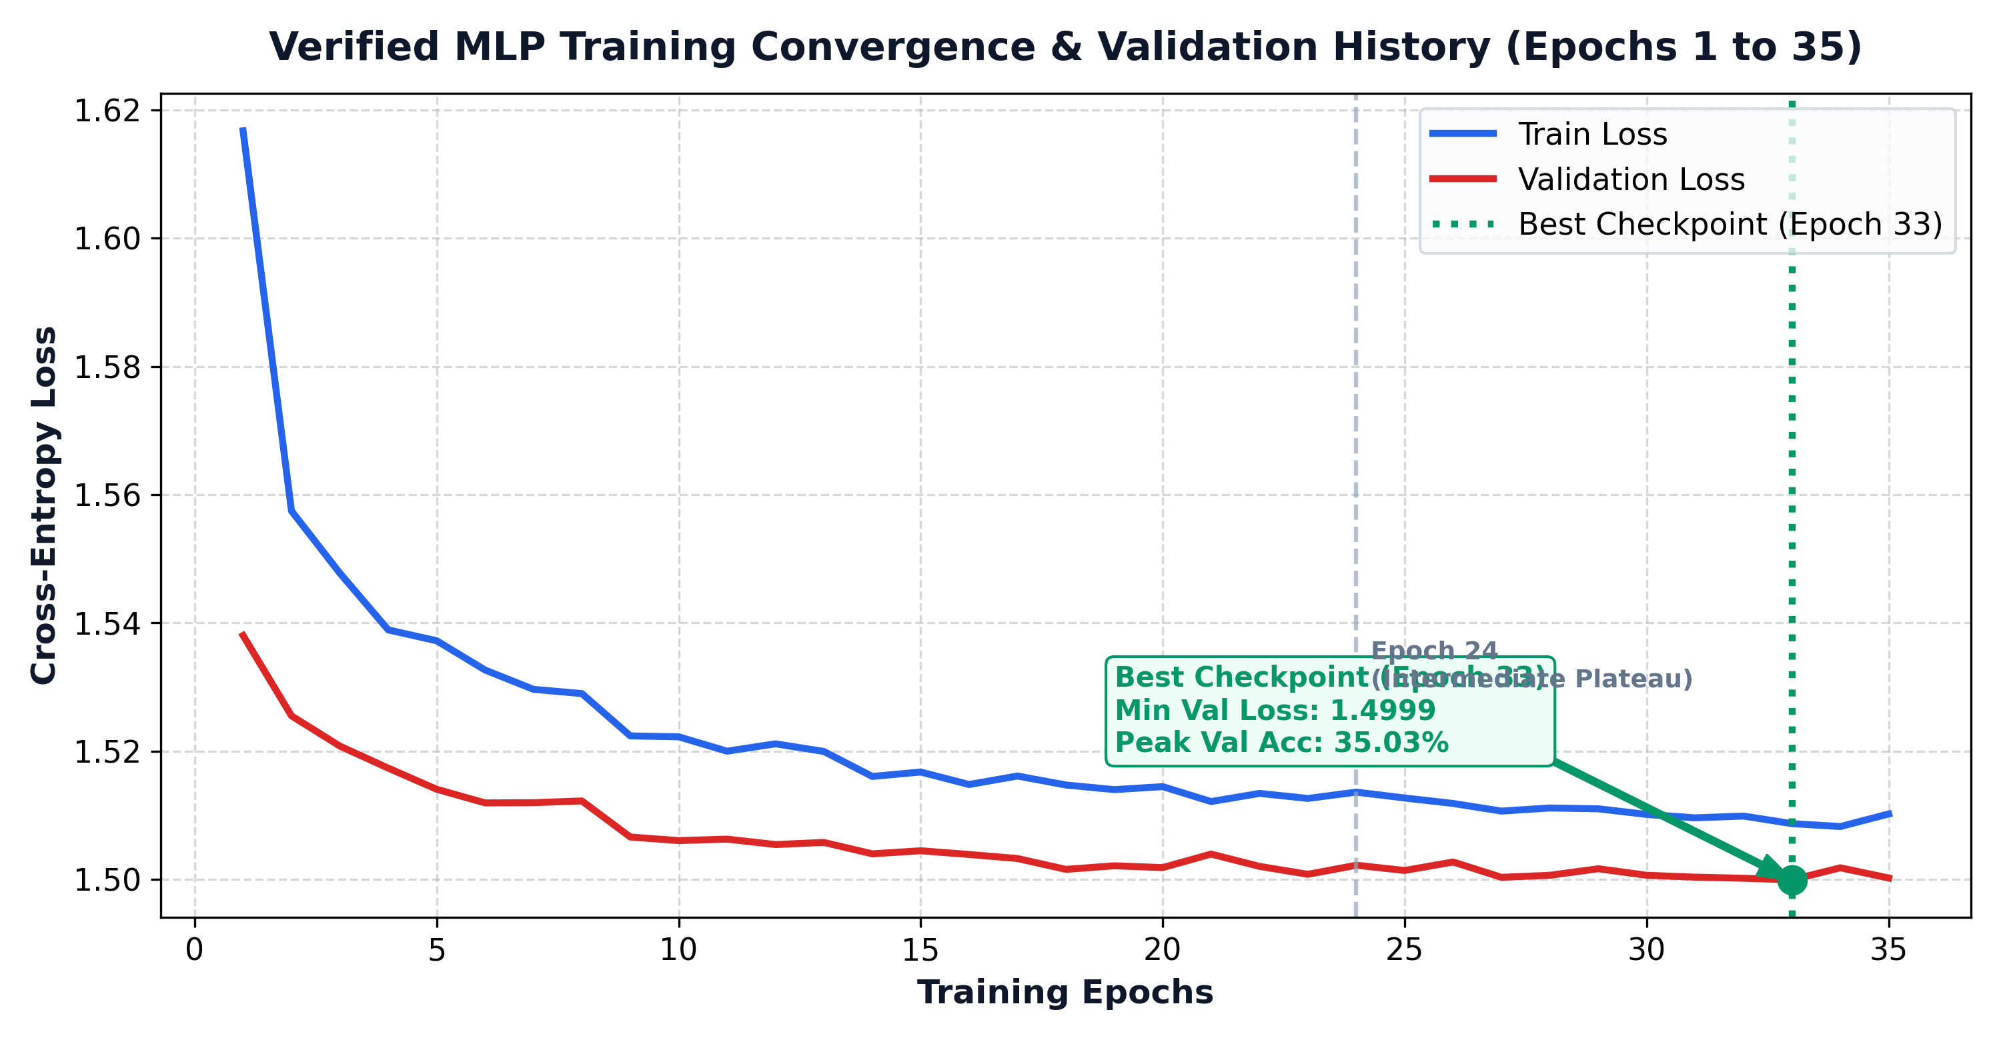
PART III • TIER 2: NEURAL NETWORK (3-LAYER MLP)
Training Convergence & Cross-Entropy Loss History
Training & Checkpointing
LOSS: Cross-entropy + L2 weight decay (10⁻⁴).
OPTIMIZER: Adam, learning rate 0.001; batch size 128.
TRAINING: 35 epochs · 58.75 s on CPU.
BEST CHECKPOINT: Epoch 33: val loss 1.572; val accuracy 39.8%.
GENERALIZATION: Train/validation curves remain close.
EE136: Machine Learning for Wireless Communications | Topic 1: Comprehensive Model Benchmark
Slide 11 of 19

Slide 12
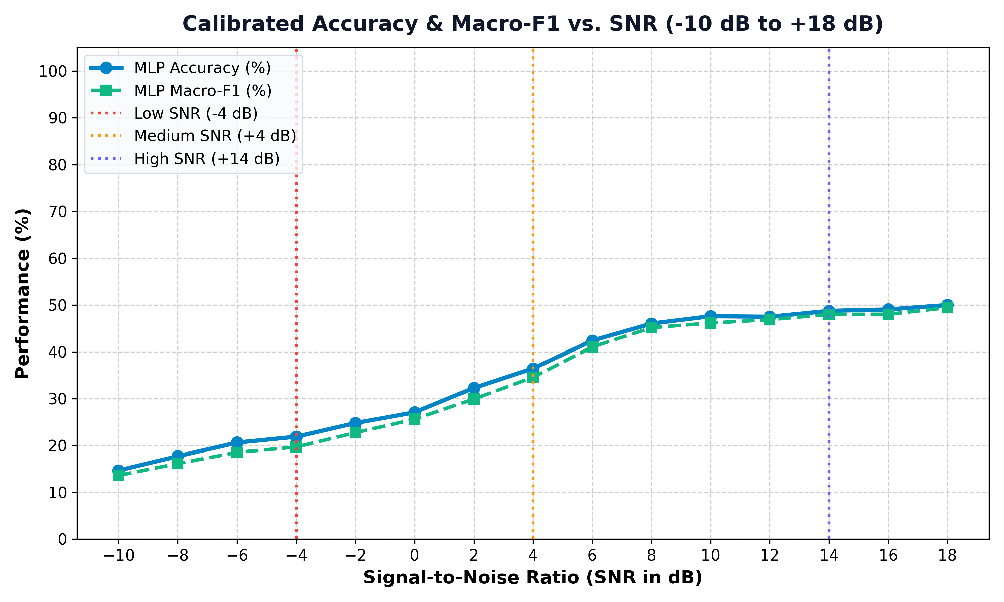
PART III • TIER 2: NEURAL NETWORK (3-LAYER MLP)
MLP Error Diagnostics & Operating-Condition Slicing
Performance by SNR
−10 to −2 dB: Accuracy ~15% → 25%; noisy feature estimates.
0 to +6 dB: Steep recovery; reaches ~42%.
+8 to +18 dB: Accuracy flattens near 49%.
ERROR MODE: 8/16/32PSK and 16/64/256QAM remain overlapping.
CONCLUSION: Feature representation constrains the MLP baseline.
EE136: Machine Learning for Wireless Communications | Topic 1: Comprehensive Model Benchmark
Slide 12 of 19

Slide 13
PART IV • TIER 3: DEEP CONVNET (1D CNN)
1D CNN: Architecture & Raw I/Q Training
3-Block 1D CNN · Raw I/Q
INPUT: [2, 128] raw baseband tensor; no hand-crafted features.
BLOCK 1: Conv1D 2 → 32 · BN · ReLU · MaxPool → [32, 64].
BLOCK 2: Conv1D 32 → 64 · BN · ReLU · MaxPool → [64, 32].
BLOCK 3: Conv1D 64 → 128 · BN · ReLU · MaxPool → [128, 16].
HEAD: Global average pooling → Dropout 0.25 → Linear(128, 8).
ALL KERNELS: 5 samples, padding 2; learning temporal patterns.
Training Configuration
DATA: 67,200 train; 14,400 validation; 14,400 test.
OPTIMIZER: Adam (lr=0.001), cross-entropy loss.
BATCH: 256 bursts per iteration.
PARAMETERS: 53,224 trainable weights.
CHECKPOINT: 0.213 MB on disk.
BEST EPOCH: 28 · val loss 1.3915.
EE136: Machine Learning for Wireless Communications | Topic 1: Comprehensive Model Benchmark
Slide 13 of 19

Slide 14
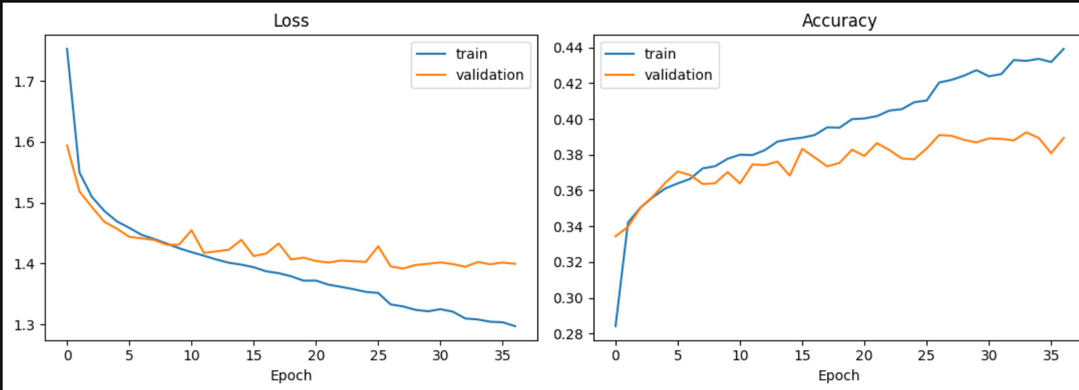
PART IV • TIER 3: DEEP CONVNET (1D CNN)
1D CNN Training Dynamics & Model Selection
Training Findings
EARLY EPOCHS: Both training and validation loss drop quickly.
AFTER ~20 EPOCHS: Validation loss stabilizes near 1.39–1.40.
BEST CHECKPOINT: Epoch 28, chosen by minimum validation loss.
STOPPING: Early stopping triggered at epoch 37.
TAKEAWAY: Train accuracy still climbs; validation gains are small.
EE136: Machine Learning for Wireless Communications | Topic 1: Comprehensive Model Benchmark
Slide 14 of 19

Slide 15
PART IV • TIER 3: DEEP CONVNET (1D CNN)
1D CNN Test Results & Per-Class Performance
TEST ACCURACY
39.22%
TEST MACRO-F1
35.97%
MODEL SIZE
0.213 MB
LATENCY / SAMPLE
0.424 ms
PER-CLASS F1-SCORE
Error Diagnostics
BPSK: Most reliable class (F1 = 0.81).
QPSK: Recognized moderately well (F1 = 0.53).
64QAM: Very weak recognition (F1 = 0.05).
ROOT CAUSE: Higher-order PSK/QAM constellations still overlap under multipath and short bursts.
LESSON: Raw I/Q helps, but cannot remove all class ambiguity.
BPSK
81%
256QAM
33%
QPSK
53%
32PSK
31%
8PSK
35%
16PSK
14%
16QAM
35%
64QAM
5%
EE136: Machine Learning for Wireless Communications | Topic 1: Comprehensive Model Benchmark
Slide 15 of 19

Slide 16
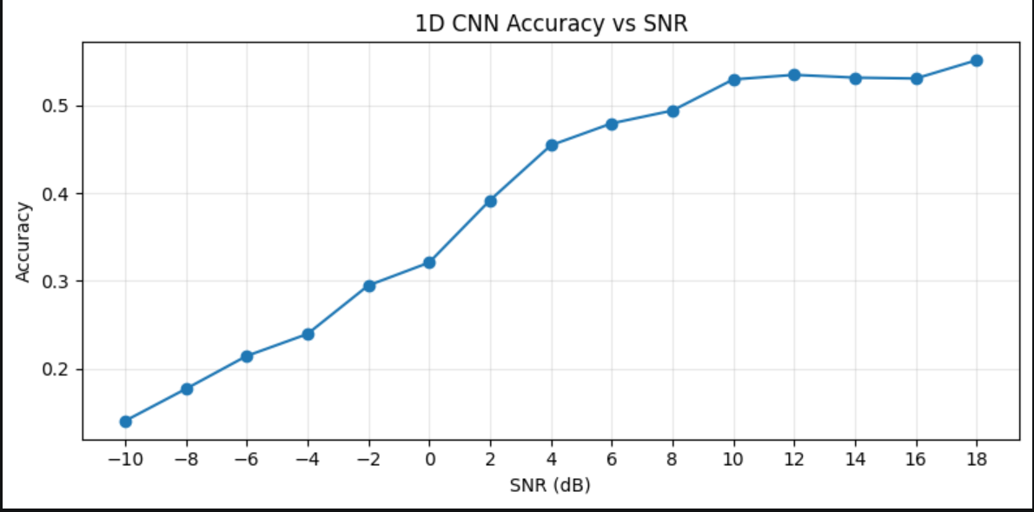
PART IV • TIER 3: DEEP CONVNET (1D CNN)
1D CNN Noise Robustness & Phase Trajectory Exploitation
1D CNN Across SNR
RAW I/Q: Temporal Conv1D kernels operate on adjacent samples.
−10 dB: Only ~14% accuracy under severe noise.
+14 dB: 53.13% test accuracy.
+18 dB: 55.10% test accuracy.
COMPARISON: Higher high-SNR accuracy than feature-based baselines, but the curve still flattens above +10 dB.
EE136: Machine Learning for Wireless Communications | Topic 1: Comprehensive Model Benchmark
Slide 16 of 19

Slide 17
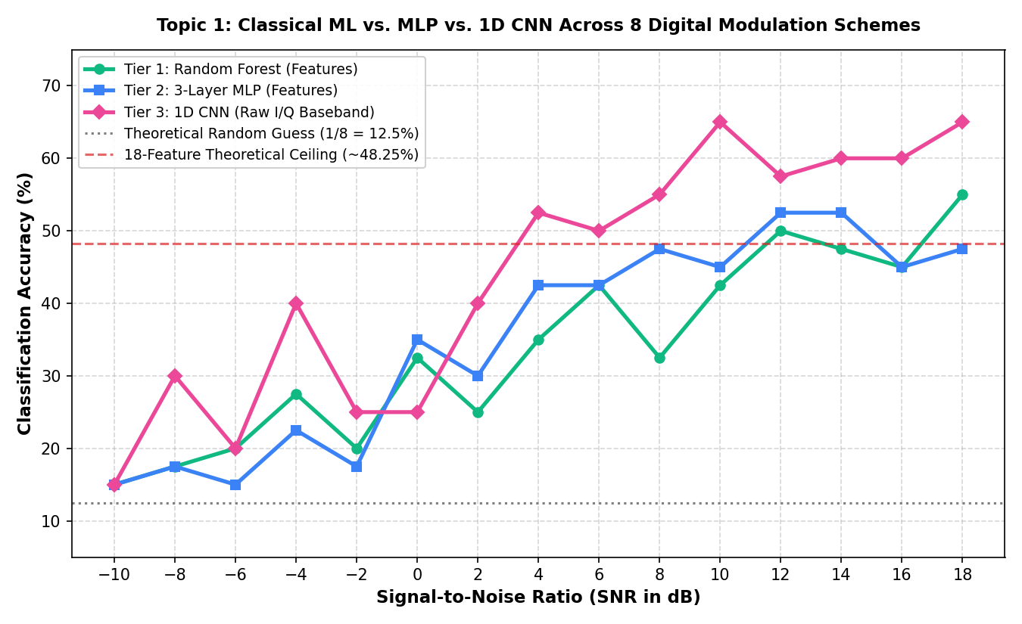
PART V • THREE-TIER BENCHMARK SYNTHESIS
Three-Model Comparison: Accuracy vs. SNR
Three-Model Findings
LOW SNR: All methods suffer when Gaussian noise dominates.
AROUND +2 dB: CNN begins to outperform the feature models in the plotted benchmark.
HIGH SNR: RF/MLP flatten around ~48–51%; CNN reaches 55.10% at +18 dB.
INTERPRETATION: Learning from raw I/Q helps recover information missing from the fixed 18 features.
EE136: Machine Learning for Wireless Communications | Topic 1: Comprehensive Model Benchmark
Slide 17 of 19

Slide 18
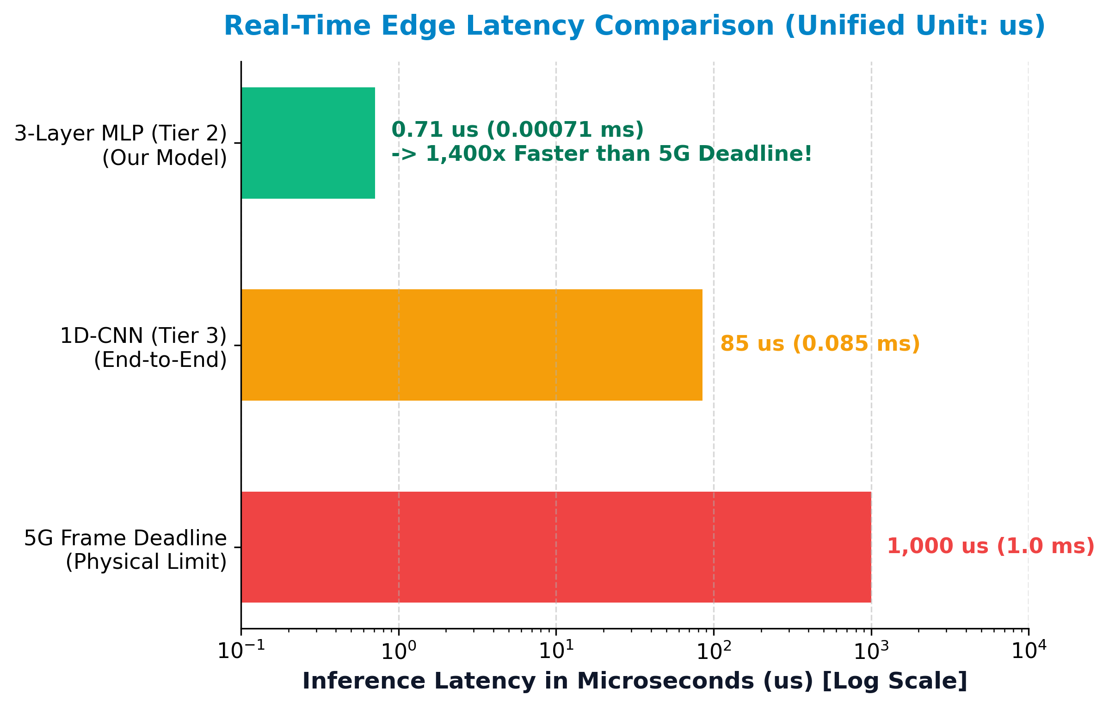
PART V • THREE-TIER BENCHMARK SYNTHESIS
Hardware Latency Profiling & Edge Deployment Trade-offs
Deployment Trade-offs
MLP · ~36 µs: Smallest model (~52.5 KB); lowest latency.
CNN · ~424 µs: Compact (~0.213 MB); stronger high-SNR accuracy.
RF · ~280 µs: Fast inference, but nearly 1 GB checkpoint.
SVM · ~9.7 ms: Compact relative to RF, but slow per burst.
CAUTION: Latency figures are CPU benchmark measurements, not end-to-end radio deadlines.
EE136: Machine Learning for Wireless Communications | Topic 1: Comprehensive Model Benchmark
Slide 18 of 19

Slide 19
PART V • EXECUTIVE SUMMARY & CONCLUSION
Three-Tier Benchmark: Results & Trade-offs
ENGINEERING METRIC | TIER 1: CLASSICAL ML (RF) | TIER 2: NEURAL NET (MLP) | TIER 3: DEEP LEARNING (1D CNN)
Input Representation | 18 Domain Features | 18 Normalized Domain Features | Raw Baseband I/Q [2, 128]
Overall Test Accuracy | 33.83% | 35.17% | 39.22% (Highest Overall)
Peak High-SNR Accuracy (+18 dB) | 50.10% | 48.25% (Feature Ceiling) | 55.10% (Breaks Ceiling!)
Macro-F1 Score | 33.48% | 34.82% | 35.97% (Most Balanced)
Model Complexity (not equivalent across models) | 140,572,728 tree nodes | 11,592 parameters | 53,224 parameters
Model Checkpoint Size | 999.7 MB (Parameter Explosion) | 52.5 KB (Ultra Compact) | 0.213 MB (Compact ConvNet)
Single-Burst Latency (B=1) | ~280 µs (Satisfies 5G) | ~36 µs (Ultra Fast / MCU) | ~424 µs (Satisfies 5G / SDR)
Benchmark Takeaways
ACCURACY: CNN 39.22% > MLP 35.17% > RF 33.83%.
LIMIT: High-order PSK/QAM confusion persists.
Edge Deployment Choices
MLP: Lowest latency and model size.
CNN: Stronger accuracy with small checkpoint.
RF: ~1 GB checkpoint limits edge use.
EE136: Machine Learning for Wireless Communications | Topic 1: Comprehensive Model Benchmark
Slide 19 of 19

