Slide 1
Species tree estimation & the multispecies coalescent

Slide 2
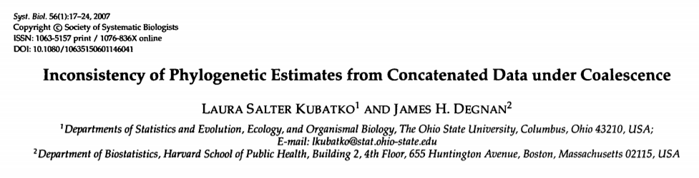
Concatenated gene sequences - assumes every gene has same evolutionary history

Slide 3
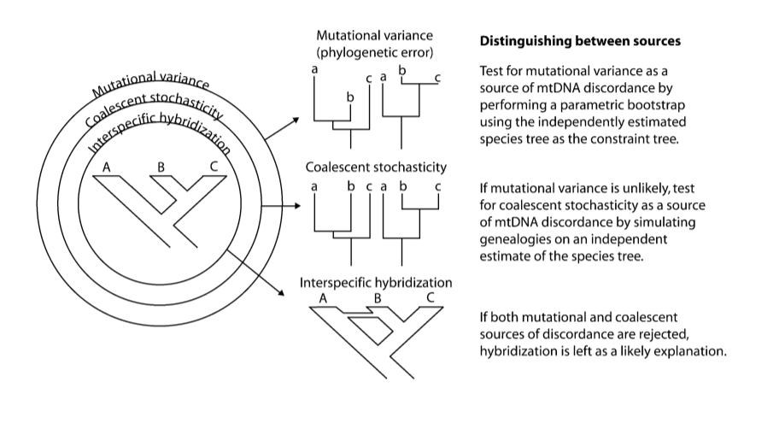
Stochasticity from:

Slide 4
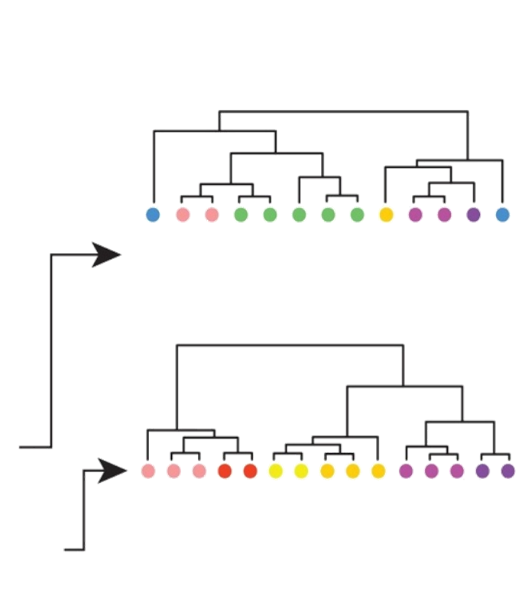
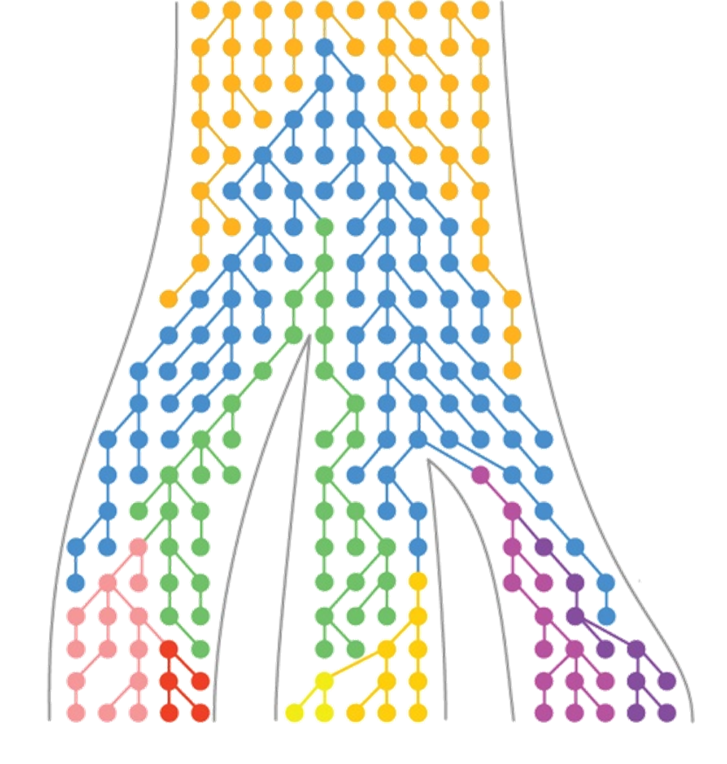
Incomplete lineage sorting

Slide 5
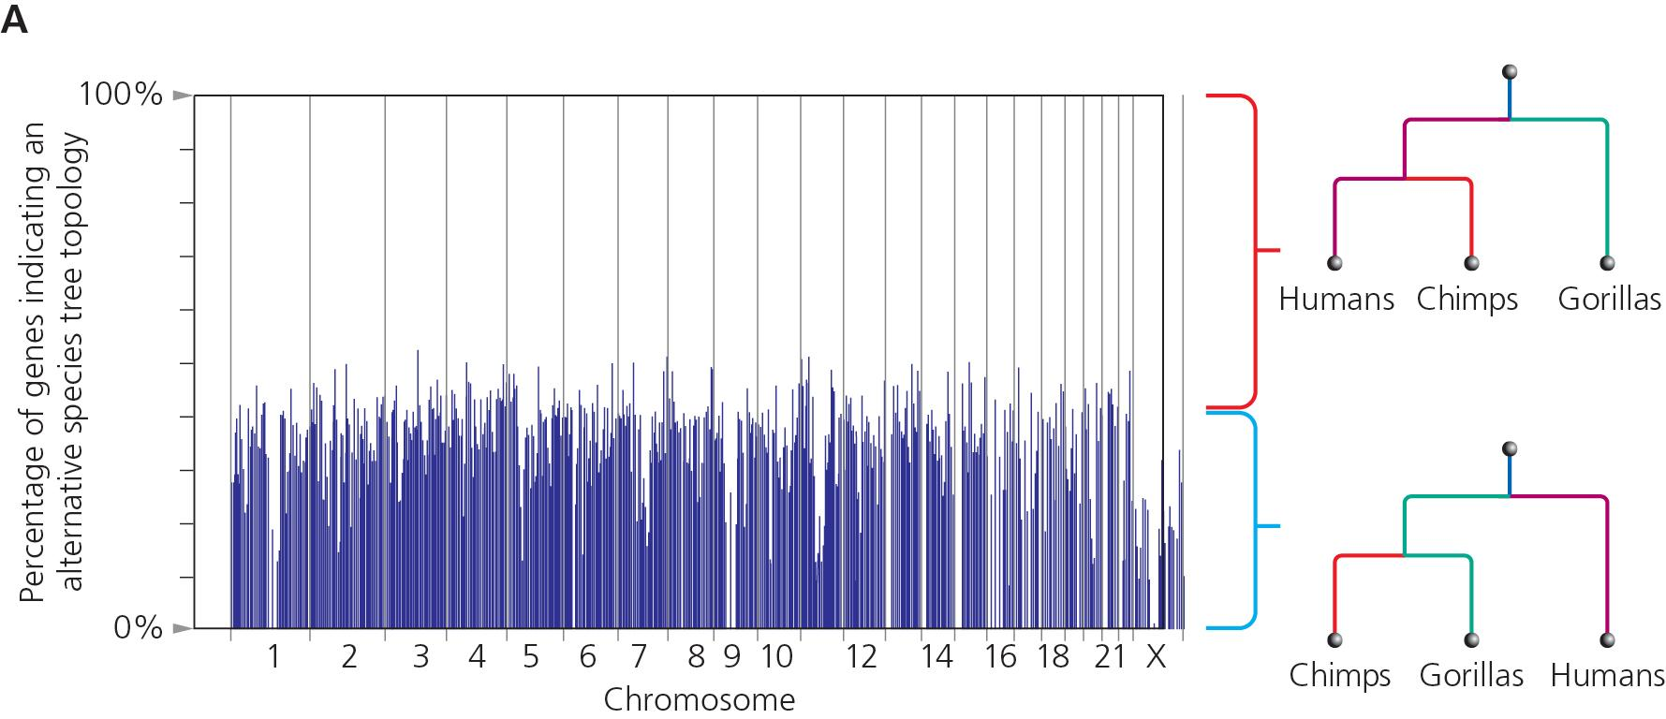

Slide 6
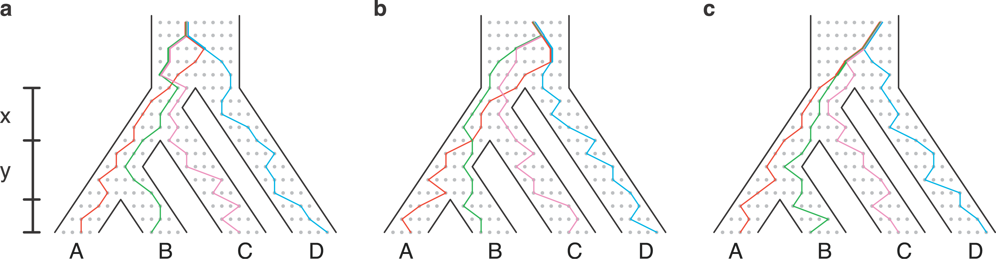
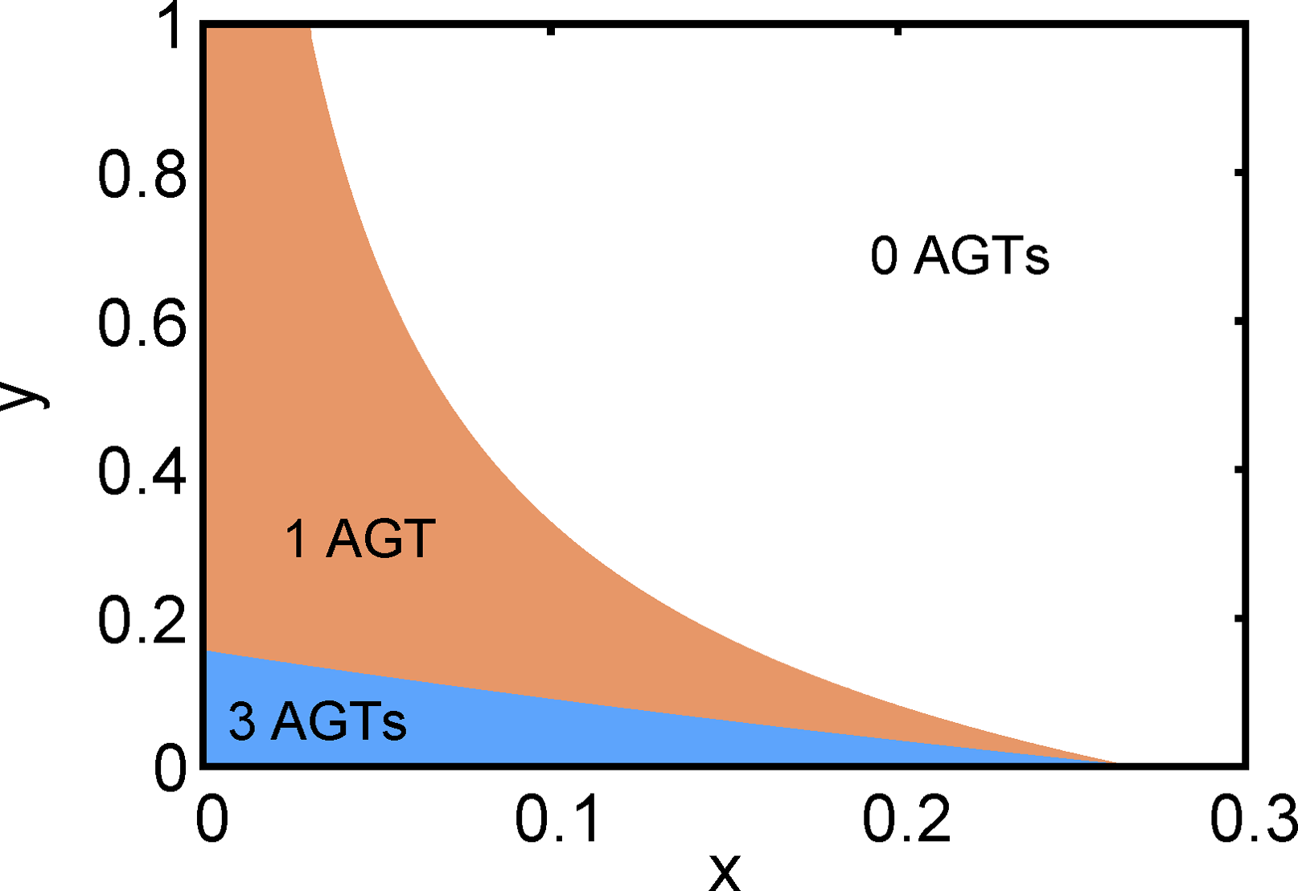
The “Anomaly zone” AGT - Anomalous gene tree with higher likelihood than the tree species topology

Slide 7
ILS will result when branches are short & population sizes are large
(often mistakenly thought only to occur in recent radiations, but ancient short internal branches just as at risk!)

Slide 8
The Coalescent
Coalescence - MRCA of a pair of genes
Built on standard population genetics (e.g. Wright-Fisher model)
Key parameter - Effective population size
Expected # of generations to coalescence - 2N

Slide 9
The Coalescent
What is the probability two copies of a gene in a randomly breeding population have an ancestor 1 generation ago?
1/(2Ne)
What about j generations ago?
(1-1/(2Ne))^{j} * 1/(2Ne)

Slide 10
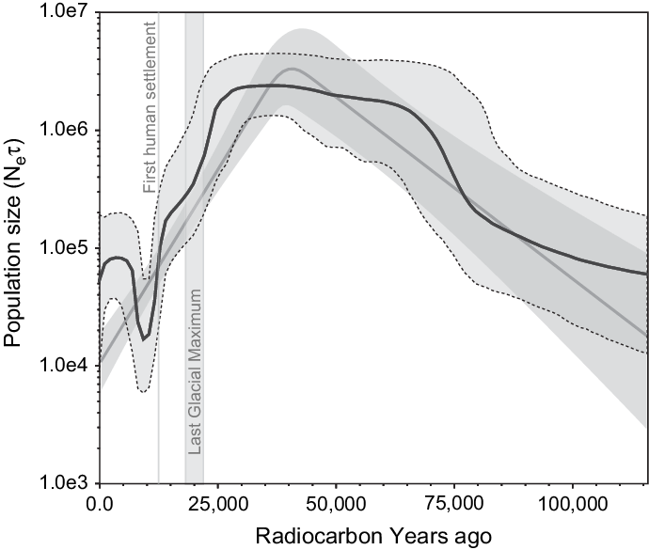
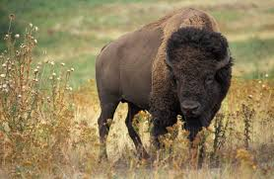
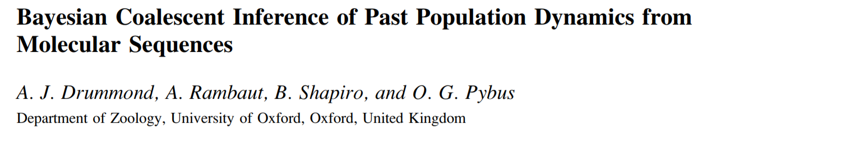
The Coalescent
Coalescence-time measured in units of Ne

Slide 11
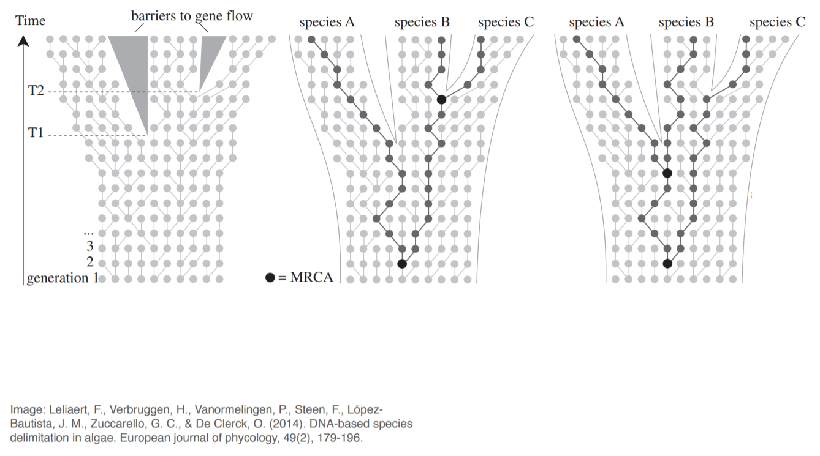
The Multispecies Coalescent

Slide 12
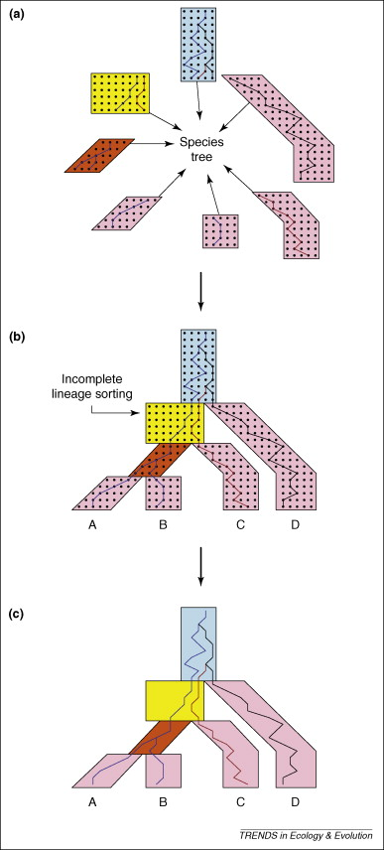
P(D_{i} | Q_{i}, π_{i}, ψ_{i}) = standard likelihood of gene tree
P(ψ_{i} | S) = Likelihood of gene tree given the species tree
“AND” rule:
P(D₁, D₂...D_{n} | S) =
P(D₁ | Q₁, π₁, ψ₁)*P(ψ₁ | S) x ...
x P(D_{n} | Q_{n}, π_{n}, ψ_{n})*P(ψ_{n} | S)

Slide 13

Methods & software
Parsimony - “MDC” species tree that minimizes deep coalescences (can be inconsistent estimator)
ML - STEM (Kubatko & Degnan 2007). Requires gene trees to be well-estimated and clock-like
Bayesian - BEST, *BEAST, BPP. Bayesian approaches that integrate over uncertainty in gene trees. Great models...but complex and hard to converge!

Slide 14
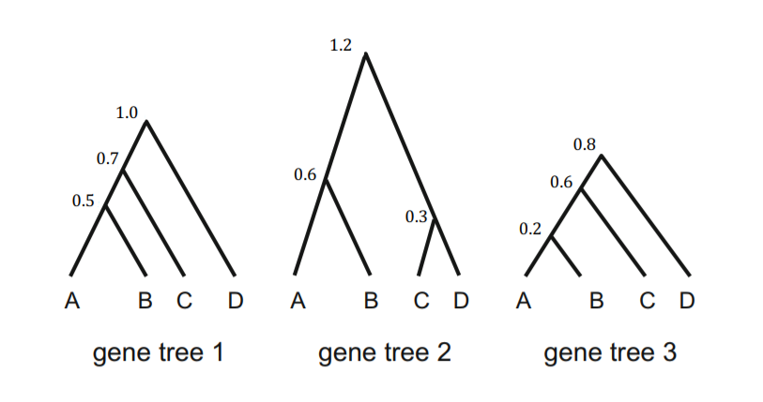
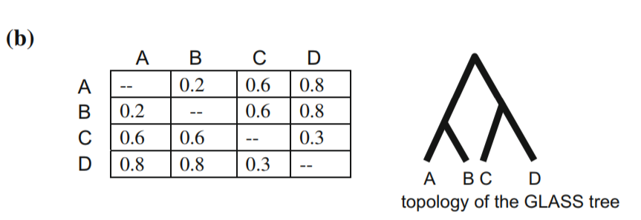
Other methods
Concordance analysis- BCA/BUCKy. Semi-parametric clustering of gene trees into “concordance blocks” without regard to process
Summary methods- Uses properties of multispecies coalescent to summarize gene trees. STAR/STEAC/GLASS

Slide 15
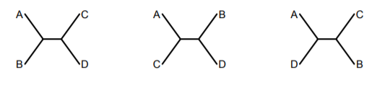
Other methods
Quartets approaches: ASTRAL/SVDQuartets
Avoids calculating full likelihood, instead focuses on site patterns over 4 taxon combinations. Good for SNPs and genomic scale data

Slide 16
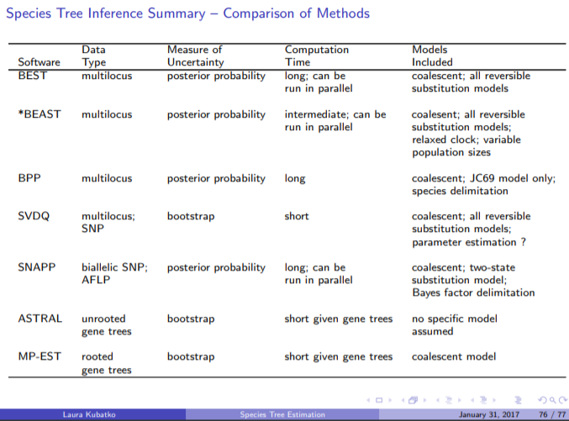

Slide 17
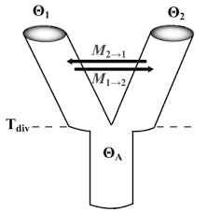
Adding gene flow...
Limited to a small number of species (IM & IMa)

Slide 18
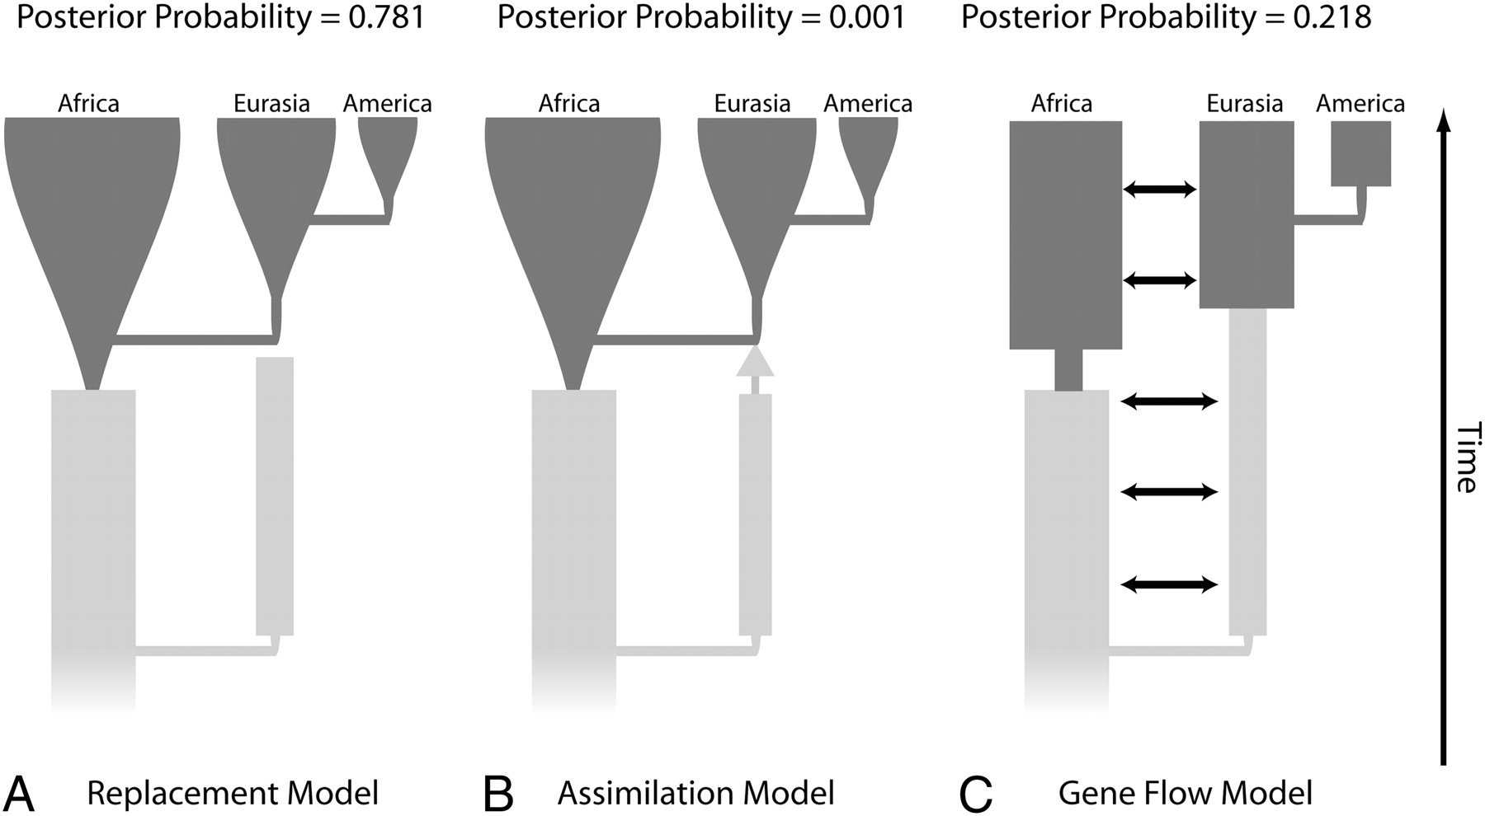
Hypothesis testing

Slide 19
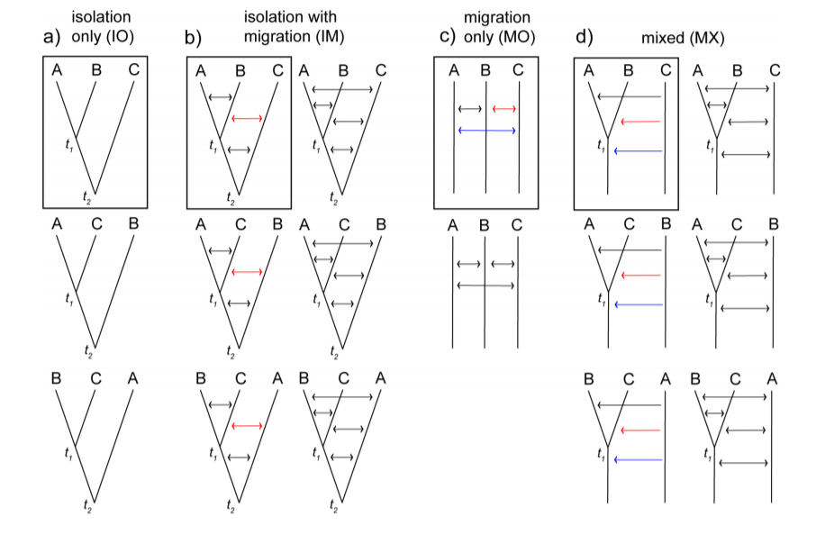
Search among all possible models... PHRAPL (Jackson et al. 2017)

Slide 20
Some general thoughts...
Scaling multispecies coalescent to genomic scale is hard, adding more data doesn't necessarily improve estimation
Filter genes to those with strong phylogenetic signal
Interrogate your data

Slide 21
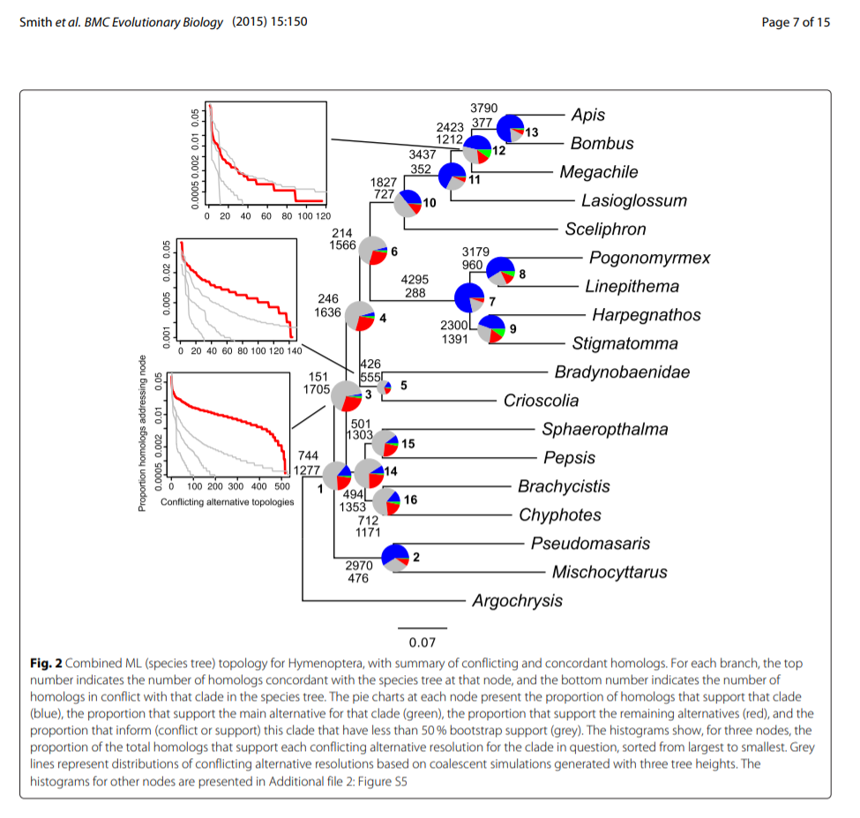

Slide 22
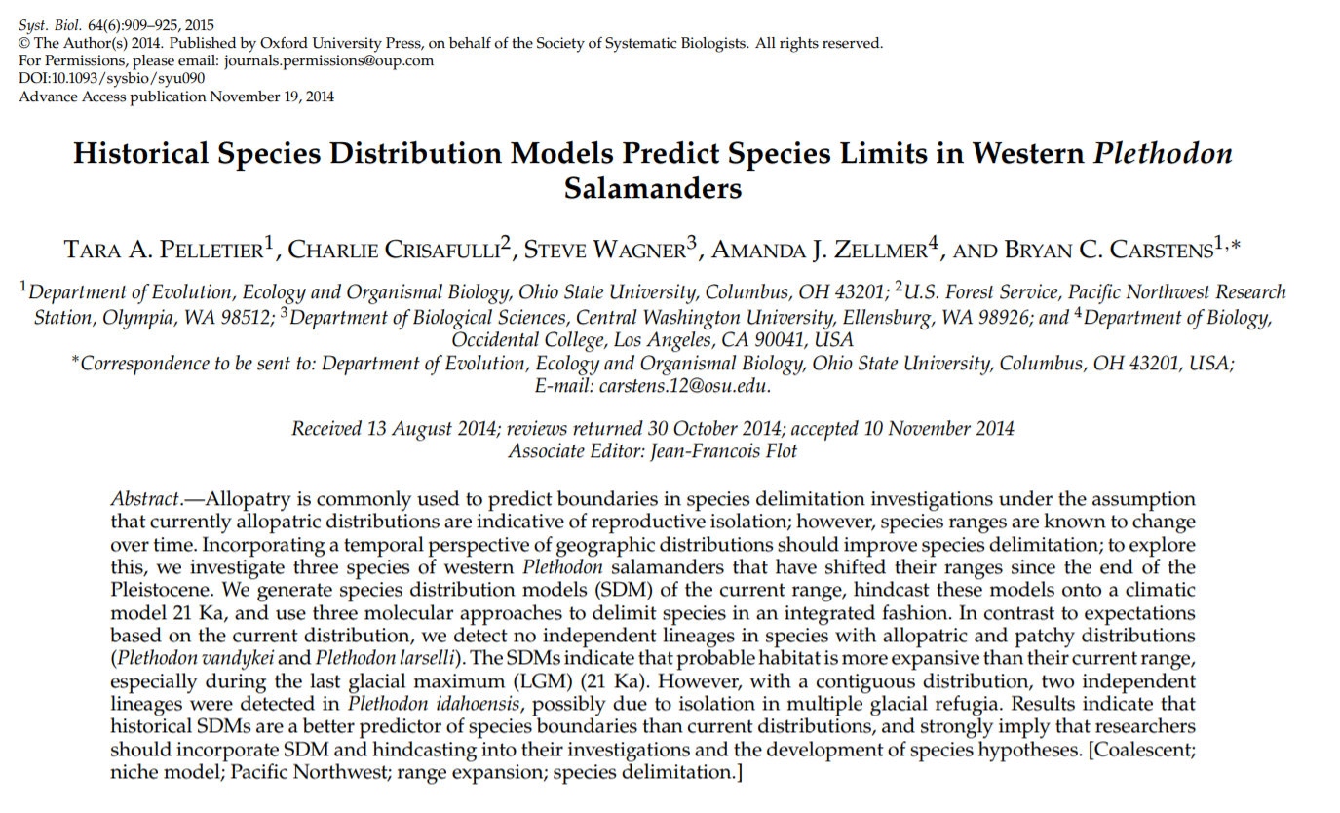
Guest speaker: Tara Pelletier
Read her paper (Pelletier et al. 2016, Systematic Biology) & have questions ready!!

