Slide 1
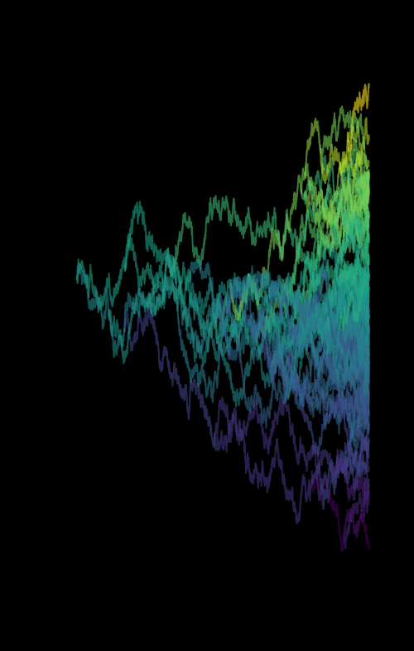
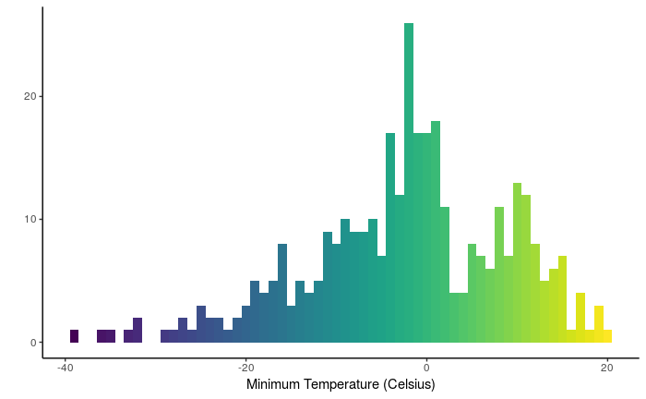

Slide 2
Phylogenetic comparative methods
Phylogenetics
Use traits to estimate tree
Phylogenetic Comparative Methods
Assume tree is known, analyze evolutionary patterns

Slide 3
Discrete trait evolution
Mk models (CTMC models! Not much new to learn)
Continuous trait evolution
Gaussian models (Stochastic differential equations)

Slide 4
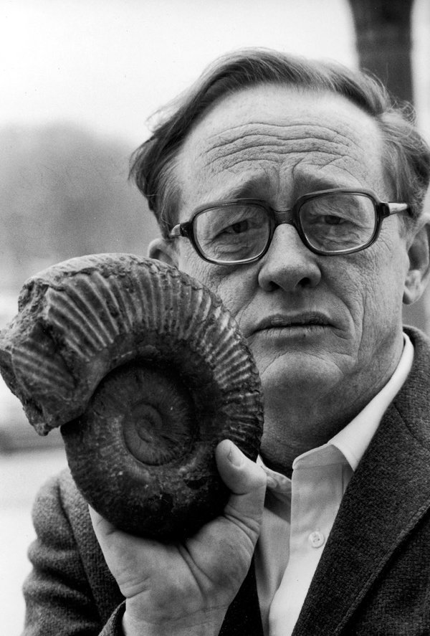
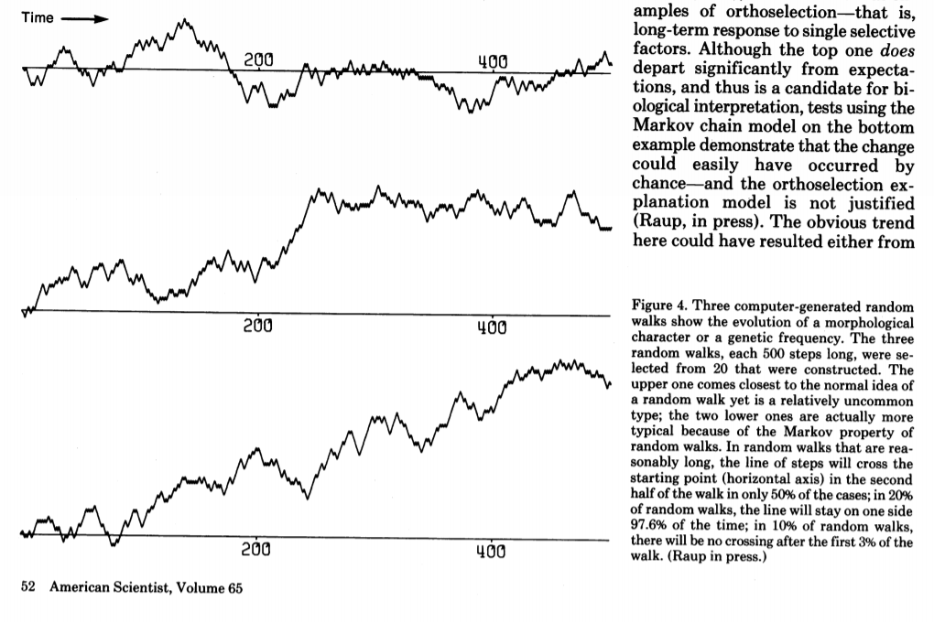
Random walks
Are patterns of trait change in the fossil record significantly different from random?
David Raup

Slide 5
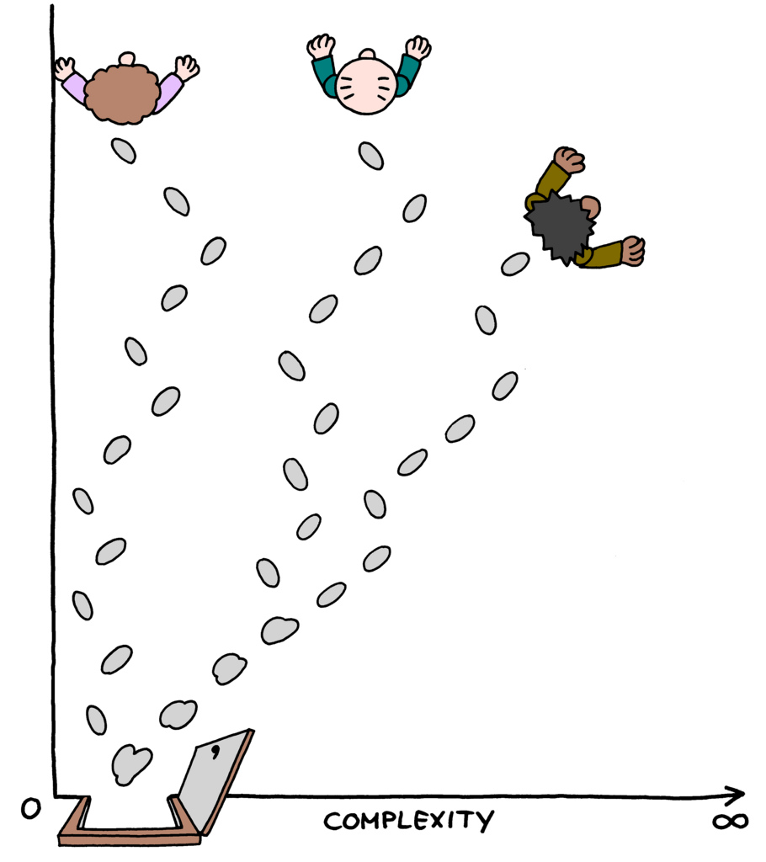
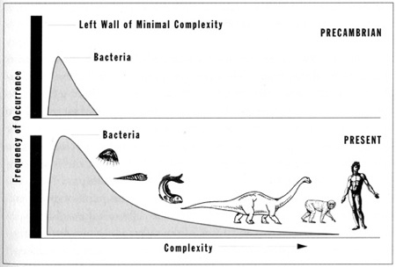
The Drunkard's Walk
Are patterns of trait change in the fossil record significantly different from random?

Slide 6
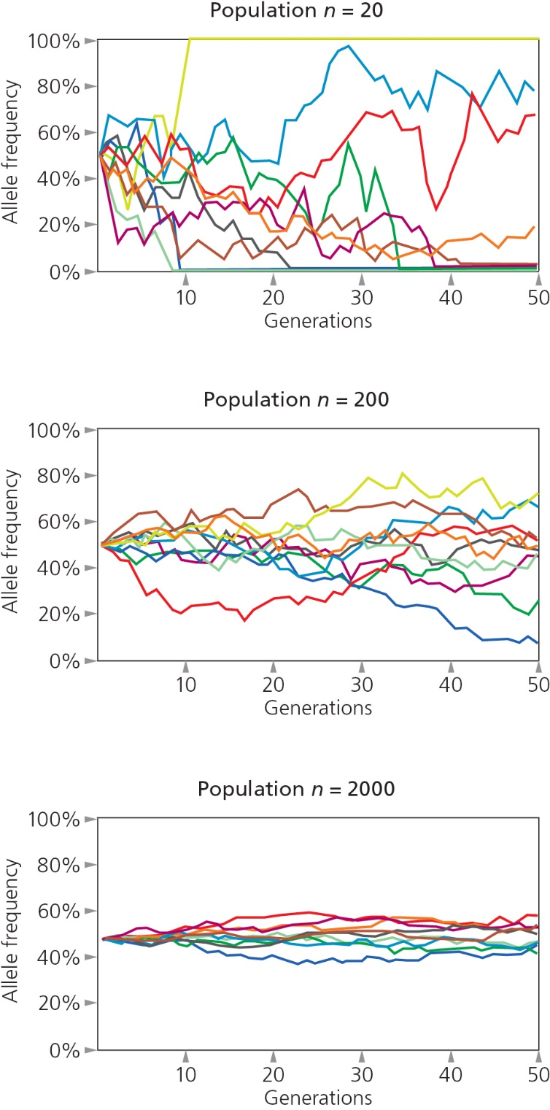
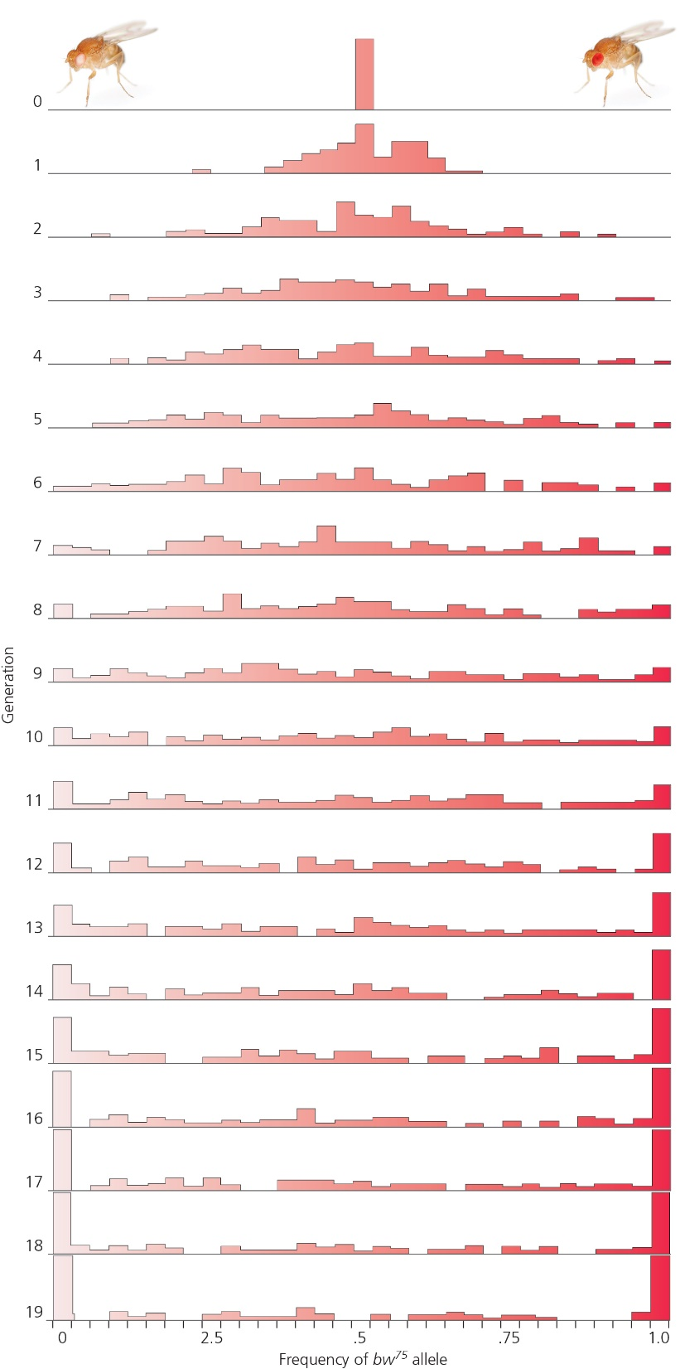
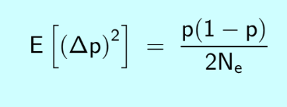
Population genetics
Luca Cavalli-Sforza & Anthony Edwards (remember them?)
Allele frequency evolution by genetic drift can be approximated by Brownian Motion

Slide 7
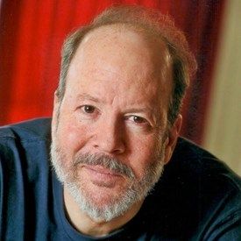
Quantitative genetics
Lande demonstrated that genetic drift in a quantitative character can also be approximated by Brownian Motion
Expected change per generation:
Δz = 0
Variance = G/Ne
Russ Lande

Slide 8
Generalized Random Walk
z_{t+1} = z_{t} + N(μ, σ²)
Cool stats rule: Variances are additive
If:
A ~ N(μ_{A}, σ_{A}²)
B ~ N(μ_{B}, σ_{B}²)
Then:
A + B ~ N(μ_{A} + μ_{B}, σ_{A}² + σ_{B}²)

Slide 9
So if you take many lineages evolving by a Random Walk for t generations, what is the variance among them?

Slide 10
Continuous time Random Walk = Brownian Motion
dz = μt + σ*dW
Wiener Process

Slide 11
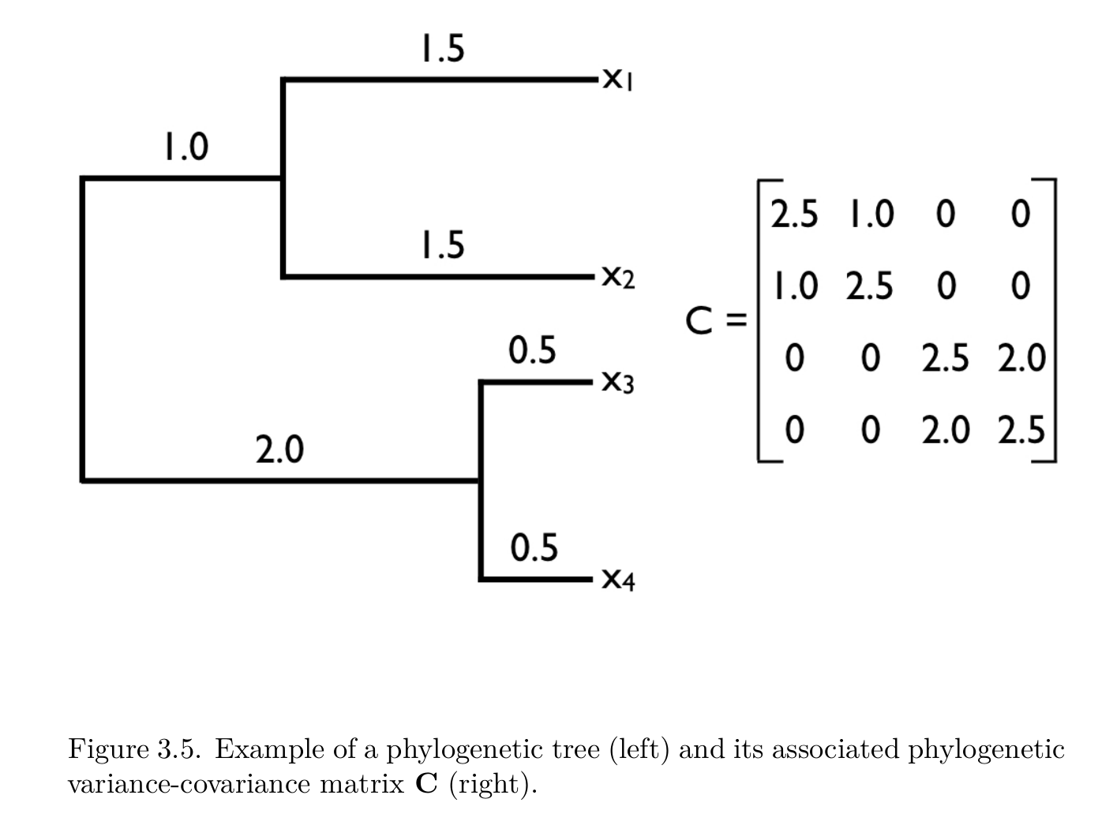
So what about phylogeny?

Slide 12
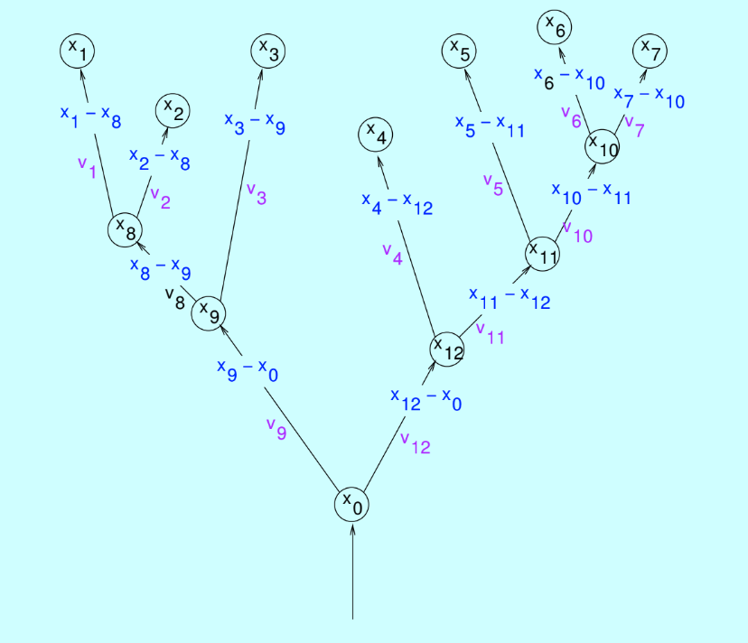
Phylogenetically “Independent” Contrasts

Slide 13
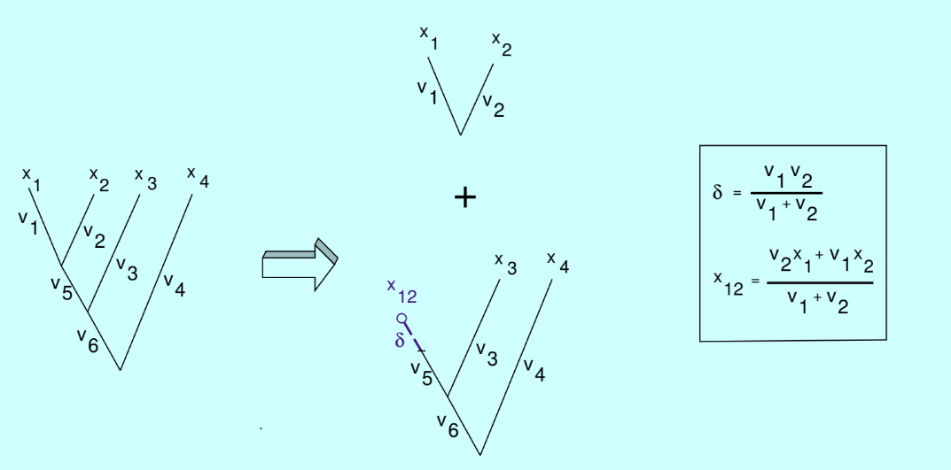
Phylogenetically “Independent” Contrasts

Slide 14
A tree of N tips leads to N-1 contrasts

Slide 15
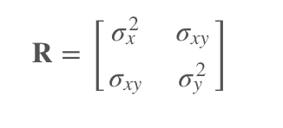
Multivariate Brownian Motion
Univariate:
root = μ
step variance = σ²
Multivariate (N traits):
root = c(μ₁, ..., μ_{N})
step variance =

