Slide 1
Model selection, Model adequacy & Hypothesis testing

Slide 2
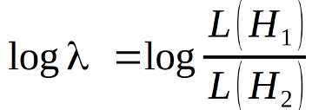
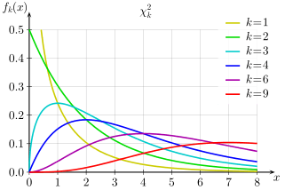
Likelihood ratio tests
Models must be nested (hierarchical)
As sample size approaches
infinity:
-2 ln λ ~ Chi-Square(p₂ - p₁)

Slide 3
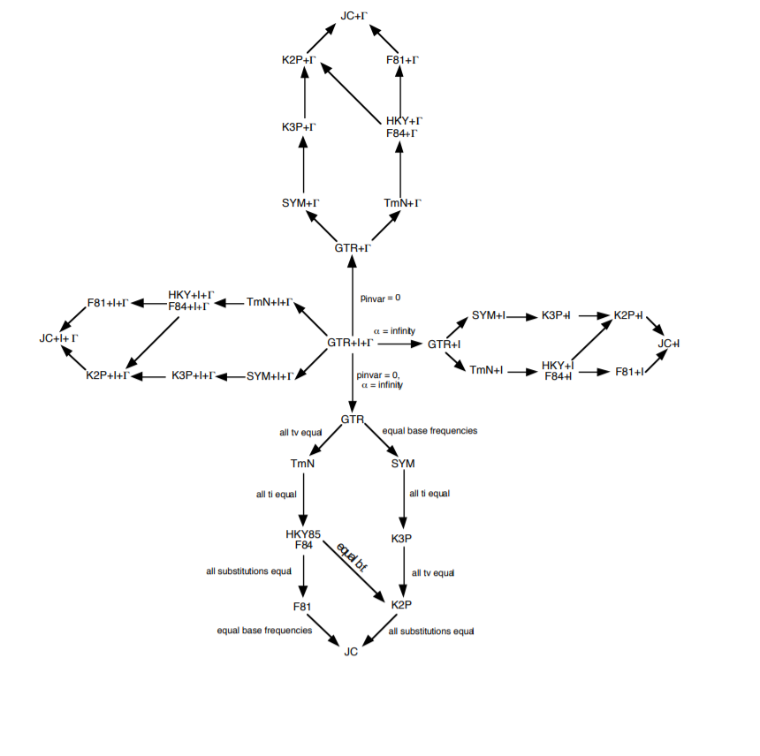

Slide 4


Information theory
Akaike Information Criterion (Approximates Kullback-Leibler Divergence asymptotic result, small sample size correction available.)
Bayesian Information Criterion
Relative fit for a given dataset
Others: Deviance Information Criterion, Focused Information Criterion etc.

Slide 5
Information theory
Minimize loss of information by maximizing relative goodness of fit while penalizing model complexity
BIC penalizes more heavily, AIC will usually find more heavily parameterized models

Slide 6
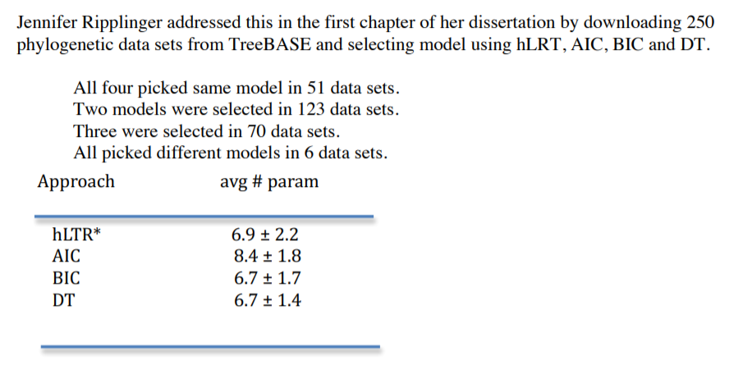

Slide 7
What is sample size in phylogenetic datasets?

Slide 8
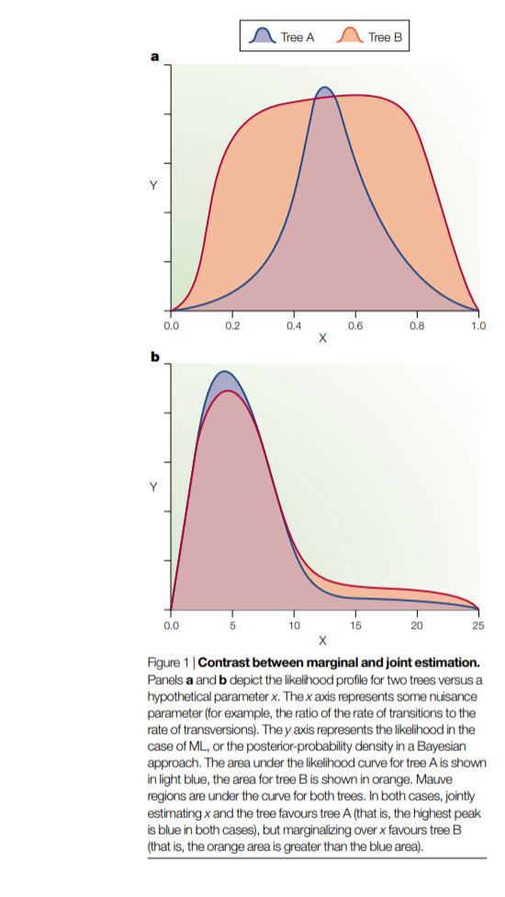
A word about Bayesian analyses and Bayes Factors...
Holder & Lewis 2003

Slide 9
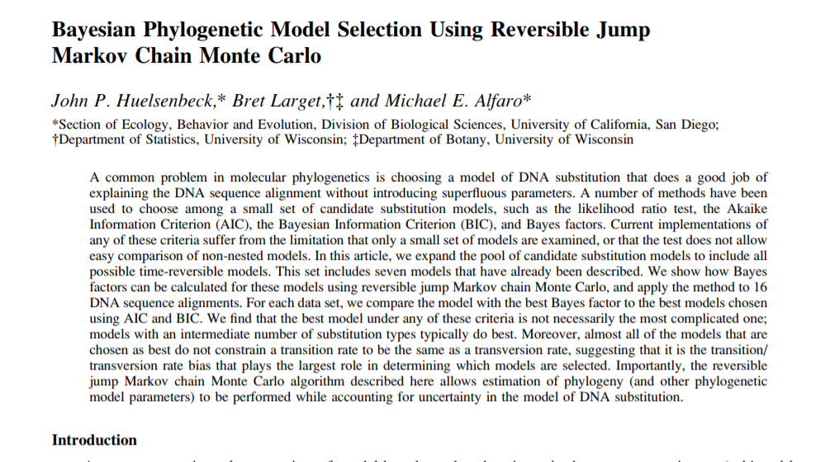
Reversible-Jump MCMC

Slide 10
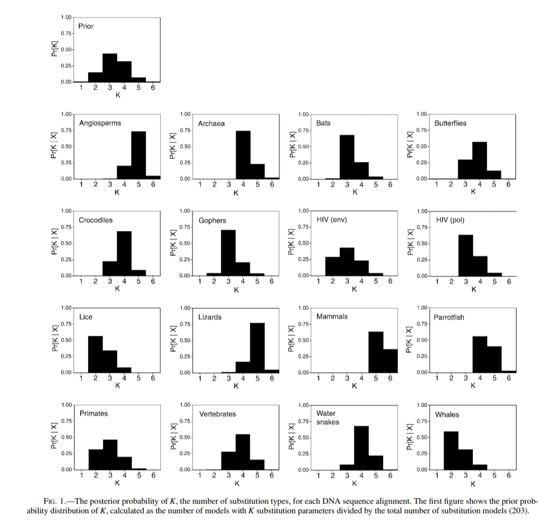

Slide 11
Relative vs. absolute goodness of fit
Best model may still be bad!
We want a model that adequately describes the data generating process.
Frequentist solution: Parametric bootstrap
Bayesian solution: Posterior predictive simulation

Slide 12
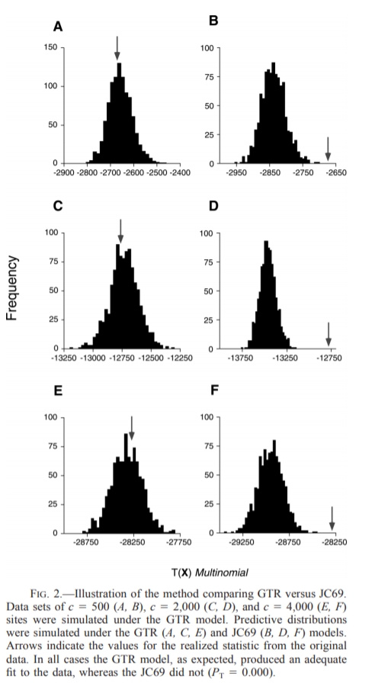
Basic idea:
Estimate parameters (either ML estimate or posterior distribution)
Simulate data using parameters
Calculate a test statistic seeing if the model predicts “similar” datasets to your original
Compare to summary statistic measured on empirical data

Slide 13
What test statistic should be used?

Slide 14
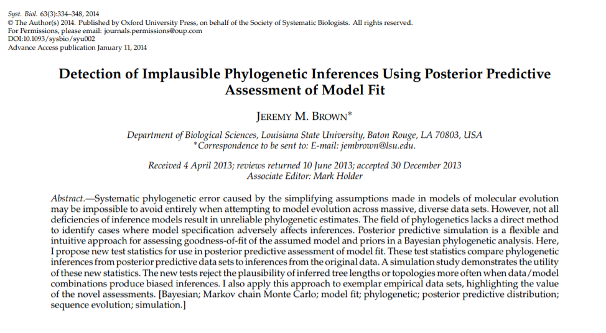

Slide 15
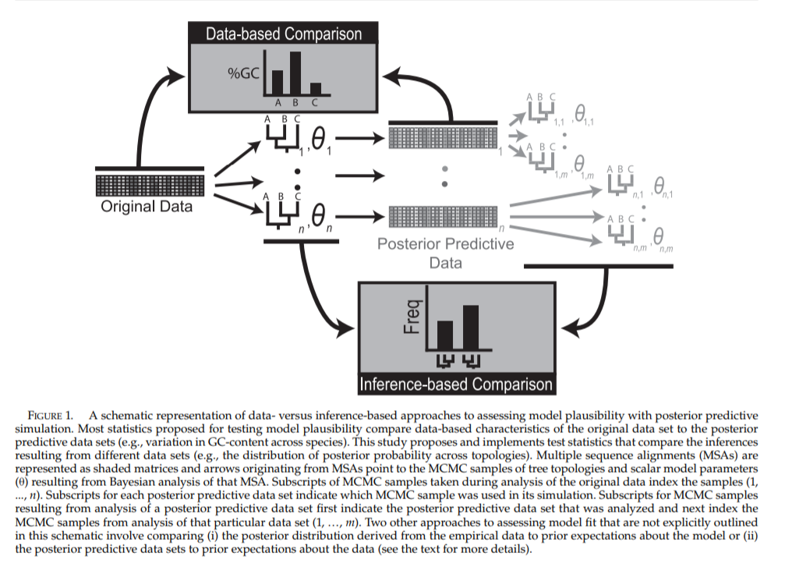

Slide 16
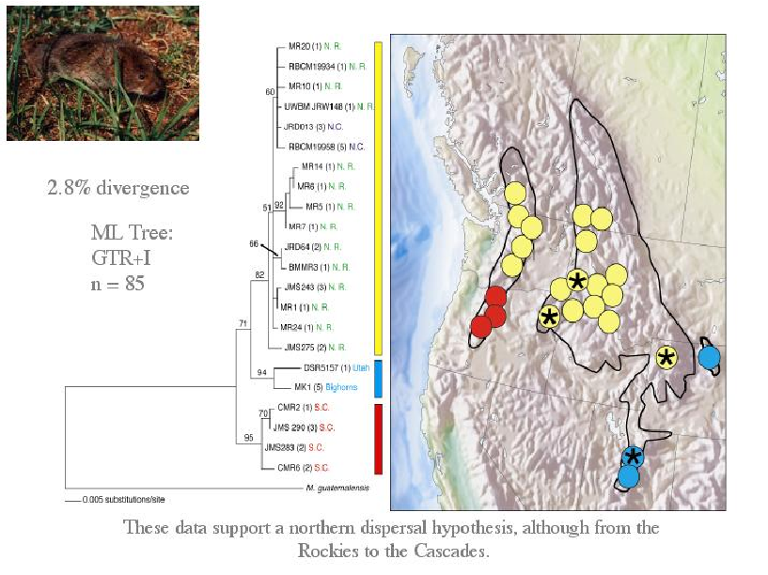
Example:

Slide 17
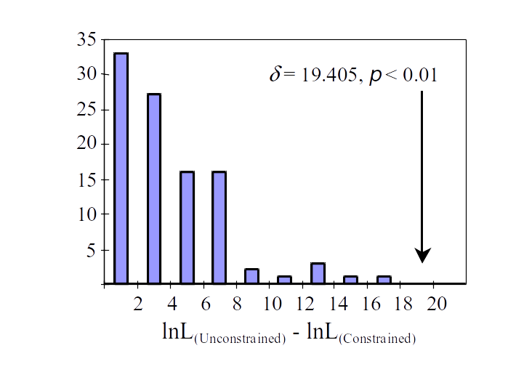
Run parametric bootstrap

Slide 18
Bayesian version...
P(θ | Data) = Posterior distribution
Hypothesis testing often just a simple matter of checking the posterior distribution!
Can also do Bayes Factors

Slide 19
Summary
Model selection using relative goodness of fit (hLRT, AIC, BIC, DT) common, useful
Often, we want absolute goodness of fit, which can be evaluated with simulations (e.g. parametric bootstrap, posterior predictive simulation), cross-validation etc.
Bayesian vs. Likelihood approaches can be very similar, but ask different questions, leading to differences in response to model complexity.
All models are wrong, targeting our inferences with hypothesis testing is useful.

