Slide 1
Today's agenda:
Absolute goodness of fit/Model adequacy
Hypothesis testing
Tying up loose ends
Exam review

Slide 2
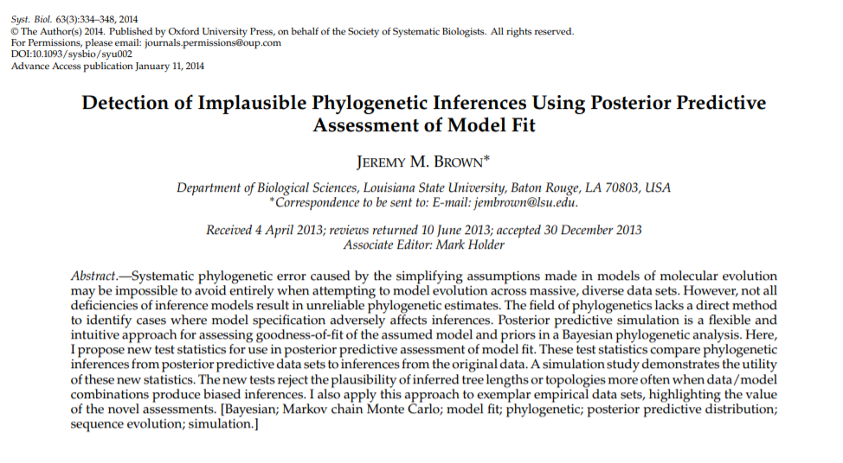

Slide 3
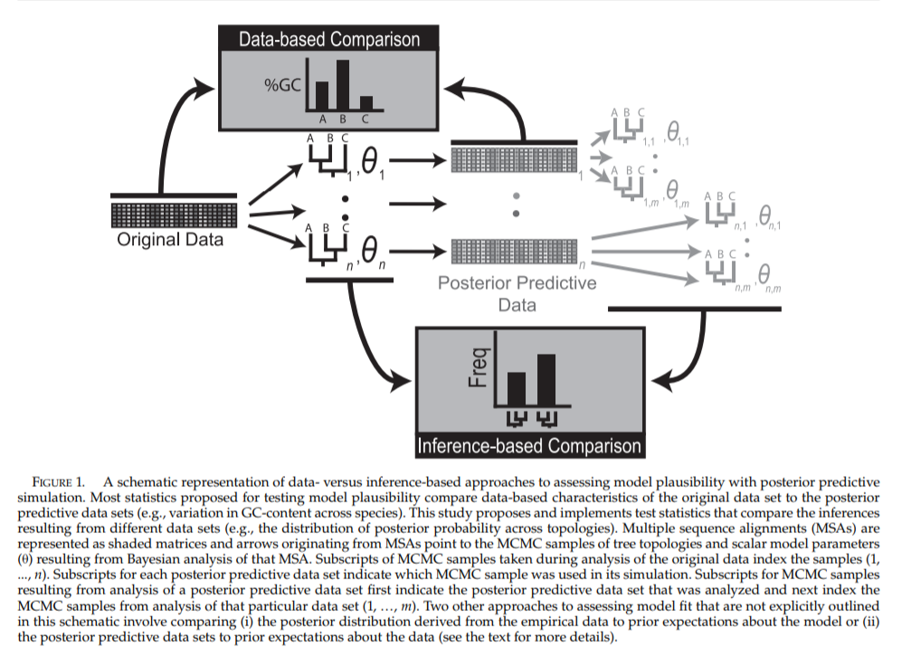

Slide 4
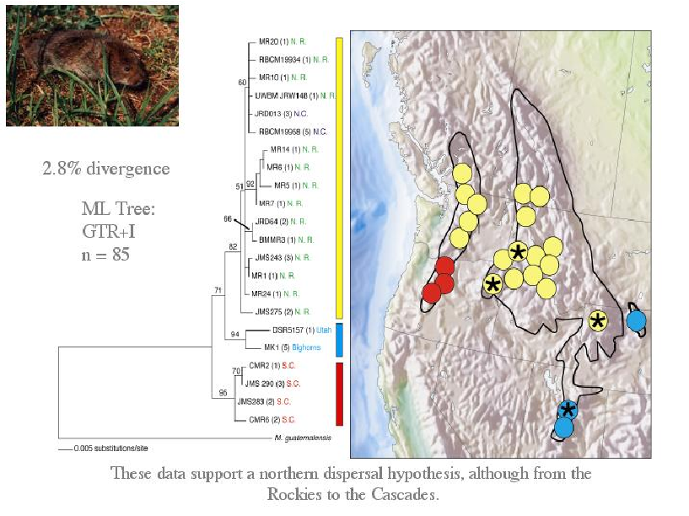
Example: Constraining trees

Slide 5
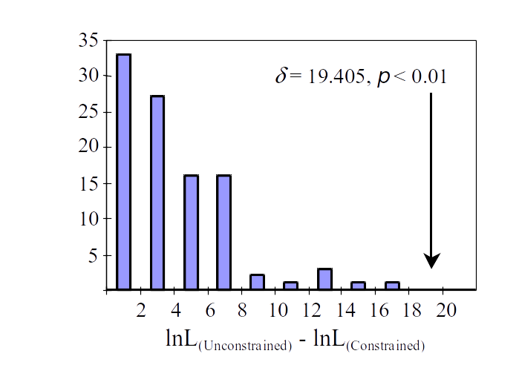
Run parametric bootstrap

Slide 6
Bayesian version...
P(θ | Data) = Posterior distribution
Hypothesis testing often just a simple matter of checking the posterior distribution!
Can also do Bayes Factors

Slide 7
Estimating Bayes Factors
Denominator of Bayes formula (marginal likelihoods of the model) difficult to estimate, but possible with new methods
RJMCMC
Path-sampling methods (e.g. Stepping-stone or thermodynamic integration)
- Computationally intensive (like running an MCMC on your data, but at least 50 times)

Slide 8
Summary
Model selection using relative goodness of fit (hLRT, AIC, BIC, DT) common, useful
Often, we want absolute goodness of fit, which can be evaluated with simulations (e.g. parametric bootstrap, posterior predictive simulation), cross-validation etc.
Bayesian vs. Likelihood approaches can be very similar, but ask different questions, leading to differences in response to model complexity.
All models are wrong, targeting our inferences with hypothesis testing is useful.

Slide 9
Loose ends

Slide 10
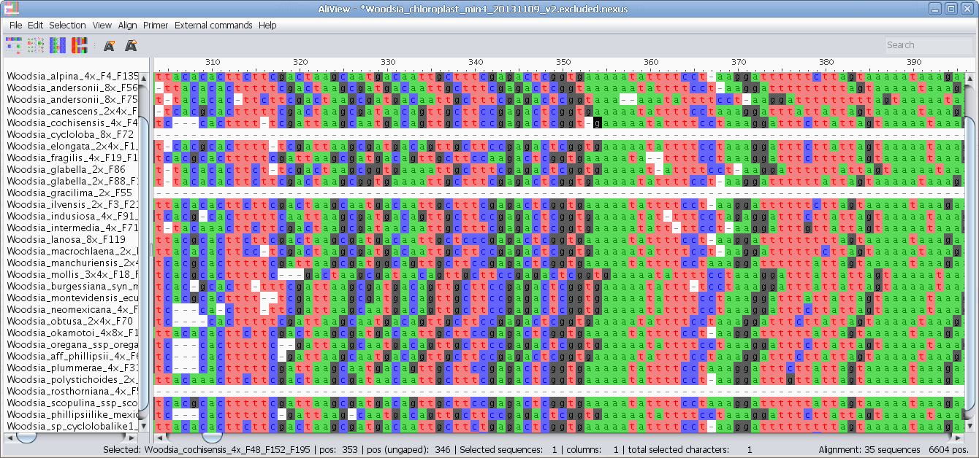
Rewind: Aligning DNA/Protein sequences

Slide 11
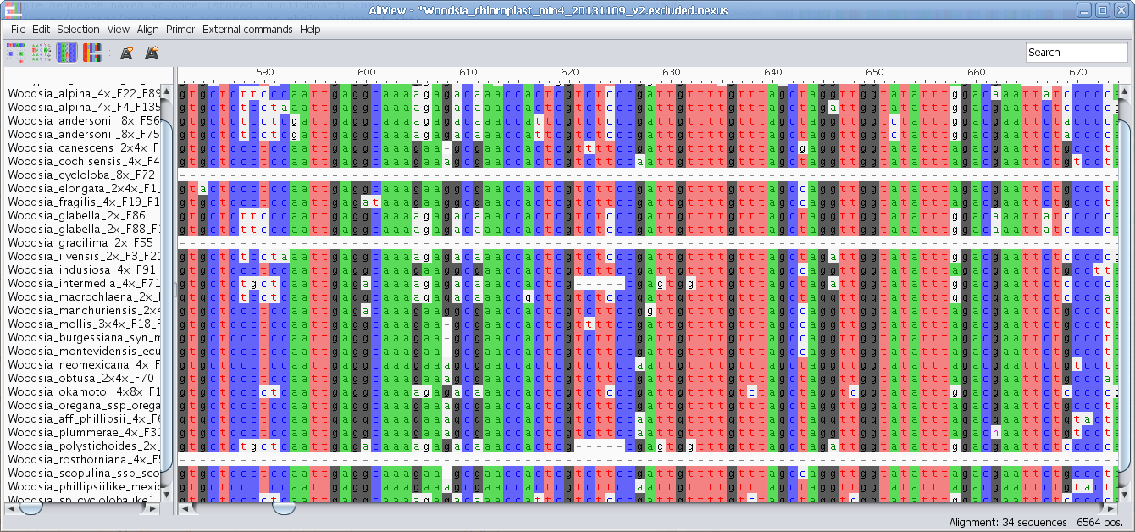
Rewind: Aligning DNA/Protein sequences

Slide 12
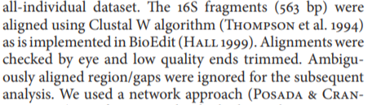

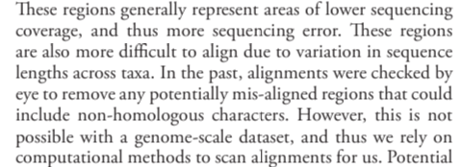
Aligning can be challenging

Slide 13
Progressive alignment
First align all pairwise sequences according to some cost function
Rank them by their similarity to generate a guide tree
Start with the most similar pair of sequences and begin adding sequences to the alignment (“multiple alignment”) until all sequences are aligned
Repeat with distance matrix with evolutionary model

Slide 14
We typically align before phylogenetic analysis
It would be be better to infer the tree and alignment simultaneously

Slide 15
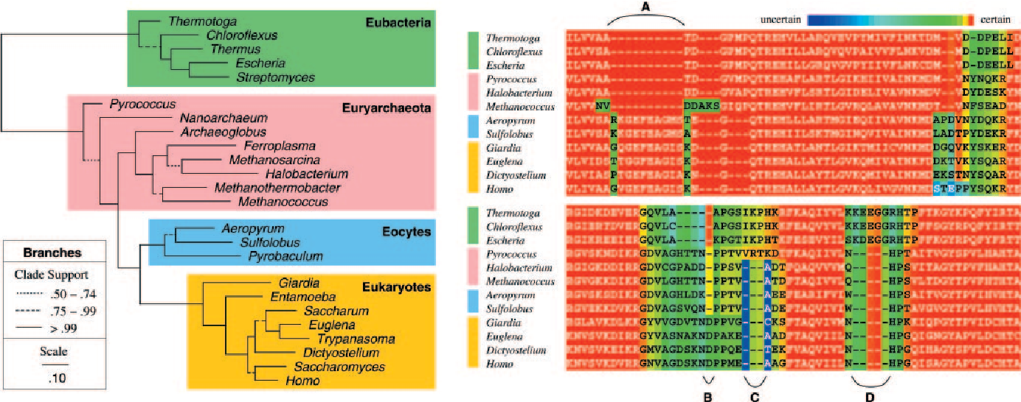
BALi-Phy (Redelings & Suchard 2005) - joint estimation of tree and alignment
POY (Wheeler) does the same for Maximum Parsimony

Slide 16
Other loose ends
Data partitioning
partition finder (Rob Lanfear)
autoparts (Brian Moore)
“autopartition” command in PAUP*
Consensus trees
Majority-rule, strict consensus etc.
Suitability for analyses?

