Slide 1
The Comparative Method
10/17/2018

Slide 2
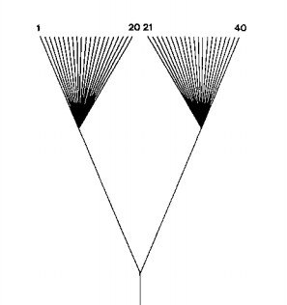
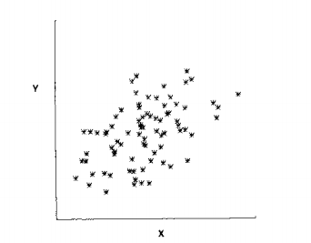
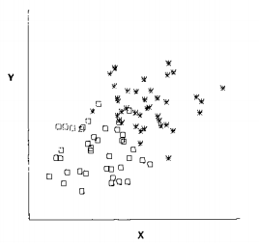
Felsenstein 1985

Slide 3
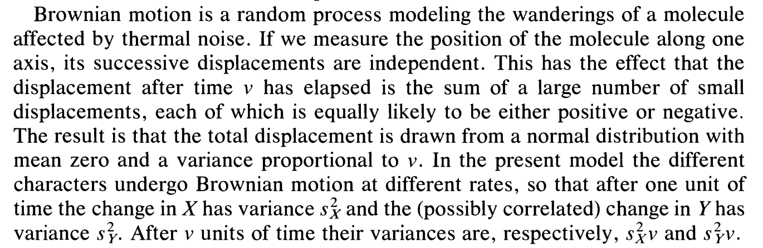

Slide 4
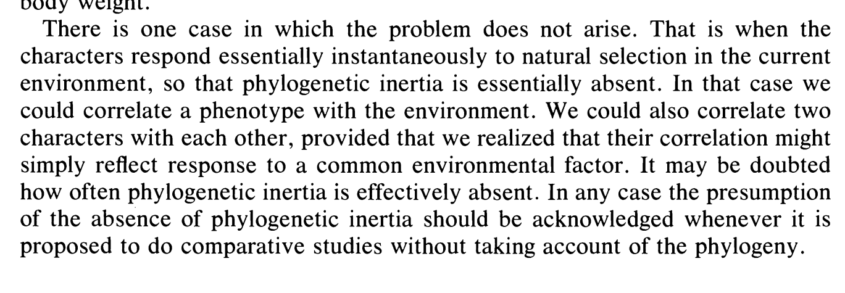
What is meant by this passage? Why does Felsenstein make this argument?

Slide 5
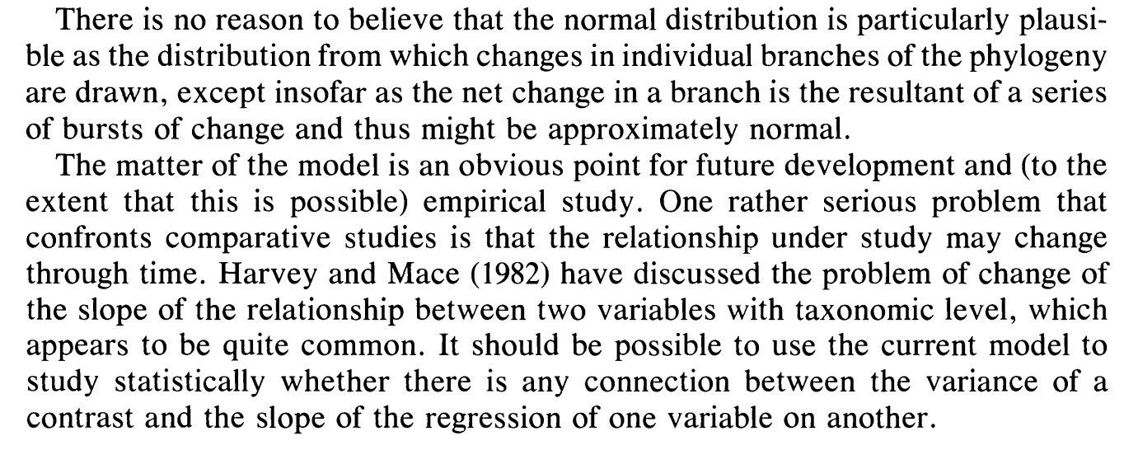

Slide 6
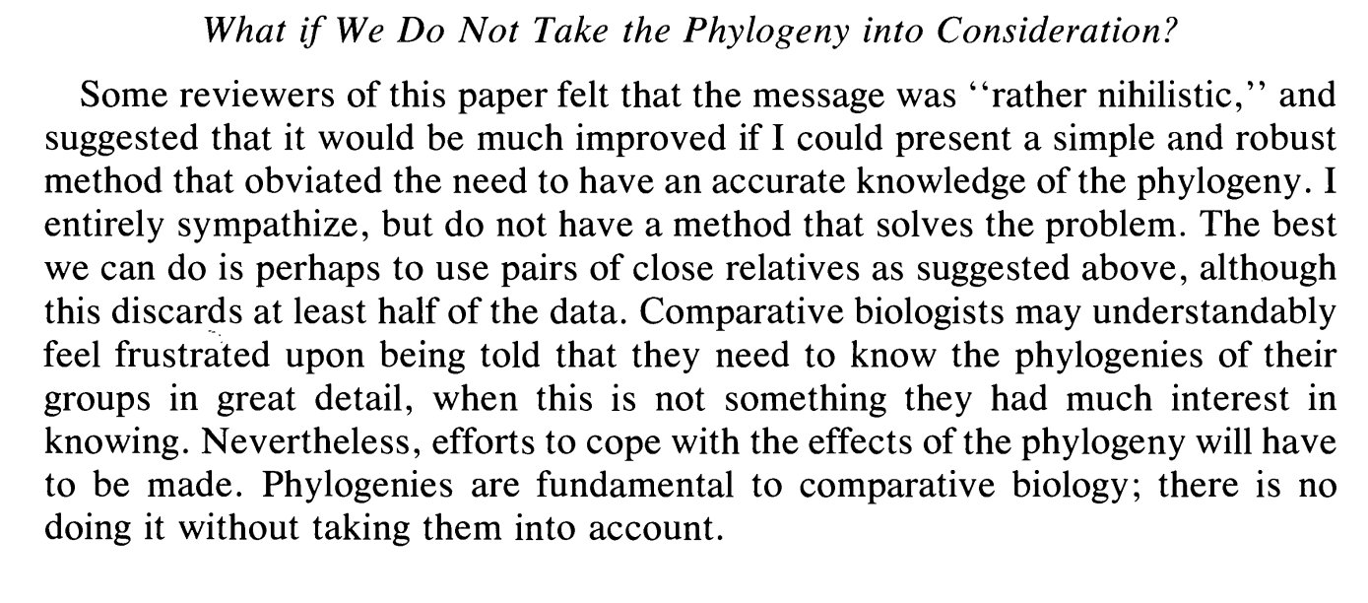

Slide 7
Phylogenetically Independent Contrasts Regression
N-1 contrasts for N tips
Regress Y ~ X (or X ~ Y) with intercept fit through the origin
Assumes multivariate Brownian Motion of both X and Y
Can incorporate measurement error in both X and Y (Felsenstein 2008)

Slide 8
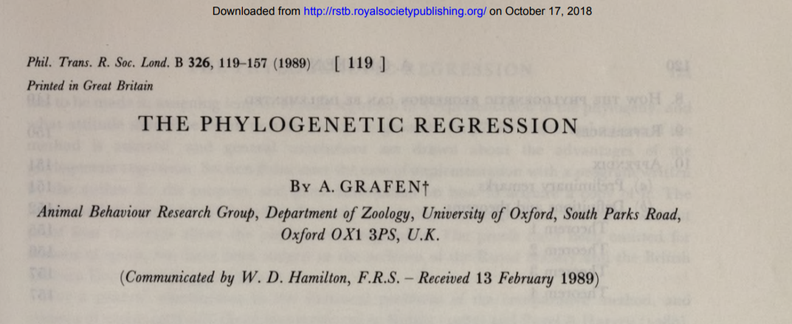
Phylogenetic Generalized Least Squares Regression

Slide 9
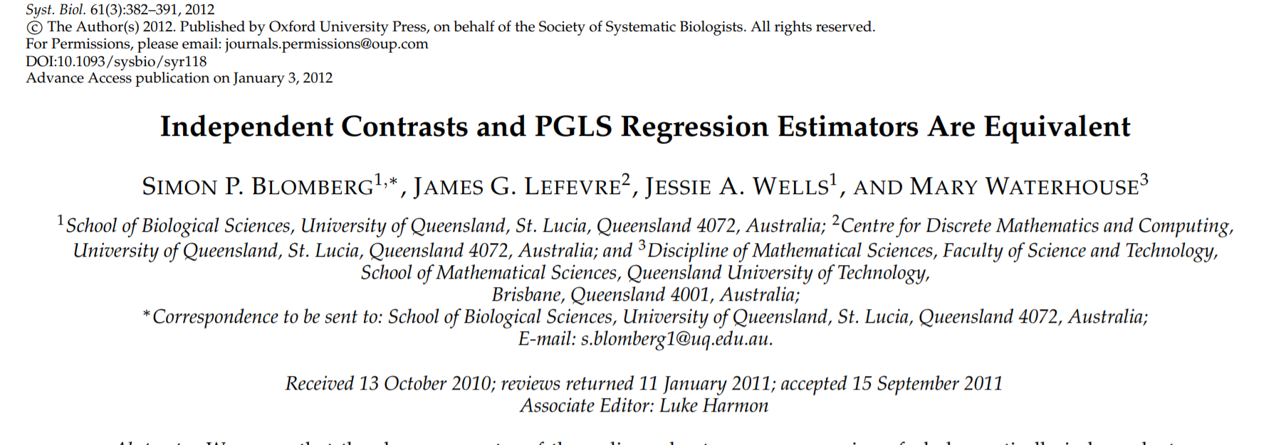
Turns out...

Slide 10
Y ~ X
E₀
E₁
E₂
E₃
E₄
E₅
E₆
Y₅
Y₆
Y₇
Y₈
X₃
X₄
X₅
X₆

Slide 11
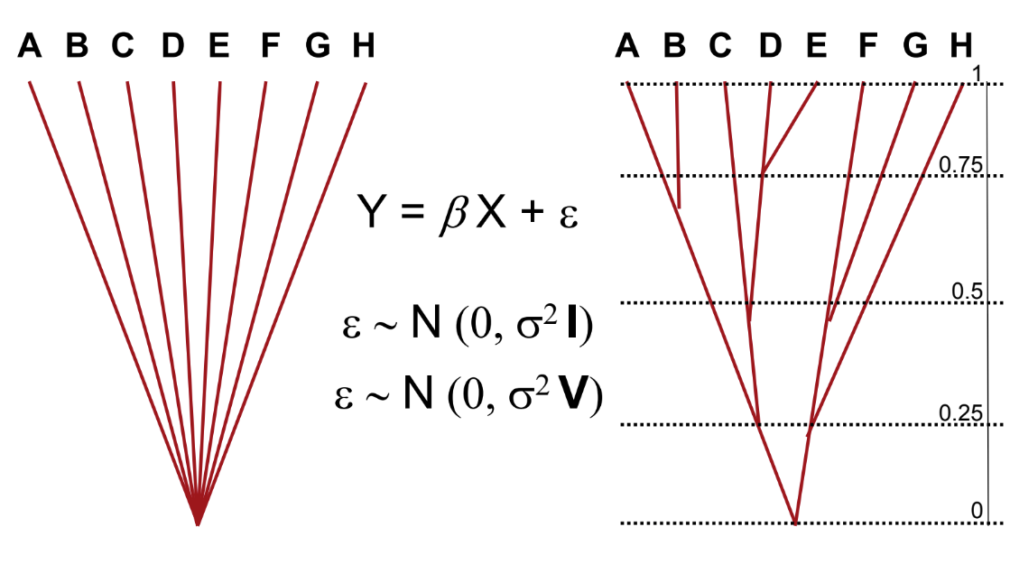
Just like before...multivariate Normal distribution
To define a mvNormal distribution, just need a mean and a variance.

Slide 12
Extensions of PGLS
Tree transformations
λ - “non phylogenetic slop” (heritability)
= 1 BM
= 0 No tree structure
κ - Speciatiational
= 1 BM
= 0 Only speciational
δ - Node heights raised/lowered to power of delta
= 1 BM
> 1 Accelerating
<1 Decelerating
Ornstein-Uhlenbeck - We will cover a lot more later!

Slide 13

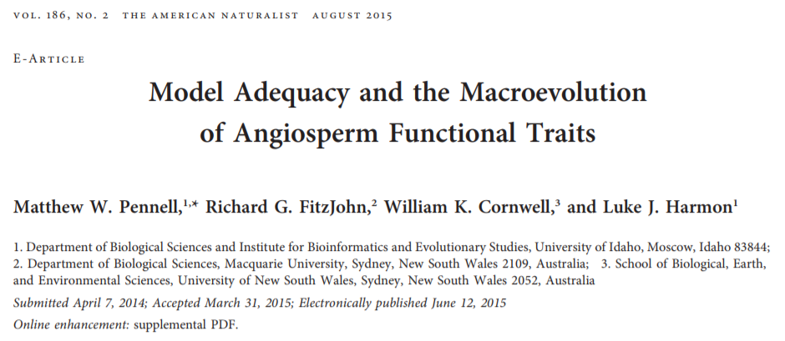
Model adequacy

Slide 14
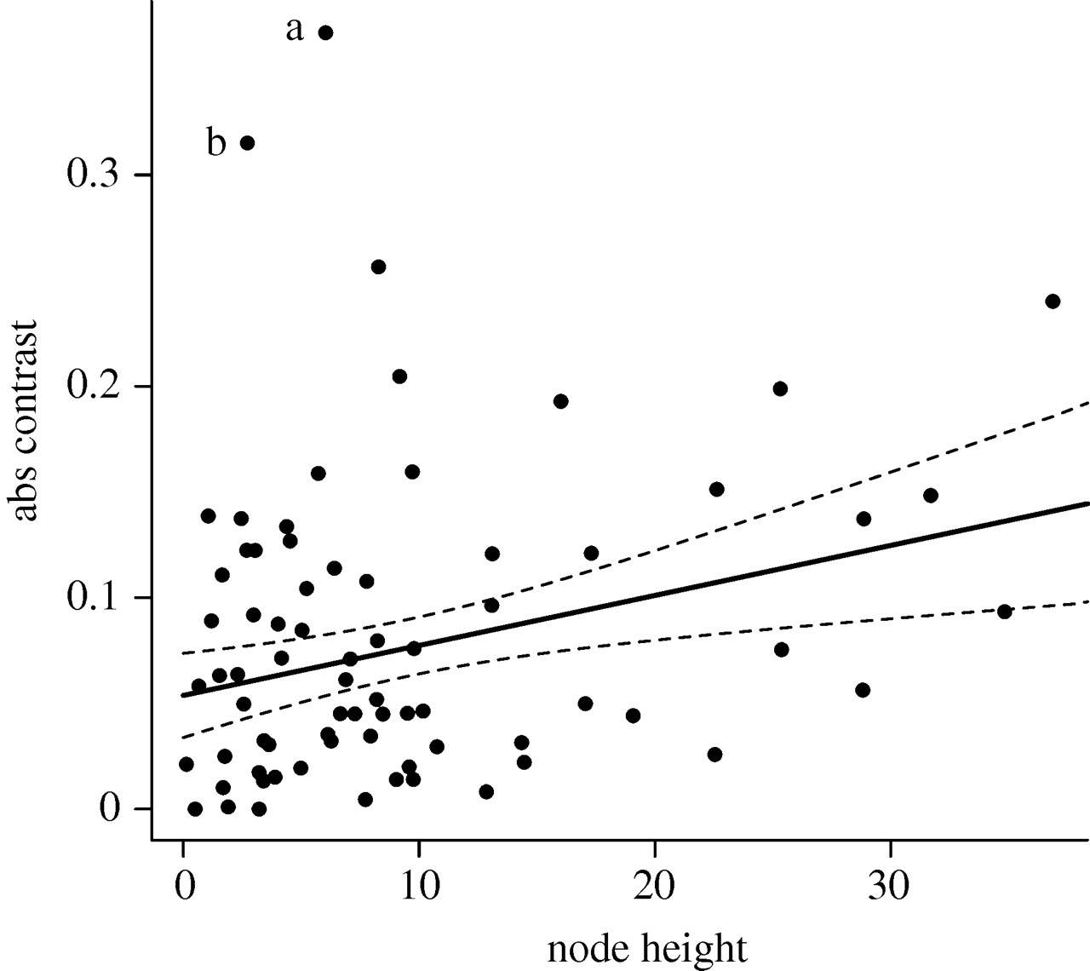
Node-Height test
Slope = 0: BM prediction
Positive - OU-like
Negative - Early burst like
Outliers - Not BM!

Slide 15
What will be the effects if:
You don't have a fully resolved tree?
You have a tree with error?
You have Y values with error?
You have X values with error?

