Slide 1
University management system Khanjan Dabhi -0872326 umang shah-0900917 Shashank Sachdev - 0904999

Slide 2
Introduction
The main goal is to use a computerized method instead of recording data by hand on books.
We can achieve that by creating a dynamic website.
It also provides facility to the students as well as professors.
This helps save time and money for the university.

Slide 3
System specification and Data Collection
System is based on:
PHP,JavaScript- Front End Scripts
MySQL,Jquery,phpMyAdmin - Database and Query Creation
Apache- Server
XAMPP- As A Configuration tool for above systems
UML and CASE tools- Visual Paradigm Online
Data Collection :
Performed by browsing the University Registration Site and all the features it supports.

Slide 4
Requirements elicitation
Login portal & Registration for Student and Professors.
To provide student’s details and professor’s important information.
Student can enrolls in courses as per program requirements.
Student can know which professors is teaching the enrolled course.
Professors can know how many students are their in his course.
If any professor or student leaves the university their data will be deleted.
It allows students to Drop & Register the course.
It allows professor to see how many students are enroll in his course

Slide 5
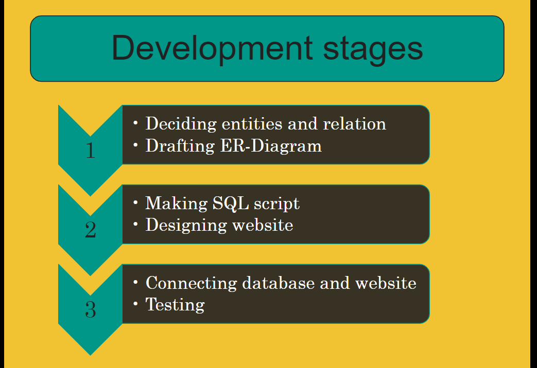

Slide 6
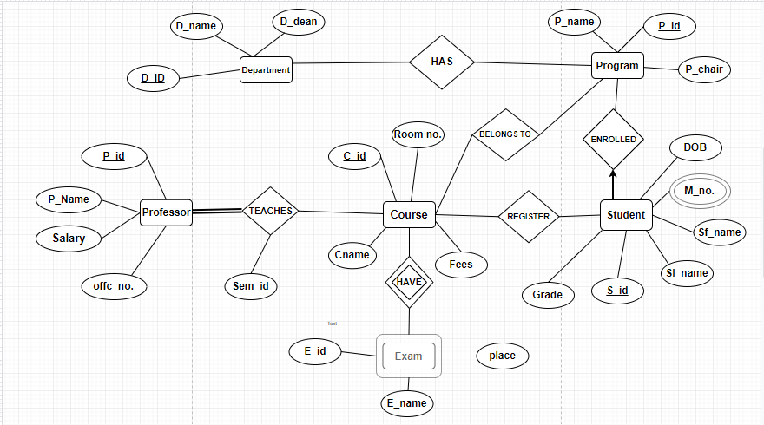
E-R Diagram

Slide 7
There are 6 Entity Sets : Professor Program Department Student Course Exam There are 8 Relationship Sets: Department HAS Program Course HAVE Exam Professor TEACHES Course Course BELONGS TO Program Student REGISTERS Course Student ENROLLED Program Student Passed Course Course Prerequisite Course

Slide 8
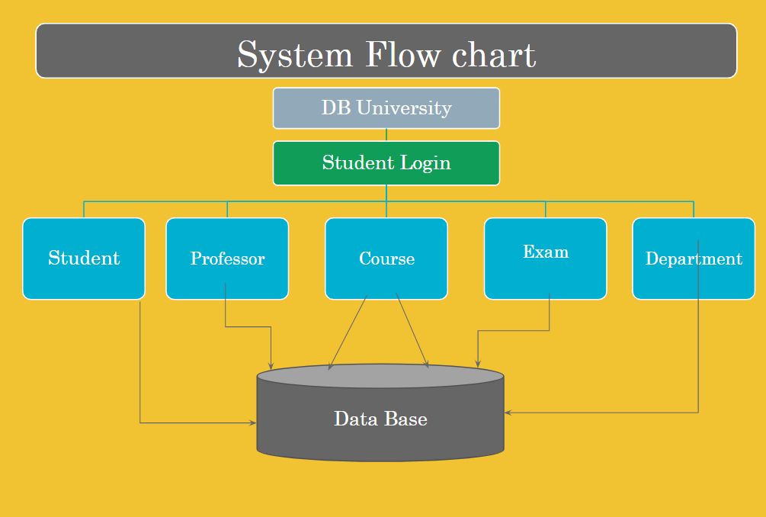

Slide 9
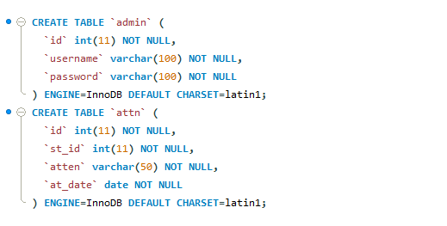
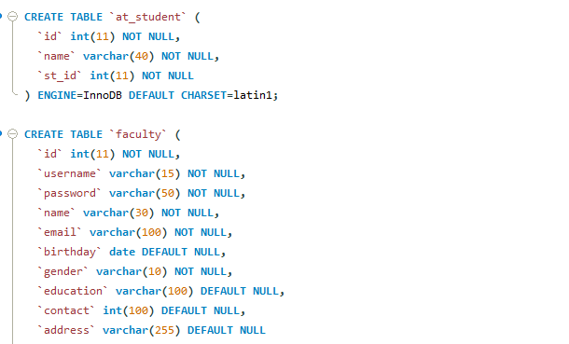
Database implementation (DDL)

Slide 10
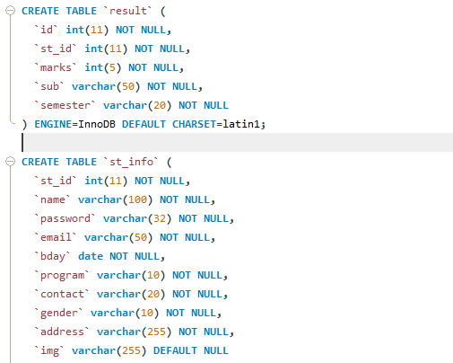
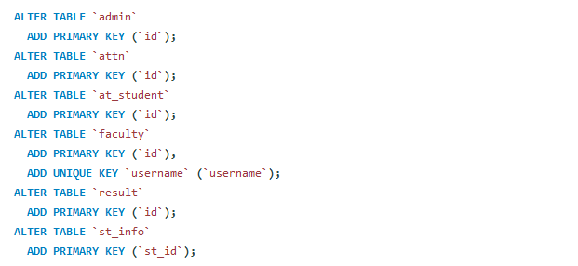

Slide 11
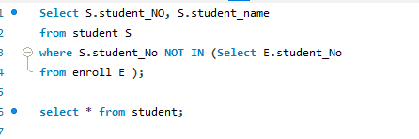
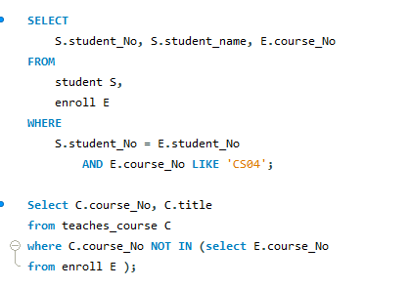
Query creation and Query implementation

Slide 12
USER INTERFACE

Slide 13
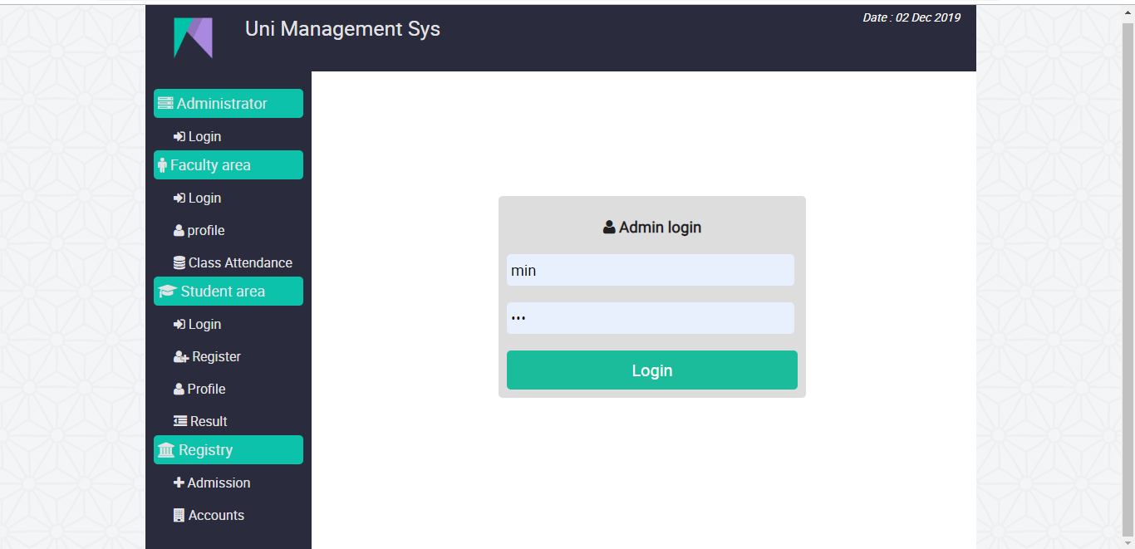
Home Page

Slide 14
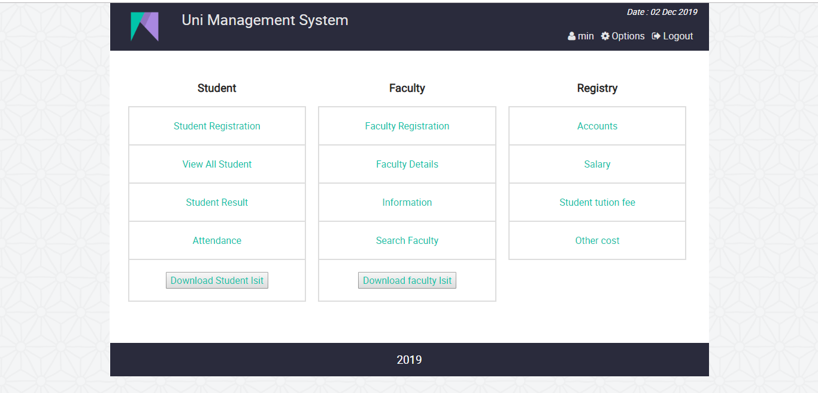

Slide 15
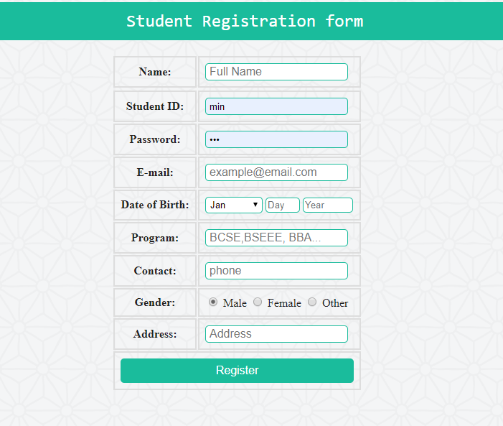

Slide 16
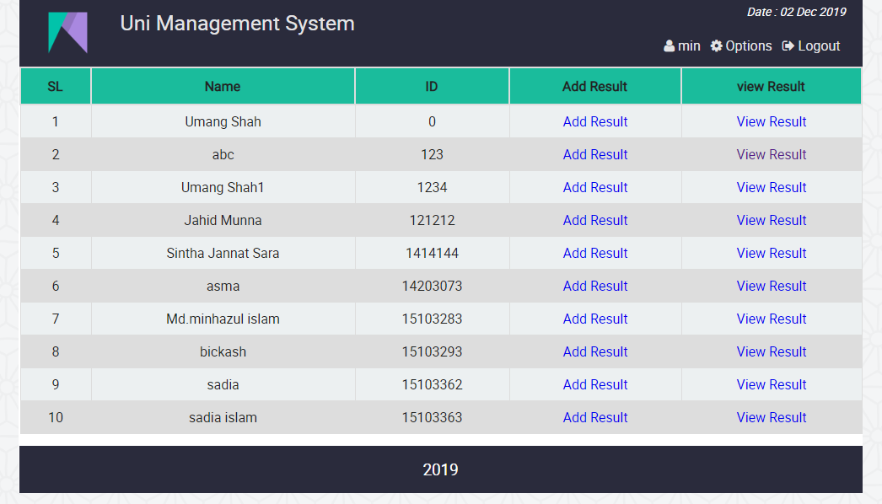

Slide 17
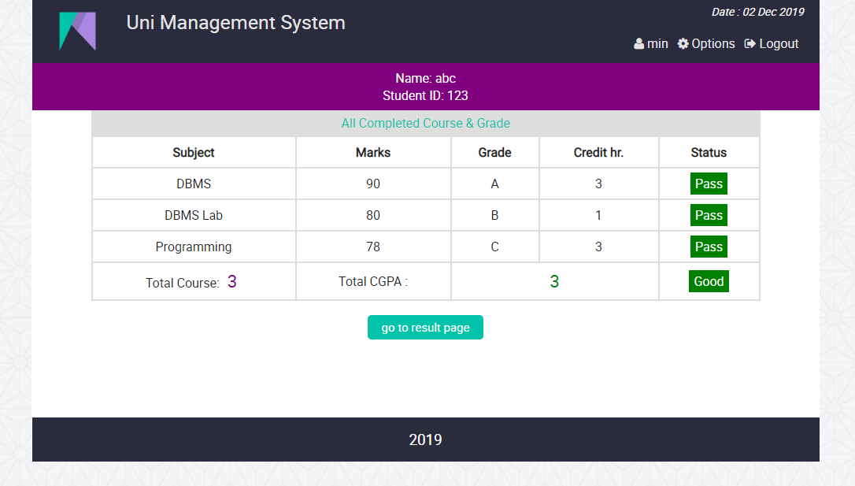

Slide 18
Project Management
Completed by :- Shashank
Deciding Entity Relations
Designing E-R Diagram
Completed by :- Umang
Making SQL Script
Designing Website
Completed by :- Khanjan
Connecting Database and Website
Testing

